Slide 1
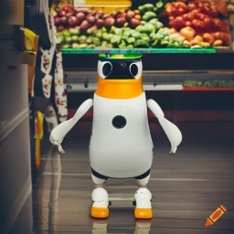
ECE4078 Intelligent robotics
AI art generated by https://www.craiyon.com/
(prompt: “a penguin robot shopping for fruits and vegetables in a supermarket”)
Lab 5: Integrated System

Slide 2
ECE4078 Intelligent robotics
Week | Objectives | Milestones
1: C1-1 | Introduction and setup
2: M1-1 | Calibration, ARUCO markers | C1 due
3: M1-2 | SLAM
4: M1-3 | SLAM
5: M2-1 | Object recognition & localisation | M1 due
6: M2-2 | Object recognition & localisation
7: M3-1 | Navigation & Planning | M2 due
8: M3-2 | Navigation & Planning
9: C2 | Integration & Improvement | M3 due
10: Final | Trial run of final demo | C2 due
11: Final | Final demo | Final demo due
12: No lab | N/A | N/A
*

Slide 3
Checkpoint 2: Integration
Checkpoint 2 (C2) is designed to give you time to integrate all the modules you completed in the previous milestones and an opportunity to practice the final demo. It integrates your work from M1 to M3 so that the robot can create a map of the arena containing the estimated poses of 10 ArUco markers (M1), 10 objects (M2), to then perform the grocery shopping task (M3).
C2 is a practice run of the Final demo process.
Final Demo Information:
The arena will always contain:
10 ArUco markers
5 unique fruits&vegs as targets for navigation (given shopping list)
5 obstacle fruits&vegs (can contain duplicates)
There are two evaluation components:
Final Demo Tasks:
Arena mapping (manual or fully-autonomous)
SLAM map
Target map
Grocery shopping / navigation: fully-autonomous navigation
Fully-autonomous mapping must be done simultaneously with navigation

Slide 4
Final Demo: Levels
The task is separated into three task levels, these levels are:
Level 1: Manual Mapping and Fully-Autonomous Navigation
The robot can be teleoperated for the Mapping task
The robot must navigate around the arena autonomously
You must navigate to targets on the shopping list in the specified order
Level 2: Manual Mapping and Fully-Autonomous Navigation with Swapped Objects
The robot can be teleoperated for the Mapping task
The robot must navigate around the arena autonomously
After mapping occurs, target and/or obstacles objects will change locations
You must navigate to targets on the shopping list as specified by level 3 requirements
Level 3: Fully-Autonomous Mapping and Navigation
The robot performs simultaneous mapping and navigation around the arena autonomously
You may navigate to objects in any order
You are still provided a shopping list, but you do not need to navigate to the targets in the same order as the list. Due to the removal of shopping list order, you must clearly indicate if the robot is stopping for an object by printing the label of the specified object to terminal and notifying the TA of the robot's intention to stop at the specific target.

Slide 5
Additional recommendations
Practice practice practice! (again)
The easiest and most influential recommendation.
Remember this ALSO includes setting up the environment as quick as you can.
Try and practice on a wide range of maps whilst trying your best to replicate the EXACT same conditions you will be performing the live demo under.
Develop, plan and discuss a strategy
Try and find a “meta” strategy that will give you the most marks in the limited live demo time
Is it better to brute force the task with many fast attempts as possible? Or is it better to try and take it slow and be more consistent?
Is there a specific driving strategy you should follow when mapping the arena?
Discuss and solidify a plan with your group with what kind of strategy you should use.

Slide 6
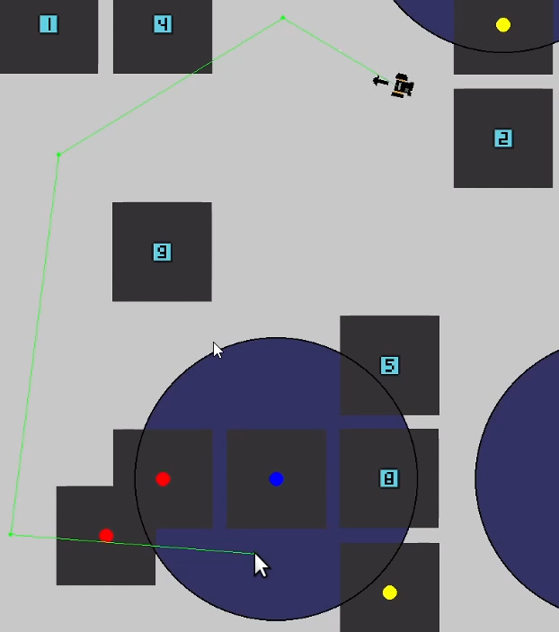
Additional recommendations (optional)
- Improved GUI
An improved GUI can really help out the mapping and navigation
Rendering the trajectory on screen can be helpful to check early on if the generated path of the robot is a viable one (and for you to decide if you want to go ahead with this path / waypoint or to generate a new one before starting the navigation)
- Path planning selection If you are using a stochastic path planning algorithm (or multiple path planning algorithms), it may be beneficial to initially generate multiple potential trajectories which the robot can select from
Remember, you can only press ONE button to start your script

Slide 7
Additional recommendations
- Add a stop button
Adding a stop button that makes the robot wheels stop without shutting the robot down or stopping your operate script would save some time and effort when you want to quickly start a new run.
- Optimise turning and reverse driving
Turning is the reason to many collisions when your robot gets too close to a marker or a target. Optimising robot movements by turning the shorter (as opposed to fixed left turning, for example) and allow reverse driving would prevent this. This also reduce the driving time.
- Clean up your submission
A clean submission prevent the risk of using the wrong files for your final demo, so make sure it only contains the files you need.

Slide 8
Additional recommendations
- Optimise sample-based path planner
Sample-based path planners like RRT does not produce the optimal path most of the time, but they run very fast. To further optimise this, you can generate multiple potential paths and select the best one based on certain criteria. For example:
- Number of waypoints
- Total distance travelled
- Average distance between the waypoints and the obstacles
- Collision detection
Your robot can use its camera to work out the distance towards a marker (using aruco_detector.py) for a fruit&veg (using detector.py). If the distance is too close, you will want to stop a robot and find a detour / back off.

Slide 9
Additional recommendations
- Everything is variable
As changing the submitted code is not allowed, it’s best not to hardcode your important variables and make them dynamic arguments than can be changed by the command line. Some important variables:
- Obstacle radius
- Distance to the target (to consider collection)
- Input files name
- etc.
Alternative, some of these can even dynamically change while the script is running. For example, if your path planner is stuck, you might want to reduce the obstacle radius automatically.
- Get out of obstacles
Sometimes you will find your robot stuck inside an obstacle and all the proposed paths are failed due to collision. Follows are some suggestions:
- Reduce the obstacle radius automatically
- Trace back to your previous waypoints or origin
- Go to a random non-occupied point

Slide 10

Final Demo: Mapping
Mapping (30 points):
slam_rating= $\frac{0.2 −slam_rmse}{0.2−0.02}$
slam _score = $\frac{base^{slam_rating}– 1}{base – 1} ∗15 ∗\frac{NumberOfFoundMarkers}{NumberOfMarkers}$, base = 16
ArUco slam map (0 ≤ slam_score ≤ 15pt):
Target map (0 ≤ target_est_score ≤ 15pt):
target_accuracy_rating[object] = $\frac{0.5 − estimation_error\left[object\right]}{0.5−0.025}$= TAR
target_est_score = $\frac{base^{mean\left(TAR\right)}– 1}{base – 1} ∗15$, base = 8
Example submission folder structure format (Please read the marking instructions carefully for this!):
.
├── C2_Team_X0
│ ├── slam_auto_4.txt
│ ├── slam_manual_1.txt
│ ├── slam_manual_2.txt
│ ├── targets_auto_4.txt
│ ├── targets_manual_1.txt
│ ├── targets_manual_2.txt

Slide 11
Final Demo: Navigation
Full auto navigation (max 70 points):
Level 1
15 marks awarded for a qualified run.
Each successful collection (within 0.3 m, in the correct shopping list order) is worth 5 marks.
Maximum contribution: 40% out of 70%.
Level 2
25 marks awarded for a qualified run.
Each successful collection (within 0.3 m, in the correct shopping list order) is worth 5 marks.
Maximum contribution: 50% out of 70%.
Level 3
30 marks awarded for a qualified run.
Each successful collection (within 0.3 m, in the correct shopping list order) is worth 8 marks.
Maximum contribution: 70% out of the 70% navigation mark (i.e. full 100%).
Penalties (Max of 5 penalties total,):
-5 points for any collision
Marks for reaching objects will always count, however you cannot stop a run manually until a run is qualified
More info see Week11/README.md

