Slide 1
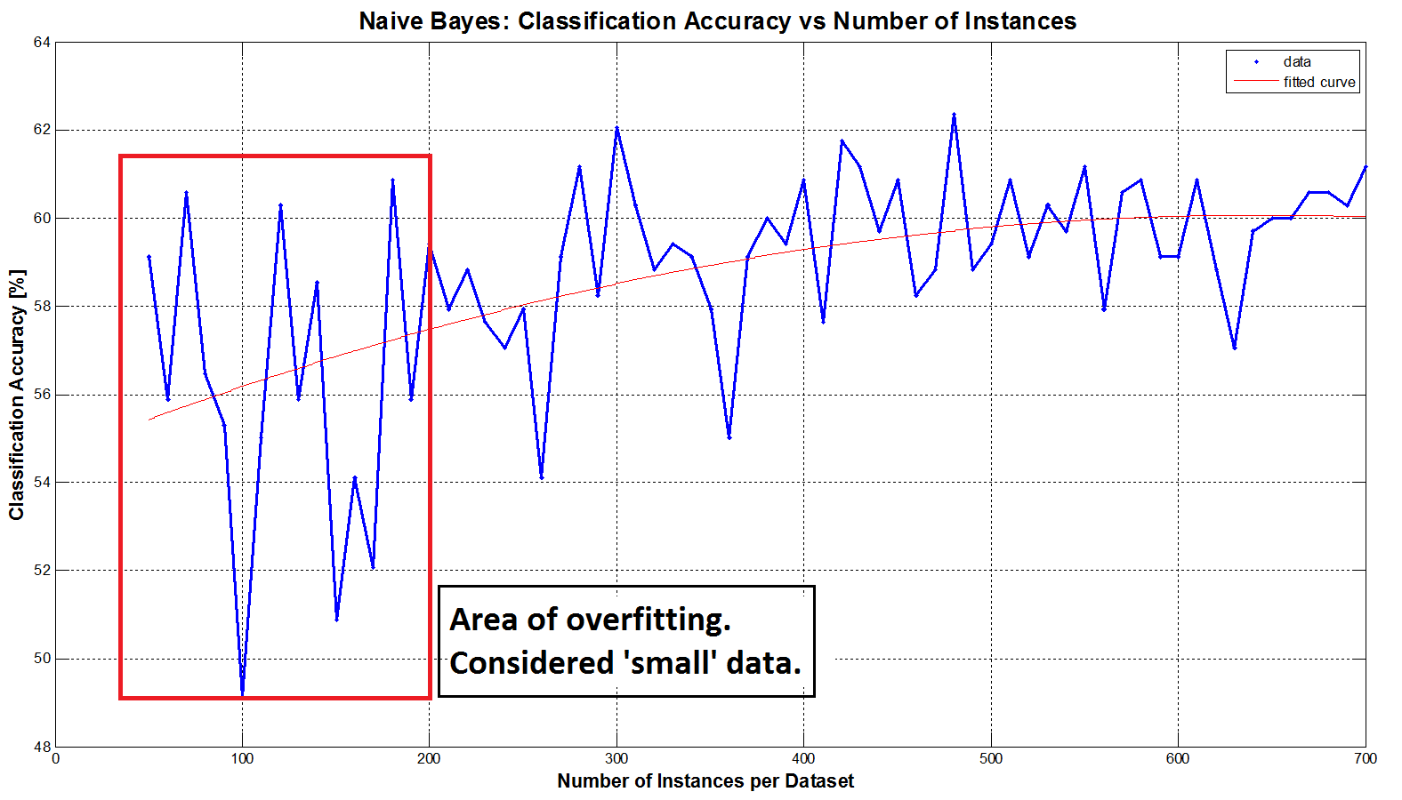
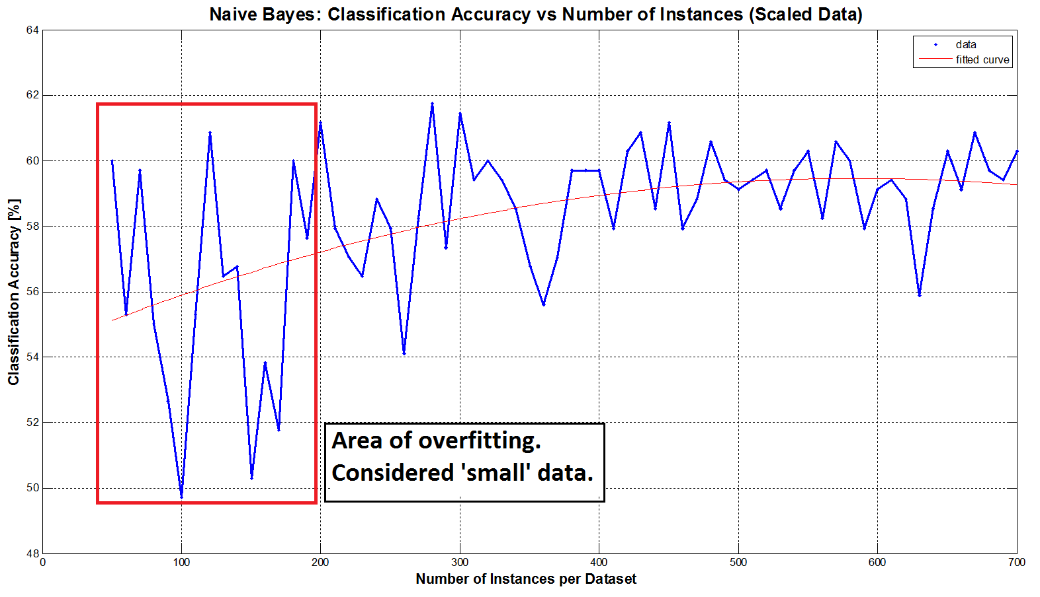
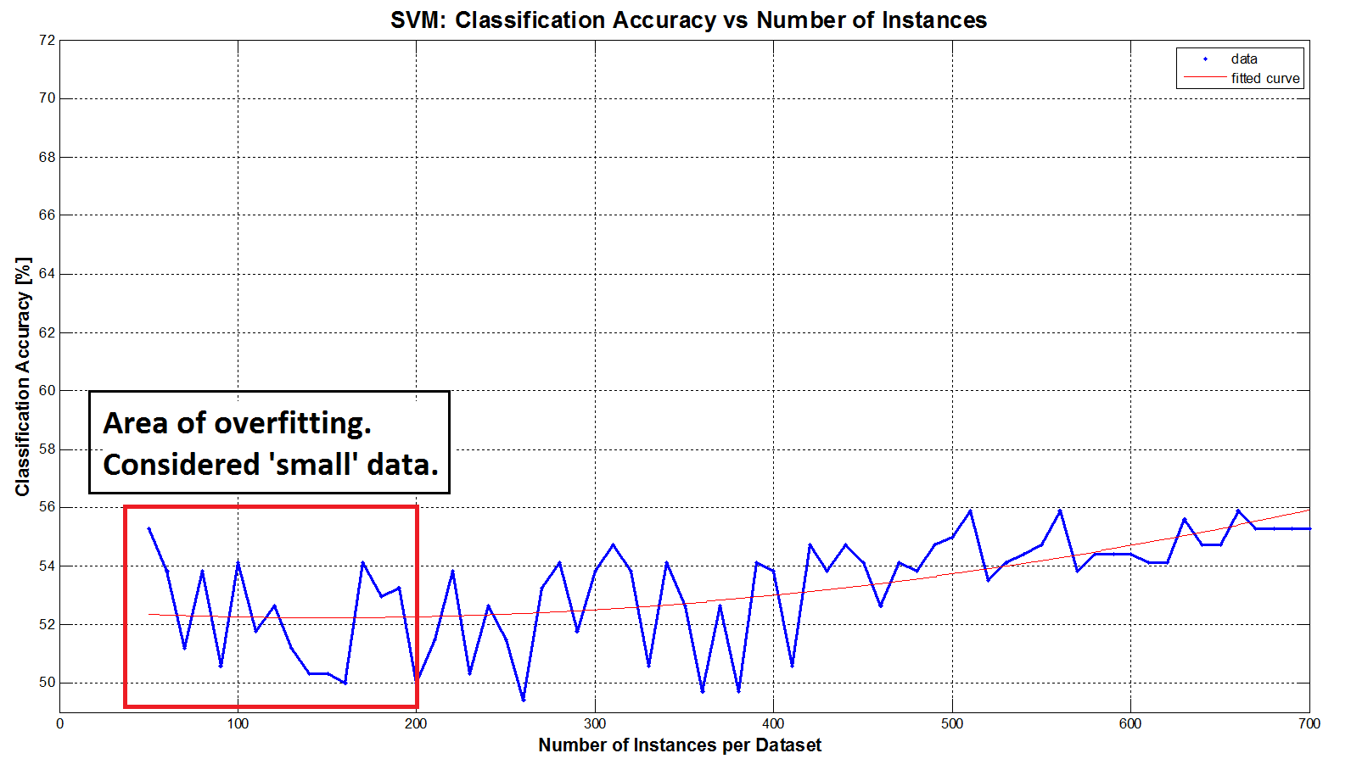
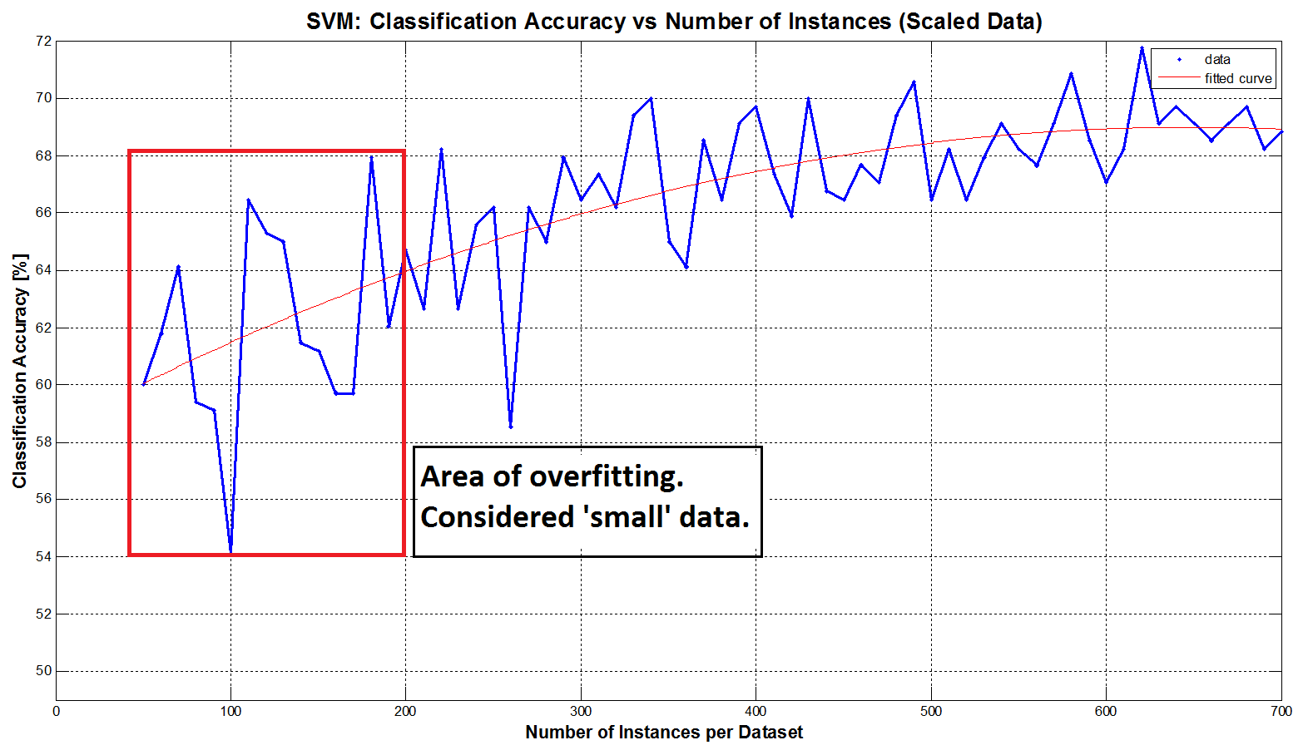
Methods for Increasing Classification Accuracy in Small Datasets
Sergio García-Vergara¹, Stephanie Gillespie¹, Oludotun Ode¹, and Matthew Rice¹
¹School of Electrical and Computer Engineering, Georgia Institute of Technology
Background
Methods
Results
Small data sets may arise due to:
Limited clinical trials
Costly to collect data
Rare occurrence of events of interest
Population diversity too great to capture
Small data sets may result in model over-fitting, the inability to classify new data that was not similar to that seen in the training data, and poor reproducibility of results in the field.
Bootstrapping
Picks 100 samples with replacement
Estimate model parameters using validation techniques
Due to already-small data sets, this technique only made our model parameters less-applicable to the full testing dataset.
Virtual Data Creation
Add normal Gaussian noise to existing data
Amount of noise based on variance of each feature
Should result in more generalized data
Principle Components Analysis
Lkjlkj
Lkjlkj
Lklklkj
GoDec (Robust PCA)
Ljlk
Ljlkj
Lkjlkj
Experimentation Procedures: insert graphic here??
Goals
S
Determine at what point a data set may be considered small
Try different combinations of techniques to reduce over-fitting
Data creation or modification
Feature dimensionality and reduction
Model simplification
Comment on changes to classification accuracy measures
Our Dataset
Parkinson Speech Dataset¹ available on UCI Machine Learning Repository
Characteristics of Data Set:
Bimodal
1040 instances (26 voice recordings from 40 participants)
Class a priori probability 50%
Labels: Presence of Parkinson’s Disease (1) or normal (0)
S
Remaining Work
What is Small?
Want to choose a subset (<700) as the “small” training dataset
Result: choose datasets of 100 instances for our “small” training dataset. Note that this is approximately 4 time larger than number of instances.
S
References
[1] B. E. Sakar et al. “Collection and analysis of a Parkinson speech dataset with multiple types of sound recordings,” IEEE Journal of Biomedical and Health Informatics, vol. 17, no. 4, pp. 828-834, 2013.

