Slide 1
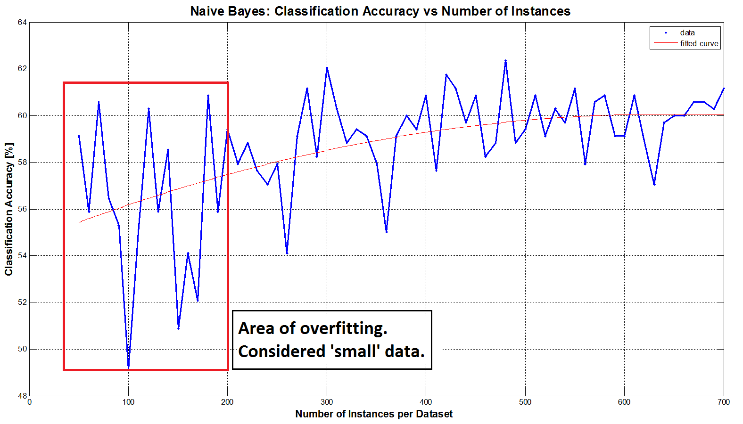
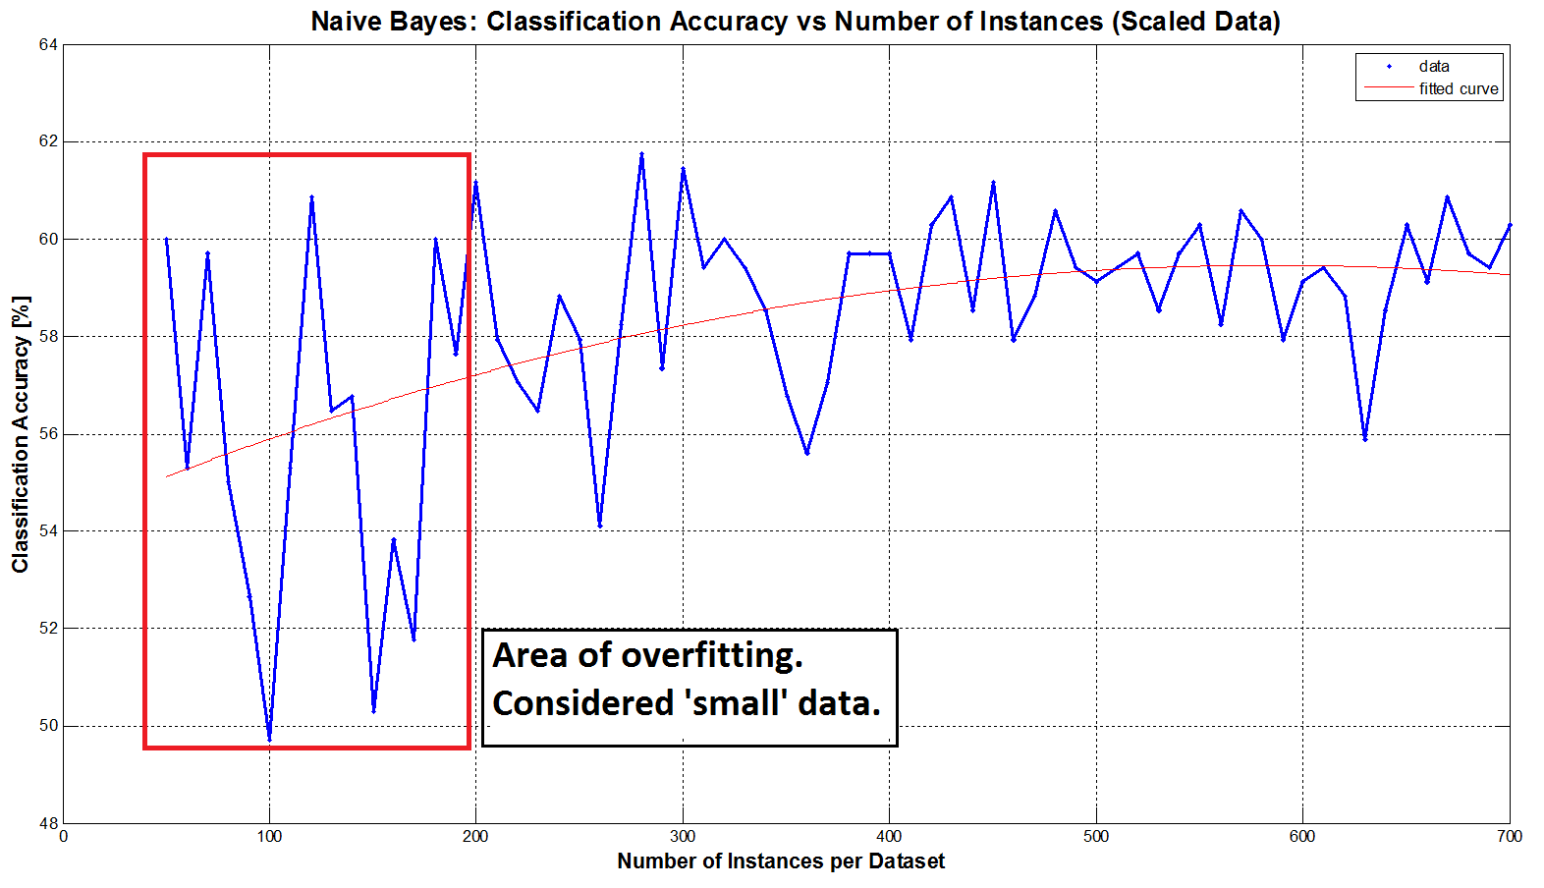
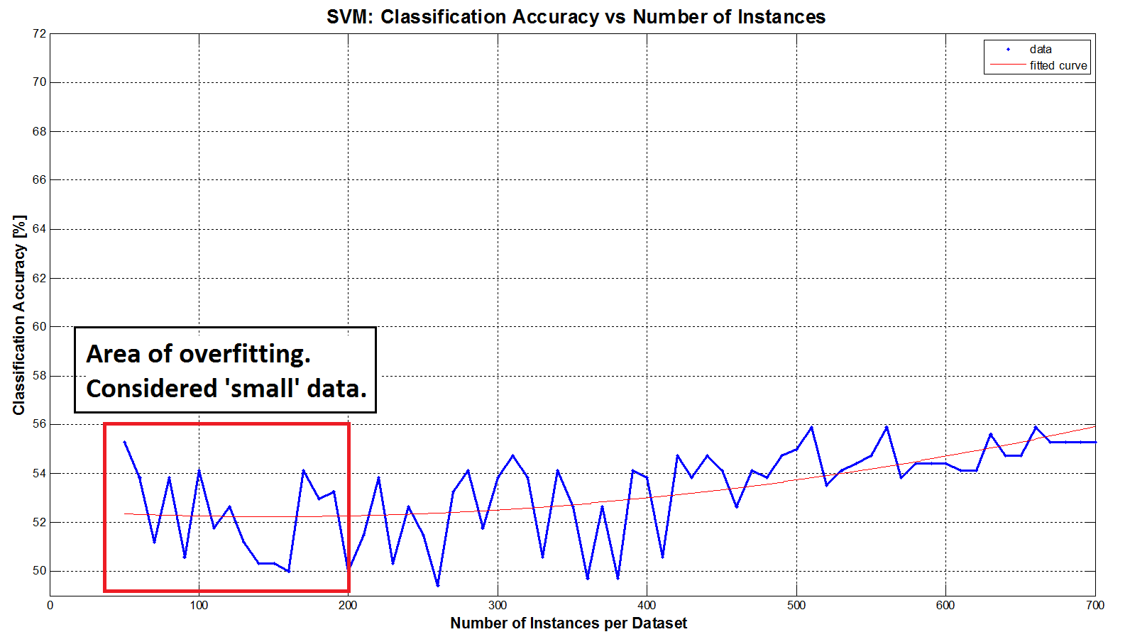
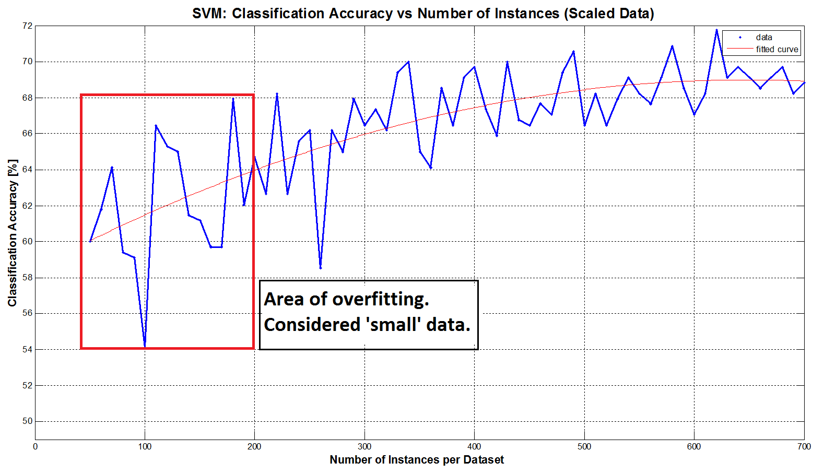
Methods for Increasing Classification Accuracy in Small Datasets
Sergio García-Vergara¹, Stephanie Gillespie¹, Oludotun Ode¹, and Matthew Rice¹
¹School of Electrical and Computer Engineering, Georgia Institute of Technology
Background
Methods Explored
Small data sets may arise due to:
Limited clinical trials
Costly to collect data
Rare occurrence of events of interest
Population diversity too great to capture
Small data sets may result in model over-fitting, the inability to classify new data that was not similar to that seen in the training data, and poor reproducibility of results in the field.
Bootstrapping
Picks 100 samples with replacement
Estimate model parameters using validation techniques
Due to already-small data sets, this technique only made our model parameters less-applicable to the full testing dataset.
Virtual Data Creation
Add normal Gaussian noise to existing data
Amount of noise based on variance of each feature
Should result in more generalized data
Principle Components Analysis
Lkjlkj
Lkjlkj
Lklklkj
GoDec (Robust PCA)
Ljlk
ljlkj
Goals
S
Determine at what point a data set may be considered small
Try different combinations of techniques to reduce over-fitting
Data creation or modification
Feature dimensionality and reduction
Model simplification
Comment on changes to classification accuracy measures
Results
Our Dataset
Data set chosen from those available on _______________________
Characteristics of Data Set:
From this, we decided to keep a-priori probability at 0.5 for all experiments
S
What is Small?
Want to choose a subset (<700) as the “small” training dataset
Result: choose datasets of 100 instances for our “small” training dataset.
S
Conclusions and Remaining Work

