Slide 1
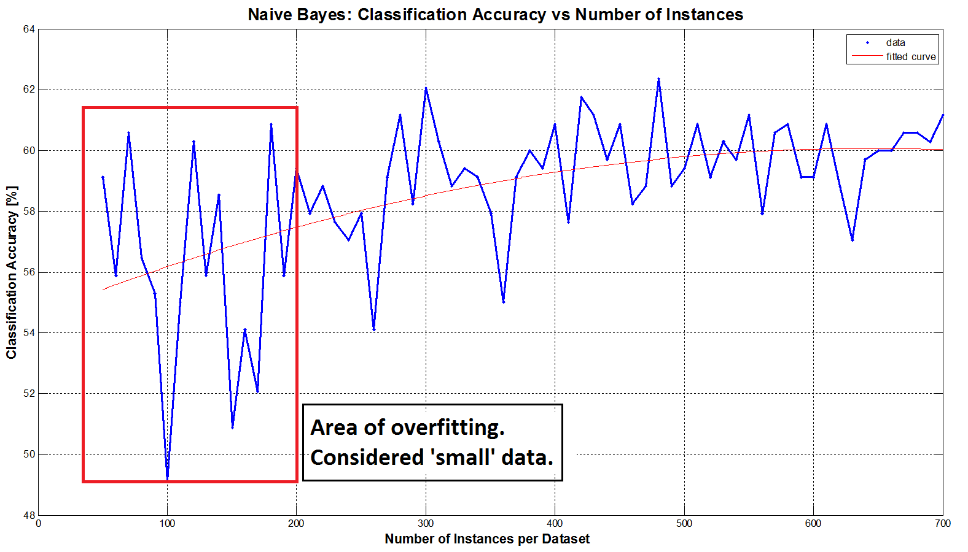
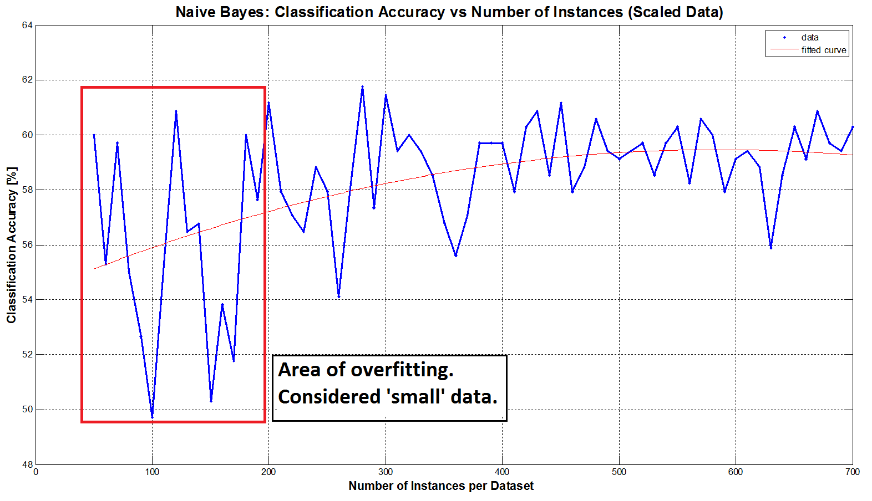
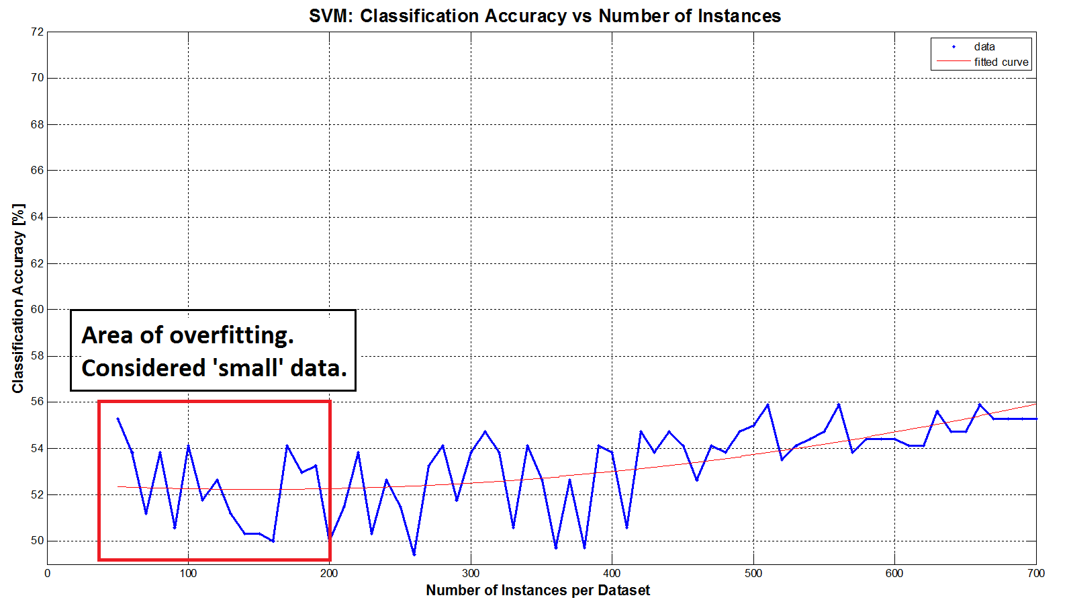
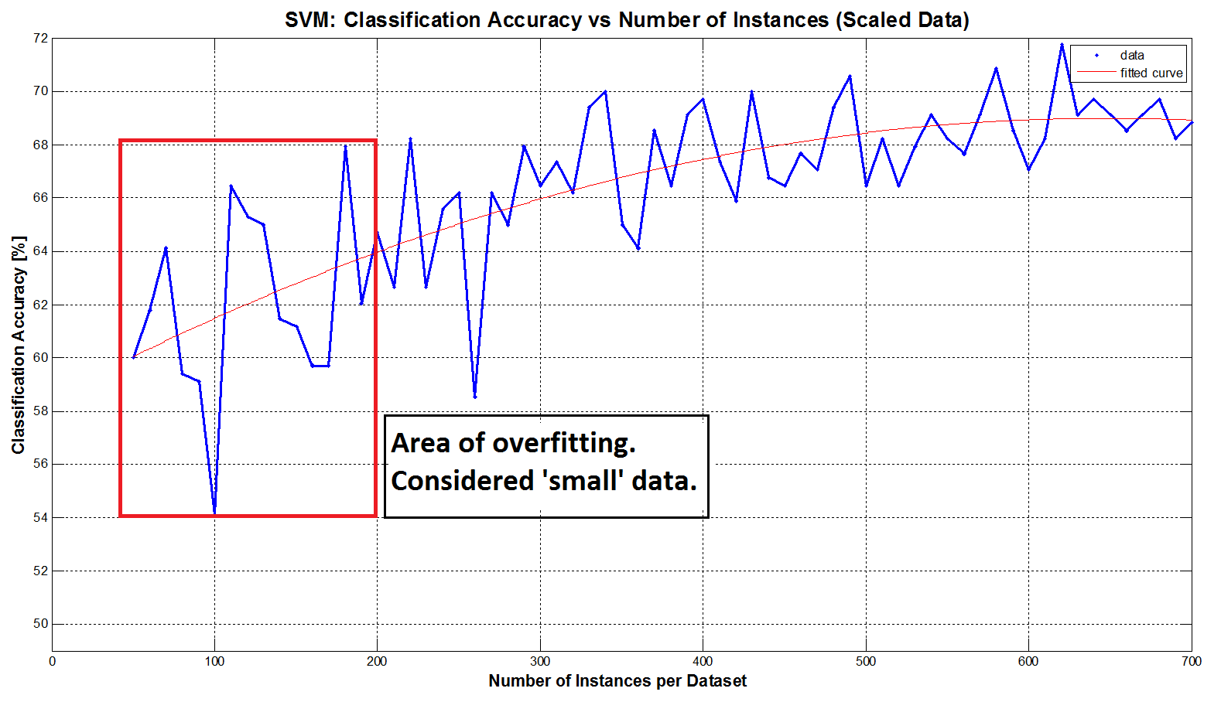
Methods for Increasing Classification Accuracy in Small Datasets
Sergio García-Vergara¹, Stephanie Gillespie¹, Oludotun Ode¹, and Matthew Rice¹
¹School of Electrical and Computer Engineering, Georgia Institute of Technology
Background
Methods
Results
Small data sets may arise due to:
Limited clinical trials
Costly to collect data
Rare occurrence of events of interest
Population diversity too great to capture
Small data sets may result in model over-fitting, the inability to classify new data that was not similar to that seen in the training data, and poor reproducibility of results in the field.
Bootstrapping
Picks multiple sets of 100 samples with replacement
Can estimate model parameters using validation techniques
Early results showed poor performance, possibly due to training set being too different from test set
Virtual Data Creation²
Add normal Gaussian noise to existing data
Amount of noise based on variance of each feature
Should result in more “generalized” data, reduce overfitting
Principle Components Analysis³
A linear dimensionality-reduction method
Helps prevent overfitting, especially when the number of observations is smaller than number of features
Used when data low-rank subspaces can explain data
GoDec (Low-rank Matrix Approximation)⁴
Decomposes the data into low-rank, sparse, and noise
Empirical studies suggest increased efficiency and robustness in comparison to Robust PCA
Goals
S
Determine at what point a data set may be considered small
Try different combinations of techniques to reduce over-fitting
Data creation or modification
Feature dimensionality and reduction
Model simplification
Comment on changes to classification accuracy measures
Our Dataset
Parkinson Speech Dataset¹ available on UCI Machine Learning Repository
Characteristics of Data Set:
Bimodal
1040 instances (26 voice recordings from 40 participants)
Class a priori probability 50%
Labels: Presence of Parkinson’s Disease (1) or normal (0)
Set aside 7 participants of each class for testing (364 instances)
S
Experiment Process
Train Data Set 100
Full Data Set
Test Data Set
Train Data Set 1
Train Data Set 1
For i=1:100
Get Train Data
i
Remaining Work
No
(Train Path)
Dimension Reduction?
No
(Test Path)
We would like to include model techniques that focus on model simplifications to reduce overfitting. However, these were not completed by the presentation date.
Additionally, we would like to consider if boosting an be used in small data sets with any success.
What is Small?
Yes
Want a subset of the remaining instances as “small” training dataset
Result: choose datasets of 100 instances for our “small” training dataset. Note that this is approximately 4 times larger than number of instances.
S
Type of DR
Do PCA
Do GoDec
No
Virtual Data?
Train path Test path
Member Workload and References
Yes
Create Virtual Data
Sergio Garcia handled the “What is Small” component and debugging of merged code.
Stephanie Gillespie led the literature review, document creation, and coded bootstrap and virtual data.
Oludotun Ode focused on PCA and goDEC methods.
Matthew Rice focused on the overall experiment code and data structures.
[1] B. E. Sakar et al. “Collection and analysis of a Parkinson speech dataset with multiple types of sound recordings,” IEEE Journal of Biomedical and Health Informatics, vol. 17, no. 4, pp. 828-834, 2013.
[2] S.S. Lee. “Noisy replication in skewed binary classification,” Computational Statistics & Data Analysis, vol. 34, no. 2 pp. 165–191, 2000.
[3] Low-Rank Matrix Recovery and Completion via Convex Optimization. University of Illinois Perception and Decision Lab, 1 Jan. 2015. Web. 21 Apr. 2015. <http://perception.csl.illinois.edu/matrix-rank/introduction.html#RPCA>.
[4] T. Zhou and T. Dacheng. "Godec: Randomized low-rank & sparse matrix decomposition in noisy case." International Conference on Machine Learning 2011.
Classifier
Type
SVM Train
Classify
NB Train
Calculate Statistics on Confusion Matrices

