Slide 1
FEATURE SELECTION USING GENETIC ALGORITHM
Ece Akçiçek – 117200059
Project Advisor : Tuğba Dalyan

Slide 2
Introduction
There are some important measurements for a system. Among others, some can be named as:
Time Complexity
Computational Cost
Accuracy / Success
Feature sets with high dimensions can increase time complexity and computational cost, and also negatively effect the performance of systems.
Feature Selection helps to eliminate the features that are either redundant or non-informative, while protecting the essence of dataset.
Notes:
Redundant and non-informative are two distinct properties of a feature. A relevant feature may be redundant in the presence of another feature, which is relevant, or vice versa. This strong correlation between fundamentally relevant features creates the need of a strong feature selection algorithm.

Slide 3

Feature Selection is a preprocessing stage for data to derive features from feature set to reduce costs, increase classifier accuracy and efficiency.
With feature selection:
Models are simplified.
Training time is shortened.
Dimensional complexity is avoided.
Intuitive, metaheuristic, methods can propose an efficient approach to Feature Selection problems.
Notes:
Noktalardan sonra:
An intuitive approach to the problem may result in better selection and can lower the computational effort. This intuitiveness that is called meta-heuristic approach. This approach does not guarantee to provide a global optimal solution, but provides practical efficacy. On large datasets, metaheuristic methods can iterate faster as well.
Aim of this project is to offer a metaheuristic approach to feature selection, to increase the efficiency. Genetic Algorithm will be used for feature selection in this paper.

Slide 4
Genetic Algorithm
GA is a population-based metaheuristic method that is inspired by the natural selection process in evolution.
It is a strong algorithm that is commonly used for optimization and search problems.
There are five important steps of Genetic Algorithm:
1. INITIAL POPULATION
2. FITNESS FUNCTION
3. SELECTION
4. CROSS-OVER
5.MUTATION
Notes:
İlk başta: From the beginning of existence, all living creatures evolved and mu- tated partially or completely in many ways, and selected naturally over time.
Individuals that had the positive evolution features increased their chance of survival, chance of breeding while negatively mutated individuals fail to complete their life cycle and breed.

Slide 5
Begin
Initial population
Calculate fitness value
Selection
Crossover
Mutation
New generation

Slide 6
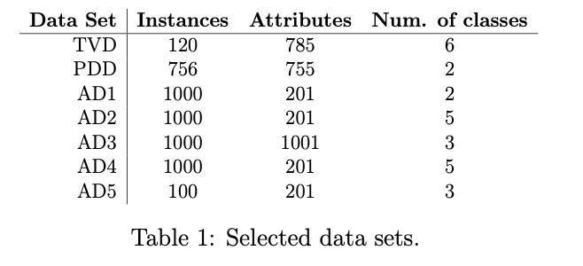
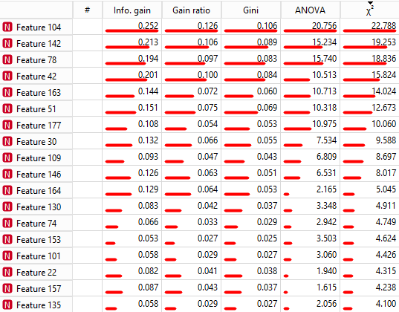
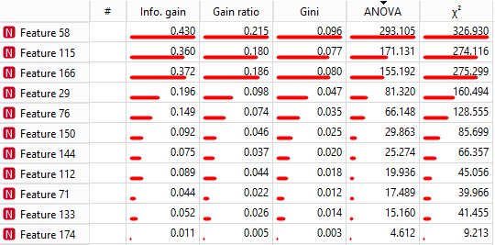
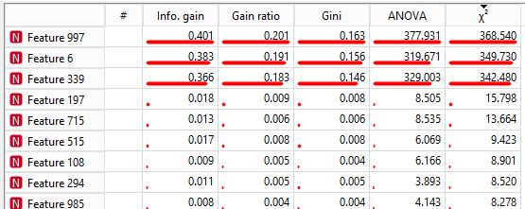
01. Initial Population & Datasets
Initial population is generated from the dataset by randomly selecting %50 of the instances.
Notes:
1-Telugu Vowel Dataset : Contains handwritten Telugu characters data, with six vowels of the Telugu language. 6 labels represent 6 vowels, linking every instance to one of the vowels.
2-Parkinson’s Disease Dataset : speech recordings of Parkinson’s Disease (PD) patients. Labels indicate diagnosis, where ”1” denotes PD exists and ”0” denotes no existence of disease.
Rest are artificial databases that are used to experiment efficiency of algorithm.

Slide 7
02. Fitness Function
This function determines how fit the given individual is, so that the algorithm can decide whether this individual should breed or not later on selection process.
Firstly accuracy is calculated with the help of logistic regression.
To reach the desired reduced number of features, selection pressure is needed.
Accuracies and fitness’ are tracked individually to be able to observe the variance through iterations, and to be able to protect the most fit and most accurate solutions from mutation and cross-over effects.
Notes:
Fitness’tan sonra: Even though the fitness is calculated through accuracy, the most fit and most accurate solutions may differ because of the effect of the number of selected features.
Accuracies and fitnesses are tracked individually to be able to observe the variance through iterations AND ALSO to be able to protect the most fit and most accurate solutions from mutation and cross-over effects.

Slide 8
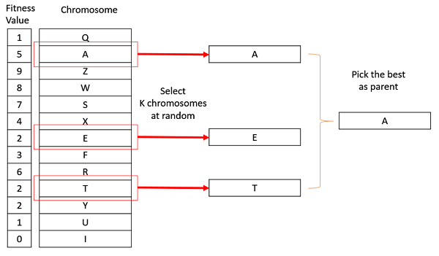
03. Selection
Tournament Selection:
Notes:
To create the new population, individuals from the existing population to be crossed and mutated must be selected. According to the theory, indi- viduals who are good should continue their lives and new individuals should be created from these individuals. Therefore, individuals with higher fitness values are more likely to be selected.
The most known selection methods are Roulette Wheel Selection, Tournament Selection and Random Selection. I used tournament selection in this algorithm.

Slide 9
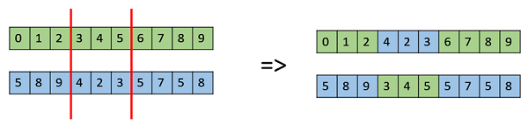
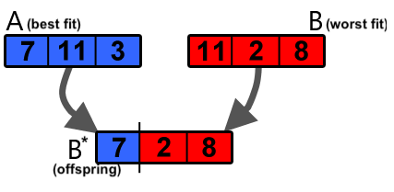
04. Crossover
Two-point Crossover:
Two points which represent the two points of chromosome to perform cross-over is chosen randomly.
Cross-over is applied to %30 of the population.
Min-max Crossover:
Notes:
Cross-over is the most discriminating phase in GA, than other FS algo- rithms. Cross-over guarantees that genetic information is exchanged across parents, resulting offspring chromosomes to be more likely superior to the parents. In this paper, asexual reproduction (cloning an existing solution) is not used.

Slide 10

05. Mutation
Scrambled mutation is used in this study.
With a low probability, given as 0.2 in the paper, mutation is applied to the 20 percent of the population.
Notes:
The main purpose of mutation is to maintain genetic diversity in the population. With mutation, some probabilities that are not present or low can have a chance to join and effect the evolutionary process of the individuals.
In general, the mutation probability is kept low. Therefore, mutation effects are less common in chromosomes. If the probability of mutation increases, the genetic search becomes an undesired random search. But it helps in finding lost genetic material again, which explains why it is necessary.

Slide 11
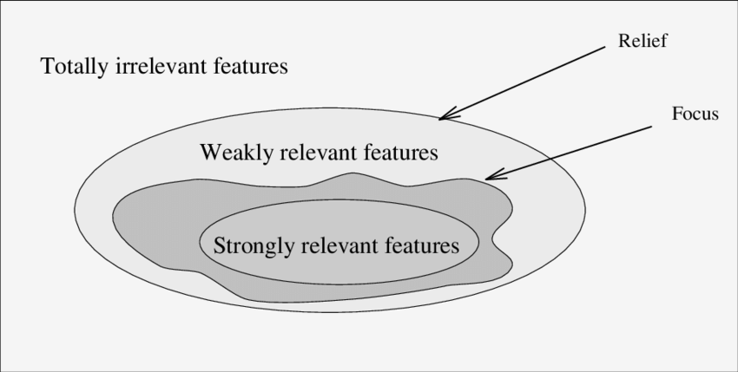
Feature Relevance: Feature relevance is used to make the algorithm even more selective and to put more pressure on selection process by eliminating the features that have lowest relevance to target class.
Elitism: Refers to the concept that the best fit individual or group of individuals is guaranteed a spot in the next generation - usually without the priority for mutation. By adopting this approach, solution with best fitness value yet to be achieved is stored safely through iterations and protected unless a better fit individual is breed.
Notes:
The term ”feature relevance” refers to a set of methodologies for providing scores to attributes, representing the relative significance of each feature while making a prediction.
Having fitness decreasing between iterations is undesired because that means with the evolutionary nature of Genetic Algorithm, best fitness achieved is not protected and can be lost through iterations. To prevent this, elitism approach is adopted.

Slide 12
Defining problem and proposing solution
Literature Review
Models Research and Analysis
GA for FS Implementation
Basic GA Implementation
Project Design
Dataset Research
Experimenting on different datasets
Analyzing Results

Slide 13
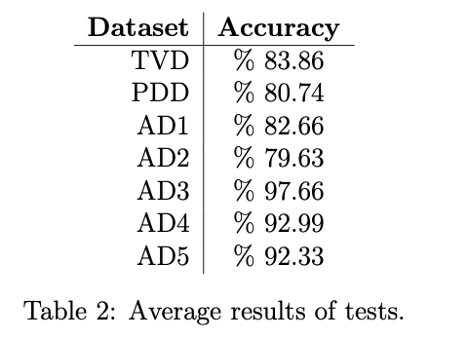
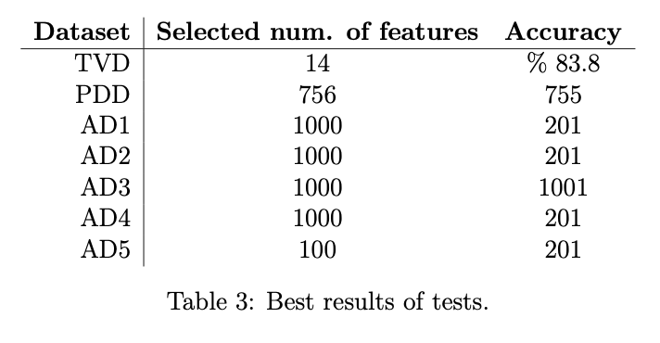
Experiment
Algorithm is constructed and ran with 0.2 mutation rate. 10 independent tests are ran on datasets with n=10 solutions and 100 iterations.

Slide 14
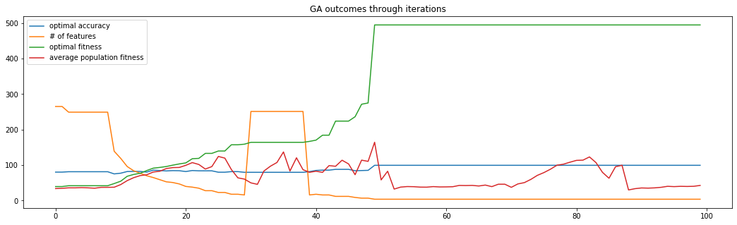
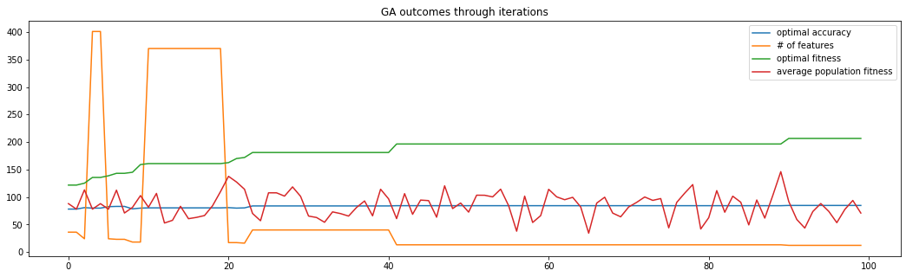
TVD Experiment: * While tests on The Vowel Dataset resulted in average of %83.86 accuracy.
* After 100 iterations, best trial selected 4 features with % 99.4 accuracy.
PDD Experiment: * Before running the algorithm on Parkinson’s Disease Dataset, some missing values (represented as NaN) was filled with average values of respected columns.
* Selected number of features in the best trial is 12. Respected accuracy is given as %84.5.

Slide 15
Conclusion
Through tests, algorithm has shown consistent results in terms of accu- racy. Reaching accuracies higher than %75 nearly in ever test shows how efficient this algorithm works.
With test results that reach even higher accuracies with very low number of features, it is concluded that with the help of proposed algorithm, computational cost and time complexity of further operations can be notably reduced.
Even though results vary, with the best solution graphs discussed earlier, potential of the Genetic Algorithm over Feature Selection can be deduced.

Slide 16
Feature Work
In the feature, some new or existing methods can be developed to put more selection pressure over population to derive more consistent results in terms of number of features selected.
Algorithm can be observed more widely with more testing and under varying constants such as population size and number of iterations.
Feature selection with Genetic Algorithm can be extended by hybridizing the Genetic Algorithm with one of the nature-inspired optimizers (e.g. Grey Wolf Optimizer), or other feature selection methods or optimizers.
Notes:
İlk nokta: Even though best results were satisfying, it is observed that in some tests algorithm selects large number of features, failing to eliminate significant number of features. Since GA is an evolutionary algorithm, these results are understandable; yet undesirable.

Slide 17
THANK YOU!

