Slide 1
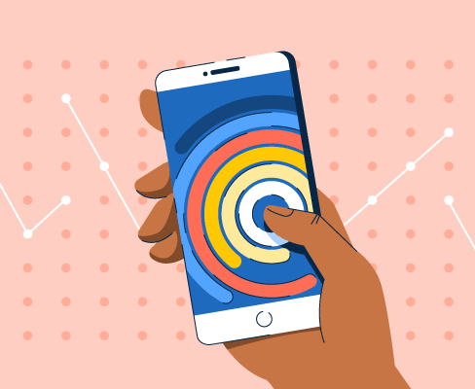
DSA210 TERM PROJECT
SCREEN TIME ANALYSIS OVER MY ACTIVITY TIMES
Ece Canan Can

Slide 2

This report analyzes my personal screen time data for December 2024, focusing on daily trends, time-of-day usage, and correlations with activity levels. The goal is to identify patterns in phone usage and understand how screen time aligns with busy times and productivity.

Slide 3

Hypothesis: There is a negative correlation between my screen time and busy periods, meaning that as activity levels or structured schedules increase, screen time decreases. It comes out true and I categorized my data as the days of week and time of the day

Slide 4
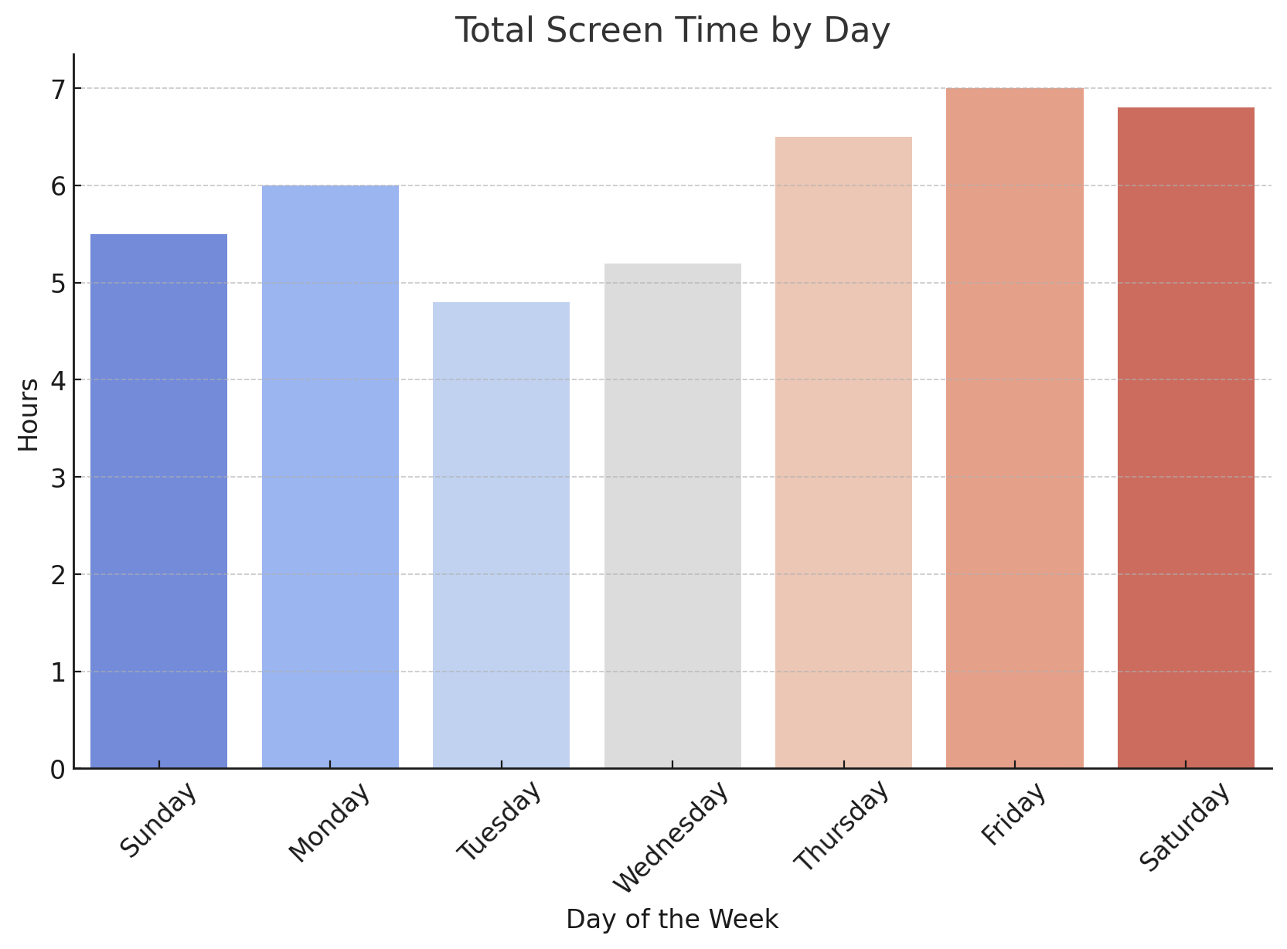
Saturday consistently shows the highest screen time across the week. This may be due to increased leisure time.

Slide 5
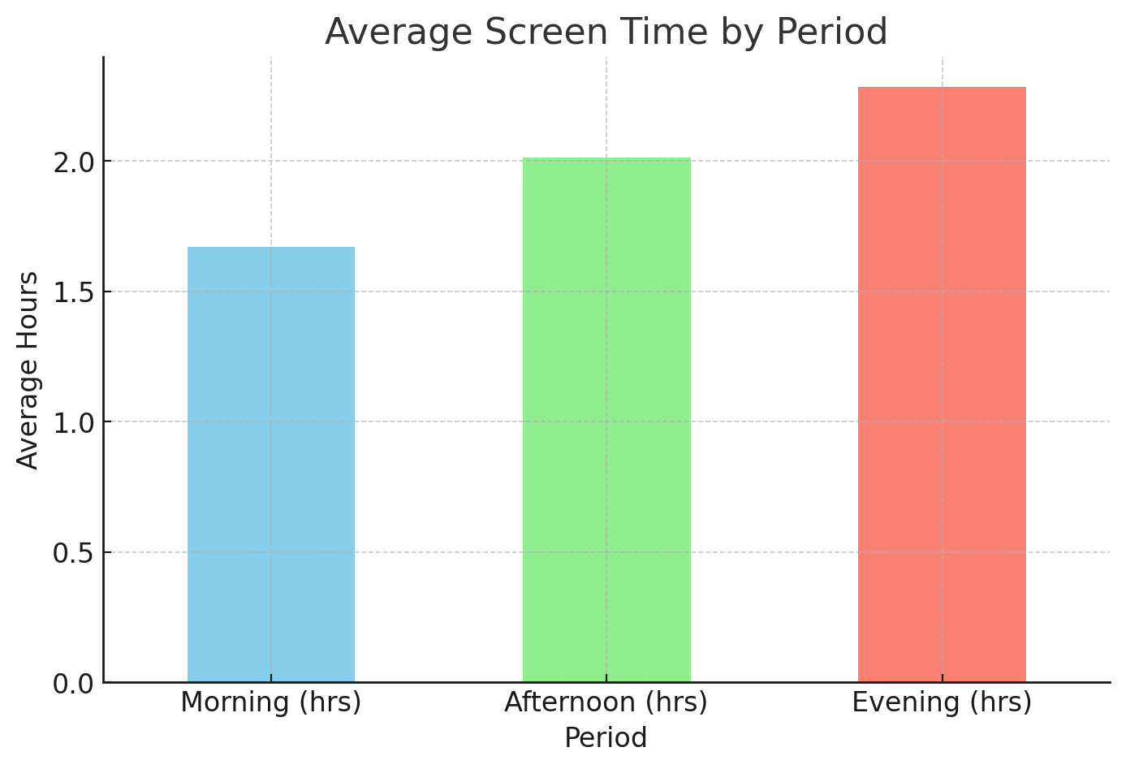
The data reveals that the majority of screen time occurs during the evening. This indicates a tendency to use the phone more extensively after completing daily tasks or work.

Slide 6
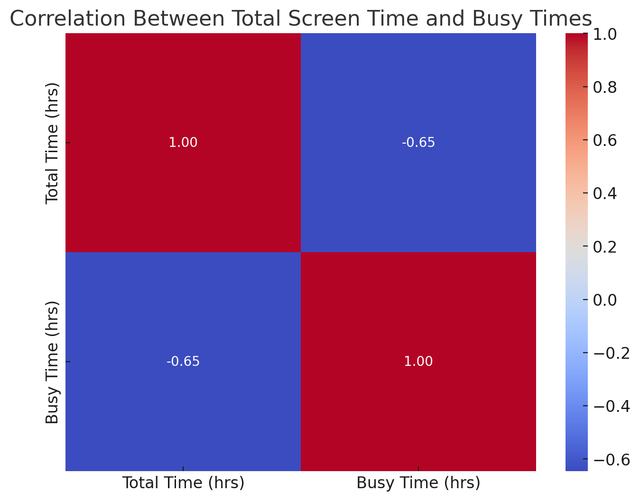
A negative correlation is observed between total screen time and busier periods (e.g., work hours, productivity-related activities). This suggests that on days with higher workloads or more structured schedules, phone usage decreases.

Slide 7
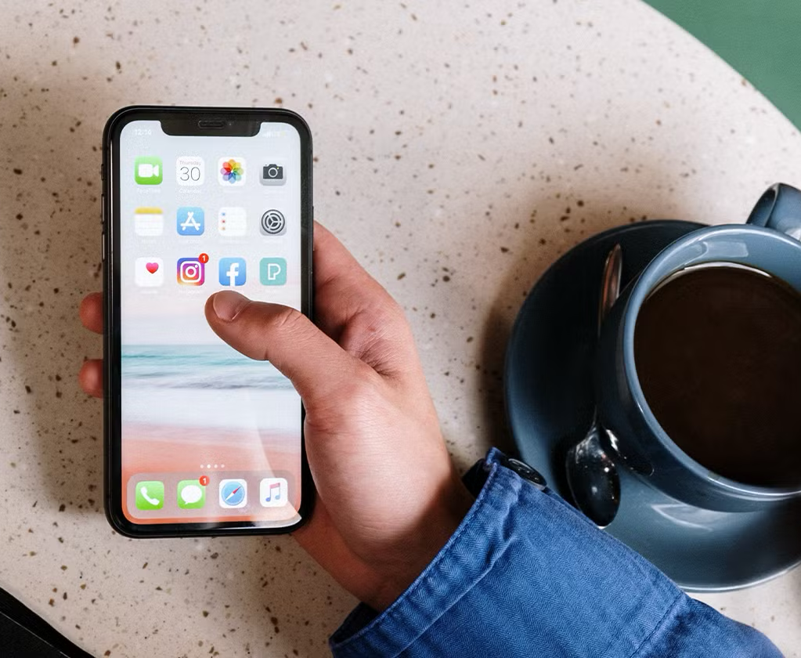
Conclusion The analysis highlights clear patterns in my phone usage, particularly the dominance of evening and Saturday screen time, as well as its inverse relationship with productivity. By addressing these patterns, it’s possible to improve my digital habits and better align phone usage with academic and personal goals.

Slide 8

Thank you!

