Slide 1


Credit Card Customer Segmentation Analysis
ECE COŞKUNÇAY

Slide 2

OUTLINE
ABOUT ME
DATASET OVERVİEW
DATA PREPROCESSİNG
DATA ANALYSIS AND VISUALIZATIONS
UP SCHOOL EXPERIENCE

Slide 3
ABOUT ME
2015
Çınarlı MTAL
2023
Computer Engineering
1998
Born in İzmir
2017
Computer programming
2023
Up School - Data Analysis Program

Slide 4

DATASET OVERVIEW
Predicting Credit Card Customer Segmentation dataset contains a wealth of customer information collected from within a consumer credit card portfolio, with the aim of helping analysts predict customer attrition. It includes comprehensive demographic details such as age, gender, marital status and income category, as well as insight into each customer’s relationship with the credit card provider such as the card type, number of months on book and inactive periods.

Slide 5
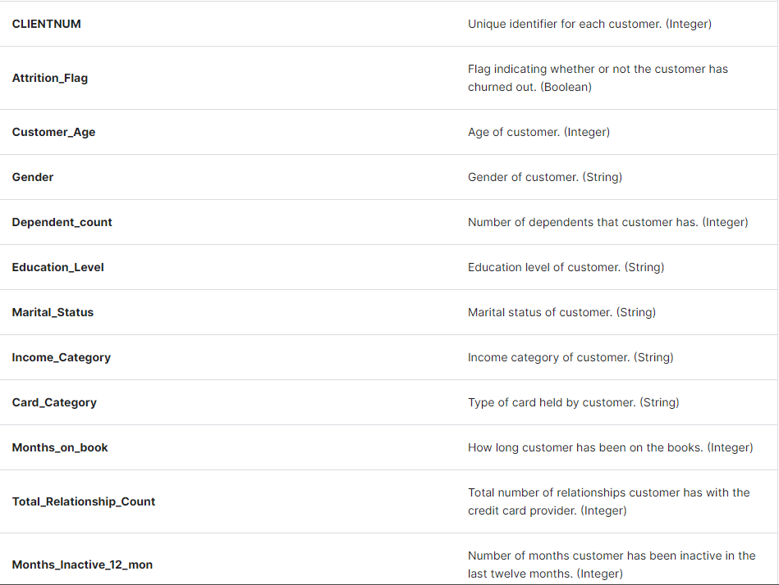
Columns

Slide 6
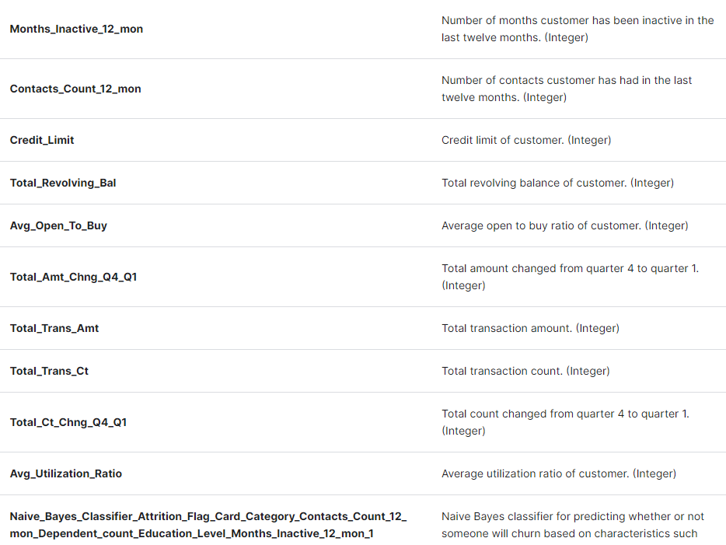
Columns

Slide 7
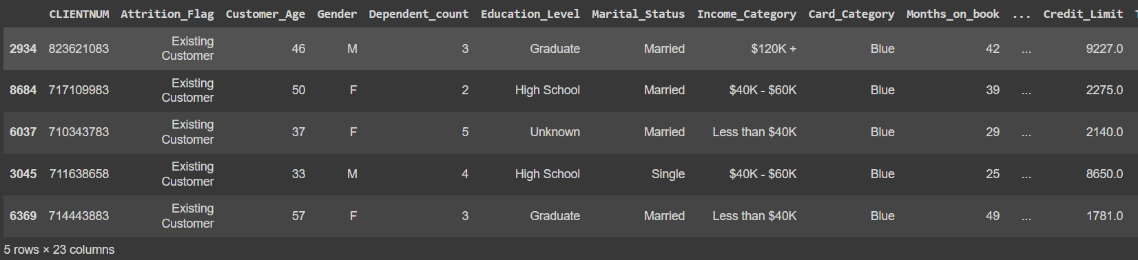
Dataset Overview

Slide 8
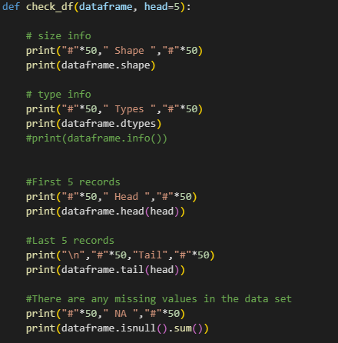
DATASET OVERVIEW
Thinking that I can both explain and show it easily, I defined a function where I can access information about the dataset at once. With this function, we can see the size of the dataset, data types, first 5 and last 5 data, whether there are null values.

Slide 9
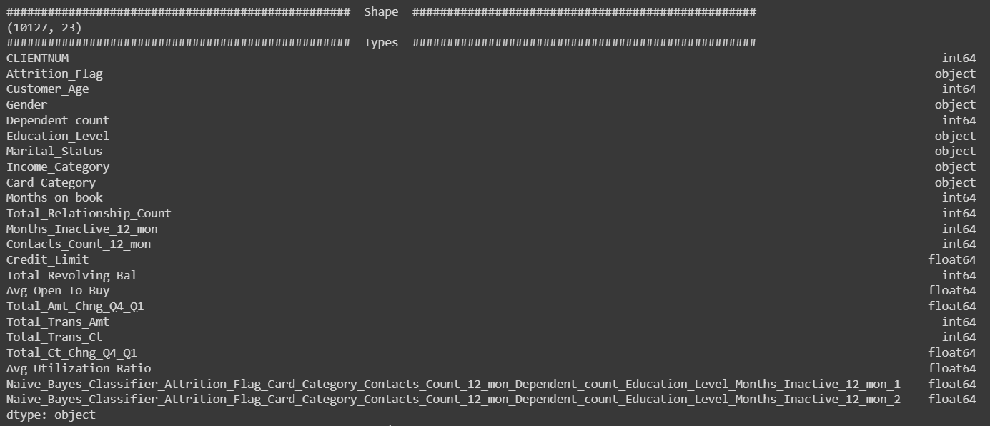

Slide 10
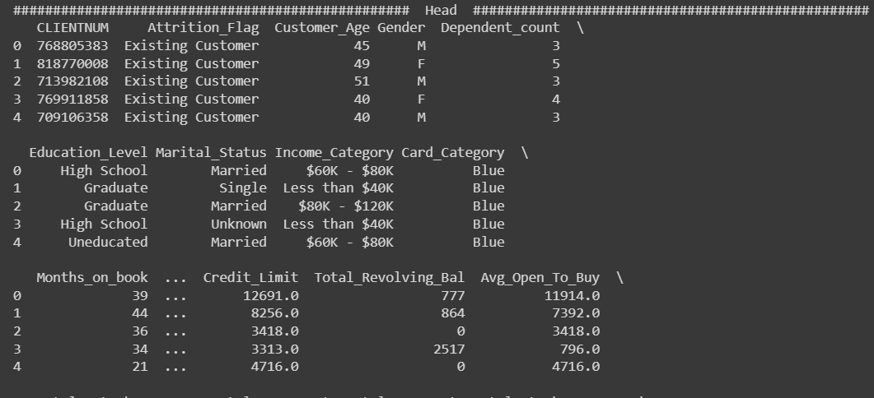

Slide 11
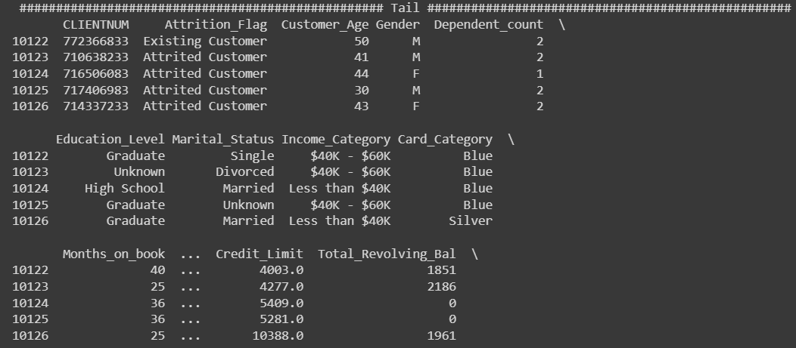

Slide 12
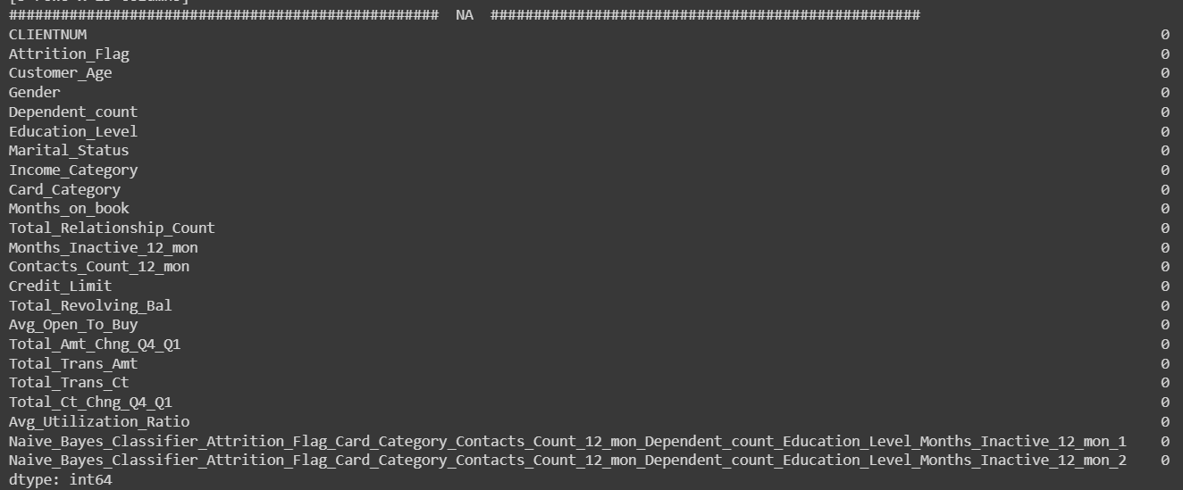
The dataset consists of 10127 rows and 23 columns.There are no null/missing values.

Slide 13
DATA PREPROCESSİNG
I used the unique function to see what values are contained in some columns and see what values each column contains. I checked how many different values in which column it has which values.
I examined the columns that I will use respectively.
Attrition flag
Age
Gender
Dependent count
Education
Marital status
Income Level
Card Category
Months on book
Credit limit

Slide 14
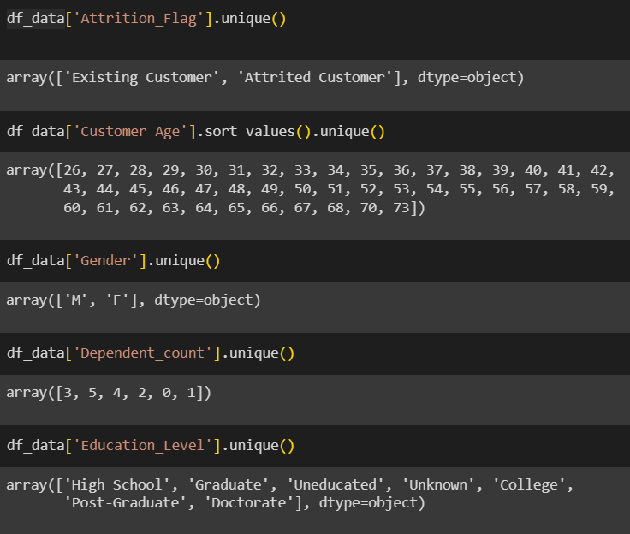
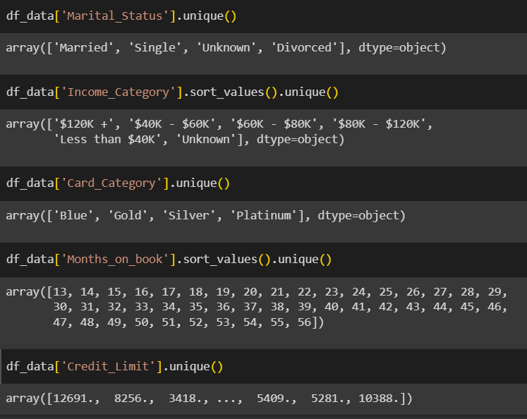
Unique values contained in the columns.

Slide 15
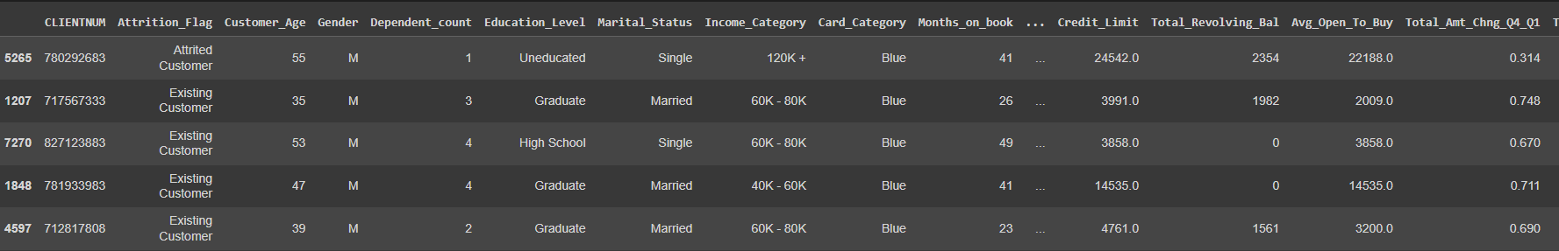
DATA PREPROCESSİNG
I removed the $ sign in the income category column for both ease of use and to avoid erroneous results.
Some columns had unknown values, just like null values, I thought that having unknown data would affect my analysis, so I removed the rows with unknown values.
When all unknown values were deleted, the initial 10127 lines of data were reduced to 7081 lines.

Slide 16

DATA ANALYSIS AND VISUALIZATION

Slide 17
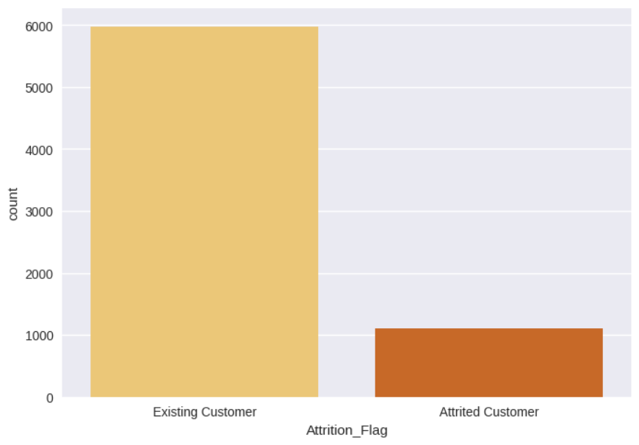

Existing and Attrited Customers
There are 5968 customers who are existing and 1113 customers who have attrited. The Attrition_Flag column gives the count of customers in each category.

Slide 18
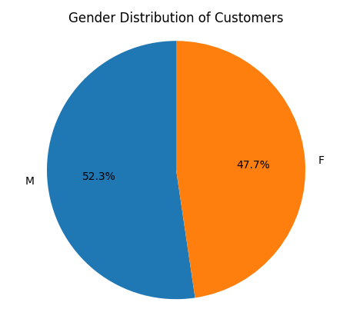

Gender Distribution of Customers
Percentages of male customers and female customers.

Slide 19
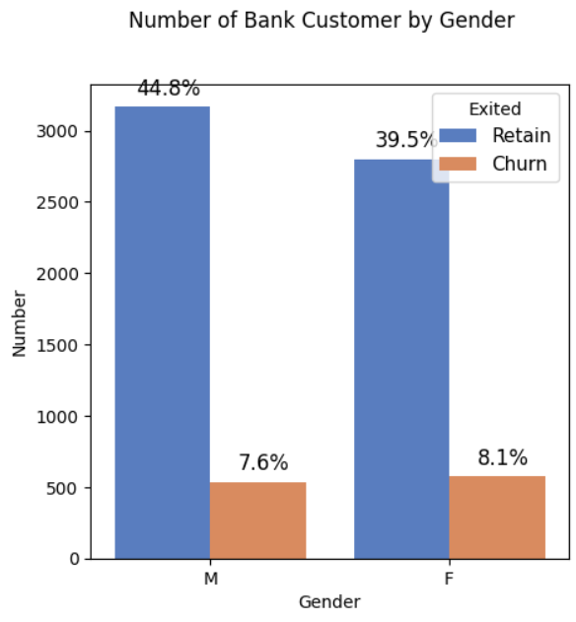
Existing and Attrited Customers by Gender

Slide 20
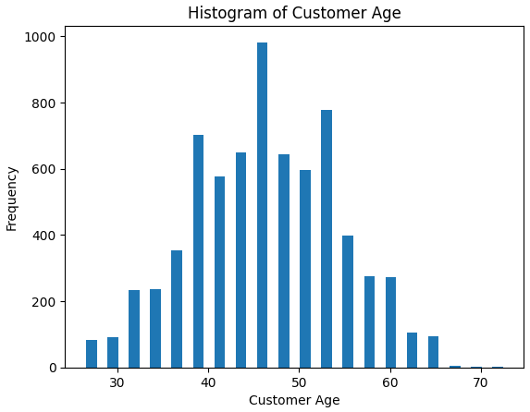
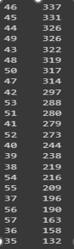

Age Distribution of Customers
We see that the most common age is 46. 337 customers were 46 years old. the minimum number of ages are 66, 68, 70 and 73 and there is only 1 customer from each.

Slide 21
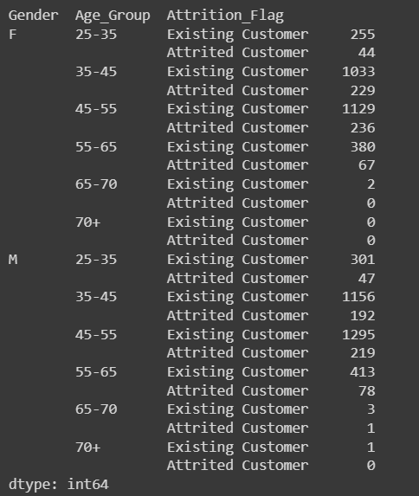
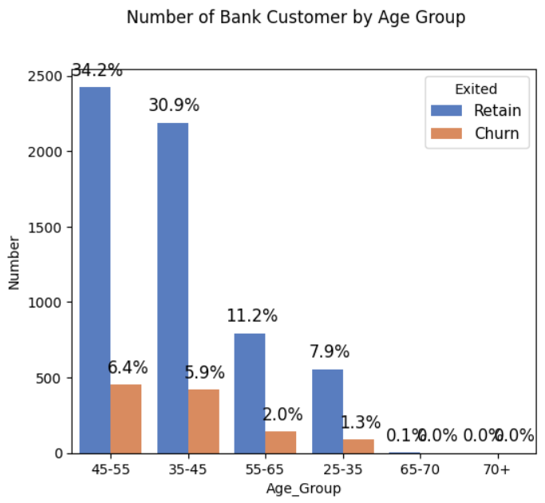
Distribution of Customers by Age Groups
In general, the most common ages are between 42 and 54, and the frequency decreases as age increases or decreases from this range. Ages with the lowest numbers are under 30 and over 65.

Slide 22
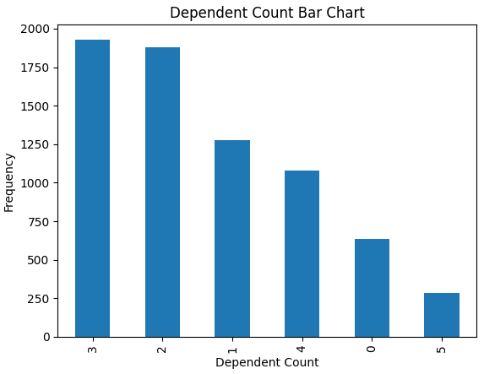
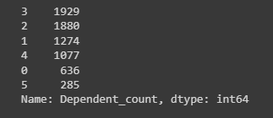
The Number of Dependents of the Customers
When we examine the number of dependents of a customer, we see that the most common number is 3. The number of dependents of 1929 customers is 3. Then it is 2 with 1880 customers. There are 1274 customers for 1 person and 1077 customers for 4 people. The least common are 0 and 5, with 636 and 285 customers, respectively.

Slide 23
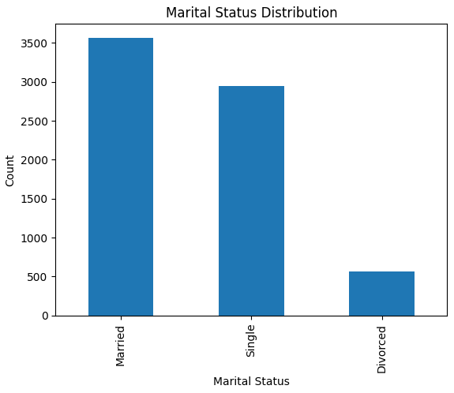

Marital Status Distribution

Slide 24
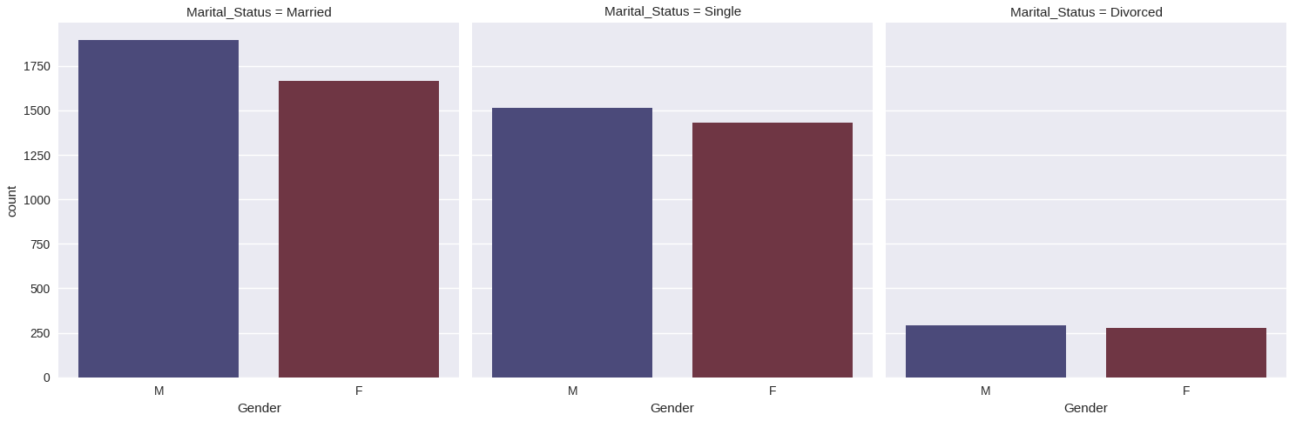
Marital Status Distribution by Gender

Slide 25
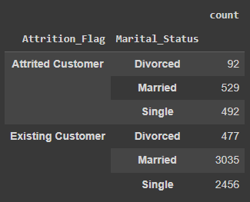
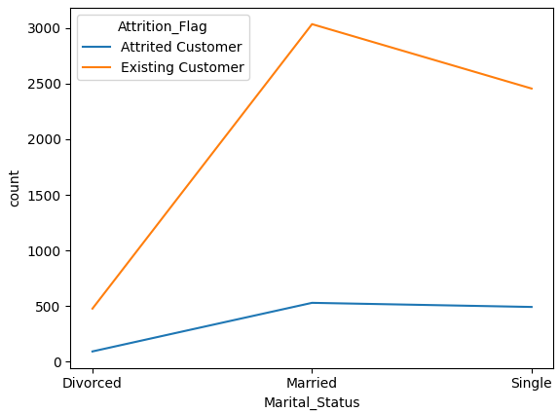
Existing and Attrited Customers by Marital Status and Gender

Slide 26
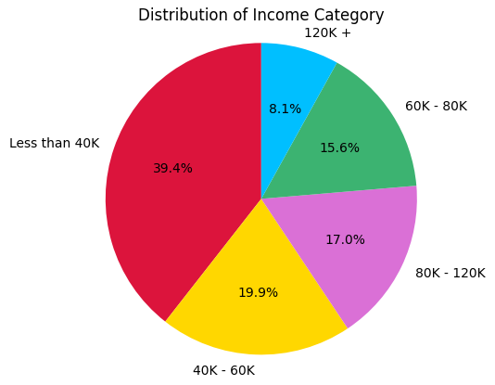
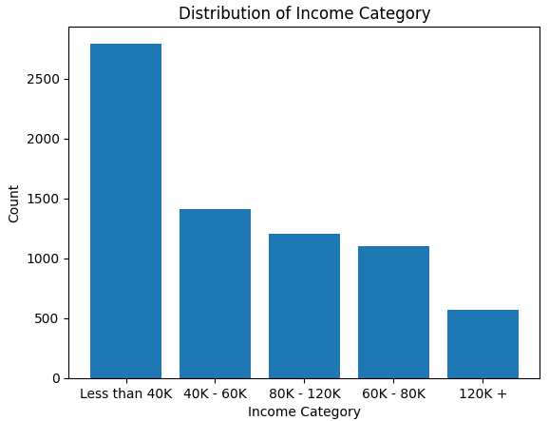
Distribution of Income Category

Slide 27
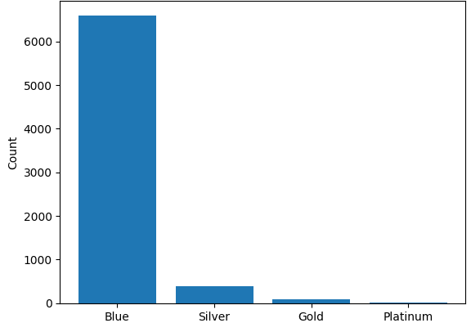
Distribution of Card Category / What type of card are most used?

Slide 28
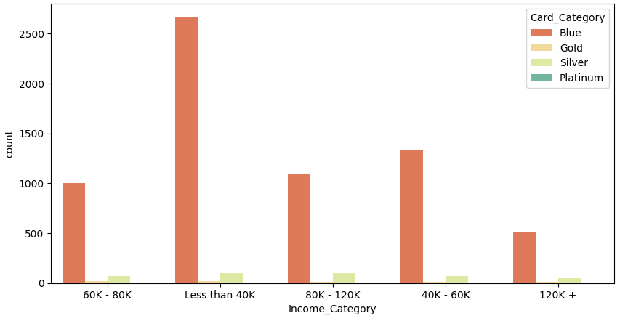
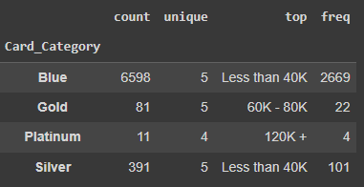
Is there a relationship between card type and income category?

Slide 29
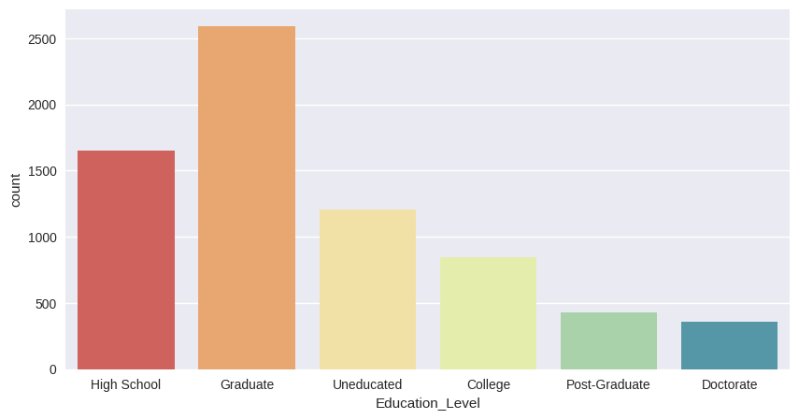
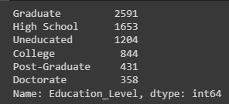
What is Education Level of Customers?
When we look at the education level in general, we see that most of the customers have graduate and high school degrees.

Slide 30
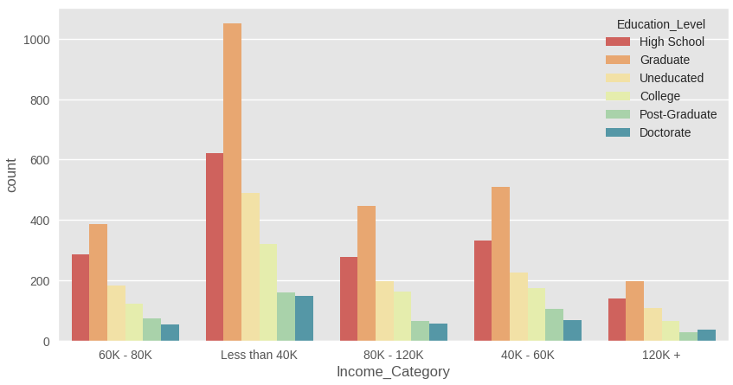
Is there a relationship between the education level of customers and their income?
In this part, I thought that there would be a relationship between the education level of the customers and their income, but as you can see, it cannot be said that there is a relationship. even at all education levels, we can see that the income level of a large part of them is less than 40K compared to the others.

Slide 31
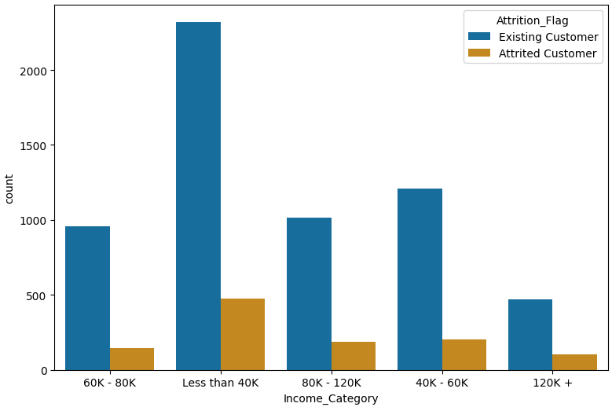
Is there a relationship between income and attrition?
It cannot be said that there is a relationship.

Slide 32
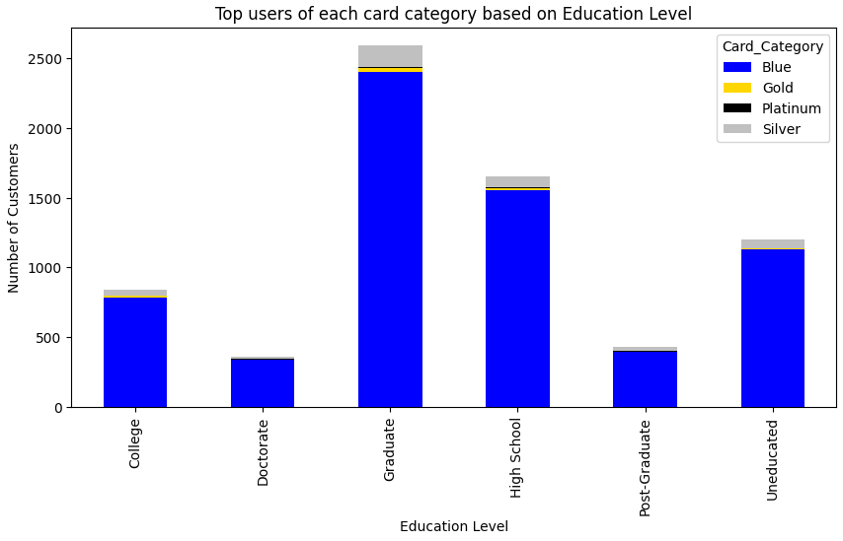
Card Category and Education Level

Slide 33
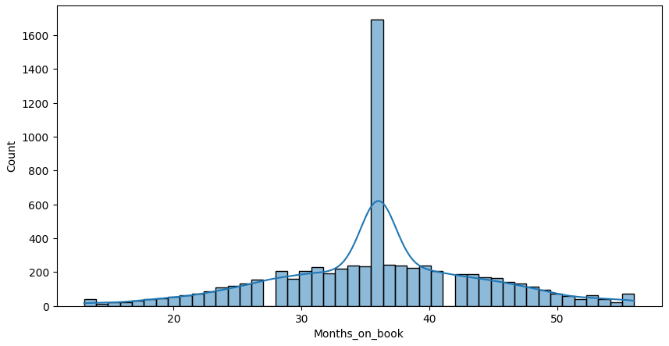
How long does it take customers to leave?
After the customers started to receive service, the maximum separation occurred after 36 months.

Slide 34
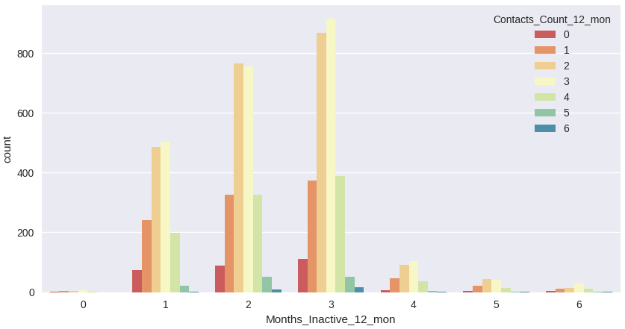
Contacts_Count_12_mon VS. Months_Inactive_12_mon
It is the normal distribution over all months.

Slide 35

UP SCHOOL JOURNEY

Slide 36



CORE SKILLS
Time Management
Self Compassion
Challenge

Slide 37


