Slide 1

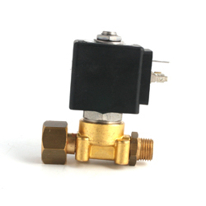
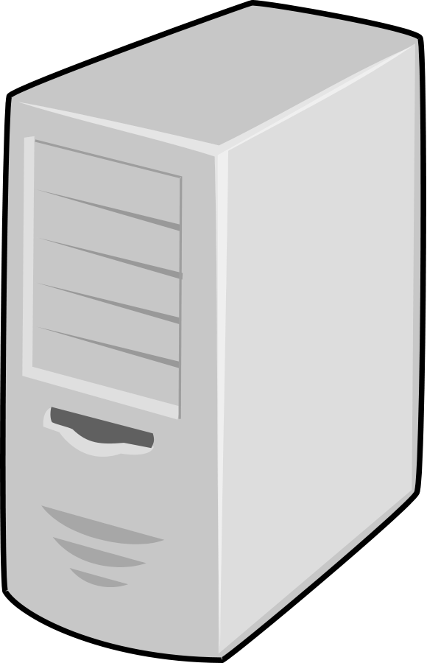



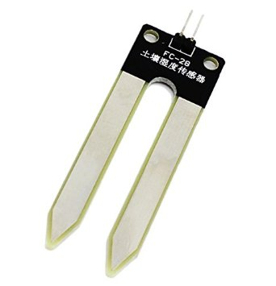

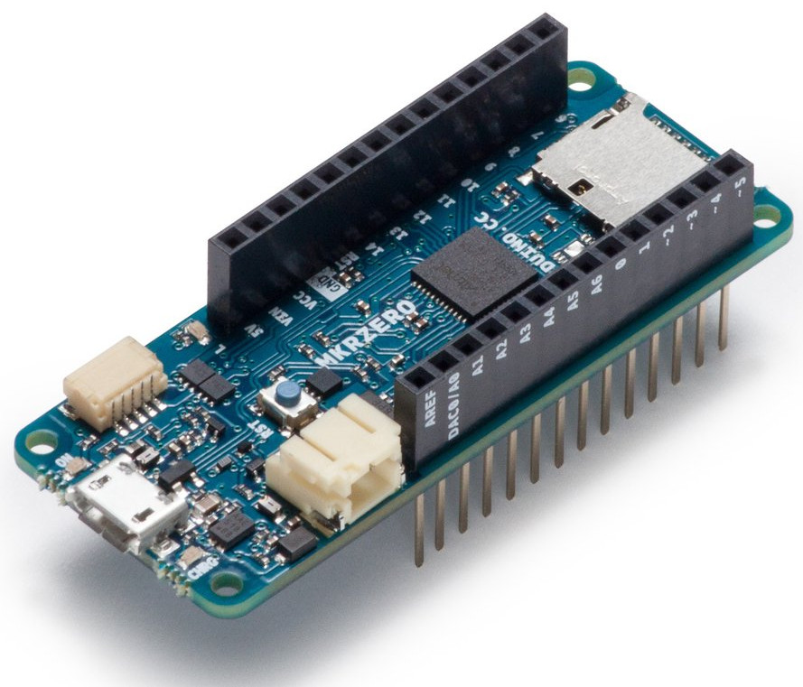
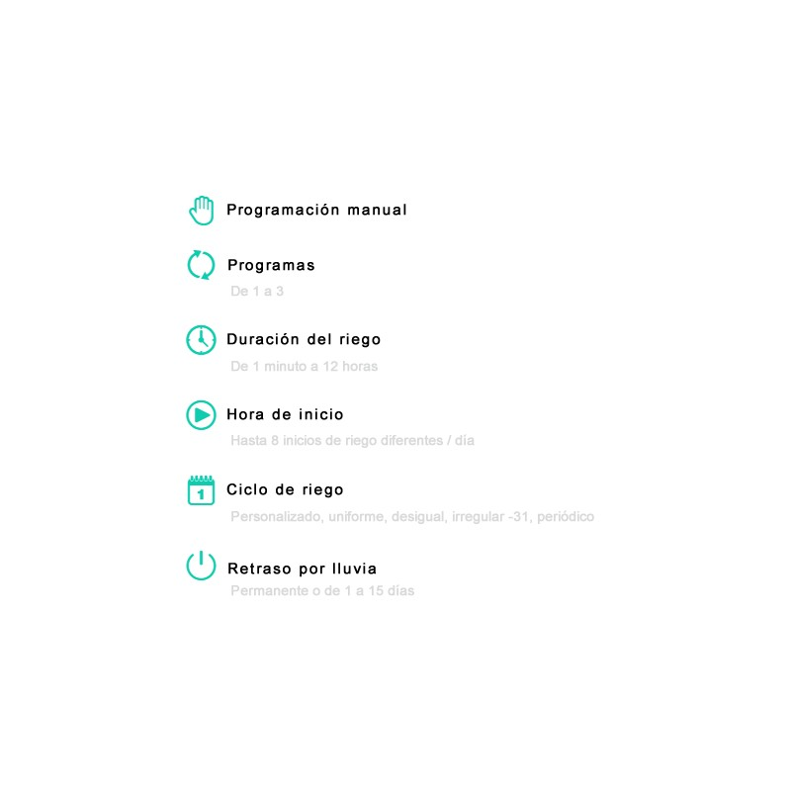


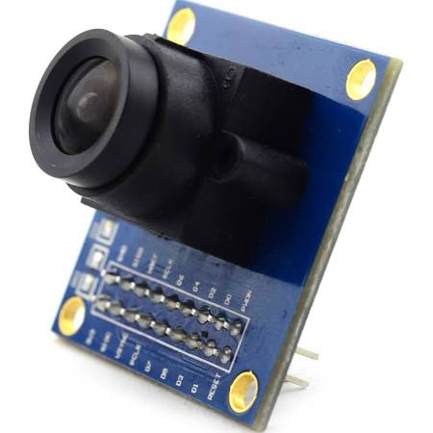

Electrovalves + relays
(LED for Demo purposes)
Home Control Hub
Web client
Telegram Bot
20,000 Ha green areas
140 Hm³ per year
~10% waste
Humidity sensors
Remote surveillance
(in project)
Watering in rainy days
Watering in hot hours
Watering in excess
Sprinkler vs. drip irrigation
Manual vs. autom irrigation
Pipe leaks
Non-native plants
Evaporation in excess
Use Cases
Remote system activation/de-activation
General case: Watering at scheduled times
Check humidity before watering + Notification (through Serial Monitor)
Stop watering when reaching humidity + Notification (through Serial Monitor)
Manual (Remote) override – Under construction
14,000,000,000 L
241 m

