Slide 1

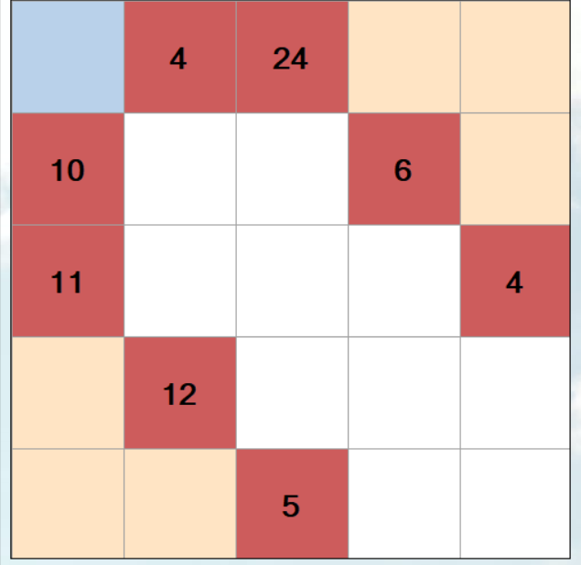
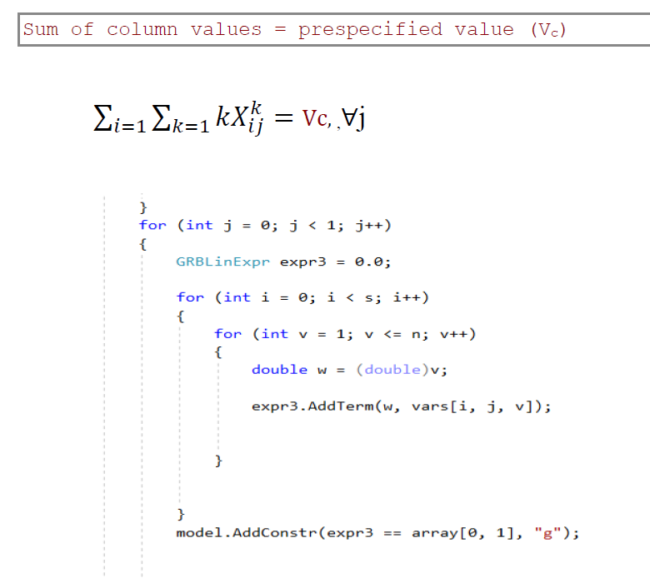
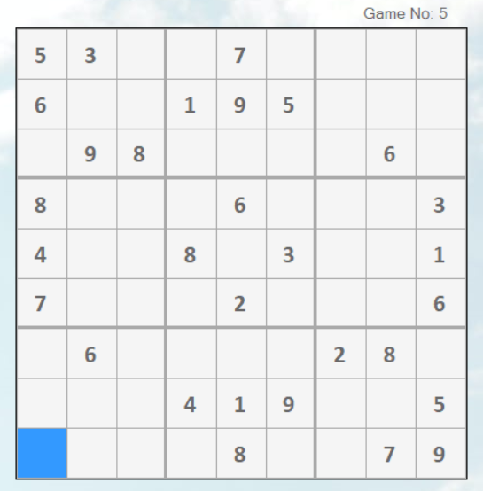
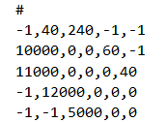
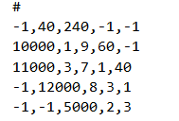
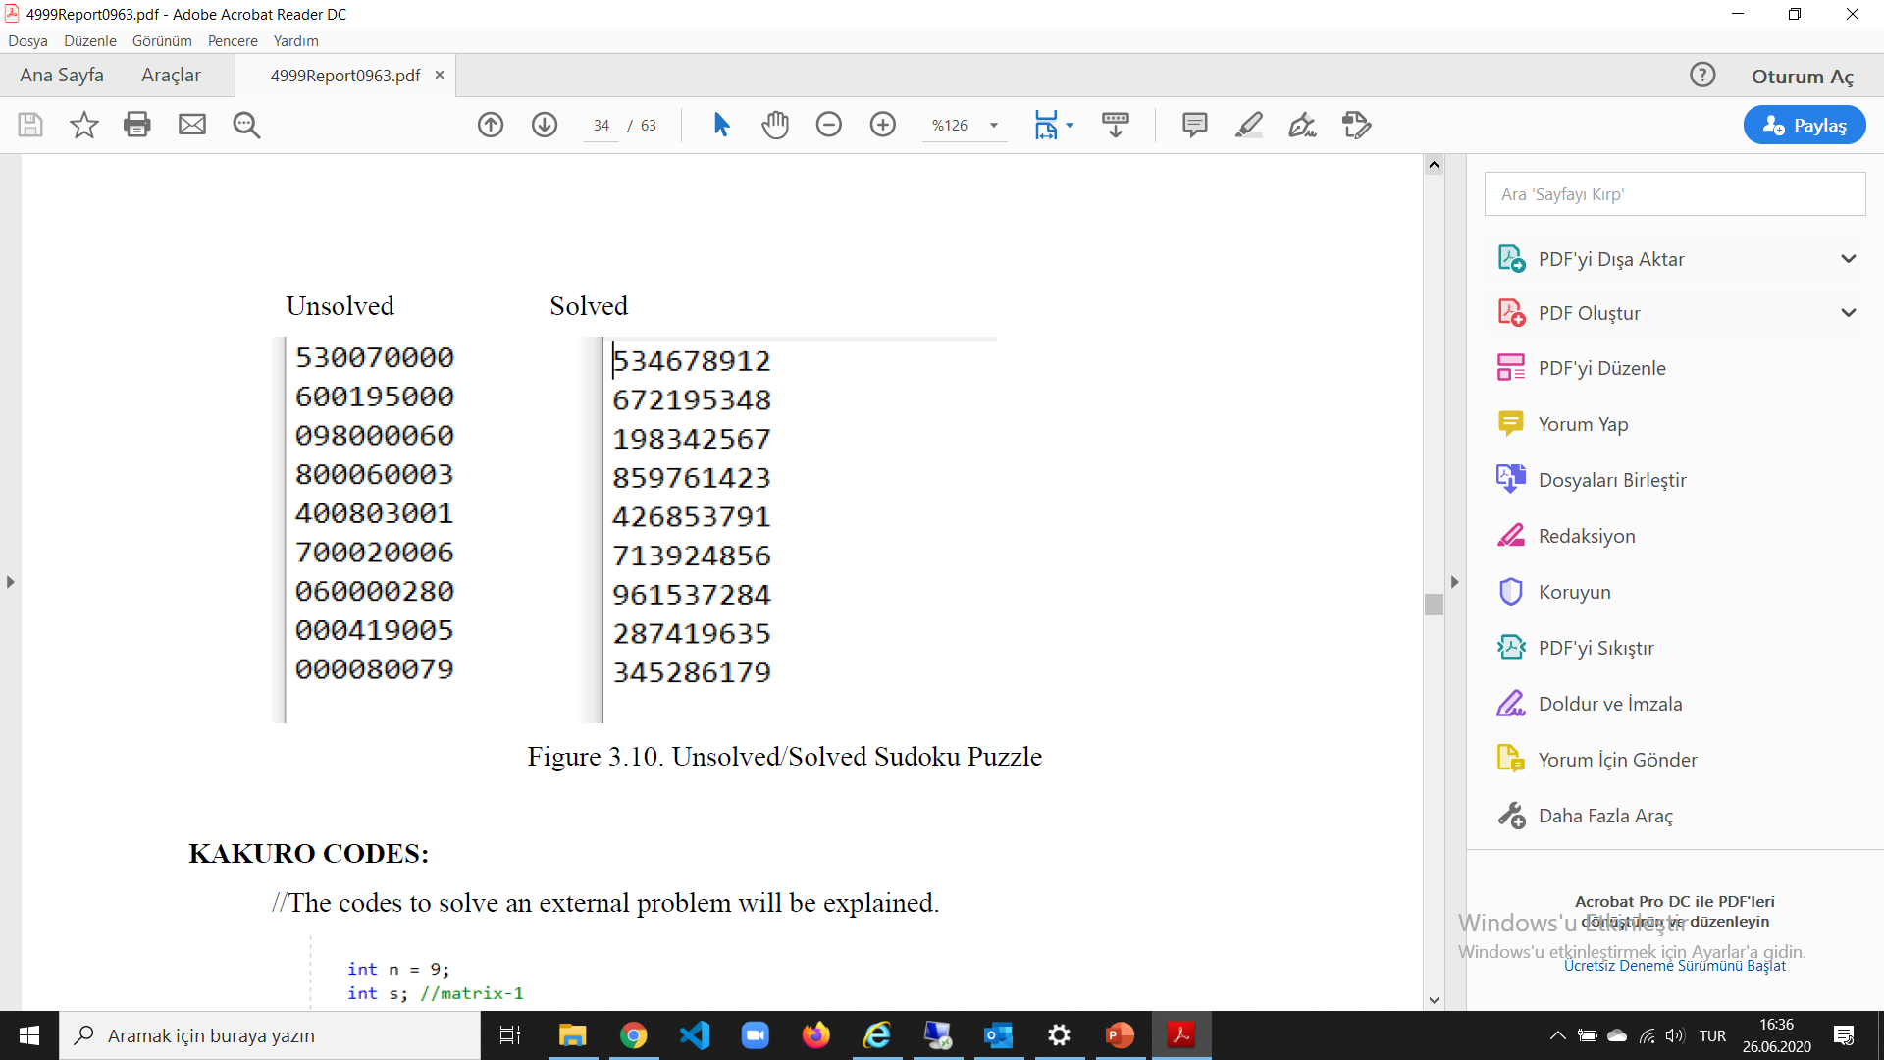
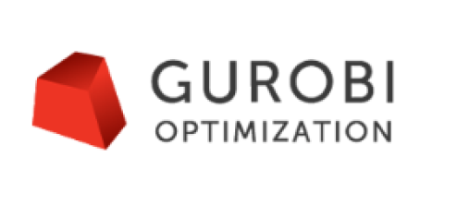
An Optimization-Based Sudoku/Kakuro Player
Şule Akça
Ecem Altınel
Assoc. Prof. Tankut Atan
Prof. Dr. Mehmet Alper Tunga
Abstract
This project provides a quality entertainment platform by letting them play and solve Sudoku/Kakuro games. It consists of two separate modules where users both can play a game of Sudoku/ Kakuro, and also see the solution of puzzles they encounter in a newspaper or on the internet.
Kakuro Board
Sudoku Board
Translating the model into optimization code (Figure above)
Data representations for unsolved and solved games (Figure below)
Conclusion
In this project an optimization-based Sudoku/Kakuro player was created successfully as a Windows Form Application image using C# language, and Gurobi optimization solver in the background. Using the developed application, users can play and solve any Sudoku or Kakuro puzzle without an internet connection.
References:
https://www.gurobi.com/documentation/9.0/examples/sudoku_cs_cs.html
http://www.baskent.edu.tr/~bkececi/userfiles/file/SUDOKU/SudokuILPModel.pdf

