Slide 1

Exploratory Data Analysis
<G2M Case Study>
<18.03.2023>

Slide 2

Agenda
Overview
Problem Statement
EDA
EDA Summary and Recommendations

Slide 3
Overview
XYZ is a private equity firm in the US. Due to remarkable growth in the Cab Industry in last few years and multiple key players in the market, it is planning for an investment in the Cab industry.
Objective of the Project is to provide actionable insights to help XYZ firm in identifying the right company for making an investment.
The analysis can be examined under 3 headlines:
- Understanding Data
- Choicing important features and extracting meaningful results
- Results and recommendations

Slide 4
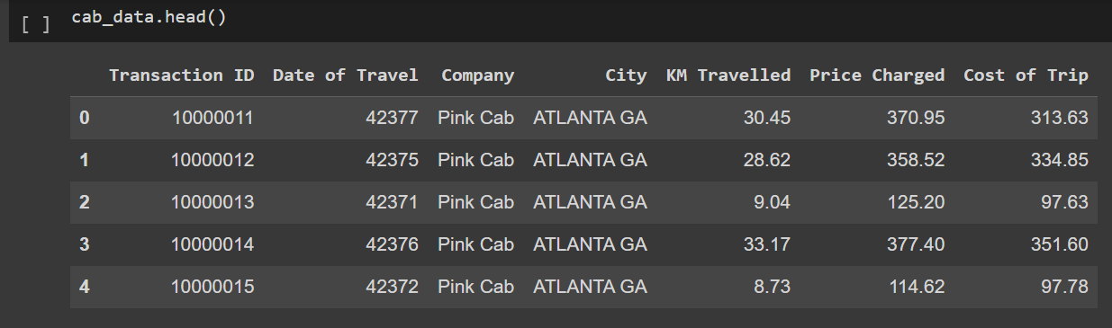

Problem Statement
We have four separate data and many features regarding two companies Pink Cab and Yellow Cab.
Cab data have very important features like price charged and cost of trip which are very important to the decision.
Plus, it includes time-based information to help us predict the future state of companies.

Slide 5
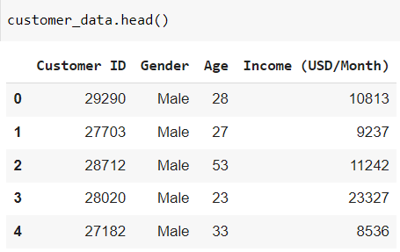
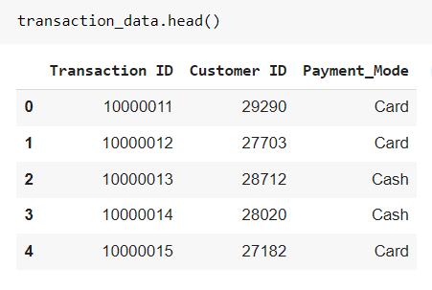

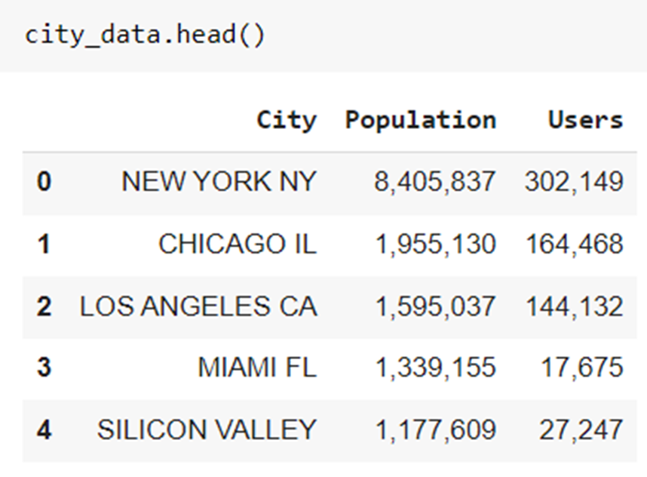

Transaction data and customer data are important for examining the user profile and identifying the most profitable and stable customers for each company. The city data also gave us the chance to examine the profit and number of users distribution of the companies over cities.

Slide 6
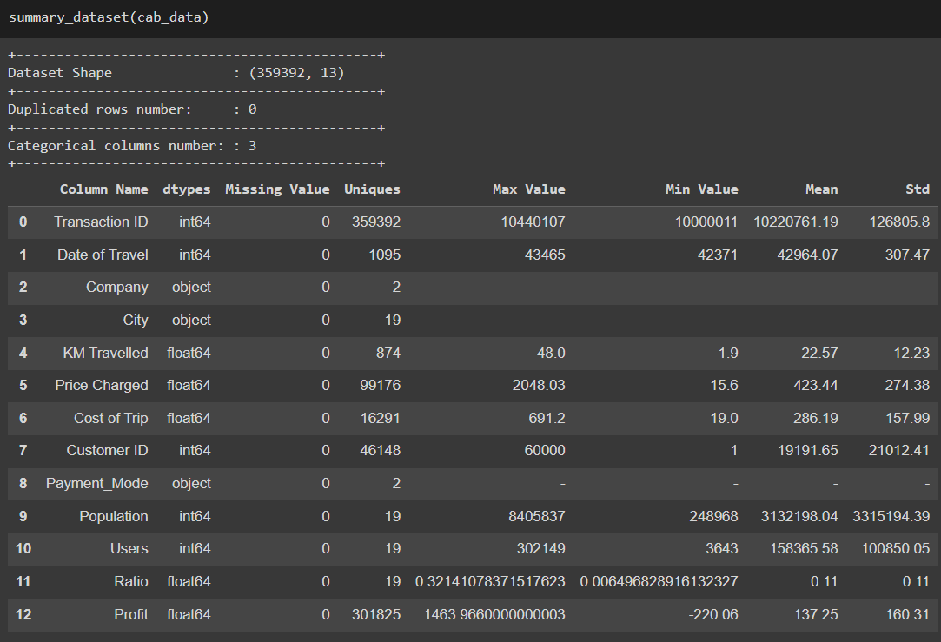
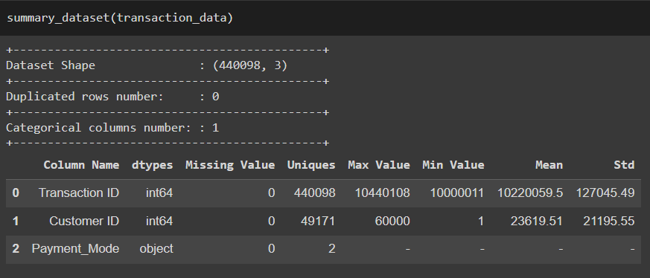
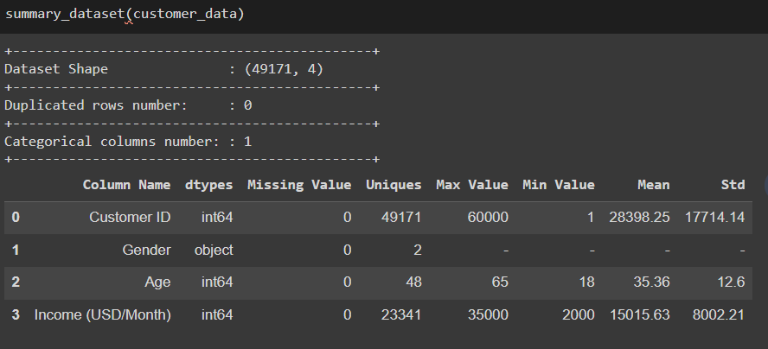
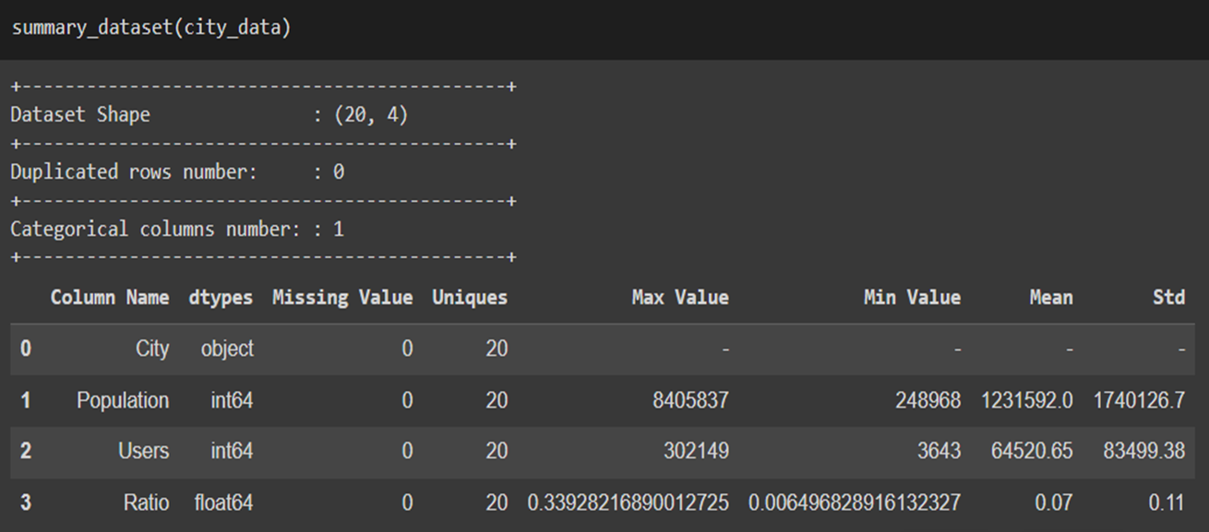
To have better insight about our data, we cleaned, formatted and did some preprocessing in our datasets and also created new features that we will use in analysis further steps

Slide 7
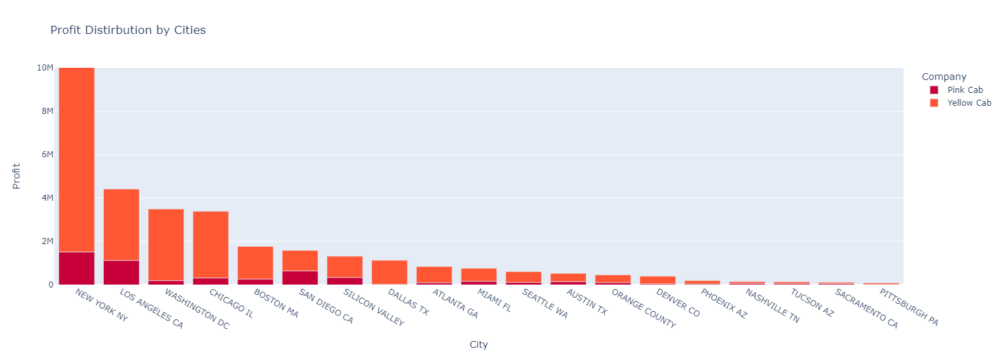
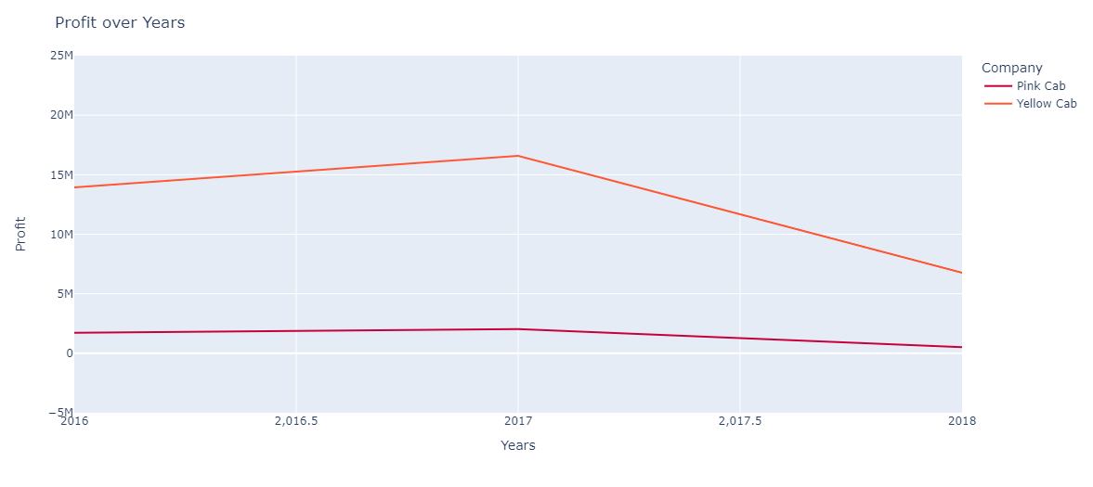

PROFIT ANALYSIS
Profit Distribution by Cities
Profit Distribution by Years
As a result of these graphs, Newyork is the most contributed city for total profit and Yellow cab has decrease in profit over last years while Pink Cab stay more stable.

Slide 8
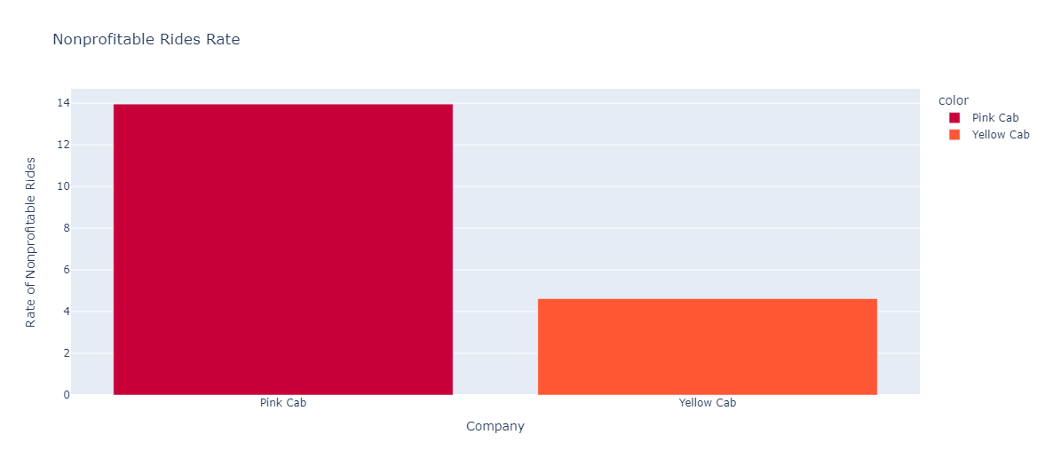
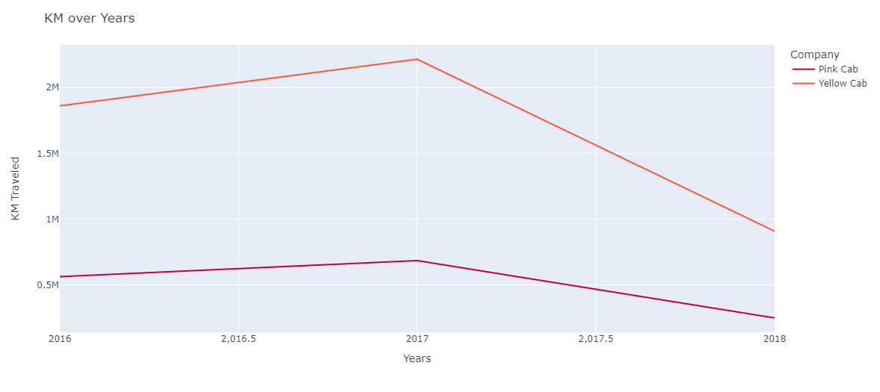
Non Profitable Rides Rate
The reason the Pink Cab has less profit might be due to the high nonprofitable trip rate compared to the Yellow Cab. It might be related to cab automobiles Pink Company uses.
Travelled Kilometer
Cab using has decreasing over last years or people prefer shoter trip more or there might be alternate transportation.

Slide 9
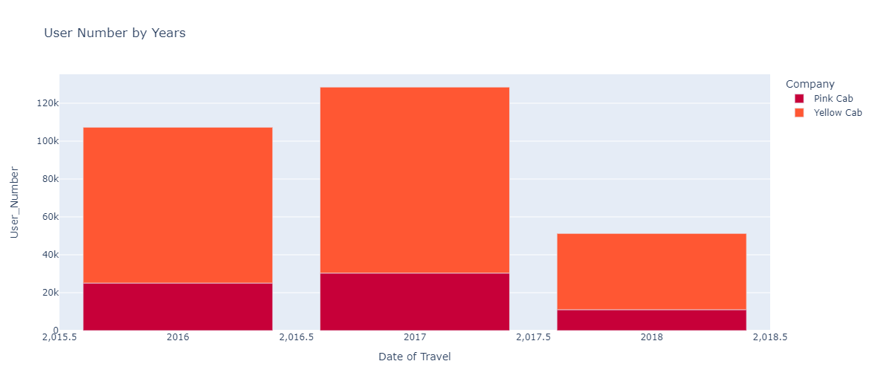
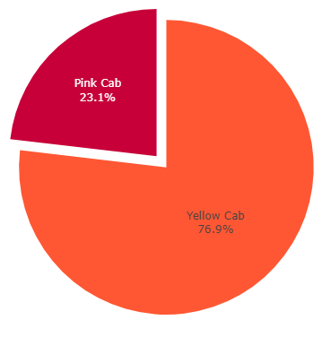
Customer Capacities
This chart is another proof of the shrinking of the Cab market over last years. For both companies, users number have decreased after 2017. However, when we consider two cabs. Yellow Cab is more dominant in the market

Slide 10
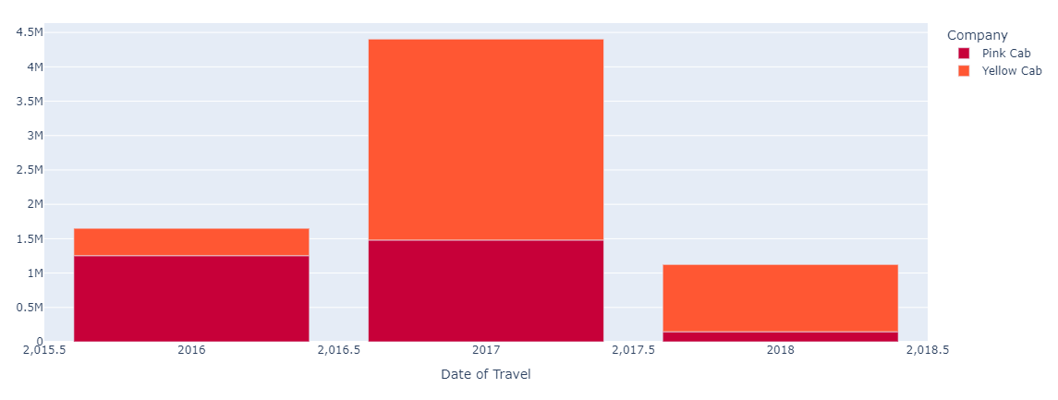
The Rate of Customers that Prefer Same Company more than 5 times
Continuity in customers is a very important parameter that should be taken consideration. According to the results. The rate of customers that prefer the same company more than 5 times over total customers is higher in Yellow Cab Company

Slide 11
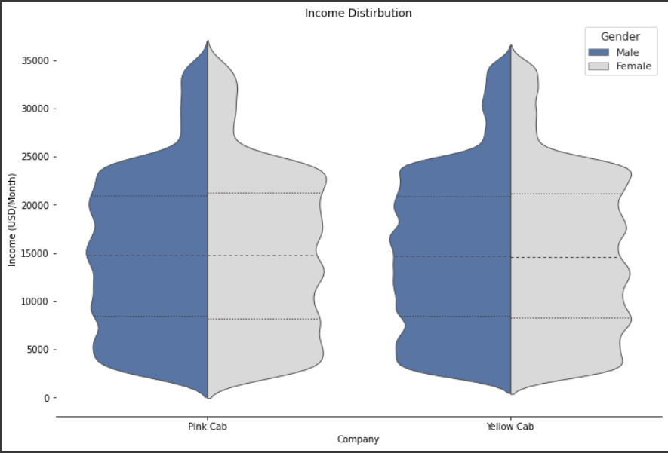
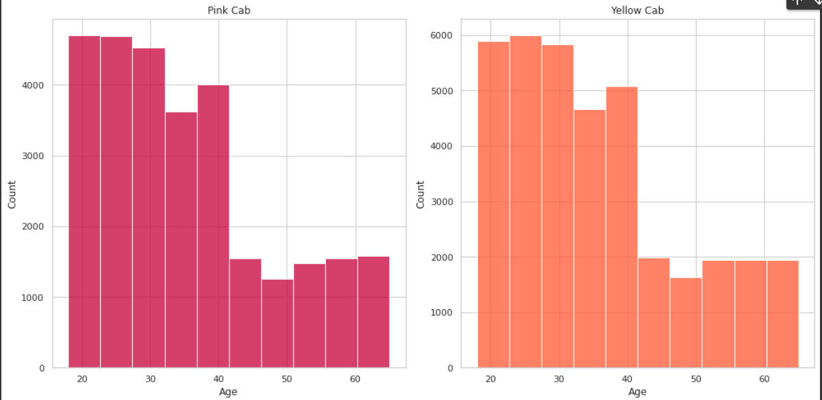
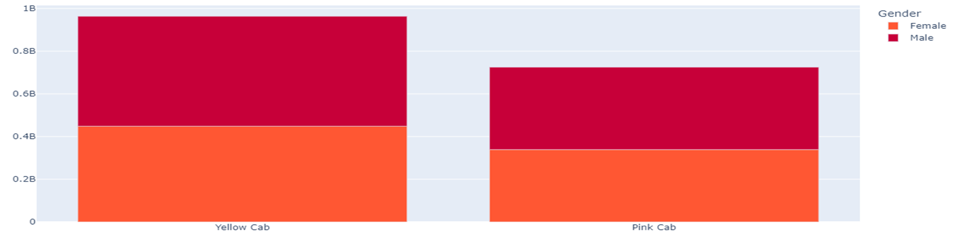
ANALYSIS OF CUSTOMERS PROFILE
For both cab company, They have customer profile age of +40
Male Female ratio is balanced and similiar in both company
Income Distirbution Profile is similiar for both company.
Average customer income around 15000 USD

Slide 12
EDA SUMMARY and RECOMMENDATIONS
Yellow Cab dominate market more compared to Pink Cab in terms of customer capacity and profit.
Yellow Cab higher continuity in customers.
Yellow Cab have higher decreasing in last years.
Both compaies has deacreased over last years. Market state should be examine carefully and popular alternate transportations in last years consider.
Since both Cab Company has more cost rate over last years, costs in transportation market might have incresed. This should research.
Both company has similiar customer profile.
Both company is prefered by average income customers.
Cab Using is not comman among the younger generation.

Slide 13
Thank You
Ecem AY

