Slide 1
SNORT & SNORT RULES
What is Snort ?
Snort working principles
Plugins while using Snort
Snort Writing Rules
Snort Rule Headers
Rule Types
Rule Options

Slide 2
Definition of Snort
Independent company software developed to work with graphical interface support based on Snort software is also available. These software perform functions such as management, reporting, logging
There are three mode of Snort

Slide 3
Snort working principles
1)Packet Sniffer
2)Packet Logger
3)NIDS(Network Intrusion Detection System) / NIPS(Network Intrusion Prevention System)

Slide 4
Plugins while using Snort
BARNYARD: Allows the records that Snort keeps while listening to the network to be written to the database within a specific template. ADODB: Allows to connetion between database and base. BASE: Provides to the user to be presented with graphical tables.
OINKMASTER: Designing to snort rules. PULLEDPORK: When snort rules updated , it enables update these rules also the system side. SNORTSAM: Blocks to IP on firewall. ACID: Analyze the data in PHP language for the web interface. SNORBY: The web application that it is monitoring the status of security.
ruby on rails

Slide 5
Snort Writing Rules
After successfully installing snort, Snort examines incoming and outgoing packets to the system based on predefined rules and generates alarms and logs accordingly. In addition to the truths of these alarms produced by Snort, there are also alarms given incorrectly. Real attacks can be overlooked in this way to avoid such a situation, you should be very careful when writing snort rules.

Slide 6
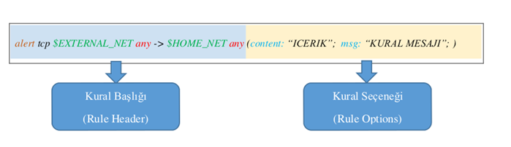
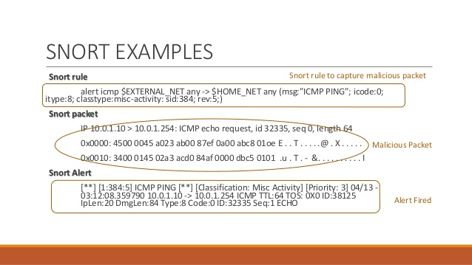
Snort Rule Headers
Alert Log Pass Drop Reject Sdrop

Slide 7
Rule Types
Protocols
ARP, IGRP, GRE, OSPF, RIP, IPX
IP Adresses
alert tcp !192.168.1.0/24 any -> 192.168.1.0/24 any (content: “ICERIK”; msg: “DIŞ AĞDAN”;)
Port Adresses
Sections are at ‘any’ as 80, 21, 22.

Slide 8
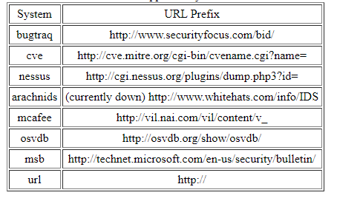
Rule Options
Rule options give snort rules flexibility and strength, and are also the most important part of these rules. The ‘;’ character is placed after each typed parameter when creating the rule Options section. The main rule options, usually used in snort rules, consist of.

