Slide 1
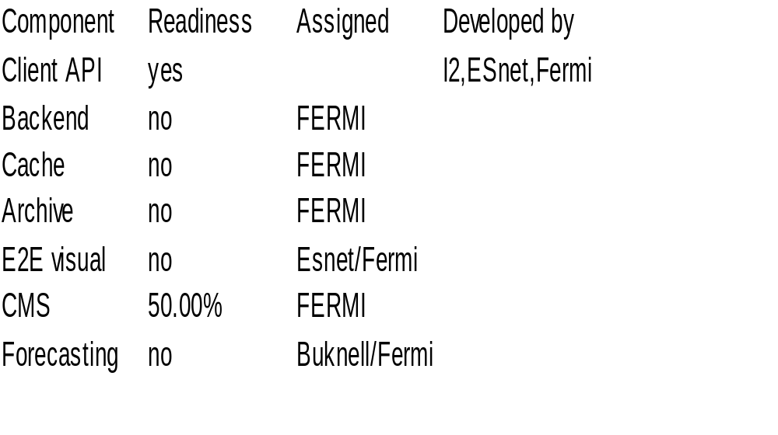
Components

Slide 2
Data fusion
Esnet SNMP data collection
  Mapping with routing data
  Errors, drops, counters and capacity
Routing MA ( proposed on ps-ps f2f, TBD)‏
  Traceroute mapped with BWCTL/OWAMP
  Separate XML schema, client API
Pinger MA collector/cache: RTT, Packet loss
On-demand tests ( for later)‏
SQL DB, avoid XML DB, no support for Xquery
Datasets for the path
    Utilization timeseries over the link, hop granularity
    Achievable BW over the link, hop granularity
    Packet loss, delay/rtt over the link, single hop

Slide 3
Data fusion(continued)‏
Timeseries ( what kind ?) for forecasting
  Long term
  Short term
Aberrant network behavior
  Path asymmetry
  BW drops, platos

