Slide 1
THINGDER
Team Members:
Andrew De Neve
Elizabeth Cepernich
Joseph Campuzano
Juan D. Cardozo
Yukio Rivera
Andy Wong
March 6, 2016

Slide 2
Application
We wanted to make a simple app that makes it easy for people to trade material items with each other. The site would be useful for people like us who are in college and don’t have a lot of fiat currency (expendable cash), but still want to be able to get new things for ourselves.

Slide 3
Project Goals
Post items and match items
Match with people and find people near you
See Items
Location and Search for People
Set up profiles and rate users
Email notifications
Payment with currency

Slide 4
Goals Achieved
Post items and match items
One way matching
See Items
Location and Search for People
Set up profiles and rate users
Email notifications

Slide 5
Challenges - Product
Learning to use Web2py and other associated web technologies
Managing github
Matching proved to be difficult to implement
Getting the rating system to work took some research
Learning to use ajax to update the page on the fly (deleting posts etc)

Slide 6
Challenges - Development process
Making group decisions that we all agree on (6 person group)
Finding time to meet with all of our conflicting schedules
Working around the homework assignments for the class (and others)

Slide 7
Technologies Used
Web2py
HTML
CSS + Bootstrap
Javascript
Github

Slide 8
Project Management
Our project management was done using the SCRUM agile framework learned in class.
In order to effectively communicate quickly we utilized Facebook messenger
SCRUM board was maintained using Google Spreadsheets

Slide 9
Enjoyed/Didn’t enjoy

Slide 10
Lessons Learned
Web2py abstracts a lot of the work from you and sometimes things work without knowing exactly why, for this reason we would probably prefer to use another framework in the future.
Using SCRUM for the first time proved to be a little bit frustrating. A lot of us are working on other commitments while SCRUM seems to be more useful for workplace environments where daily commitment to a product is implied.

Slide 11
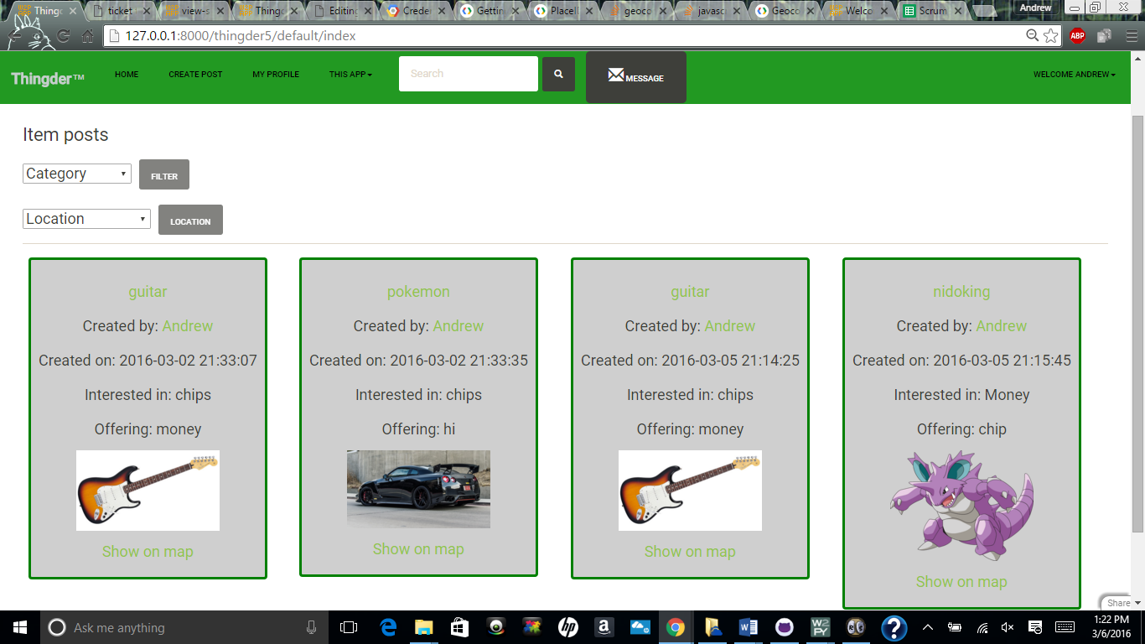

Slide 12
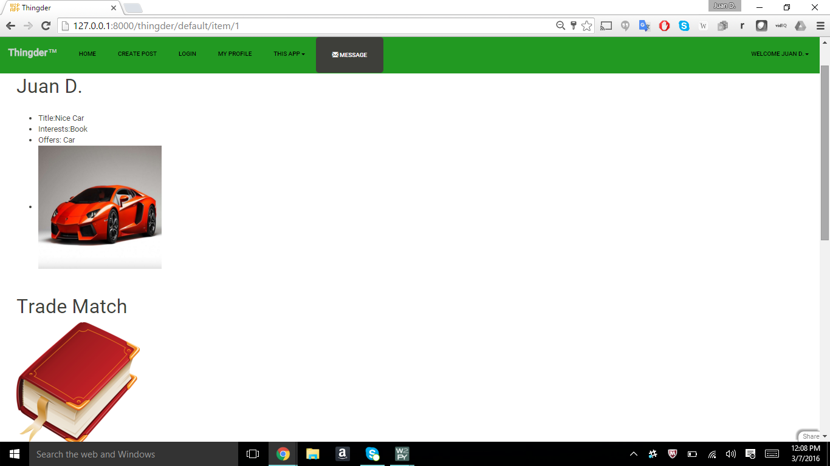
I see you.

Slide 13
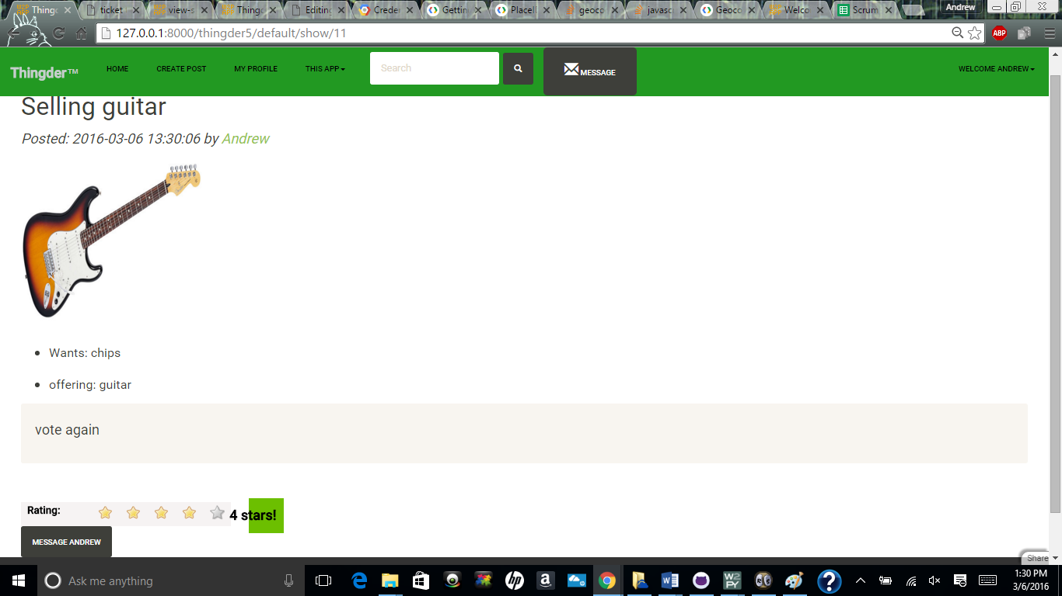
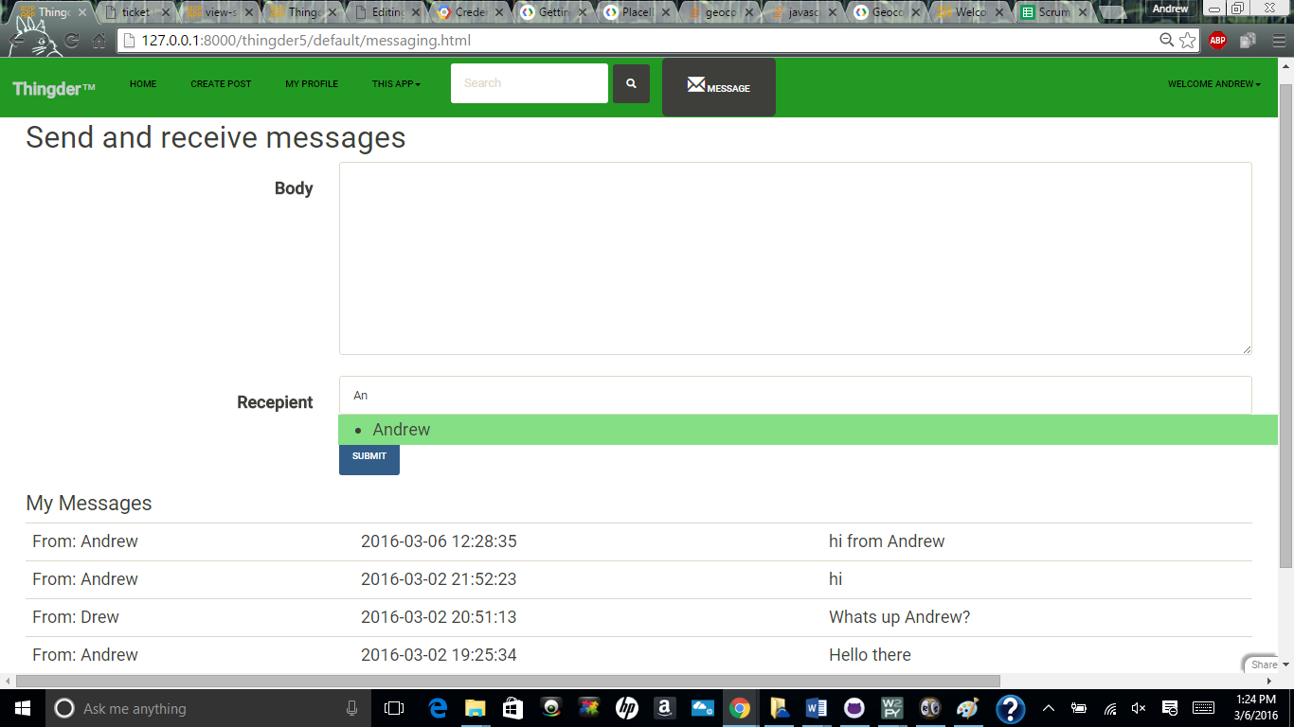

Slide 15
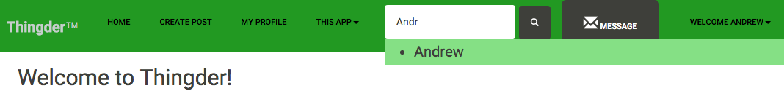
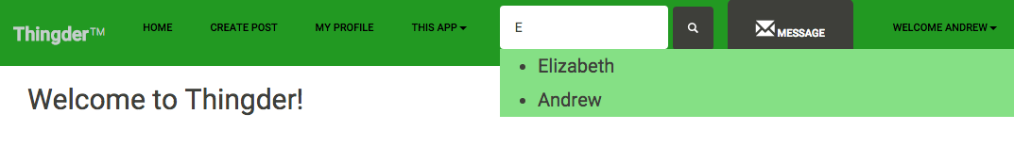

Slide 16
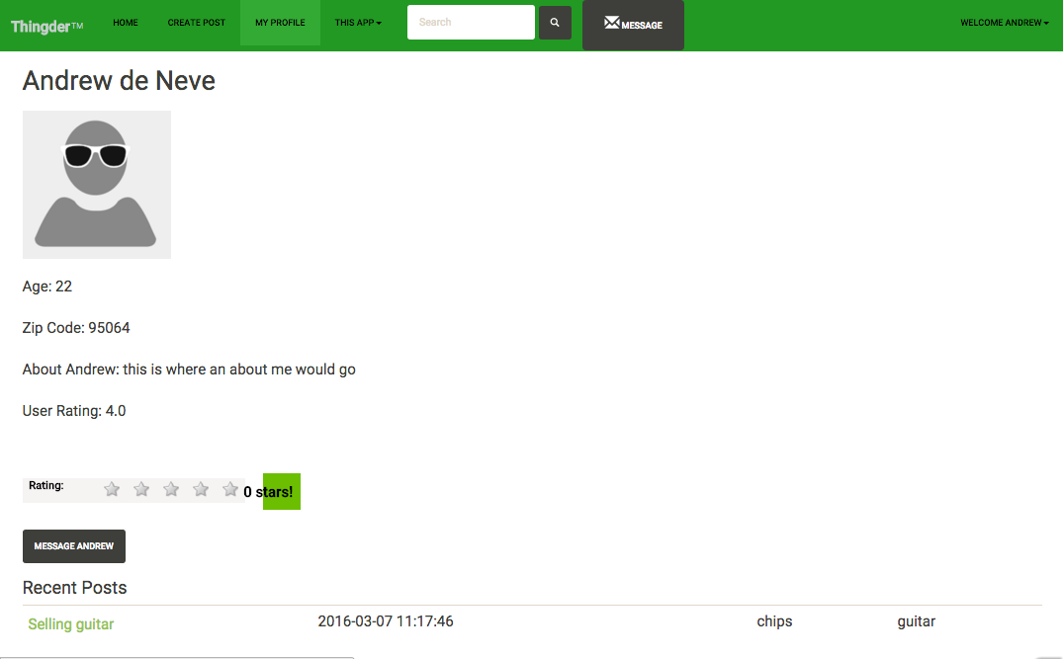

Slide 17
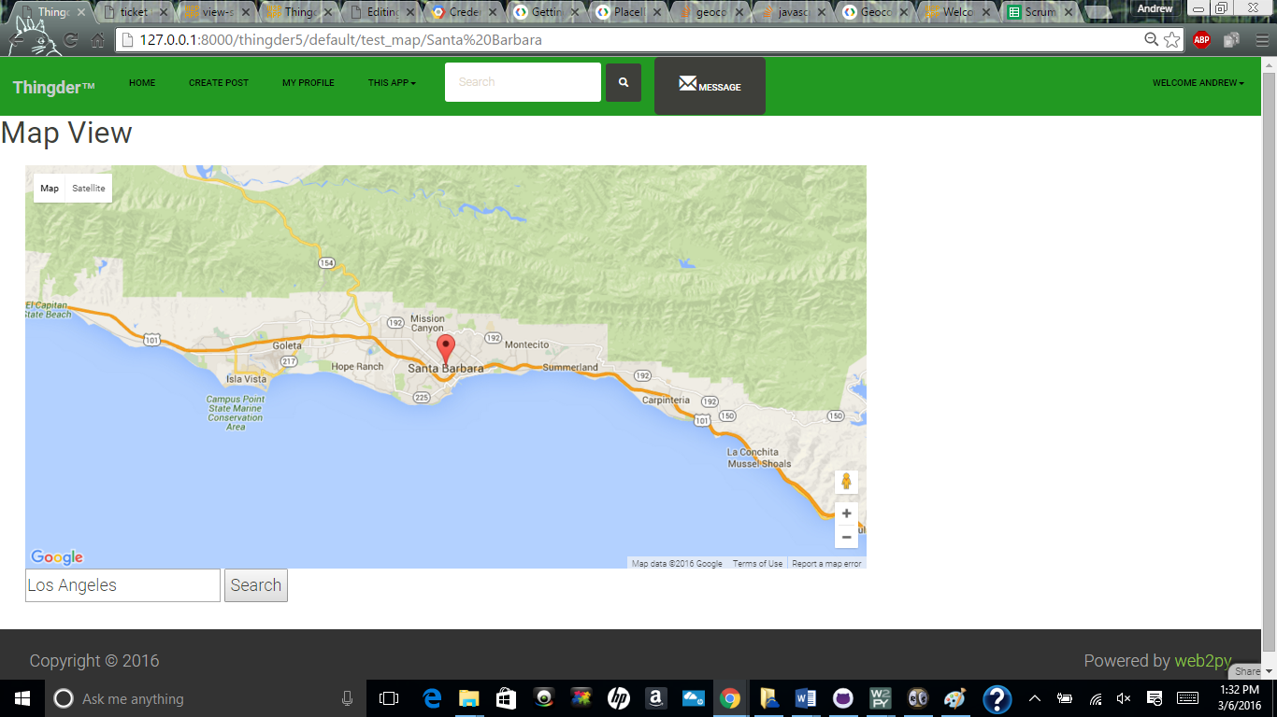

Slide 18
