Slide 1

DESIGN AND IMPLEMETATION OF AN ACCESS CONTROL SYSTEM USING A BLUETOOTH DEVICE
BY
UGWU, IKECHUKWU A.
2015/197993
UGWUANYI, ANTHONY .C
2015/200280.
SUPERVISOR : ENGR. ALOCHUKWU ANIMALU
Department of Electronic Engineering, University of Nigeria, Nsukka

Slide 2
ABSTRACT
In this paper, we describe the use of BluetoothTM technology for the development
of novel applications for home and intelligent buildings scenarios, as well as scenarios in which security and access control is necessary (e.g., garages). The design of the solution has been done following a hierarchical scheme, starting from a simple and functional module and providing new features that will give an added value to the final product. This methodology allows to generate a wide range of products with several features for the final consumer and end users. The developed system is low cost, autonomous, scalable (both from a physical point of view and functionality) and capable of interacting and being controlled by the end user and by other similar modules in range.
Establishing communication with the system is quite simple as well as cost effective, since the universal key for these access points can be managed by user’s mobile phone or PDAs.

Slide 3

PROBLEM AND MOTIVATION
Imagine coming home from work after a long day at work, only to realize you’ve forgotten your key at the office, or worst still your key fell into the drain.
Now getting into your house is a problem, you either have to burgle your house or drive all the way through traffic to get your key back.
The means of securing / guarding an entrance or a lock vary, some make use of padlocks, passwords locks, some RFID sensor or the fingerprint, and others face recognition methods.

Slide 4
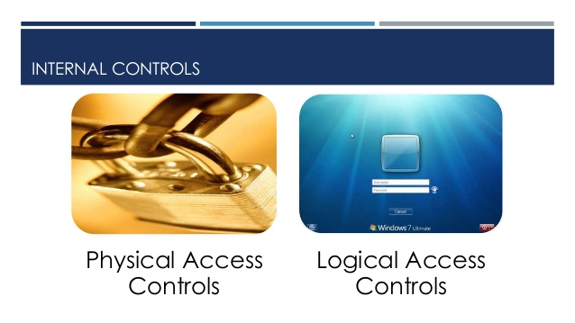
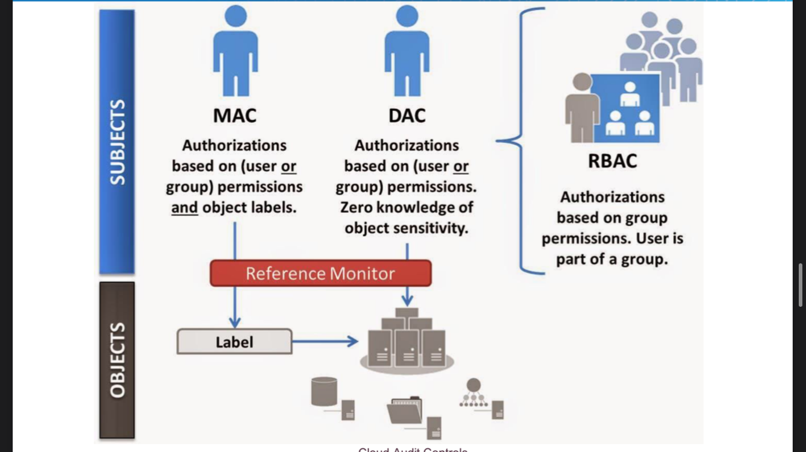

BACKGROUND OF STUDY
Access control is a security technique that regulates who or what can view or use resources in a computing environment. It is a fundamental concept in security that minimizes risk to the business or organization.

Slide 5
LITERATURE REVIEW
Bluetooth Enabled door lock by Richard Hoptroff.
RFID based door lock by Shilpi Banerjee.
Bluetooth-based Home Automation System by M. Ryan.
SMS-based Home Automation System by A. Alheraish.
Android Based Security And Remote Surveillance System.

Slide 6
OBJECTIVES
The aim for this project is to design and develop a smart door lock using a Bluetooth module as the medium for connecting the controller (smartphone) to the door lock, for house safety and future technology usage. The development of this system will be using the android phone to open and close a door through Bluetooth with a smart phone.

Slide 7
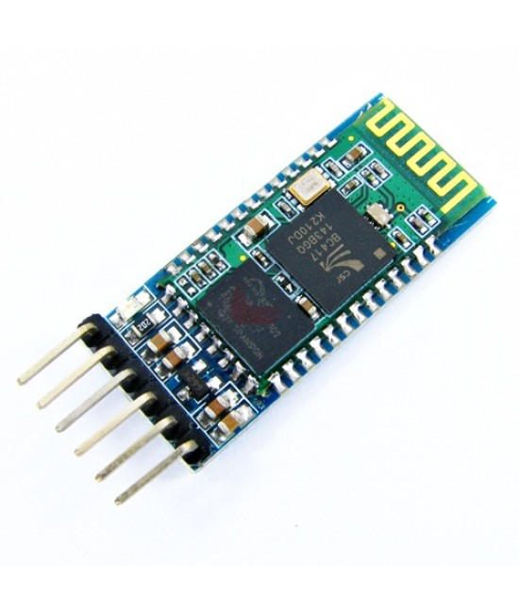
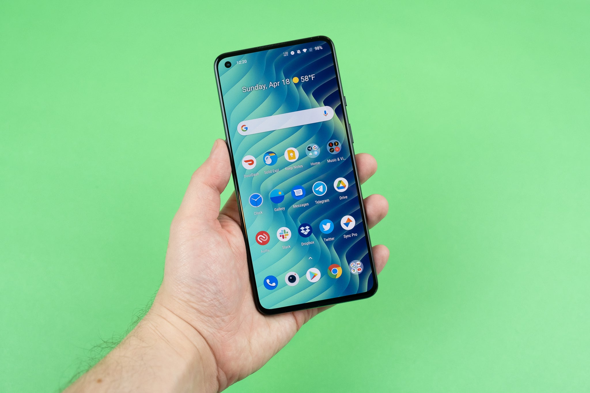
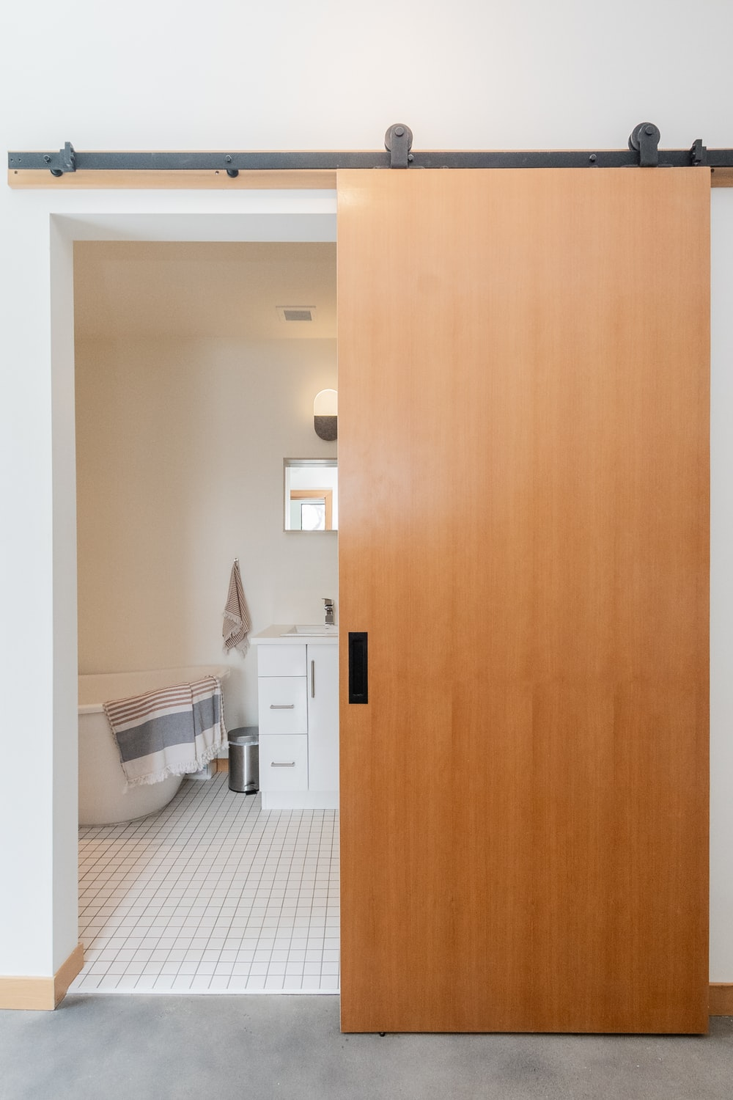
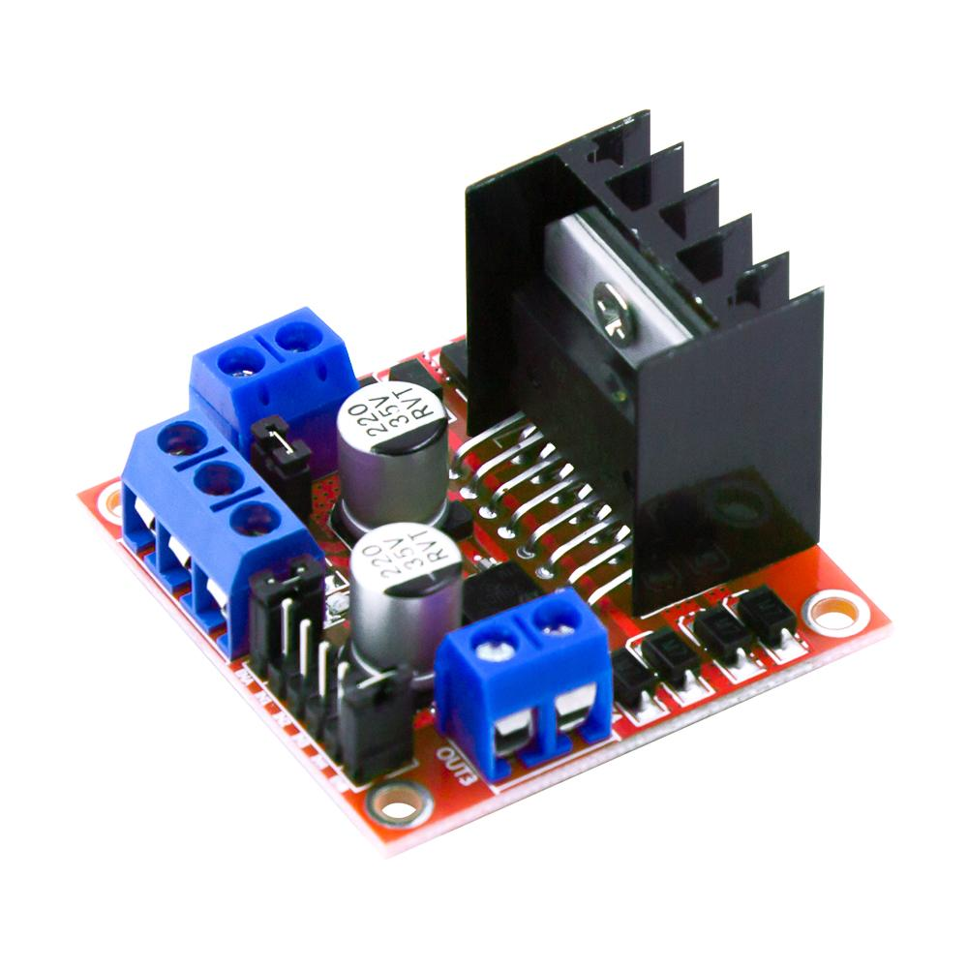
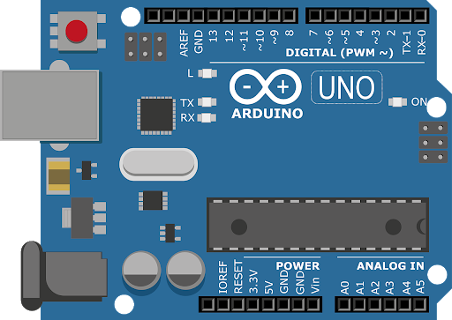
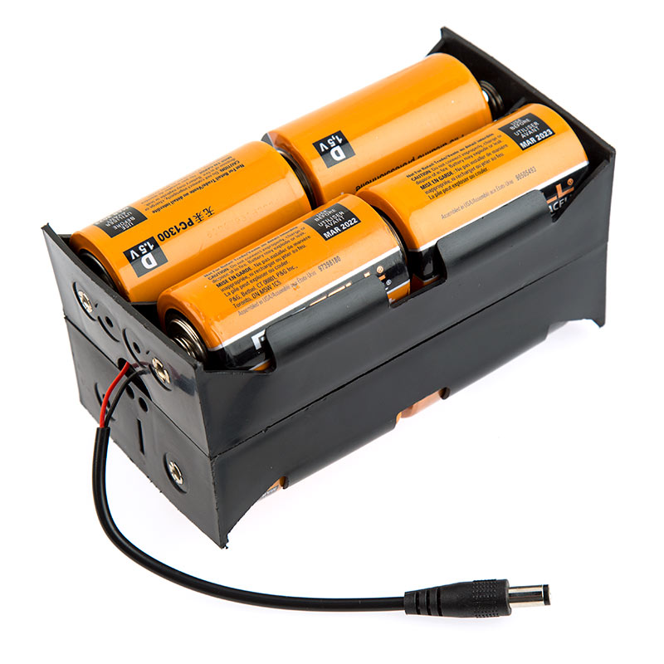
Design Methodology
Hc-05 (Bluetooth module)
Sliding Door
L298N BRIDGE
Smartphone
Arduino UNO
12V DC Power Supply

Slide 8
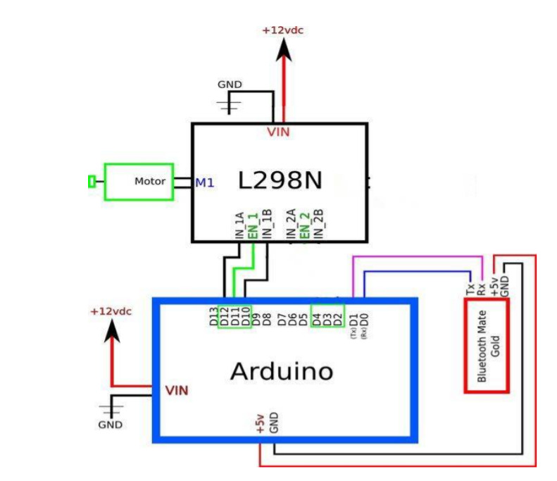
DESIGN AND IMPLEMENTATION

Slide 9
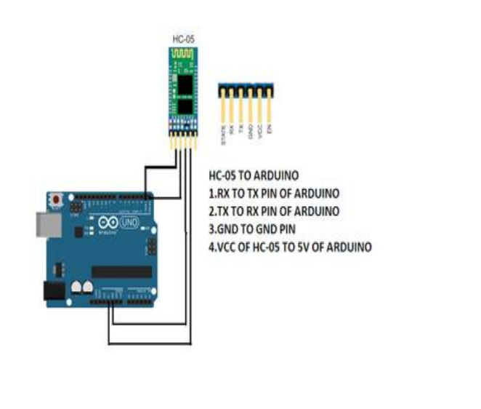
CONNECTING AND TESTING THE HC-05

Slide 10
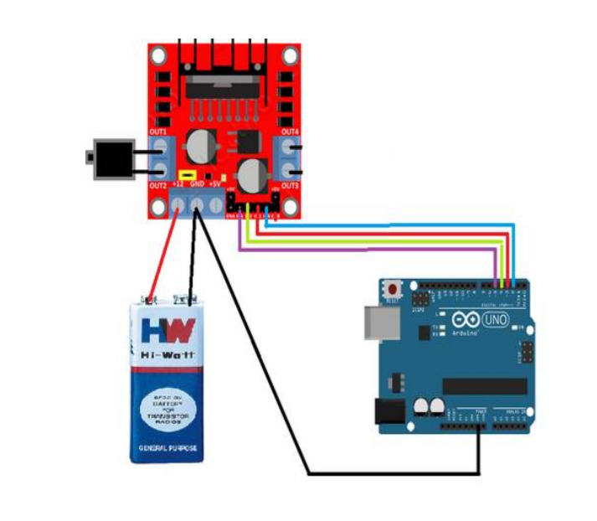
CONNECTING AND TESTING THE DRIVER MODULE

Slide 11
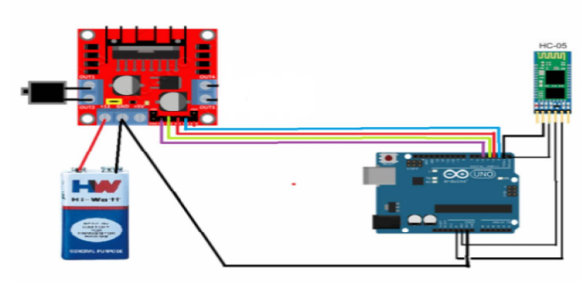
CONNECTING THE WHOLE SYSTEM

Slide 12
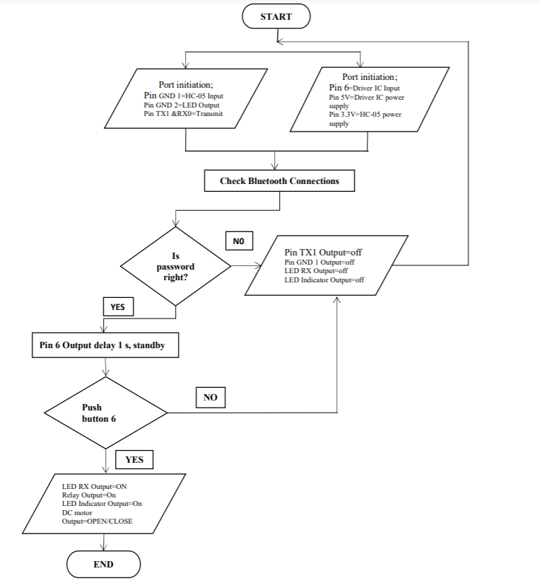
FLOW CHART

Slide 13
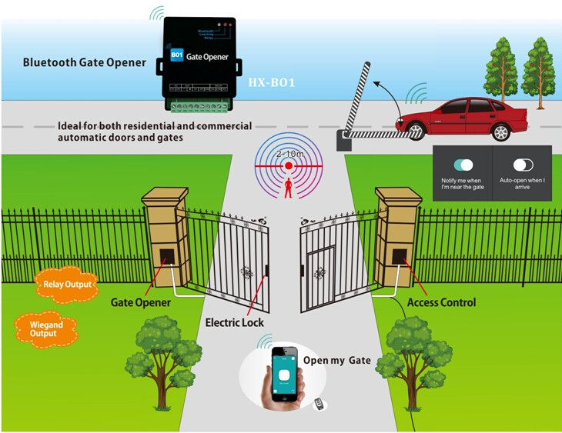

HOW IT WORKS
HAUSA
IGBO
YORUBA

Slide 14

SIGNIFICANCE AND CONTRIBUTION
This system will be of great use in the following areas:
It will help reduce carrying your keys around thereby reducing the risk of loosing your keys.
Since it’s a sliding door, you don’t have to turn the door knob to open your door which makes opening doors less stressful

Slide 15
RESULT AND CONCLUSION
This is an ongoing project. This paper gives basic idea of how to control home security for smart home, especially for sliding door locks. We use sliding door system (DVD ROM) as a prototype for indoor and outdoor lock system. It also provide a security and easy for Android phone/tab users. This project based on Android and Arduino platform both of which are Free Open Source Software. So the implementation rate is inexpensive and it is reasonable by a common person. Accomplishment of wireless Bluetooth connection in microcontroller permits the system installation in more easy way.
The system has been successfully designed and prototyped to control the door condition using an Android Bluetooth-enabled phone and Bluetooth modules via Bluetooth HC-05. We have discussed a simple prototype in this paper but in future it can be extended to many other regions.

Slide 16

THANKS

