Slide 1


BY:
AKUBUE OKWUDILI E.
ONOH CHIMAOBI C.
SUPERVISOR :
ENGR. F. C. UDECHUKWU
JULY, 2021
BY:
OKOYE AUGUSTINE E.
NWOFOR AMUCHE P.
OKOLO CHIBUIKE J.
SUPERVISOR :
ENGR. DR. D. OYEKA
JULY, 2021
Design and implementation of 100 watts audio amplifier
NFC CONTROLLED HOME AUTOMATION SYSTEM
A PROJECT DEFENCE PRESENTATION IN PARTIAL FULFILLMENT OF THE AWARD OF DEGREE OF BACHELOR OF ENGINEERING IN ELECTRONIC ENGINEERING
A PROJECT DEFENCE PRESENTATION IN PARTIAL FULFILLMENT OF THE AWARD OF DEGREE OF BACHELOR OF ENGINEERING IN ELECTRONIC ENGINEERING

Slide 2
INTRODUCTION
An audio power amplifier (or power amp) is an electronic amplifier that amplifies low-power electronic audio signals such as the signal from an mp3 player to a level that is high enough for driving loudspeakers or headphones.

Slide 3
AIM/OBJECTIVES
To design a 100 watts audio amplifier
To design a class AB power amplifier driven by an active 3-way cross-over network and a pre-amplifier
The total power of the two power amplifiers should sum up to 100 watts
To design the total power of three amplifiers which sum up to 100 watts

Slide 4
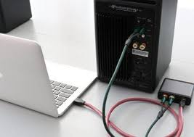

IMPORTANCE OF THE STUDY
This project is important because without amplification:
clear audio signal will be difficult
220 volts may be too dangerous to be used on a loudspeaker
Improves sound quality

Slide 5
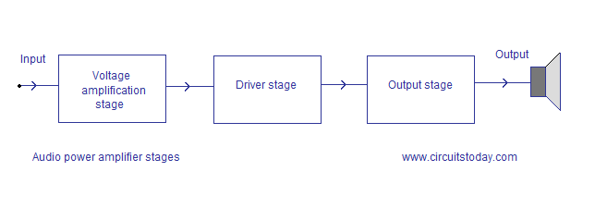
STAGES OF AMPLIFICATION

Slide 6
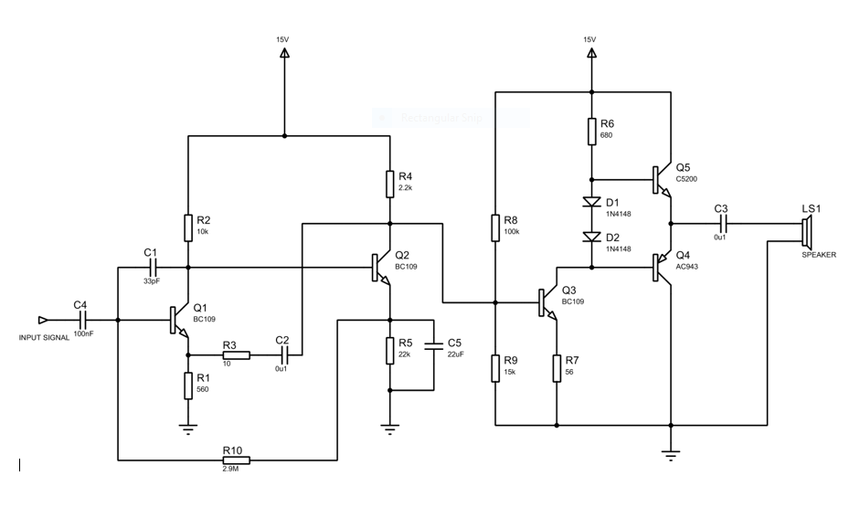
CIRCUIT DIAGRAM

Slide 7
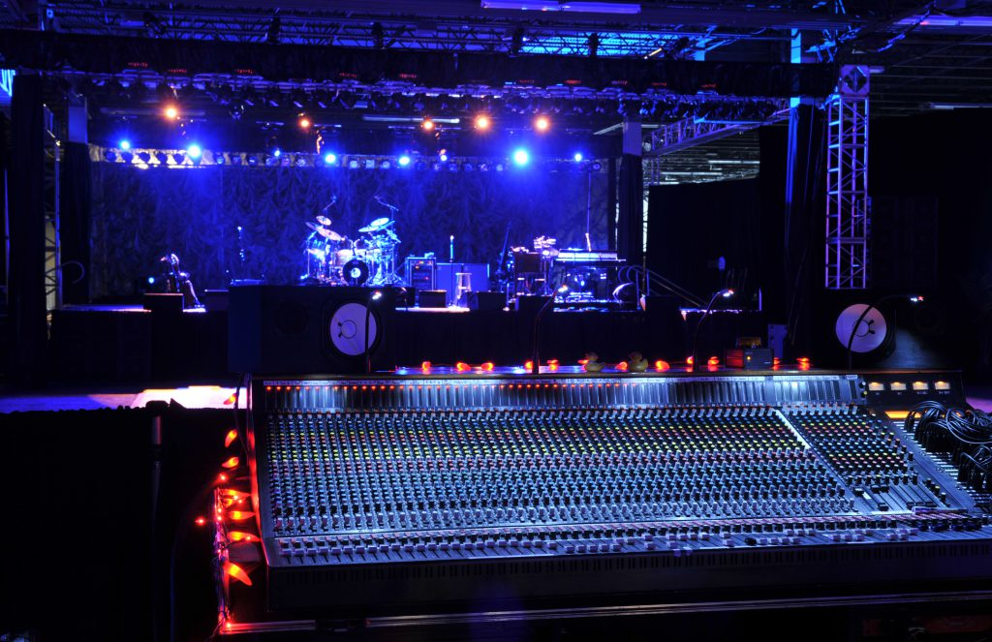
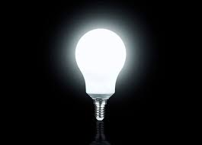
REAL LIFE APPLIFICATION OF AUDIO AMPLIFIER
Radio and broadcasting station
Loudspeakers used in concerts
In military as acoustic weapon
Wireless transmission of signals

Slide 8
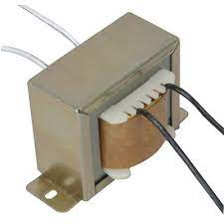
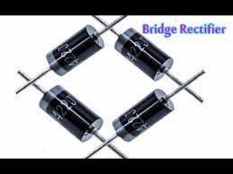
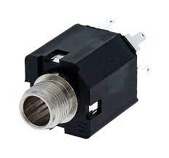

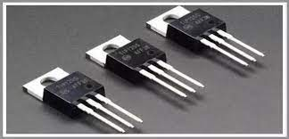
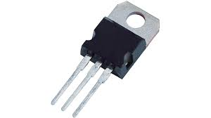
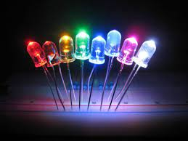
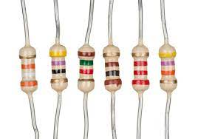
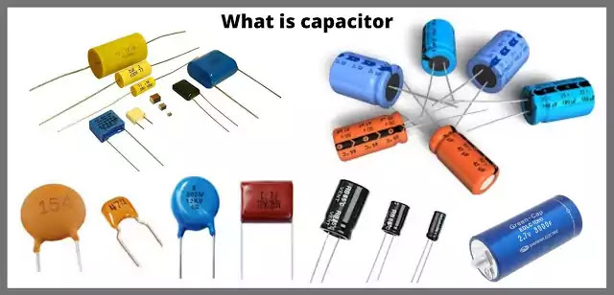
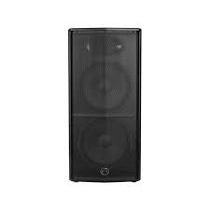
COMPONENTS USED
TRANSFORMER
BRIDGE DIODES
JACK SOCKET
HEAT SINK
TRANSISTOR
VOLGATE REGULATOR
LEDs
RESISTORS
CAPACITOR
SPEAKER

Slide 9
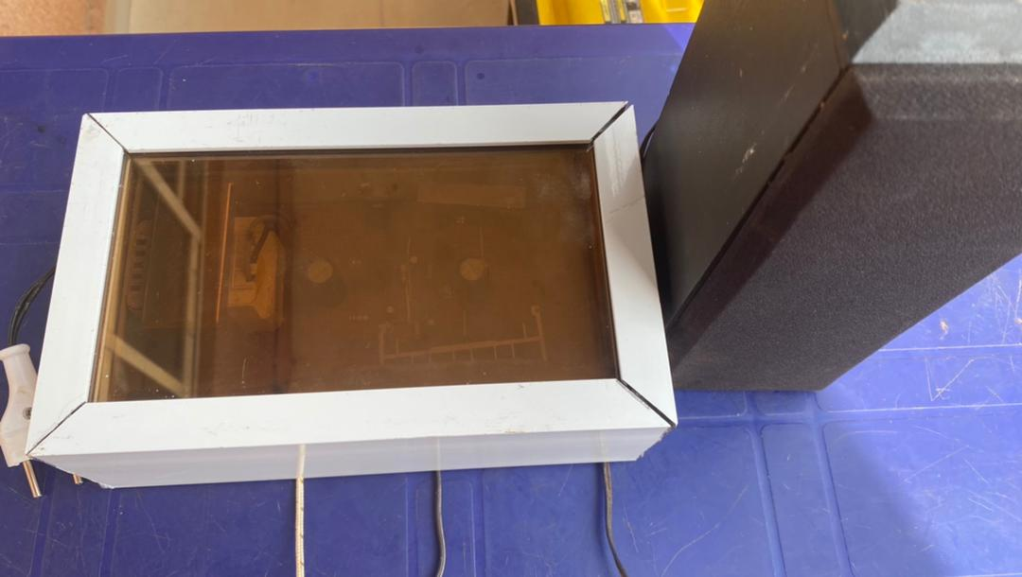
PROTOTYPE

Slide 10
CONCLUSION/RECOMMENDATION
The aim of this project was to design and implement a 100 watts audio amplifier, it is justifiable to uphold that the defined aim of this project has been actualized using simple NPN C5200 and PNP AL943 transistors
This design is only a model that can be modified in order to accommodate some other specifications which may include big audio output wattage other than 100 watts.

Slide 11
THANK YOU
FOR
LISTENING

