Slide 1
A Model for Biometric-based Online Voter Registration and Voting System
BY
ARONU, UCHECHUKWU CHUKWUKA
SUPERVISOR: DR OGECHUKWU N. ILOANUSI
SEPTEMBER, 2015.

Slide 2
PRESENTATION OUTLINE
INTRODUCTION
STATEMENT OF THE PROBLEM
OBJECTIVES OF THE WORK
SIGNIFICANCE OF THE WORK
SCOPE OF THE WORK
PROJECT PLAN

Slide 3
INTRODUCTION
ELECTIONS
Definition
Importance
BIOMETRICS
Brief explanation
Brief Introduction of Fingerprints, Face and Iris

Slide 4
STATEMENT OF THE PROBLEM
Problematic software
Duplicate Registration and duplicate votes
Impersonation of voters
Stealing of ballot boxes
Loss of registeration and voting data during manual reconciliation
Inability of eligible citizens outside the country to register and vote.

Slide 5
OBJECTIVES OF THE WORK
To Model an online voter registration and voting system.
To propose fused multimodal biometrics for voter registration and voting.
To eliminate multiple citizen identity in a voting system.
To eliminate voter impersonation in a voting system.
To enable qualified citizens vote from any approved part of the country or the world.
To eliminnate the use of ballot papers and ballot boxes for voting.
To ensure secure and accurate reconciliation of registered voter details and casted votes from any part of the country or the world

Slide 6
SIGNIFICANCE OF THE WORK
Show the commitment of the government towards boosting the confidence of voters in the electoral system and their votes.
Encourage greater participation in elections and greatly reduce if not eliminate the need for violence.
Save the country money spent on damages from election related violence.
Expunge the negative image of Nigeria as a corrupt and unruly country in the international community.
Show the willingness of the country to welcome positive advances in technology and make Nigeria more attractive to investors.

Slide 7
SCOPE OF THE WORK
Design of use case model for the system
Design of Architectural model of the system
Design of communication model of the system
Design of system data flow model
Design of system interface model

Slide 8
METHODOLOGY/ WORK PLAN
The Gnatt chart in fig. 1 illustrates the project plan from September 2015 to December 2015. The activities in figure 1 are described as follows.
Literature review of voting and biometric authentication
Design of system models
Data collection
Analysis of data obtained
Comparison of results with existing techniques
Collation of thesis
Publication

Slide 9
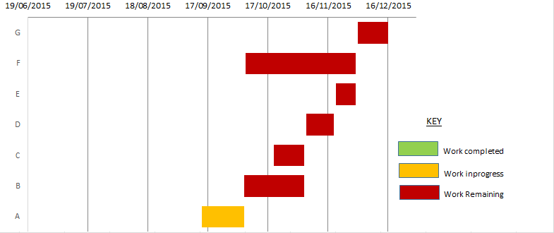
Fig. 1: Project Plan

