Slide 1
CLEARANCE PORTAL FOR UNN
STUDENTS: EJIRIBE OGONNA ESTHER – 2015/199864
OKOLI EMILIA CHINENYE – 2015/199869
SUPERVISOR: ENGR NATHAN DAVID

Slide 2
INTRODUCTION
Clearance is defined as an official authorization for something to proceed or take place. In the University of Nigeria, final year students having met the academic requirements for graduation must undergo a clearance process before they disengage from the university.

Slide 3
CURRENT CLEARANCE SYSTEM
a manual process is in place which involves the under listed departments:
The Student’s department and faculty
The Bursary department
The Students Affairs department
The Library
Alumni department
Security department

Slide 4
STATEMENT OF PROBLEM
Cost
Graphical representation of estimated expenses
 | ENUGU | ABUJA | LAGOS
Time Spent (hrs) | 144 | 168 | 168
Transportation cost (₦) | 2000 | 12000 | 15000
Feeding (₦) | 4000 | 4000 | 4000
Accommodation (₦) | 25000 | 25000 | 25000
Extra Expenses (₦) | 2000 | 2000 | 2000
Total (₦) | 33000 | 43000 | 46000
Estimated expenses of 3 major travel location

Slide 5
STATEMENT OF PROBLEM
Issues | Percentage (%) | Amount spent(₦)
Library Issues | 9 | 36,900,000
Security Issues | 11 | 45,100,000
Hostel Issues | 20 | 82,000,000
No Issues | 60 | 246,000,000
Representation of students with clearance issues

Slide 6
STATEMENT OF PROBLEM
Graphical representation of amount spent by student with issues

Slide 7
STATEMENT OF PROBLEM
Other limitations includes:
It attracts unnecessary payment at the point of clearance.
The clearance forms are documented in a file cabinet.
The system is slow in processing information.
It is time consuming.
The manual system of clearance is restricted to a limited number of students daily.
Information is subject to mutilation.

Slide 8
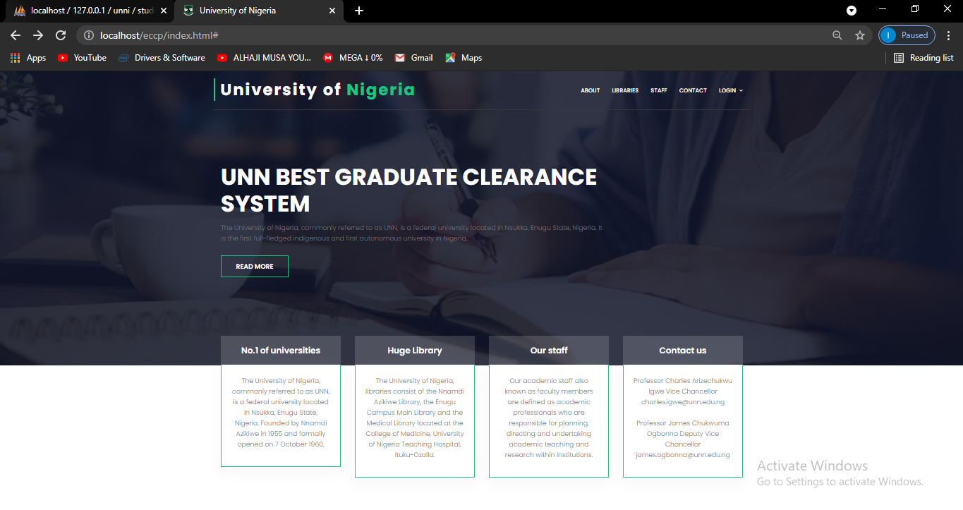
OUR PROPOSED SYSTEM

Slide 9
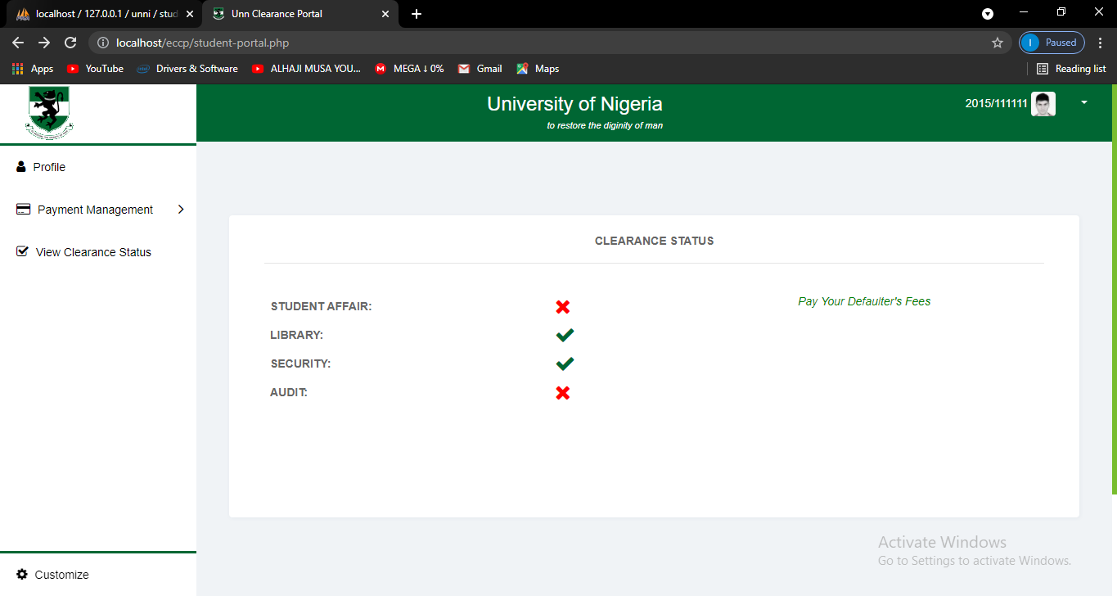
OUR PROPOSED SYSTEM

Slide 10
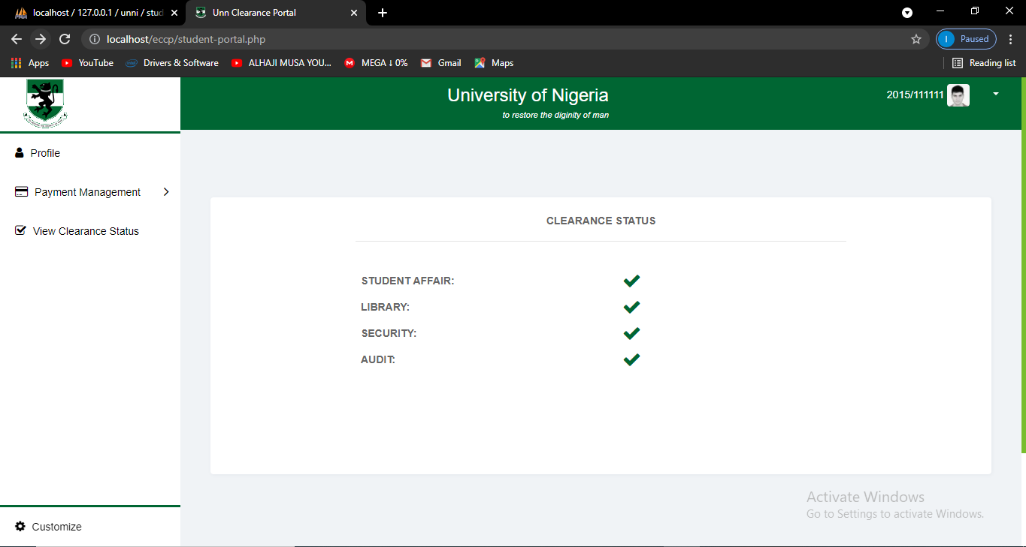
OUR PROPOSED SYSTEM

Slide 11
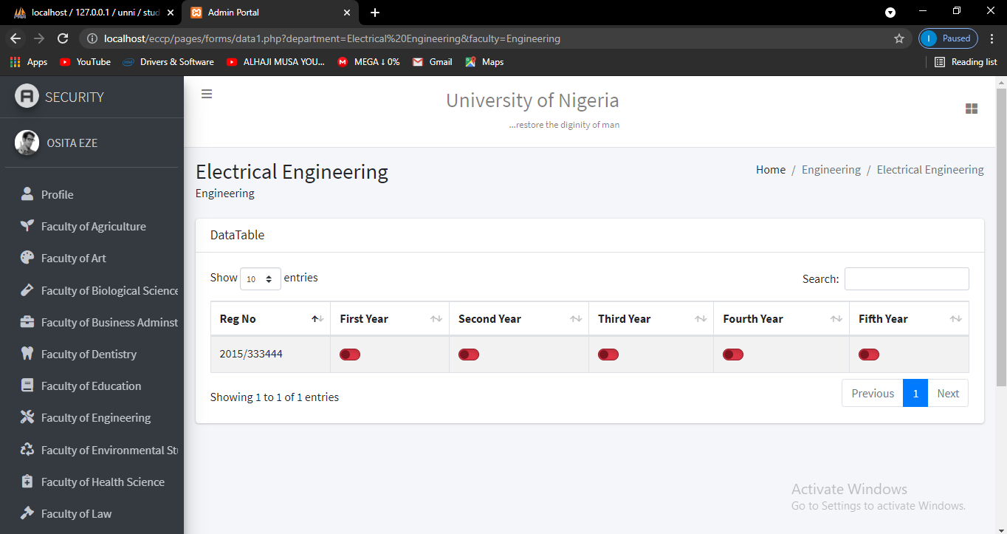
OUR PROPOSED SYSTEM

Slide 12
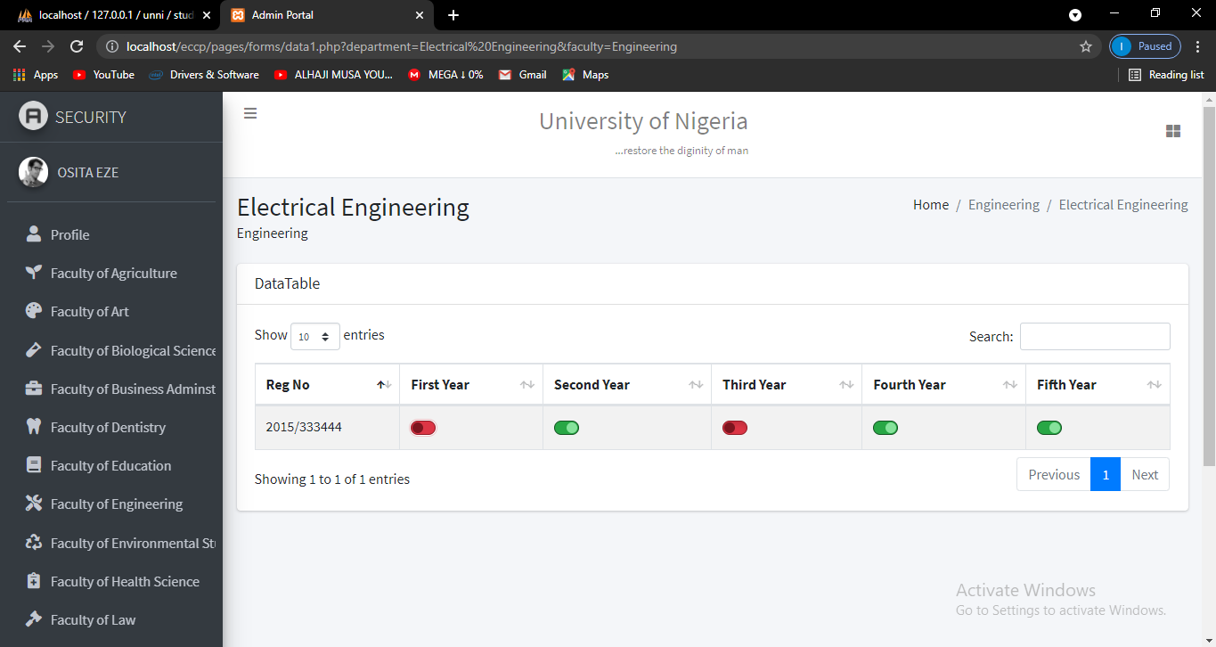
OUR PROPOSED SYSTEM

Slide 13
CONCLUSION
The proposed system is:
better in terms of speed.
more accurate, efficient and less time consuming.
very convenient to use anywhere at any time
very fast avoiding delays
inexpensive to students and school management.
reduces cost such as labour and stationery.
More secure

Slide 14
THANK YOU

