Slide 1
University OF Nigeria, Nsukka
ELECTRONIC ENGINEERING DEPARTMENT

Slide 2
COMPARATIVE ANALYSIS OF DISTRIBUTED POWER CONTROL ALGORITHMS IN CELLULAR SYSTEMS
A SEMINAR PRESENTED IN PARTIAL FULFILMENT FOR THE AWARD OF MASTERS IN ENGINEERING DEGREE (COMMUNICATION)
NWACHUKWU NANCY NWAKAURU
PG/MENG/13/66697
SUPERVISOR
PROF. COSMAS I. ANIH

Slide 3
ABSTRACT
Wireless Communication is one of the most active areas of technological development of our time. It covers a very wide array of applications, leading to an ever growing demand on the limited radio resources with the influx of mobile phone users. Consequently, the need for efficient management of the limited radio resource has become imperatively a global issue. The complexity of the cellular system and the variation in the propagation channel contribute to different interference level, resulting in the degradation of the system capacity. Transmit power otherwise known Power Control is an efficient radio resource management technique to mitigate both adjacent and co channel interference under fading condition, suppresses the Near – Far problem, enhances the battery life and the system capacity. In the light of this, different power control algorithms have been proposed by different authors but the choice of an appropriate power control algorithm is of great importance, as it should aim at improving the quality of service (QOS) to all the users and increasing the efficiency of the system. In this work, comparative analyses would be carried out on three promising distributed power control algorithms through simulation on the basis of performance metrics like speed of convergence.

Slide 4
INTRODUCTION
In wireless system, the need for cellular communication became apparent as a result of the mobility of the users.
This wireless communication networks provides communication between the User Equipment and the Base Station via radio channels
The concept of cellular communication involves dividing the coverage area into small regions called cells

Slide 5
This cell size changes with time and is dependent on the traffic the area to be covered.
The spectrum allocated for a cellular network is limited and to manage this scarce resource, one could apply some cell techniques like; Frequency reuse, cell splitting.
There has being rapid growth in the number of wireless communication users
This has lead to tremendous technological advancement and evolution of the cellular systems

Slide 6
EVOLUTION OF 3G
1. First Generation (1G)
2. Second Generation (2G)
3. Third Generation (3G)
The 3G technology ran two separate networks concurrently with help of the UMTS Terrestial Radio Access Network (UTRAN)
MULTIPLE ACCESS TECHNIQUE
3G employs Code Division Multiple Access.(CDMA)

Slide 7
UMTS
Universal Mobile Telecommunications System, is a 3G networking standard used mainly as an upgrade to existing GSM.

Slide 8
Services provided by 3G
1. voice
2. broadband data
3. messaging
4. paging.
The provision of these services has led to an increase in the number of users or capacity of the system. .
To improve the performance and capacity of the wireless network, there is a need for radio resource management.

Slide 9
What is Radio Resource Managemnt?
Radio Resource Management is the system level control of co-channel interference and radio transmission characteristics in wireless communication systems.
Functions of Radio Resource Management
1. Handoff control
2. Power Control
3. Call Admission control
4.Packet scheduling control.

Slide 10
power control
This is the intelligent selection of transmitter power output in a communication system to achieve good performance within the system.
POWER CONTROL MECHANISM
Open-Loop Power Control (OLPC)
Closed-Loop Power Control (CLPC)

Slide 11
IMPORTANCE OF POWER CONTROL
It is used
To Reduce interference of all kind in the network
Mitigate the near-far problem by providing the minimum power required for each connection.
Increase the capacity of the system
Reduce battery power consumption.

Slide 12
OBJECTIVE
The objectives of this thesis include the following:
To carry out a critical review of the advances made in the area of power control schemes.
To analyse some of the promising distributed power control algorithms proposed by some researchers.
To finally carry out a performance analysis on three selected distributed power control algorithms on the basis of their speed of convergence and in a multi-user cellular environment

Slide 13
Problem Statement
In WCDMA, many users transmit over the same radio channel using the same frequency band and time slots so that the signal of a user becomes interference for the other users.
To ensure an efficient cellular network, may researchers have looked into this area and came up with different power control algorithms which could be used to ensure that users transmit at the same power level thereby mitigating the effect of all kind of interference. But not much significant works have been done on performance evaluation of some of the power control algorithms.

Slide 14
Methodology
The following methodology was adopted to realize the set objectives:
Review of the different power control algorithms in UMTS.
Review of distributed power control algorithms that could be employed in the uplink part of UMTS.
Choose and analyse three of the algorithms as in the number 2 above.
Run simulation of the three PC algorithms.
Analyse data in terms of performance metrics
Carry out comparative analysis on the three algorithms on basis of their speed of convergence.
Collation, compilation and submission of the thesis.

Slide 15
literature review

Slide 16
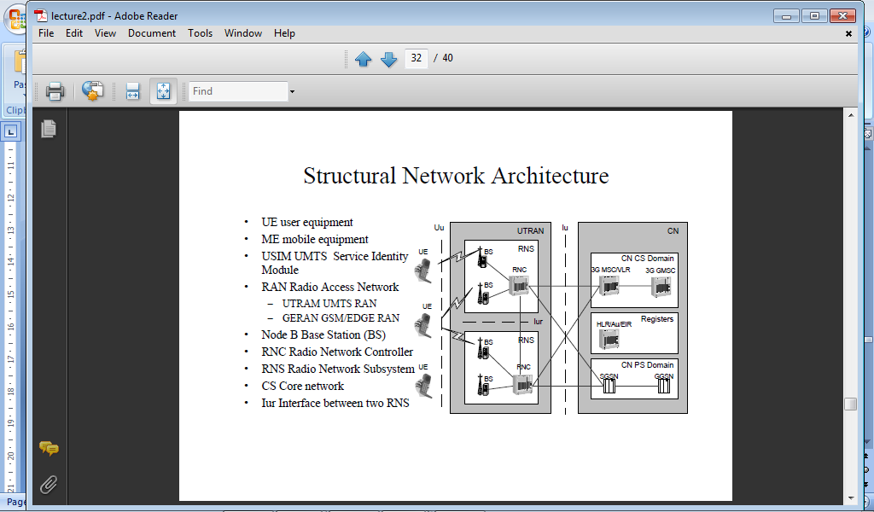
UMTS ARCHITECTURE

Slide 17
UMTS network
A UMTS network consist of three interacting domains;
Core Network (CN).
UMTS Terrestrial Radio Access Network (UTRAN)
User Equipment (UE)

