Slide 1
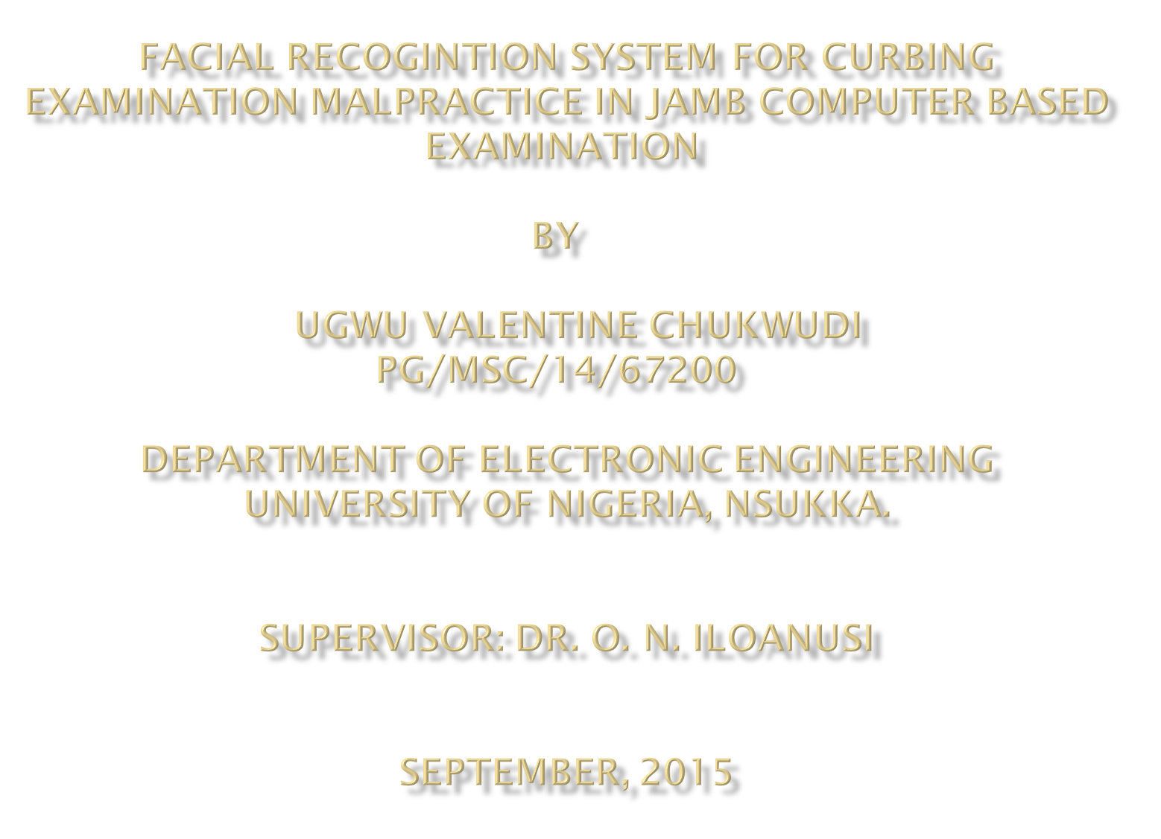

Slide 2

Examination: this is one of the best method of evaluating the knowledge and ability of an individual.
Method of examination: various methods have been employed in examining an individual starting from manual means to information technology means.
Computer Based Examination: JAMB and other educational bodies have engaged in electronic registration and examination system for testing the ability of the candidate.
Verification and authentication
Biometric: physiological characteristics and behavioral traits based system

Slide 3
Advantages of Face recognition over other
biometric methods:
Face Recognition may not require candidate Consent.
Partial face damage does not render face recognition data useless.
Equipment for facial recognition economical
Based on this advantages, this research work
will focus on modeling a facial recognition
system for JAMB CBE.

Slide 4

Candidates involve in examination impersonation because there are no efficient student verification techniques.
The availability of secured and accurate verification and identification technique will eliminate impersonation.

Slide 5

The objective of this research study is as follows:
To propose a model for utilizing and integrating a facial biometric system in laptops and desktops, to be used for JAMB Computer Based Examination.
To demonstrate the possibility of computer technology in the satisfaction of human needs and also enforce strict security measures that ensure elimination of imposters in an examination.

Slide 6

JAMB educational board implementing the end
result of this research work into their Computer
Based Examination system will ensure:
An accurate verification and authentication during examination.
That impersonation which has eating the educational system will be eliminated and standard of student educational performance would be increased.

Slide 7

This research work is limited to:
Proposing a model for utilizing and integrating facial recognition system in desktops and laptops for JAMB Computer Based Examination.
Planning communication layout and analyzing how it works.

Slide 8

In order to realize the model, the following will be employed:
Unified Modeling Language (UML): This is object-based decomposition of systems showing the interaction between these objects and the dynamics of these objects.
Use Case diagram: Use case diagrams give a user point of view of a system.
Activity diagram: Activity diagram are graphical representations of workflows of stepwise activities and actions with support for choice, iteration and concurrency.
Class diagram: Class diagrams depict the relationship among the different classes in a system.
Simulation and analysis of the system.

Slide 9

Activities | Duration
Study and familiarization with the thesis area | 2 weeks
Collection of literatures review | 1 month
Collection of image data | 2 weeks
Model designing | 3 weeks
Model Simulation and data collection | 3 weeks
Data analysis | 2 weeks
Discussions and conclusion | 1 week

Slide 10

At the end of this research, a model of facial recognition system for verification and authentication for eliminating imposters in an examination will be developed and analyzed

