Slide 1

DESIGN AND IMPLEMENTATION OF ELECTRONIC HAND DRYER WITH DISPLAY
University of Nigeria, Nsukka
Faculty of Engineering
Department of Electronic
ECE 592 PROJECT PRESENTATION

Slide 2
SUPERVISOR
DR J.N ENEH
CONTRIBUTORS
NZURIKE IFEANYI DAVID 2015/198387
EZUGWU IFEANTICHUKWU 2015/201781

Slide 3
PRESENTATION OUTLINE
Introduction
Aim/Objectives
Scope
Literature review
Block diagram
Components used
Design and implementation
Conclusion and recommendation

Slide 4
INTRODUCTION
We are presenting an electronic hand dryer that works automatically without a push button. It is a device that blows off particles of water from a wet hand when placed at some distance below it. This circuit design uses a microcontroller that acts as the brain of system.

Slide 5
AIM/OBJECTIVES
The aim of this project is the Design and Implementation of electronic hand dryer with display.
The specific objectives for this project design can be listed as follows:
To design a hand dryer using a microcontroller.
To incorporate a sensor that will detect the presence of an Object (hands), thereby making the hand dryer automatic.

Slide 6
SCOPE
The scope of this project is as follow:
Design of the system using microcontroller(nano arduino)
Hands position to the air blower is 2cm to 6cm away.
Producing hand dryer with a minimal noise

Slide 7
LITERATURE REVIEW
Electronic hand dryers have become an innovative piece of technology in all washrooms, with the ability to dry hands quickly and efficiently. The ever growing development of technology is visible everywhere, and when it comes to electronic hand dryers, it does raise the question about their history and how they have now revolutionized the industry with intelligent and modern designs. Below are electronic hand dryers with downside/s
Electronic hand dryer | Downside
Airdry the electric towel | It uses floor pedal
The Jet Genius from Japan | It is noisy and high drying time

Slide 8
There have been some improvement and modifications in hand dryer over the years. Modern hand dryers are now efficient, quick drying time and minimal noise produced when used.
Xlerator Success
Dyson Airblade

Slide 9
BLOCK DIAGRAM
POWER SUPPLY
INFRA-RED SENSOR
MICRO CONTROLLER
LCD
ELECTRIC FAN
RELAY
POWER SUPPLY

Slide 10
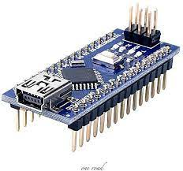
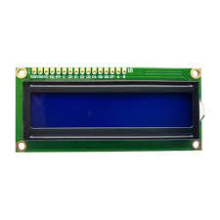
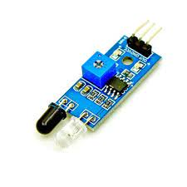
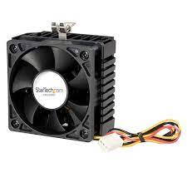
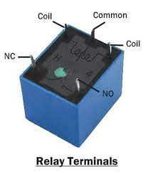
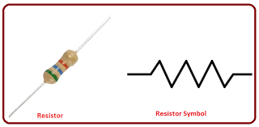
COMPONENTS USED
lcd
Arduino nano IR module

Slide 11
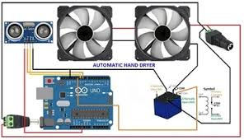
CIRCUIT DIAGRAM OF ELECTRONIC HAND DRYER
DESIGN AND IMPLEMENTATION

Slide 12
When a wet hands is place relatively to this device (electronic hand dryer) at a specific range of distance, the device is being turned on through a sensor that senses the presence of an obstacle, thereby sending signal to the programmable micro-controller, which in return transmit electrical signal to the relay that control the electric fan and print a message on the LCD “Hand detected”. In this sequence, the electric fan is turned on and it produces air that blows off the water particles from the wet hand.
This project remains to be a prototype, Though there is still room for improvement in terms of adding certain features to this design:
Nicrome wire to produce hot air
Temperature sensor
Fan regulator

Slide 13
CONCLUSION AND RECOMMENDATION
To this end, we were able to come out with a well-designed and implemented electronic hand dryer with a display in such a way that the noise which was draw back factor of the earliest related designs was greatly reduced.
And it is economical and reliable
This design “electronic hand dryer machine” can be recommended for use in homes, factories, schools, churches, industries and so on.

Slide 14
REFERENCING
[1] “Design And Construction of Automatic Hand Dryer with Temperature Display”[onlineserial].Available:https://projectng.com/topic/co699/design-construction-automatic-hand-dryer
[2] “How to set uo a 5v relay on arduino” [online serial]. Available: https://www.circuitbasics.com/setting-up-a-5v-relay-on-the-arduino/
[3] jeevan, “Arduino Automatic Hand Dryer” [online serial]. Avaible: https://letsmakeprojects.com/arduino-automatic-hand-dryer/
[4] wekipedia, “Hand dryer”, [online serial]. Available : https://en.wikipedia.org/wiki/Hand_dryer
[5] TÜV Produkt and Umwelt GmbH “A report concerning a study conducted with regard to the different methods used for drying hands”, Report No. 425-452006, September 2005.

Slide 15
Question and Answer

Slide 16
END
Thanks

