Slide 1
Final Year Project Defence Electronic Engineering Dept, UNN
Topic: Automatic Object Recognition & Description
By
Mmesoma S. Enibe 2015/198344
Mamah Joy Amuche 2015/203773
Thursday
July 8, 2021
Supervisor: Dr. Ijeoma J.F. Ezika

Slide 2
Agenda / Topics
Project Introduction
Project Description (Aims & Objective)
Abstract
Scope
Project Methodology
Block Diagram of Object Recognition Process
Key Findings/Results
Research drilldown
Conclusion

Slide 3
Abstract
As the need for automated systems and robot assistance systems increases day by day, the need to be able to correctly detect, recognize and describe these objects becomes paramount.
Local images object recognition and description aims to bridge this gap, and provide an easy interface for accurate object recognition and description, locally and across borders

Slide 4
Scope
Trained on 12 classes of local objects comprising of apple, banana, broom, corn, flip-flop, ogbono seed, okpei, onga maggi, onga stew seasoning, orange, pineapple and sponge.
Object recognition and description of 12 locally existing items/object.

Slide 5
Aim:
This project aims to design a software which automatically recognizes and describes conventional and locally available objects in English and Igbo languages.

Slide 6
Objectives:
Learning to work with already existing image classification models.
Building models with different CNN architectures and determining the one with the best performance measure.
Improving prediction performance using transfer learning technique.
Life detection of twelve local images in english and igbo languages.

Slide 7
Procedure/Methodology:
Gathering image data of twelve local images.
Seven out of twelve of our image categories were taken life with a phone camera.
The other five comprising apple, banana, corn, orange and pineapple were gotten from fruits360 dataset found at kaggle: https://www.kaggle.com/moltean/fruits/
The images were then split into a training set and a test set.

Slide 8
Procedure/Methodology (contd.)
2. Preparing the development environment:
Installed python 3.
Downloaded and installed Anaconda.
Opened jupyter notebook via our local browser interface.
Installed libraries for data-science and computer vision tasks: tensorflow, numpy, sklearn, keras, opencv-python, matplotlib.
Imported the specific libraries to be used into the current development environment.

Slide 9
Procedure/Methodology (contd.)
3. Training the model and using it to make predictions:
Turned our gathered images into a dataset and splitted it into two categories- training data 67% and test data 33% of the data, and saved the model after training.
Using transfer learning, we included our locally collected image dataset to weights from Imagenet pre-trained model.
Weights from ImageNet were used in a technique called transfer learning.
We used the VGG-16 CNN architecture. Others include InceptionV3,VGG16 and RESNET50 etc.

Slide 10
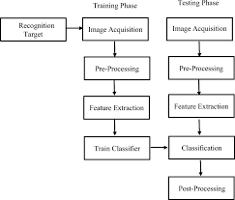
Block Diagram of Object Recognition Process:

Slide 11
Transfer Learning & its Approaches
Transfer learning is a machine learning method where a model developed for a task is reused as the starting point for a model on a second task.
Develop Model Approach
a) Select Source Task
b) Develop Source Model
c) Reuse Model
d) Tune Model
Pre-trained Model Approach
a) Select Source Task
b) Reuse model
c) Tune model

Slide 12
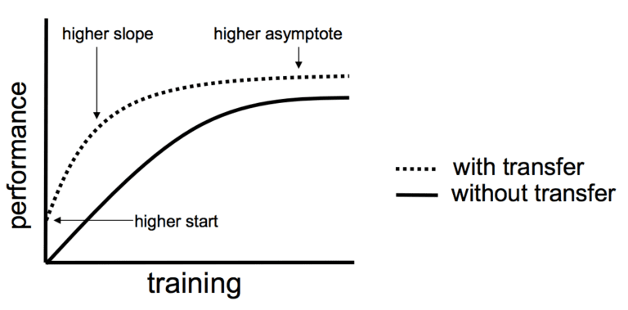
Benefits of Transfer Learning
It is a shortcut to saving time or getting better performance
Higher start
Higher slope
Higher asymptote

Slide 13
Procedure/Methodology (contd.)
Make predictions to check how well our trained model predicts and describes images from the dataset.
It was determined that the VGG16 architecture performed best.
4. Live detection of the objects:
The necessary libraries for object detection were imported to the development environment.
The model was loaded and used in life detection of the twelve categories of images in our image dataset.

Slide 14
Live Detection
For the live detection, we connect an external camera that will detect and describe any of the objects in our trained dataset :
Using external camera
Using Phone camera
Using webcam

Slide 15
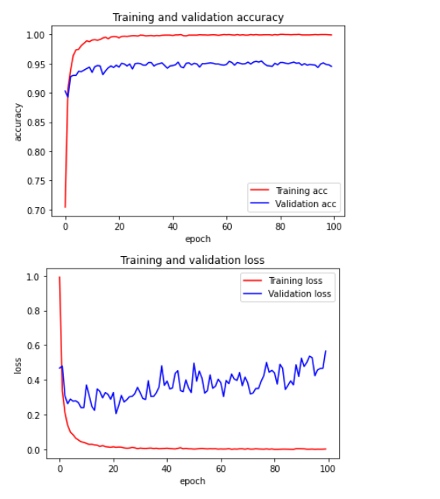
Graph of our result

Slide 16
Key Findings/Results:
From the result gotten, the local image prediction and description is high, because the accuracy of the prediction is quite high, which means that the model was properly trained.
Our trained model is able to describe and detect objects correctly.

Slide 17
Conclusion
Our model was able to correctly predict objects included in our dataset, to a reasonable degree of accuracy
The prediction accuracy was 94.53%, quite large for a new classification system

Slide 18
Recommendation
This software may be made more robust and able to detect more object classes found both locally.
It can be furtherdeveloped intoo a mobile app/software.
Can be applied in obstacle avoidance robots and other industrial/manufacturing processes such as selective sorting etc.

Slide 19
References
https://towardsdatascience.com/a-comprehensive-guide-to-convolutional-neural-networks-the-eli5-way-3bd2b1164a53
https://towardsdatascience.com/a-simple-cnn-multi-image-classifier-31c463324fa
https://towardsdatascience.com/vgg-neural-networks-the-next-step-after-alexnet-3f91fa9ffe2c
https://builtin.com/data-science/tour-top-10-algorithms-machine-learning-newbies
https://towardsdatascience.com/a-comprehensive-hands-on-guide-to-transfer-learning-with-real-world-applications-in-deep-learning-212bf3b2f27a

Slide 20
Thank You !!!

