Slide 1
Proposal of the project topic: BIOMETRICS-ASSISTED IDENTIFIER FOR PATIENT IDENTIFICATION
By
EKE CHIMA STANLEY
Reg. No: PG/MSC/14/68093
on Sept. 23, 2015
Supervisor: Dr. O.N. Iloanusi

Slide 2

Background
Just a moment;
patient-provider familiarity

Slide 3
Background contd.
Traditionally, a patient’s medical care was provided by a single practitioner or healthcare organization.
As a result, there was usually a high level of familiarity between the care provider and the patient.
Hence, the care provider, at least, knew them facially and by name.

Slide 4

But now…
The situation is different

Slide 5
Now…
A patient’s care may be provided by various experts and institutions
Providers are fairly or highly unfamiliar with their patients
The provider would rarely recognize their patients
Healthcare has grown complex
Therefore, healthcare providers need help to overcome this new challenge

Slide 6
The answer...Unique Patient Identifier
Unique Patient Identifier (UPID) is the value permanently assigned to an individual for identification purposes in healthcare and is unique across the entire national healthcare system

Slide 7
Uses of the UPID
Positive identification of a patient
Record-keeping/Information management
Administrative functions such as billing
Storage and retrieval of historical Information
Aggregation of a patient’s care record from multiple healthcare providers

Slide 8
Components of UPID
According to the ASTM
An Identifier (numeric, alphanumeric, etc.) Scheme
Identification Information
Index
Mechanism to hide or encrypt the Identifier
Technological infrastructure to search, identify, match, encrypt, etc.
Administrative infrastructure including the Central Governing Authority

Slide 9
Prevalent Patient Identifiers
Demographics: Name, address and date of birth
Organization-based identifier such as Medical Record Number (MRN)
Third-party and government-issued identifiers and documents such as Social Security Numbers (SSNs), driver licenses or health insurance cards

Slide 10
Problem statement
Consider the following scenarios:
A patient who got registered with a care provider but provides a different credential (e.g. name, address) from the one provided earlier. This scenario creates multiple identifiers and thus causes an array of issues.
Even worse, what if the patient gives the name and insurance details of another person? That is, identity theft.
A non-responsive unidentified patient who requires treatment.

Slide 11
The solution…My Project objective
To develop a conceptual model for the realization of:
a Unique Patient Identifier (UPID) that is scalable and has the basic demographic and health information of the patient
a biometric system that can identify a patient (for non-responsive patients) or verify a patient’s claimed identity.

Slide 12
Consequences
Accurate patient identification
Identifiable anywhere; at any healthcare organization
Accurate identification of patient information
Makes patient referencing across MPIs and enterprises possible and easier.
Supports the protection of patient’s privacy and confidentiality

Slide 13
Methodology
Review of existing UPIDs
Proposal of suitable biometrics for assisting the UPID
Experimental analysis of the reliability of at least one of the chosen biometrics in identification and verification
Development of the conceptual model of biometrics-assisted patient identifier

Slide 14
Scope
This work will be limited to:
Conceptual formulation of UPID
Conceptual modeling of the biometric-assisted identifier system
It will not consider security issues related to patient identifiers such as encryption and access control to the patients’ index.

Slide 15
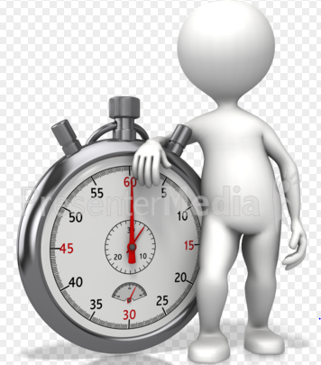
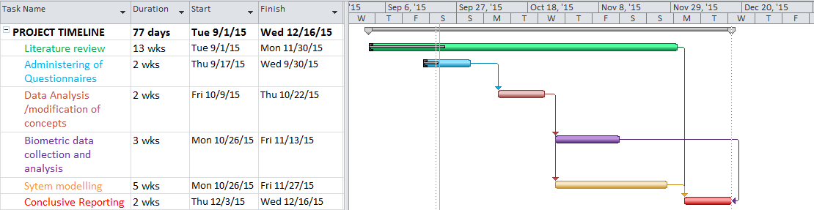
Plan and timeline

Slide 16
Conclusion
A successful realization of this work will pave way for greater healthcare safety and cut the costs related to patient misidentification, record and procedure duplication, and identity theft in healthcare.

Slide 17
Greetings
Thank you
for
listening

