Slide 1
OPTIMAL PLANNING AND DESIGN OF RENEWABLE ENERGY SYSTEMS IN NIGERIA
BY
ODOEZE JIDEOFOR A.H
SUPERVISED BY
PROF.OGBONNA OPARAKU

Slide 2
A PROPOSAL PRESENTED IN PARTIAL FULFILMENT FOR THE AWARD OF MASTER’S IN ENGINEERING
(DIGITAL ELECTRONICS AND SPECIALIZATION)
DEPARTMENT OF ELECTRONIC ENGINEERING
UNIVERISTY OF NIGERIA NSUKKA
ENUGU STATE, NIGERIA

Slide 3
PRESENTATION OUTLINE
INTRODUCTION
PROBLEM STATEMENT
OBJECTIVES
SIGNIFICANCE
SCOPE OF THE WORK
PROJECT PLAN

Slide 4
Definitions :
Renewable energy
Types of renewable energy
Hydropower
Geothermal Energy
Solar Energy
Wind Energy
Bio Energy
Optimal renewable energy planning
INTRODUCTION

Slide 5
PROBLEM STATEMENT
Nigeria is a country with 36 states divided into 6 Geo Political zones with different climatic conditions. Therefore there is need to study the different climatic condition as to know the best Renewable Energy type that would be installed there. This is to ensure that we get the maximum Energy from the renewable energy resources available in the place.

Slide 6
OBJECTIVES
The objectives of this work are:
to analyze the climatic condition of the 6 Geo-Political zones in Nigeria
to optimally plan and design renewable energy system that will have maximum generation per installation.
to estimate the capacity of renewable energy systems to be installed in each Geo-Political zones in Nigeria to provide sufficient energy.

Slide 7
SIGNIFICANCE
The work will help the Nigerian Energy policy marker to make the right decision on Renewable Energy installation in the country.
It will also be of great help to an individual or company who wish to go into power generation business.
If adopted and successfully implemented, would solve the Nigeria power challenge and meet up with International Energy Agency standard.
It will also provide job for the teeming unemployed Nigerian and in turn lead to the growth of our Economy and hence rapid development.

Slide 8
SCOPE OF THE WORK
In the course of this work, I considered only 4 types of Renewable energy; Solar Energy, Wind Energy, Bio Energy and Hydropower. I also considered a state from each of the 6 Geo-Political Zones of Nigeria to represent the Geo-Political zone. Thus Abuja State for North Central, Adamawa State for North East, Kaduna state for North West, Enugu State for South East, Edo State for South South and Edo State for South West.

Slide 9
METHODOLOGY
Develop a model of the system using HOMER
Simulate the model with HOMER
Collect data
Analyze result

Slide 10
OVERVIEW OF THE HOMER SOFTWARE
The HOMER (Hybrid Optimization Model for Multiple Energy Resources) is a software that that simplifies the task of evaluating design options for both off-grid and grid-connected power systems for remote, stand-alone, and distributed generation (DG) applications . Developed by the National Renewable Energy Laboratory (NREL) in US.
It has 3 powerful tools
Simulation
Optimization
Sensitivity analysis

Slide 11
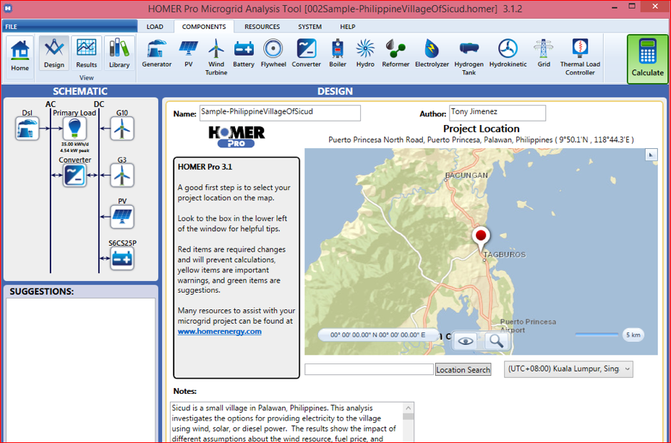
HOMER software outlook

Slide 12
CONCLUSION
At the end of this work there would be a working model, that would be used to install renewable energy system that would ensure maximum renewable energy resources usage that will in turn result to maximum power generation per location in Nigeria.

