Slide 1


DESIGN AND IMPLEMENTATION OF SELF-SERVICE DELIVERY SCHEME APP FOR A FUEL DISPENSER
BY
Udeani Chukwuebuka Louis(2015/199872)
Uzochukwu Ebubechukwu Emmanuel(2015/197985)
Supervisors: Engr. Rev. E.C. Anoliefo
Department of Electronic Engineering, University of Nigeria, Nsukka

Slide 2
INTRODUCTION
As at 2018, The Publicity Secretary of the Licensed Petroleum Station Owners Association, Nigeria, stated that filling stations owners want to stop holding cash in their stations since the advent of cashless economy or electronic banking system introduced by the Central Bank of Nigeria(CBN)[Guardian Newspaper, 2018].
This is as a result of the rising armed robbery attacks in filling stations across the country due to lack of security and the notion of making away with a handsome sum of money(cash) with little to no opposition[Guardian Newspaper, 2018].
Also, there have been reports of drivers who “gas-and-dash”, where a customer refuels and then drives away without paying for it and even cases of mismanagement of the business by the filling station attendants.[Archive News] In addition, employing filling station attendants can decrease profitability from paying salaries.
All these problems are couple with the rise in number of smartphone users every year, which has now risen to a range of about 6 billion as at the end of 2019.

Slide 3
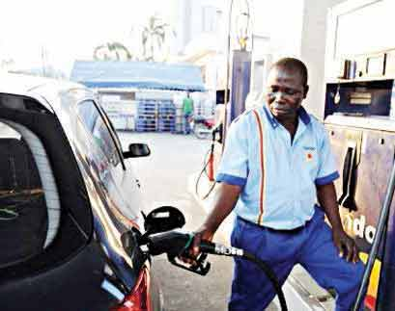
PROBLEM AND MOTIVATION
Insecurity at filling stations
Mismanagement of business by attendants
Reduced profitability due to employed staff
Increase in number of smartphone users(25 to 40 million in Nigeria currently, according to Statista.com)

Slide 4
AIM AND OBJECTIVES
The aim of this project is to develop an android application that facilitates a compatible fuel dispenser to be fully self-operational(independent of an attendant). To achieve this aim, the specific objectives were:
To build a mobile app that will be able to generate one time tokens and store them in a database.
To provide a system that automatically bills the end user.
To program a system in the app that will compile a comprehensive list of all purchases made by customers and display to the filling station owner.

Slide 5

SYSTEM GENERIC ARCHITECTURE
Consumer Interface
Retailer Interface
Compatible Fuel Dispenser
Database(Firebase)

Slide 6
SOFTWARES AND SERVICES USED
Visual Studio Code
Flutter
Firebase

Slide 7
HOW IT WORKS!

Slide 8
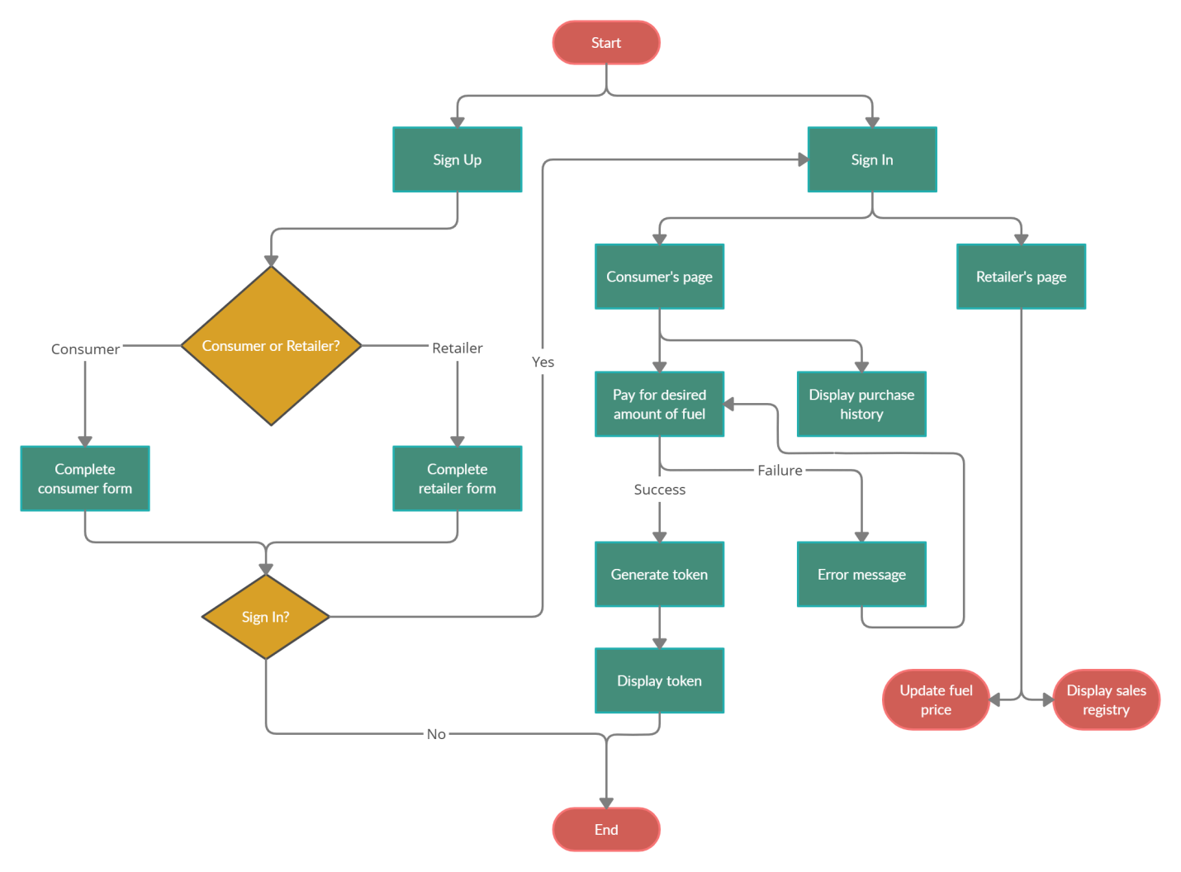
DESIGN ARCHITECTURE OF THE MOBILE APPLICATION

Slide 9
SIGNIFICANCE OF THE WORK
The significance of this work cannot be overemphasized as its service is indispensable in our modern society. However, the following but not limited to them have been listed as its significance.
It serves as a useful way of improving security for both the consumers and filling station owners.
It facilitates better management of the business by the filling station owners.
It reduces queues.
Faster transactions.
It also helps to build a stronger brand and allows the filling station owner to reach a higher customer engagement level.

Slide 10
LIMITATIONS
Even with the proposed advantages, it was observed the mobile application has the some shortcomings.
The mobile application only works for filling stations that are compatible to its service.
It can only be used by smartphone users running android operating systems.
The application is dependent on the availability of internet connectivity within its area of operation.

Slide 11
CONCLUSION
The implementation of self-service delivery scheme apps for filling stations will help reduce the rate of mishaps that arise from insecurity and also facilitate better management of the business by the owners.
Hence FillUp, a cost effective, easy to use Self-service Delivery Scheme Mobile App was developed.

Slide 12
THANKS

