Slide 1
AN UNDERGRADUATE PROJECT PRESENTED TO THE DEPARTMENT OF ELECTRONIC ENGINEERING.
Prepared by:
NWALA ENYINNA E.- 2015/197718
NNAM PRECIOUS CHIAMAKA- 2015/197164

Slide 2
SOUND DETECTION NOTIFICATION SYSTEM FOR INTRUDER/VISITOR ALERT
PROJECT TOPIC:

Slide 3
ENGR. ASIEGBU NNAEMEKA
PROJECT SUPERVISOR:

Slide 4
CONTENTS
Introduction
Problem Statement
Aim/Objectives
Scope of Study
Literature Review
Methodology
Major components and technologies employed
Project working principle
Block diagram and Flow chart
System implementation
Hardware system
Software system
Costing, Limitations and recommendations.
Conclusion

Slide 5
INTRODUCTION
The issue of security of life and property in the society.
According to a survey burglary rate in Nigeria as of 2013 was 1.5 cases per 100,000 up from 1.2 cases per 100,000 the previous year.
This is partly due to the fact that most homes have not adopted home security systems due to the inflating cost of acquiring and maintaining an effective security system.
This project proposes a low cost sound detection security system which provides acoustic surveillance, allowing users have a compact system which can be placed at strategic and concealed areas of the household, while still working effectively.

Slide 6


BURGLARY IN NIGERIA

Slide 7
PROBLEM STATEMENT
The use of some of these security systems may be seen as luxury due to the inflating cost of acquiring these systems.
During poor climatic conditions that lead to poor illumination and other phenomenon that could distort sensor data, information obtained about the possible danger might be insufficient.
Due to the fact that most of the security systems are dependent on the consistence of power supply, the need for a low power system capable of being battery powered is much needed in a country like Nigeria.

Slide 8
AIMS/OBJECTIVE
This project is aimed at the design and construction of a reliable alarm system that can detect, warn and notify users of a possible intrusion or harmless visit.
This would be achieved through the following specific objectives.
Construction of a sound detection system which picks up/detects sounds around the system.
Implement an alarm system that is triggered when the sound detected exceeds a certain threshold.
Design a notification system.
Design a means of controlling and monitoring the system over the internet.

Slide 9
SCOPE OF PROJECT
The project deals with the construction and design of sound detection notification system for intruder/visitor alert system.
The system would only employ acoustic means of surveillance without the use of machine learning techniques like sound classification.

Slide 10
LITERATURE REVIEW
The following are the related works reviewed for this project:
Sending sound over the internet by David Middlecamp (2015).
Real-Time Detection of Impulsive Sounds for Audio Surveillance Systems by Faycal et al (2018).
An Environmental Sound Source Classification System Based on Mel-Frequency Cepstral Coefficients and Gaussian Mixture Models by Guanghu Shen et al (2012).
IoT Based Notification System Using Android App by Biswajit Das (2017).
Development of a Simple Sound Activated Burglar Alarm System by Mahmud Shehu et al (2006).
Noise Detector with Automatic Recording System Using Arduino by Ashwini Kumar (2019).

Slide 11
METHODOLOGY
To realize the objectives of this project, the following methodology was adopted:
Reviewing of past works in Design and Construction of Sound detection systems.
Design and construction of sound detection system using MAX9814 electret microphone amplifier module.
Design alarm system using a high decibel active buzzer.
Design an online notification system using an ESP8266 NodeMCU Wi-Fi module to connect the system web platform on a server to stream sound obtained from the microphone module.
Interfacing the system with the blynk IoT mobile application allowing user to have easy control of the system.
Testing system in different scenarios at different times of the day.
Collation and compilation of project work.

Slide 12
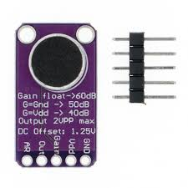
MAJOR COMPONENTS AND TECHNOLGIES EMPLOYED
MAX9814
The MAX9814 is a low-cost, high-quality microphone amplifier with automatic gain control (AGC) and low-noise microphone bias.
This amplifier is great for when you want to record or detect audio in a setting where levels change and you don't want to have to tweak the amplifier gain all the time

Slide 13
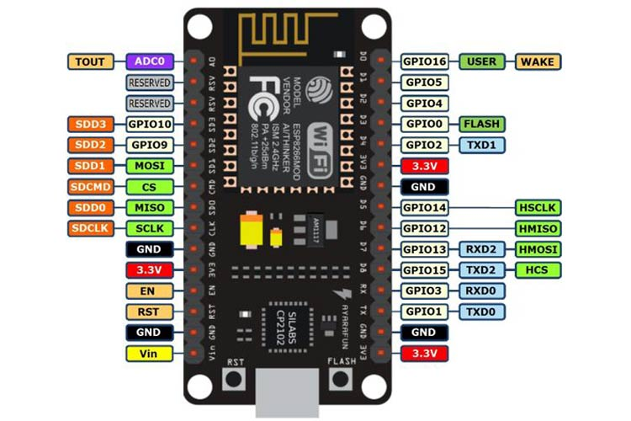
MAJOR COMPONENTS AND TECHNOLGIES EMPLOYED
WI-FI
Wi-Fi allows local area networks (LANs) to operate without cables and wiring, making it a popular choice for home and business networks.
NODEMCU
NodeMCU serves as the microcontroller for interfacing the components and also keeps the system connected to the internet.
BLYNK IOT PLATFORM
Blynk is a platform that allows you to quickly build interfaces for controlling and monitoring your hardware projects from your iOS and Android device.

Slide 14
PROJECT WORKING PRINCIPLE
The NodeMCU board is used for the system programming and connecting the system to the internet.
Sound sensing system consists primarily of the MAX9814 chip with an electret condenser microphone.
The recording system consists of a NodeJS server running on a local PC, sound data is sent through a TCP connection from the NodeMCU to the server.
The notification and streaming systems consist of a blynk IOT mobile app that sends push notifications to the user’s mobile phone. The notification consists of information about possible intrusion and a link to the website to stream the audio and allow the user listen in on audio.
The alarm system is basically a high decibel buzzer.
The system works as follows:

Slide 15
PROJECT WORKING PRINCIPLE (CONT’D)
Sound detection and recording is done throughout the day and night.
Sound picked up from the microphone is sent to the server and is stored on the local system's hard drive.
The intruder detection is carried out using a thresholding system for different times of the day
The system has the ability to automatically calibrate its threshold depending on if it is day or night.
If the threshold is exceeded, the system sends a notification to the users mobile phone via the blynk IoT application allowing him listen in on the audio and determine whether or not it’s an intrusion. the user can control the alarm from the blynk app.
The website consists of a media player for both streaming and accessing pre-recorded audio data.

Slide 16
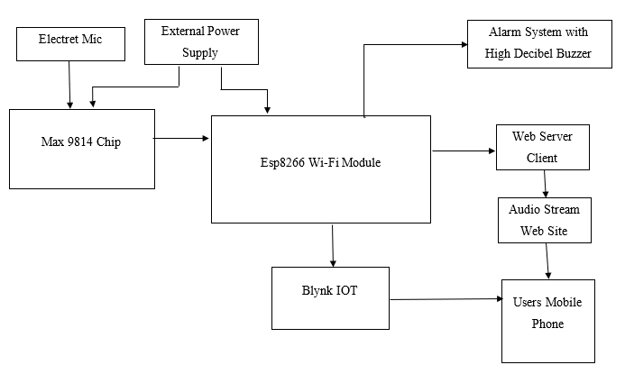
BLOCK DIAGRAM OF THE SYSTEM
Block diagram of a sound detection Notification System

Slide 17
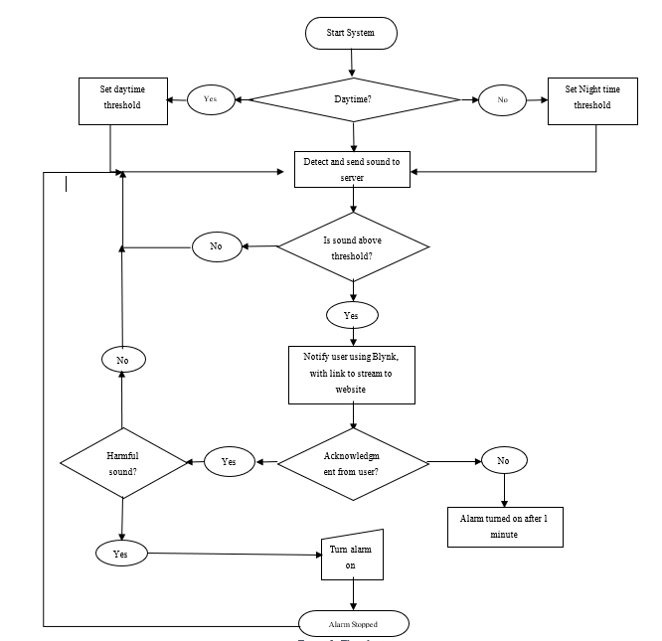
FLOWCHART OF THE SYSTEM

Slide 18
SYSTEM IMPLEMENTATION
HARDWARE
This project consists of three main hardware systems: the audio detection system, the control/ automation system and the alarm system.
Audio detection system consists of the electret microphone and MAX9814 amplifier.
The control/automation system consists of the Esp8266 microcontroller.
The alarm system consists of the active piezo buzzer.

Slide 19
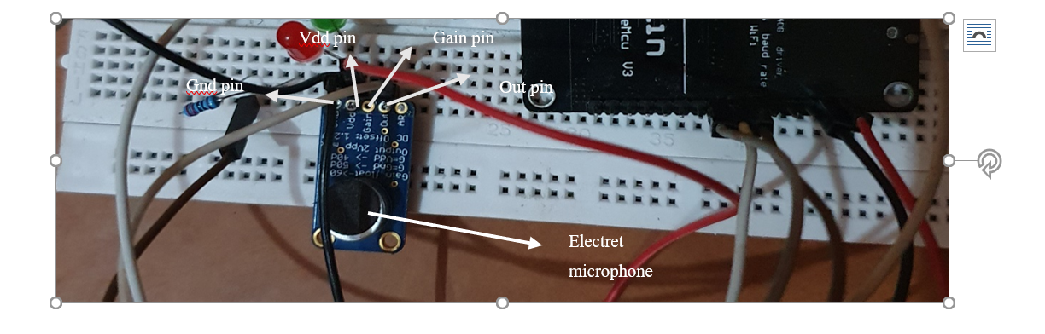
AUDIO DETECTION SYSTEM

Slide 20
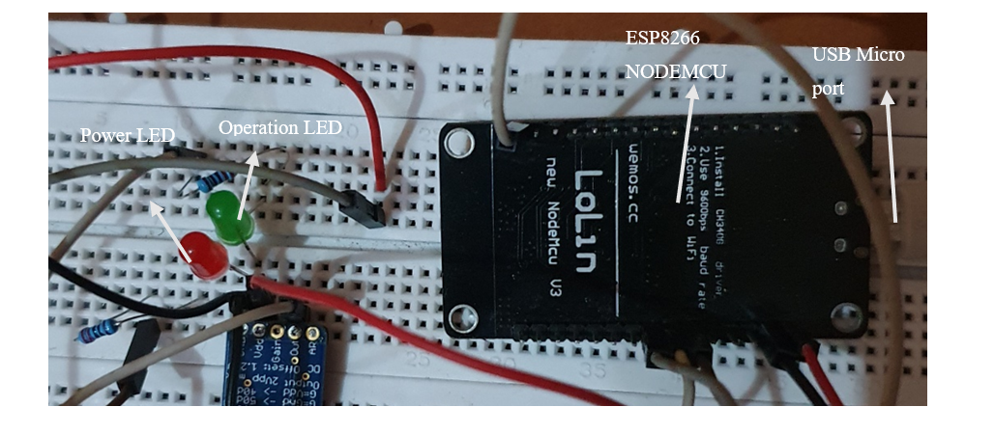
CONTROL/AUTOMATION SYSTEM

Slide 21
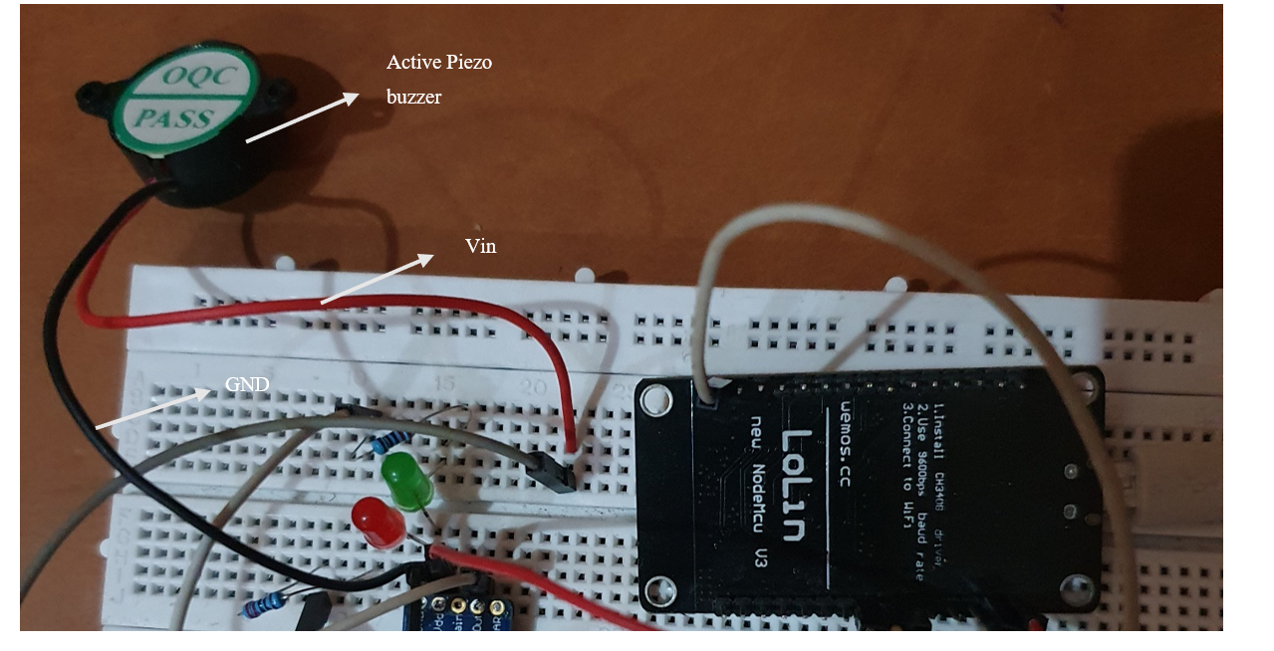
ALARM SYSTEM

Slide 22
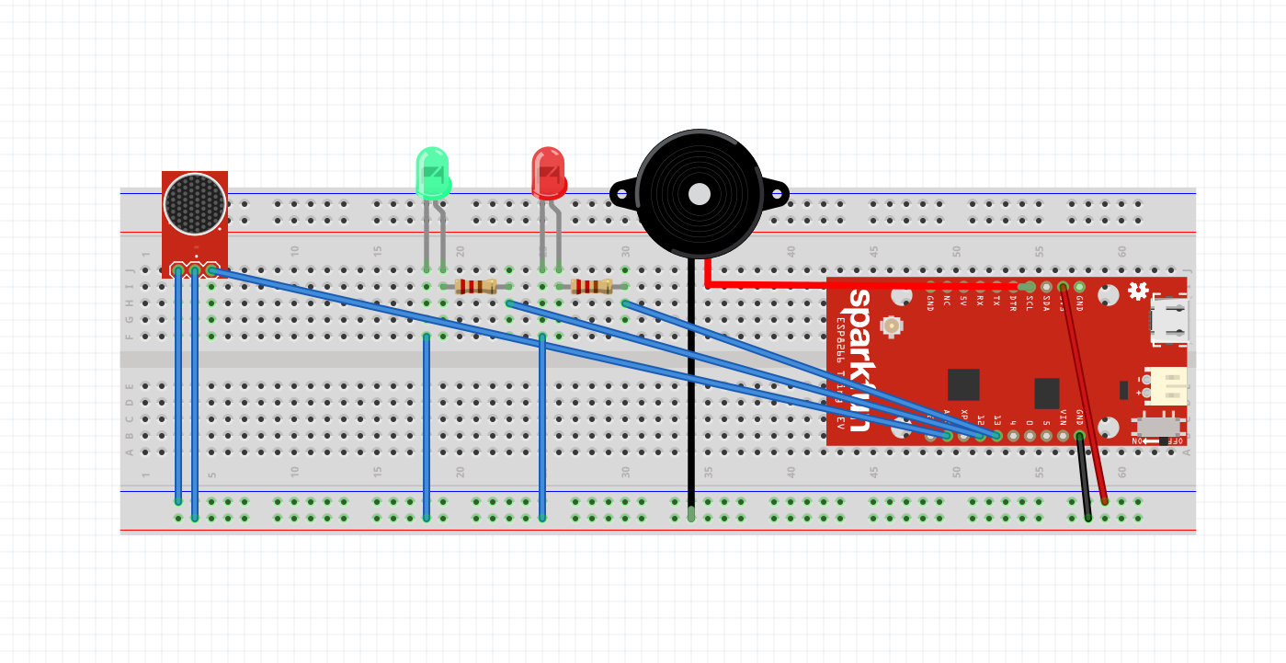
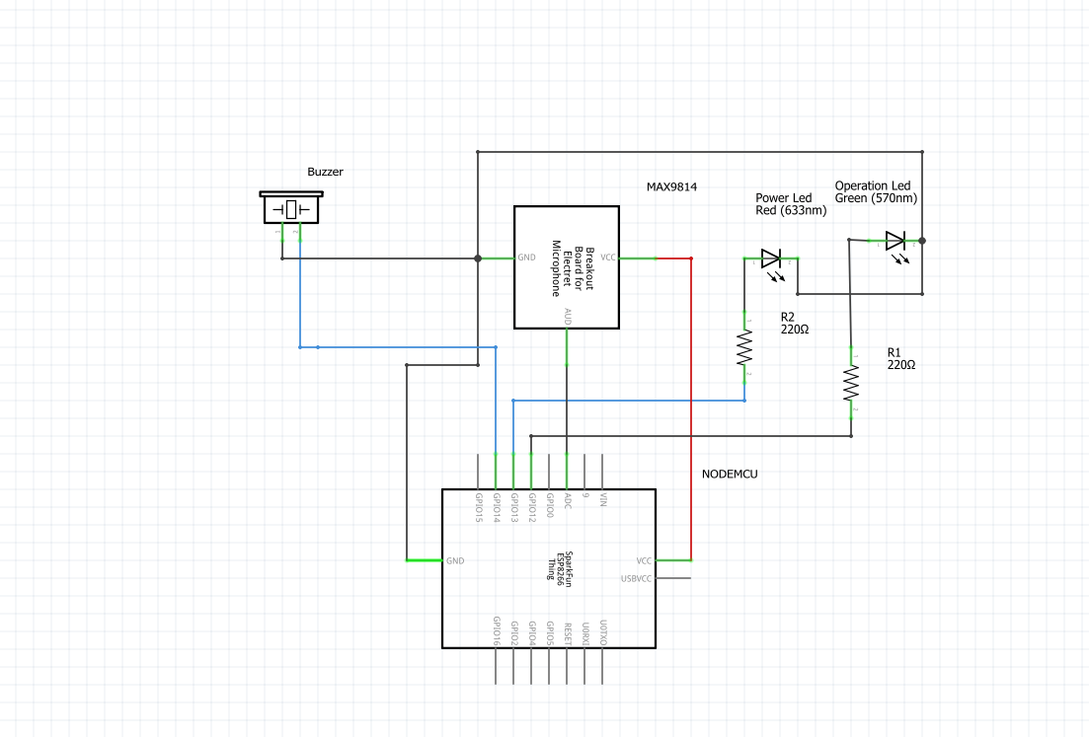
FULL HARDWARE SYSTEM SCHEMATIC

Slide 23
SYSTEM IMPLEMENTATION
SOFTWARE
The software part of the project consists of:
The main Esp8266 program: This program controls and automates the hardware system.
It defines the parameters necessary to connect the system to a Wi-Fi network and then to the internet or LAN.
The program also connects to a local server for sending packets of the audio data from the microphone to a local server and connects to the Blynk Server for notification purposes and user control (IOT).
The Node.js TCP server and Node.js backend server for the website.
The TCP server creates a server to allow connection between the Node.js program and the NodeMCU and transfer audio data and alarm control.
The HTTP server is the back-end server for audio stream website, for serving the audio files and automatic controls of the audio player element.
The HTML, CSS and JavaScript code for the website: These are the programs written for the design of the audio stream website.

Slide 24
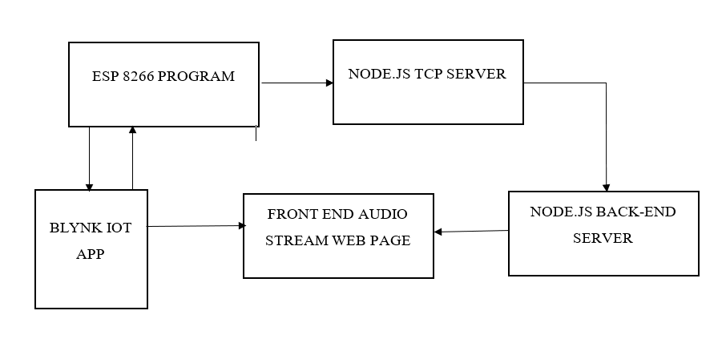
SOFTWARE BLOCK DIAGRAM

Slide 25
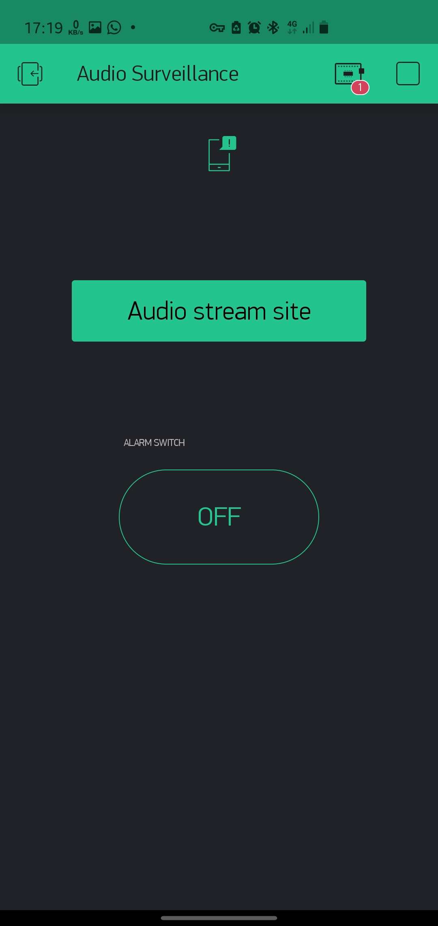
BLYNK IOT APP SCHEMATIC
Run App
Push Notification widget
System detail button
Audio Stream website button
Alarm Control button

Slide 26
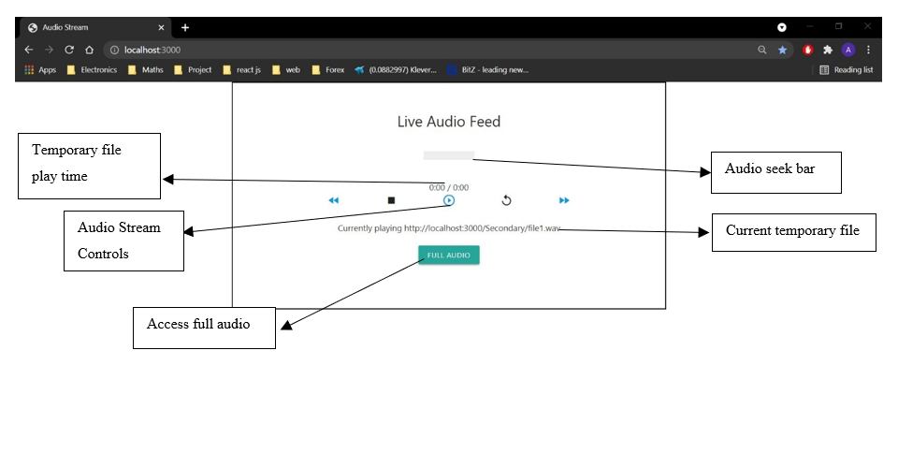
Web Page Schematic

Slide 27
PROJECT COSTING
 | Components | Prices (N)
1 | NodeMCU | 2700
2 | Max9814 | 5000
3 | Packaging/wires | 650
4 | Active buzzer | 350
 | Total | 8600

Slide 28
LIMITATIONS
This project doesn't have the ability to differentiate between harmful and harmless noises, its notification is strictly based on threshold techniques
This project has not been launched on the internet; the project is currently limited to a local server but can be scaled to the internet with additional costing.

Slide 29
RECOMMENDATIONS
The use of Sound classification would greatly improve the efficiency of the project.
It is recommended that the system is attached to an independent power supply to enable 24/7 surveillance.
It is also recommended that the project is hosted to the world wide web to enable the system to be controlled in remote places.

Slide 30
CONCLUSION
A reliable, efficient and cost-effective alarm system that can detect, warn and notify users of a possible intrusion or harmless visit was designed and costructed.
The System is divided into three subsystems which includes the sound detection subsystem, alarm subsystem and notification system.
The sound detection subsystem consists basically of the MAX9814 and NodeMCU for detecting sound in the environment, the alarm system includes an active buzzer interfaced with the sound detection systems and lastly, the notification system which also serves as a means of controlling and monitoring system over the internet.

Slide 31
THANK YOU FOR LISTENING!

