Slide 1
IMPROVED FAIRNESS SCHEME FOR WLAN ACCESS CONTENSION
BY
ASIEGBU NNAEMEKA CHRISTOPHER
(PG/MENGR/14/68103)
SUPERVISOR: PROF. COSMAS I. ANI
DATE: SEPTEMBER, 2015

Slide 2
A PROPOSAL/WORK EXTENT PRESENTED IN PARTIAL FULFILMENT FOR THE AWARD OF MASTERS IN ENGINEERING DEGREE (COMMUNICATION)
DEPARTMENT OF ELECTRONIC ENGINEERING UNIVERSITY OF NIGERIA NSUKKA

Slide 3
ABSTRACT
Recent advance in Wireless Local Area network (WLAN) based standard has pushed the wireless bandwidth up to 600mbps while keeping the same wireless medium access control (MAC) schemes for full backward compatibility. In an 802.11 environment which uses Distributed Co-ordination Function (DCF) as the mac protocol, workstations or node make access to the wireless media using random access techniques, in such networks, each node adjusts its contention window to the minimum size irrespective of the number of competing nodes, this has proved to perform below par in high workstation density scenario. in the case of large number of workstations competing for resource through a particular hotspot, the network performance in terms of access time fairness and delay is highly reduced and also results to increase in the probability of collision. this work proposes an improved fairness scheme that will guarantee impartiality on the part of accessing the link and reduced probability of collision.

Slide 4
PRESENTATION OUTLINE
WLAN INTRODUCTION
PROBLEM STATEMENT
WORK OBJECTIVES
SCOPE OF THE RESEARCH
RESEARCH METHODOLOGY
PROJECT SCHEDULE GANTT CHART
WORK STATUS
CONCLUSION

Slide 5
WLAN INTRODUCTION
ORIGIN 802.11
  Emerged In 1997
  1 Or 2 Mbps
PROPAGATION METHODS
  Communicate Over the Air Through EM Waves
  Radio Wave (RF): 2.4ghz and 5ghz Unlicensed ISM Band
MERITS:
  Mobility
  Ease of Deployment

Slide 6
THE ARCHITECTURE OF IEEE 802.11 WLAN
BASIC COMPONENTS
  Station (STA)
  Access Point (AP)
  Distribution System (DS)
TOPOLOGY
  Ad Hoc
  Infrastructure

Slide 7
ARCHITECTURE OF IEEE 802.11 CONTD.
AD HOC TOPOLOGY
  Peer-to-peer Connection
  No Access Point
  No Server
INFRASTRUCTURAL TOPOLOGY
  Point-to-multipoint
  AP: Interconnecting Wired And Wireless Network

Slide 8
AD HOC TOPOLOGY
STA A
STA C
STA D
STA B

Slide 9
INFRASTRUCTURE TOPOLOGY
DS
AP
STA A
STA C
STA B

Slide 10
THE MAC OF IEEE 802.11 WLAN
MAC Access Methods
  Contention Free
  Contention-based
MAC Access Topology
  Distributed Coordination Function (DCF)
  Hybrid Coordination Function (HCF)
    Enhanced Distributed Channel Access (EDCA)
  Point Coordination Function (PCF)
MAC Access Protocol
  CSMA/CA

Slide 11
MAC OF IEEE 802.11 WLAN CONTD.
MAC ACCESS PROTOCOL
  CSMA/CA
    Mainly contention based with DCF
    Reduces the Probability of Collision on the Channel
  CONTROL FRAMES
    RTS
    CTS
    ACK
  INTER-FRAME SPACES (IFSS)
    SIFS
    DIFS
    PIFS

Slide 12
PROBLEM STATEMENT
Channel Access Time.
Collision of Packets.
Optimisation and Utilisation of the Channels.

Slide 13
PROJECT OBJECTIVE
To Review The Access Control Techniques For WLAN.
To Develop An Improved Contention Management Scheme For An 802.11 Environment.
To Reduce Probability of Collision.

Slide 14
SCOPE OF THE RESEARCH
IEEE 802.11 Overview and Standards.
Wireless Local Area Network Medium Access Control (MAC).
WLAN Contention Management Scheme.

Slide 15
RESEARCH METHODOLOGY
Review of Wireless Local Area Networks.
Review of 802.11 Medium Access Control (MAC) and Their Standards.
Review of WLAN Channel Access Contention Management Schemes.
Development of Choice Network Architecture for Modelling.
Development of Choice Contention Management Scheme.
Computer Simulation and Implementation of the Chosen Scheme.
Validation of Model with Performance of Existing Techniques/Schemes.
Publication of Research Findings.
Collation, Compilation and Submission of the Project Thesis.

Slide 16
PROJECT PLAN
A. Literature Review of 802.11.
B. Literature Review of Channel Access Contention Management Schemes.
C. Problem Statement.
D. Development of Proposed Improved Scheme For WLAN Access Contention.
E. Validation and Comparison of the Proposed Scheme.
F. Analysis of Results Obtained.
G. Collation and Publication of Thesis.

Slide 17
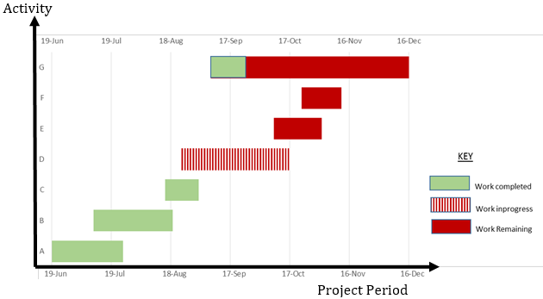
PROJECT SCHEDULE GANTT CHART

Slide 18
PROJECT STATUS
Estimation from our project schedule Gantt chart indicates a 52% work completion.
IEEE 802.11 WLAN networks and its MAC protocols was critically reviewed.
The Improved contention management scheme is still on the modelling development stage.

Slide 19
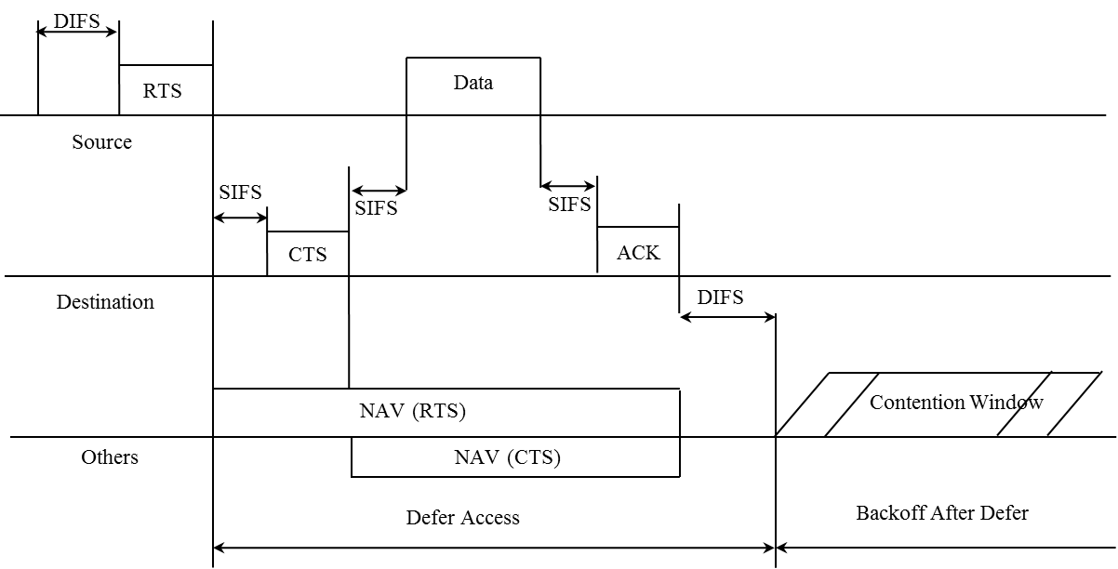
ANALYSIS
Analysis of the DCF MAC contention Technology

Slide 20
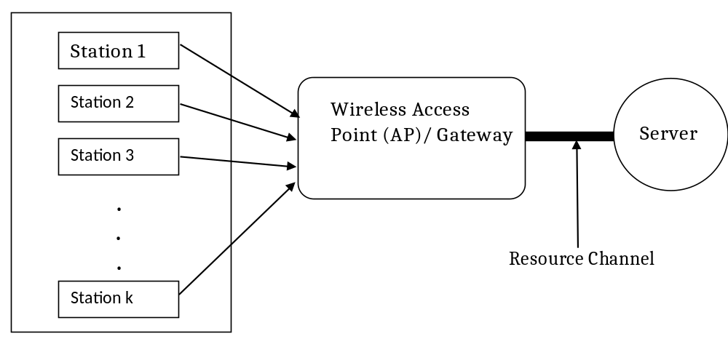
ILLUSTRATION
Proposed Physical Model Diagram of contending stations

Slide 21
CONCLUSION
The proposed project is currently at the stage of WLAN access contention scheme modelling, hopefully before the duration of the project plan, a scheme capable of enhancing fairness quality of service metric and reduced collision of packets from workstations contending for channel access will be achieved.

Slide 22
THANK YOU

