Slide 1
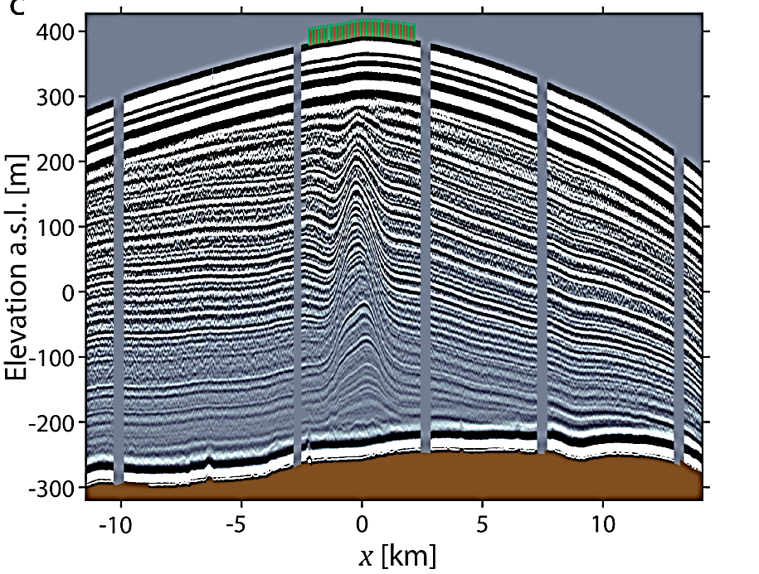
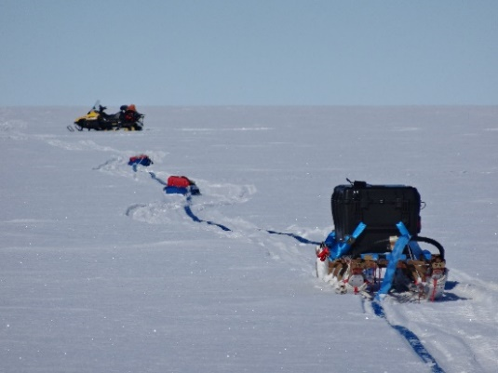
Korff Ice Rise
Notes:
An ice-penetrating radar profile from Korff Ice Rise collected using the Deep-Looking Radio-Echo Sounder (DELORES).
Kingslake, J. “Ground-based ice-penetrating radar surveys of ice rises in the Ronne Ice Shelf region” Polar Data Centre, Natural Environment Research Council, UK Research & Innovation. https://doi.org/10.5285/e7f0dff3-bd30-482a-939b-61bb2f2c1e57

Slide 2
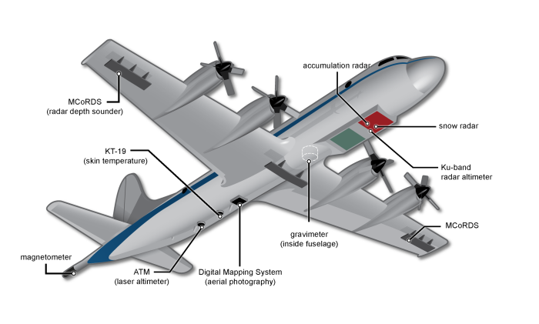
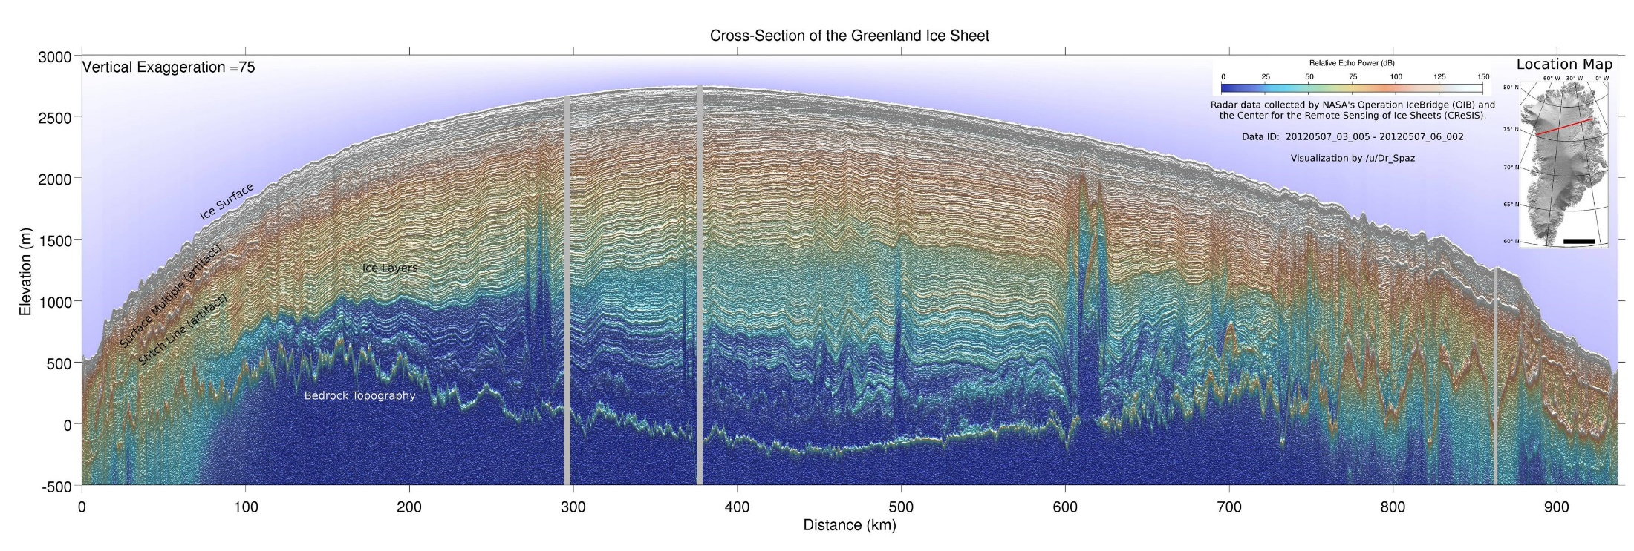

Greenland Ice Sheet

