Slide 1
Make A Copy Of This Deck And Update The Red Ink Based On Your Notebook Results

Slide 2

Instructor Kick-off
Analyze A/B Test Results
© 2019 Udacity. All rights reserved.

Slide 3
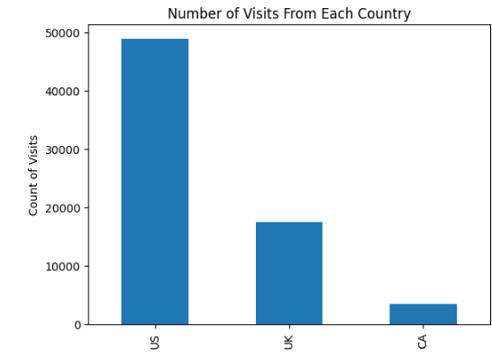
How Was The Experiment Implemented?​
Total Variant Visitors: 69889
Total Control Participants:​ 35211
​

Slide 4
Conversion Rates
 | U.S. | U.K. | CA
Control | 10.7% | 10.2% | 9.4%
Treatment | 15.8% | 14.9% | 15.4%
Executive Summary: These probabilities indicate that the Treatment page is consistently associated with higher conversions across all countries. This suggests that the Treatment page has a positive impact on conversion regardless of location. Also, due to the fact that the individual countries have minimal differences in conversion, this suggests that the itself has little influence on conversion.

Slide 5
Experiment Results
Treatment Conversion Rate: 12.88%
Control Conversion Rate:​ 12.90%
Delta in Treatment vs. Control Conversion Rate:​ p-value:​ -.0.002
Conclusion:​ The conversion rates for the Treatment and the Control groups are nearly identical. The p-value of -.0.002 suggests that there is no statistically significant difference between the two groups.

Slide 6
Country Results
Conclusion:​ There are minimal differences in conversion rates between countries. This suggests that no matter the location, roughly the same amount of people are likely to convert.

