Slide 1


A few ideas how to integrate Wwise Authoring API (WAAPI) in your project workflow
Eugene Cherny
NetEase Games
DevGAMM Fall 2021

Slide 2
About this talk
The goal is to provide a concise introduction to WAAPI, how to integrate it, with examples
Rough plan
  Basics, important concepts, reference pages to bookmark
  Overview of tools involved and some ideas how to use them, also on how to make your own tools that use WAAPI
  Examples
  Some pitfalls that you may or may not encounter

Slide 3
About WAAPI
Allows to perform editing actions on a Wwise project that’s currently open in the Authoring tool
Possible: creating banks, events, containers, reading and modifying their properties, importing audio
Your code can also subscribe to changes done in Wwise project
  E.g. to auto-rename event .uassets!
Some things aren’t reachable from WAAPI yet, e.g. RTPCs and blends
  Though keep an eye on the changelog
WAAPI has a client-server architecture: the authoring tool is a server, and your code is a client
  For better or for worse
  Also, accessible either via a WAMP or a HTTPS endpoint

Slide 4
Things to bookmark
Wwise Authoring API Reference – Functions
https://www.audiokinetic.com/library/edge/?source=SDK&id=waapi_functions_index.html
  Things that can be queried or modified
Wwise Authoring API Reference - Functions
https://www.audiokinetic.com/library/edge/?source=SDK&id=waapi_topics_index.html
  Notifications Wwise Authoring tool can send to you

Slide 5
A little bit about Wwise projects
Essentially, Wwise projects are hierarchies of objects that together define playback rules for the sound engine runtime
Each object belongs to certaing type / class (e.g. “Event”, “RandomSequenceContainer”)
Each class has their own set of properties (e.g. “BusVolume”, “IsStreamingEnabled”)
Child objects inherit some of the properties from the objects higher in the hierarchy
Some things are exceptions, e.g., IIUC, RTPCs aren’t quite properties

Slide 6
To bookmark
Wwise Objects Reference
https://www.audiokinetic.com/library/edge/?source=SDK&id=wobjects_index.html
  Lists all available Wwise object types
  And their properties — which is essential when working with WAAPI

Slide 7
How to use WAAPI
C++, C#, NodeJS, Python — these languages have WAAPI clients from Audiokinetic
Also from Unity and Unreal Engine
Wwise Authoring tool must be running
  I think it can also be ran in a headless mode using WwiseConsole.exe
  with “waapi-server” command
For the rest of the talk, we are going to be focused on Python

Slide 8
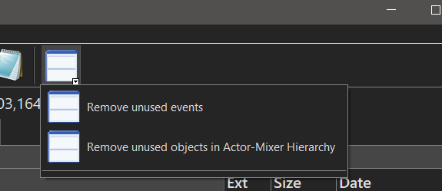
Running WAAPI scripts (1/2)
I like when tools don’t require working with CLI
Our team has a custom Total Commander that we distribute internally through SVN
  It bundles lots of portable tools and scripts
  We create top-bar menu items which can one-click run them
  Including WAAPI scripts, of course
Seriously, you should try Total Commander!

Slide 9
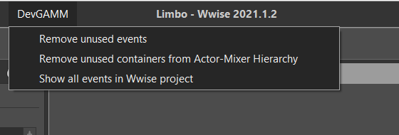
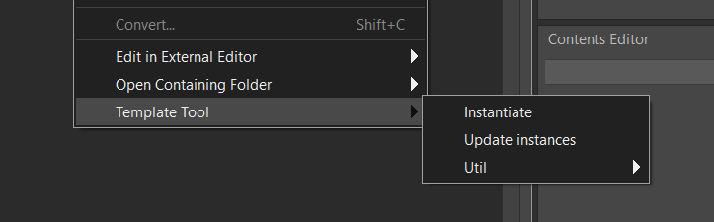
Running WAAPI scripts (2/2)
We also create Command Add-ons for Wwise Authoring tool
They allow to execute arbitrary commands and pass some project-specific arguments to them, such as GUID of selected objects, path to Wwise project, etc.
And they allow to add new commands to menus, both a main menu and a context menu
  “My new favorite thing of all time!” © P. Griffin
More on this in the examples section

Slide 10
Distributing Python scripts (1/2)
Ideally, teammates shouldn’t have to configure anything in order to run tools
We solved this, again, with our Total Commander build
  A portable Python distribution was included with Total Commander
  All dependencies were installed there and synced through SVN, so everybody has identical environments to run our tools
  This environment doesn’t conflict with system’s Python which can occasionally be used by game projects we work with
  Occasional hiccups related to compiled packages such as NumPy
Essentially, SVN Checkout of our Total Commander updates all internal tools for everyone in our team, i.e. about 30 people

Slide 11
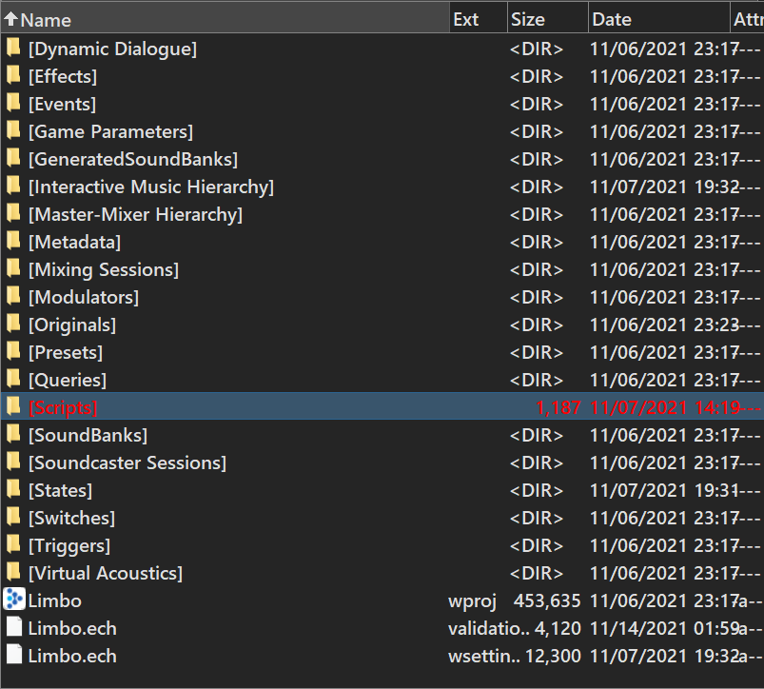
Distributing Python scripts (2/2)
A super simple alternative is to keep Python scripts in the Wwise project directory, e.g. “Scripts”
Audio team will always have latest scripts, but they must configure Python environment themselves
  Which is not hard with instructions
  Don’t forget to update them when a new tool introduces new package dependency
    Can probably be solved by adding “install_python_requirements.bat” to the Wwise project root
We’re going to use this approach in the examples ahead

Slide 12
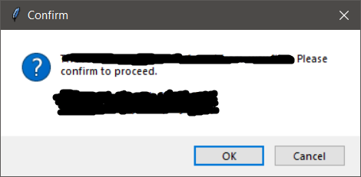
And one more thing
Most of the WAAPI scripts I wrote were essentially CLI tools, they accept arguments, print info to the console, etc.
I found that adding simple dialogue windows confirming success or failure, asking for permission to proceed, etc. hugely improve experience working with such small tools
  It’s just satisfying to know that the tool just finished and it gives some assurance to proceed further with other things
The good part, these things can be easily displayed with Python’s Tk — any of such dialogue windows is one or two lines of code in most cases

Slide 13
Getting to examples
The purpose of those examples is to give a taste of how actual useful WAAPI scripts might look like, as well as to, dare I say, to inspire to apply some of the mentioned techniques to your own projects
Due to slide format, I’ll omit some parts of the code
I’ll also use a few helper functions that I wrote for myself that simplify communicating with WAAPI a bit by handling JSON request and response packing and unpacking
So, basically, consider the examples as pseudocode rather than final code
The code should be available here:
https://github.com/ech2/DevGAMM_2021_Fall
  Warning: don’t expect scripts to be polished as I couldn’t just copy code used on projects, so these were basically whipped up one day before the submission deadline (kidding, mostly)

Slide 14
Prerequisites
In order to run scripts you’ll need a Python installed
  On Windows, tick “Tk” and “pip” check-boxes during installation
  And, of course, Python executable must be in PATH
Also install additional packages like follows:
pip install pyperclip waapi-client
pip install -U git+https://github.com/ech2/waapi_helpers.git

Slide 15
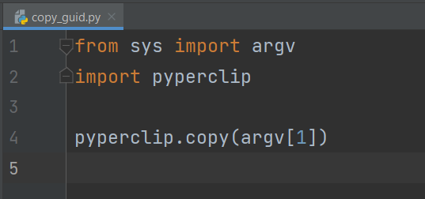
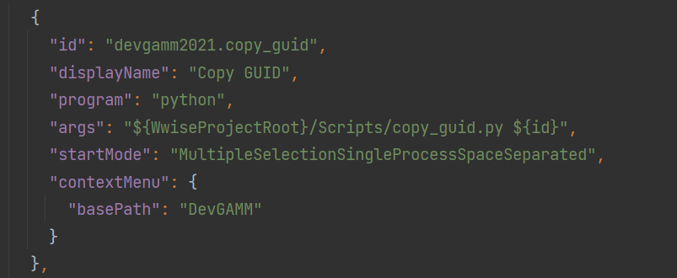
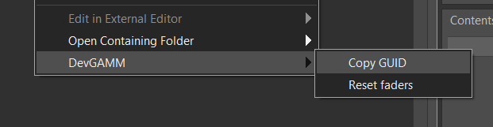
E1: copy GUID of a selected object
No WAAPI yet, but super useful and a good example on how to configure a command add-on
Pass a selected object GUID as an argument to Python script which just copies it to the clipboard
Right click on any object in the hierarchy to see the following option
  Courtesy of the Command Add-on on the right −−−−−−−−−−−>

Slide 16
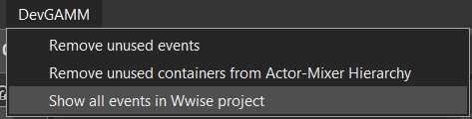
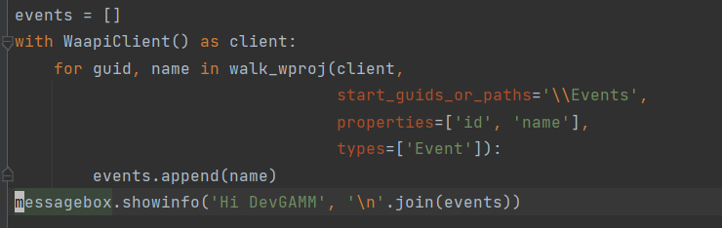
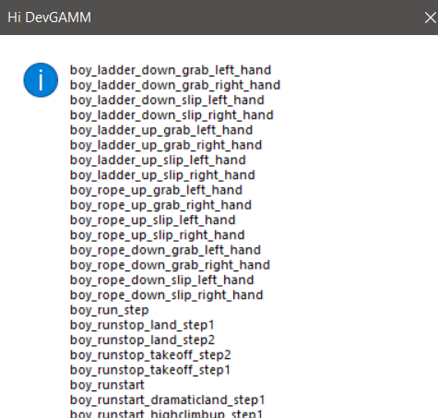
E2: print names of all events
A simple script that lists all events in a project and shows it in a dialogue window
The script traverses the project starting from “Events” directory and yields only objects that have type “Event”
  To be precise, not just objects their GUIDs and names

Slide 17
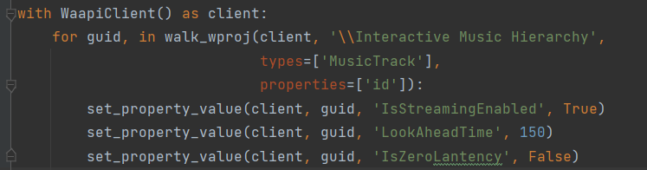
E3: configure streaming for MusicTrack objects
Set streaming properties for all MusicTracks
  Super easy to forget and a bit annoying to do: need to go down to the hierarchy or use Wwise Queries, which I always forget how to use
Unexpectedly, “Latency” is spelled “Lantency” — couldn’t understand why my script failed to set this property first time I wrote this :)

Slide 18
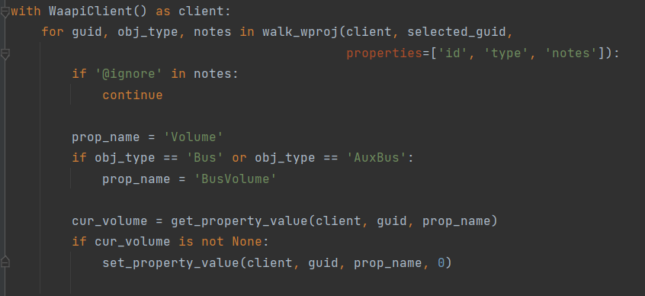
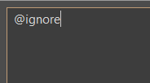
E4: reset faders to zero
Set all faders under selected object to zero, except objects containing “@ignore” tag in their comments
Note, objects in the Actor-Mixer Hierarchy have property “Volume”, but ones in Master-Mixer Hierarchy use “BusVolume”
This example also shows a technique of storing metadata in the “notes” section, which tools can use for something

Slide 19
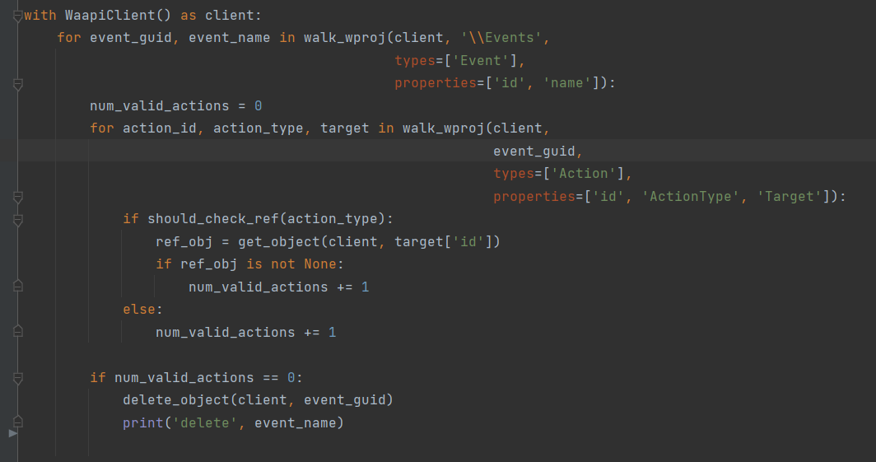
E5: remove invalid events
Event is invalid if it has no actions or actions point to non-existing object

Slide 20
Idea: automatic .wav import workflow
Goal is to create hierarchies, banks and events automatically when new .wav files are imported — basically your own Wwise “templates” that can be instantiated
  Also feasible to regenerate implementations of already imported sounds
Approach 1: create objects right with WAAPI
  Easy to implement and debug
  IIRC, access to blends and RTPCs is quite limited
Approach 2: create “template” hierarchies in Wwise, copy and modify properties properties, etc.
  Easy to understand, as “templates” live in a Wwise project
  Not trivial to implement, e.g. we had to store a bunch of metadata in object notes

Slide 21
Other WAAPI ideas
As you can see, lots of useful things can be done relatively easy
Some other ideas for further studies (we are quite time limited today):
  Automatically rename .uasset files in Unreal Engine when their corresponding objects in Wwise are renamed
  Remove unused objects from Actor-Mixer Hierarchy
  Add game-specific Wwise project health checks, like reporting “Override Parent” in unexpected places (hard to spot if it causes a bug!), check naming consistency — everything that Integrity Report can’t do
    Can run offline, generate HTML status pages, etc.
  Brew freshly ground coffee

Slide 22
Things to be aware of
WAAPI server halts when dialog windows in Wwise are open, e.g. User Settings or Source Control
WAAPI call can time out when request was too large, e.g. requesting GUIDs of all objects in the hierarchy
  I solved this in my scripts by only requesting direct children in one WAAPI call, Python iterators make it basically invisible
When copying or moving things with WAAPI, MediaID can change in work units, which might lead to inconveniences when using UE’s event-based packaging (lots of unrelated things in changelists, need to regenerate data, etc.)
  For one of our tools we solved this by patching work unit files to preserve MediaIDs
Command add-ons can’t handle paths with white spaces in some cases
  Can be solved by adding tokens to arguments and parsing them in the scripts

Slide 23
Acknowledgments
One way or another, most of things presented here resulted from working with these amazing people, in alphabetical order:
  Dmitry Patrakov
  Ruslan Nesteruk
  Viktor Ermakov
Also, while preparing this presentation, I used Limbo project as a playground for testing scripts

Slide 24
Thank you!
Feel free to reach me out
me@eugn.ch
Discord ГРИА

