Slide 1
The reconstruction of Speech using Noise-cancelling Algorithms
Group 58
Edward
Timothy

Slide 2
Topics
Our Motivation
The Problem that exist
Our Research Plan
Dataset
Existing approach
Spectrograms
Generative Adversarial Network
Helper classifier
Summary

Slide 3


The Motivation
Signal to noise ratio (SNR)
Low SNR → Background noise signal > Speakers voice signal
Example: Friend at a concert
High SNR
Low SNR

Slide 4
The Problem
Existing methods for speech enhancement
Statistical model-based methods
Machine learning methods
Machine learning: unknown filter and not mathematically modelled
Very low SNR ~ -10dB
[1] Manamperi, W., Samarasinghe, P. N., Abhayapala, T. D., & Zhang, J. (2022). GMM Based Multi-Stage Wiener Filtering for Low SNR Speech Enhancement. International Workshop on Acoustic Signal Enhancement, IWAENC 2022 - Proceedings, 0–4. https://doi.org/10.1109/IWAENC53105.2022.9914707
[2] Pascual, S., Bonafonte, A., & Serrà, J. (2017). SEGAN: Speech Enhancement Generative Adversarial Network. http://arxiv.org/abs/1703.09452

Slide 5
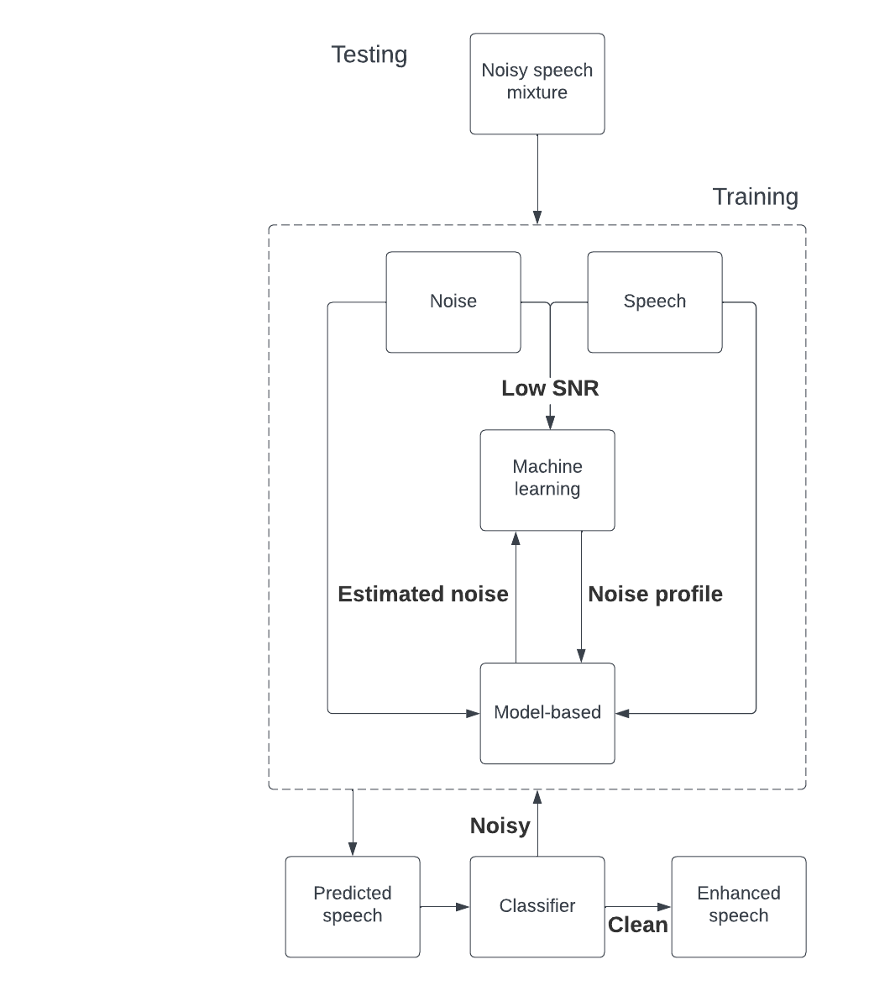
Research Plan
Australian National University used an iterative approach
Our method uses a predictive approach shown on the flowchart
Predicted speech = Noisy speech mixture - Estimated noise
[1] Manamperi, W., Samarasinghe, P. N., Abhayapala, T. D., & Zhang, J. (2022). GMM Based Multi-Stage Wiener Filtering for Low SNR Speech Enhancement. International Workshop on Acoustic Signal Enhancement, IWAENC 2022 - Proceedings, 0–4. https://doi.org/10.1109/IWAENC53105.2022.9914707

Slide 6
Dataset
Speech dataset (CSTR VCTK Corpus) → English Multi-speaker Corpus for CSTK Voice Cloning Toolkit from the University of Edinburgh (48kHz)
106 English speakers with 400 sentences each
Noise dataset (DEMAND) → Diverse Environment Multichannel Acoustic Noise Database (16 and 48kHz)
17 noise environments
[3] Veaux, C., Yamagishi, J., & King, S. (2013). The voice bank corpus: Design, collection and data analysis of a large regional accent speech database. 2013 International Conference Oriental COCOSDA Held Jointly with 2013 Conference on Asian Spoken Language Research and Evaluation, O-COCOSDA/CASLRE 2013. https://doi.org/10.1109/ICSDA.2013.6709856
[4] Thiemann, J., Ito, N., & Vincent, E. (2013). The Diverse Environments Multi-Channel Acoustic Noise Database (DEMAND): A database of multichannel environmental noise recordings. Proceedings of Meetings on Acoustics, 19, 1–6. https://doi.org/10.1121/1.4799597

Slide 7
Existing approach
Uses Gaussian Mixture Model and overdetermined equations[1,5].
Gaussian Mixture Model groups up similar noise and calculates the average noise per group
Overdetermined equations determine how much each average from each group should contribute.
Once calculated, add them all up and we now have an estimate of noise.
May need more than one set of averages to get rid of all the noise
[5] S. Chehresa and M. H. Savoji, “MMSE speech enhancement based on GMM and solving an over-determined system of equations,” in 2011 IEEE 7th International Symposium on Intelligent Signal Processing, Sep. 2011, pp. 1–5. doi: 10.1109/WISP.2011.6051692.

Slide 8
Continuing on…
The current proposal is to use an interactive approach.
Uses more sets of averages to remove leftover noise
But what are the implications of this?
Let’s look at some spectrograms.

Slide 9
Spectrograms - signals as an image
Spectrograms show us the frequencies of a signal through time
The intensity of the colour shows how much energy each frequency has at a certain time.
Let’s take a look at some.

Slide 10
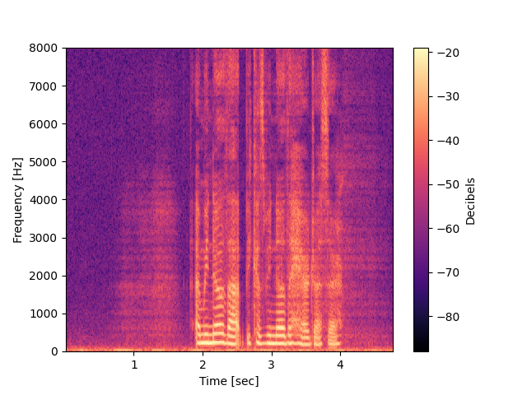
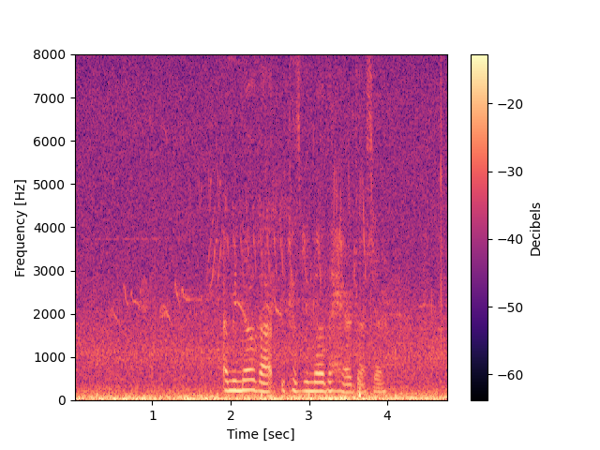
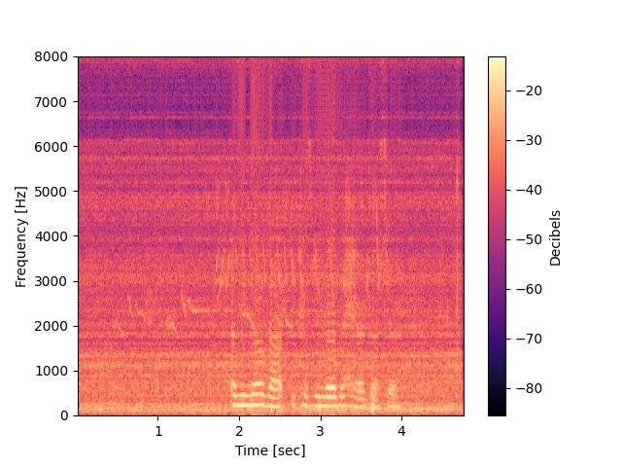
Pure speech
Noisy speech
Filtered speech
“And we know that because we know the hairdresser”

Slide 11
On the prediction of accurate sets of averages
Getting the ‘best’ set of average is impossible
Therefore, we take advantage of a recent advancement in machine learning

Slide 12
Generative Adversarial Networks (GAN)
Commonly used for image generation.
Made out of two neural networks
The discriminator teaches the generator.
We apply it to the developed model.
We present the strength of this algorithm

Slide 13
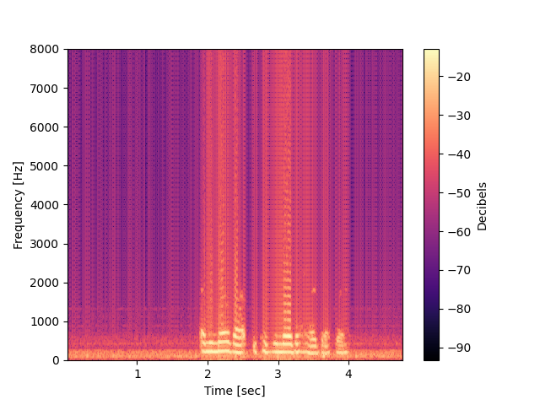
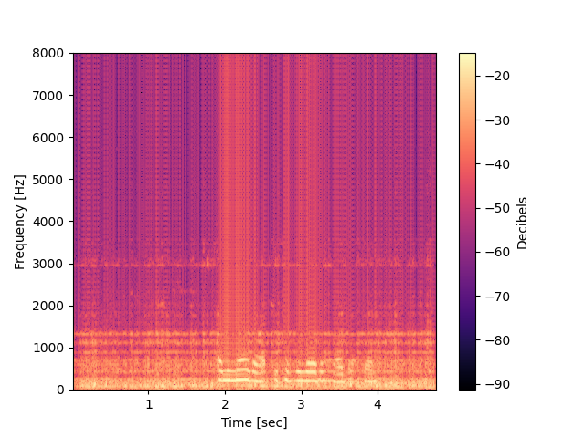
Exact noise
Pure speech
GAN noise
“And we know that because we know the hairdresser”

Slide 14
Classifier (CNN) as a helper
Convolutional neural network
Usually used for image classification
Therefore we can insert spectrograms
SNR levels considered as clean speech (9dB, 6dB, 3dB, 0dB)
SNR levels considered noisy speech (-9dB, -6dB, -3dB)

Slide 15
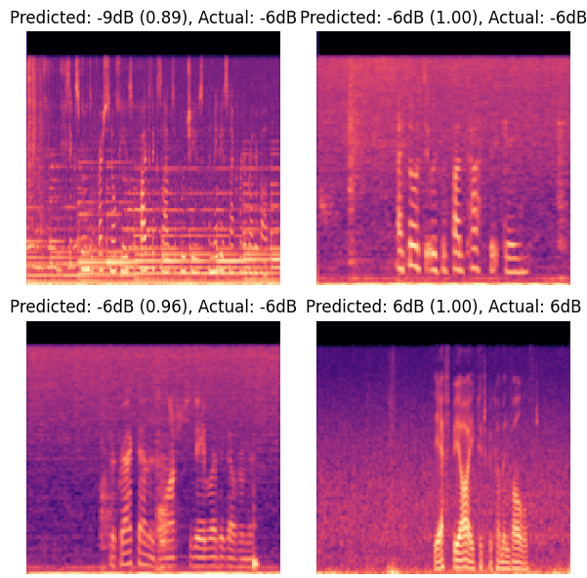
Example outputs
Currently has 91% accuracy

Slide 16
To summarize
Proposed iterative approach could introduce distortions.
We developed a predictive approach, results look promising.
We hope that this contributes to this field of research.
Next steps are to compare the performance compared to other machine learning and statistical model.

Slide 17
Parameters
For reconstructability we present the following parameters:
WAV files are downsampled to 16Khz
Anti-aliasing filter: Recursive (IIR) butterworth low-pass filter
Bit-depth = 16
Codec = PCM 16
Window size: 512 (32ms)
Hopsize/overlapping samples = 128/384 (75% overlap)
NFFT :1024
Zero-padding
Window type: Hann/Hanning
Reconstruction method: Overlap-add (75% overlap)

Slide 18
End of presentation

