Slide 1
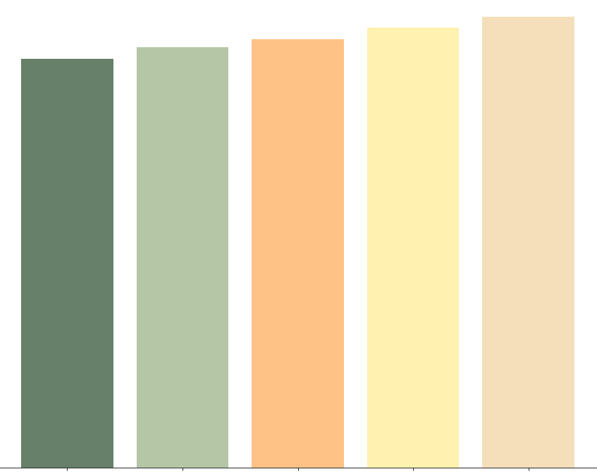
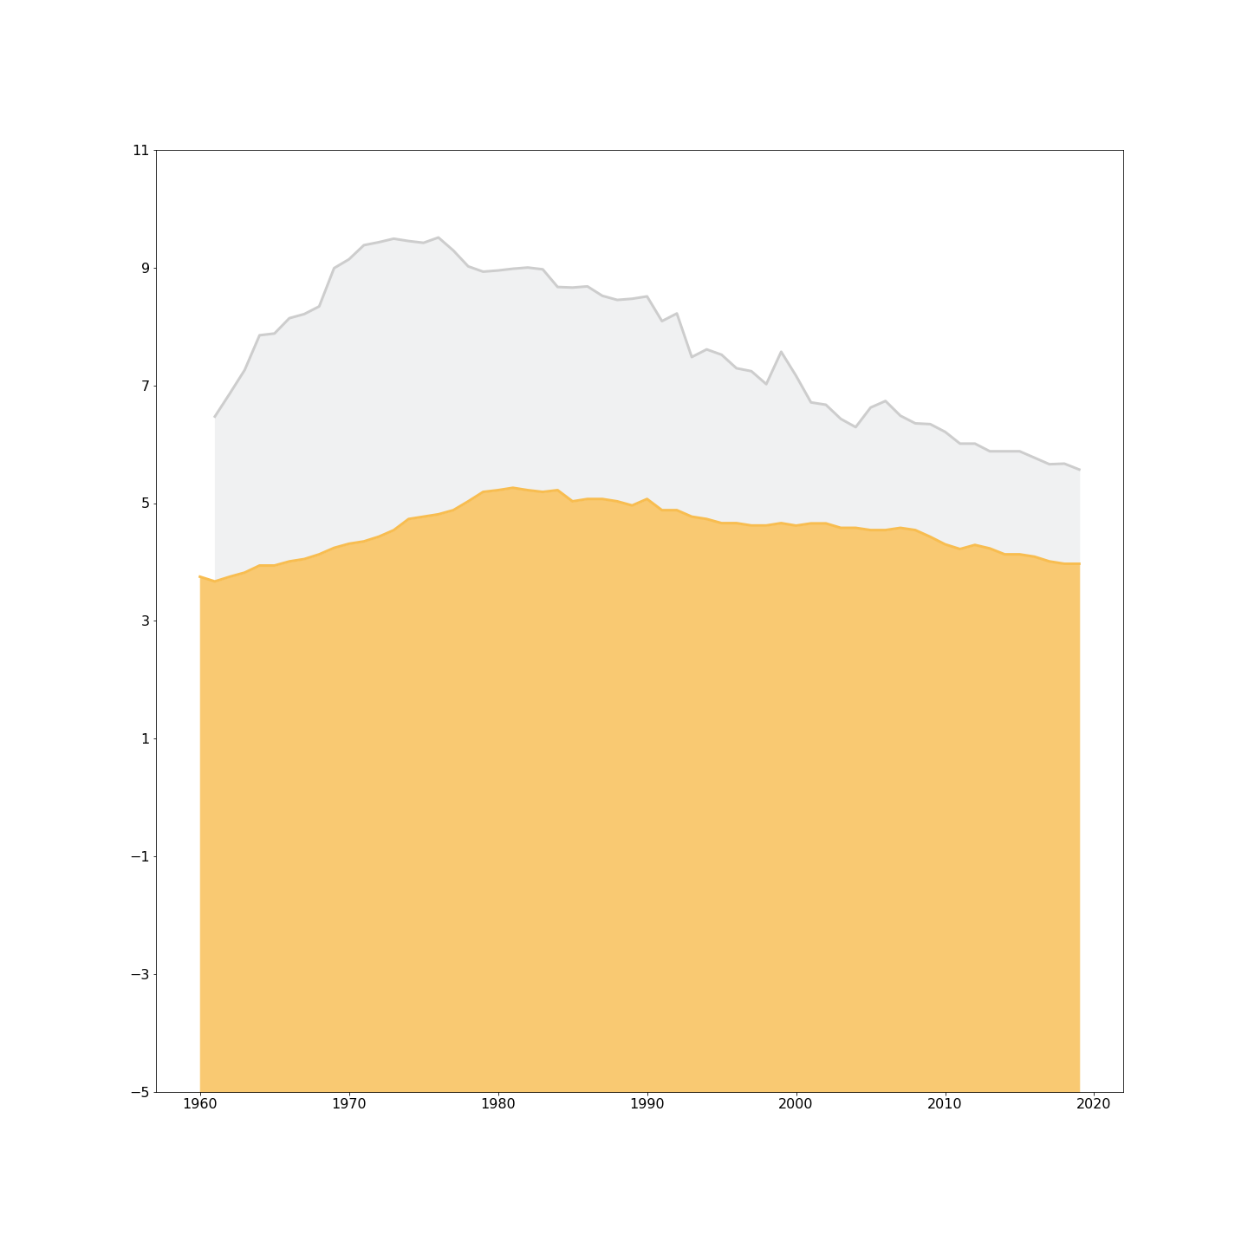
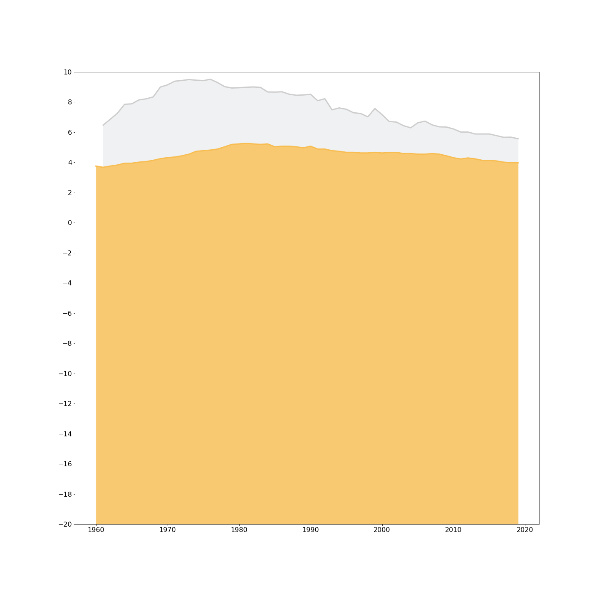
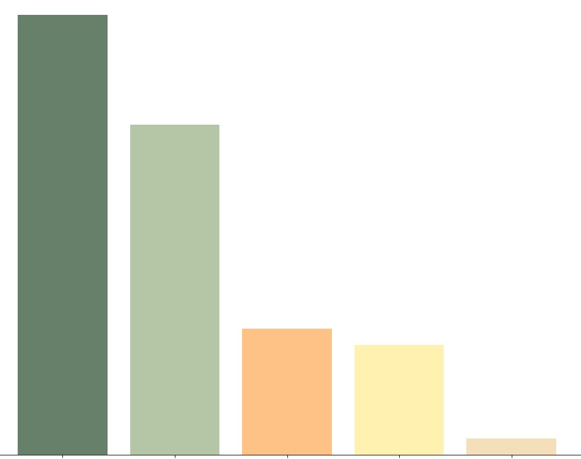
Global Annual Beer Consumption
Average annual per capita beer consumption, measured in liters of pure alcohol.
Top 5
1970
1990
2010
GERMANY
9.51
1960
1980
2000
2020
Liters per Person per Year
Countries with the highest peak beer consumption in the past 60 years.
9.25
UNITED STATES
9.51
9.70
9.96
10.21
5.26
Liters per Person per Year
Belgium
Germany
Australia
Ireland
Eswatini
Bottom 5
The global beer consumption rate has been decreasing in nearly all countries for the past few decades.
Countries with predominant religious views opposing alcohol naturally have the lowest consumption rates
Despite this decrease, the popularity of independent craft, brewing is on the rise in the United States.
0.040
0.030
0.011
0.010
0.001
Mauritania
Somalia
Afghanistan
Pakistan
Bangladesh
Source: WHO Global Health Observatory

