Slide 1

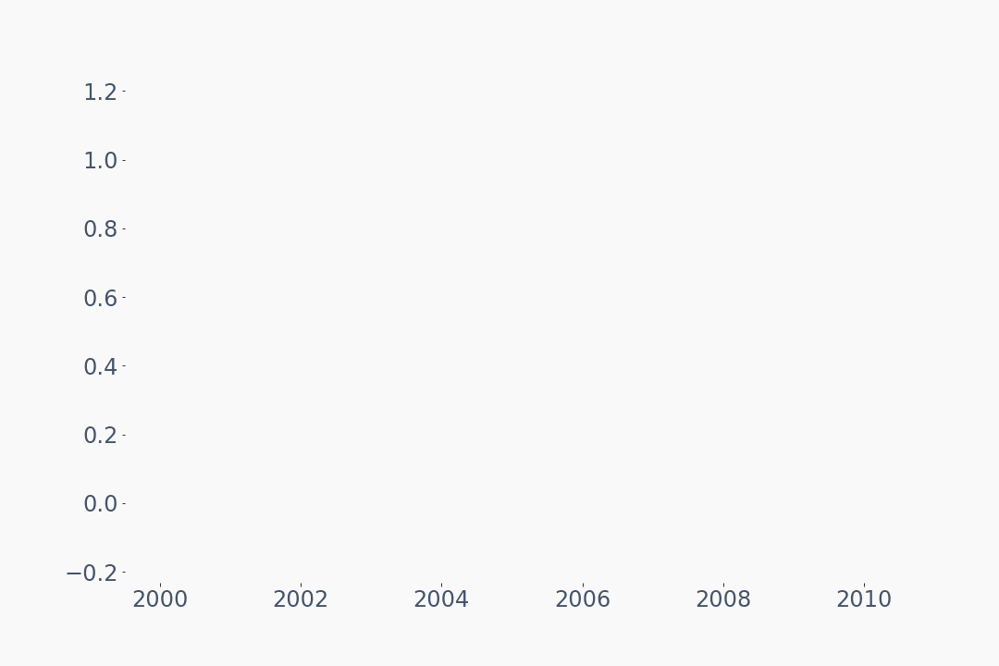

Which Generation Owns the Most Wealth?
United States – From 1989 to 2021
Baby Boomers
$71.6T
1946-
1964
Generation X
Trillion $
$42.3T
1965-
1980
Silent Generation
$27.1T
1928-
1945
Millennials
Percentage of Wealth Owned
$9.1T
1981-
1996
47.7%
28.2%
18.1%
6.1%
$9.1T
Millennials are 65% more poor than their parents were at their age.
Boomer
Gen X
Silent
Millennial
Source: Federal Reserve - Distribution of Household Wealth in the U.S. since 1989

