Slide 1
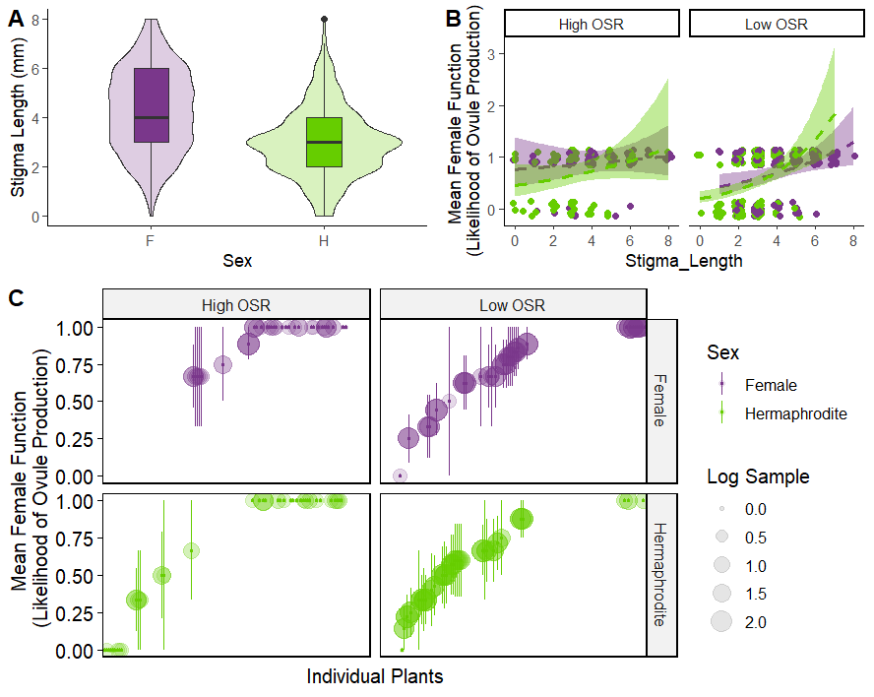
1 Sterile Plant (2 flowers)
10 Functionally Male Plants (13 flowers)
1 Functionally Male Plant (1 flower)

Slide 2
