Slide 1
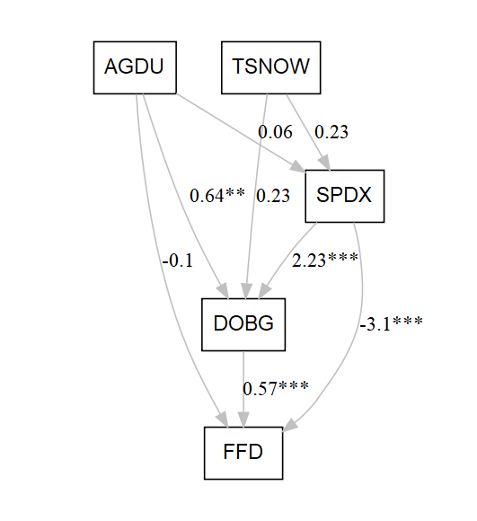
Amorpha canescens

Slide 2
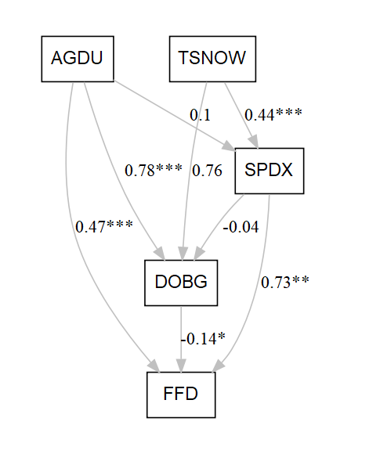
Caltha palustris

Slide 3
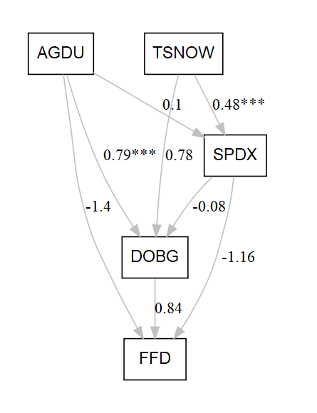
Campanula rotundifolia

Slide 4

Lithospermum canescens

Slide 5
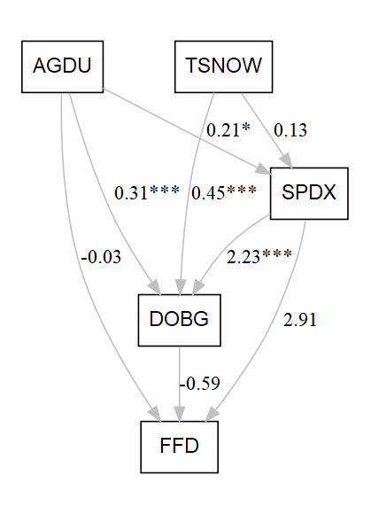
Oenothera nuttallii

Slide 6
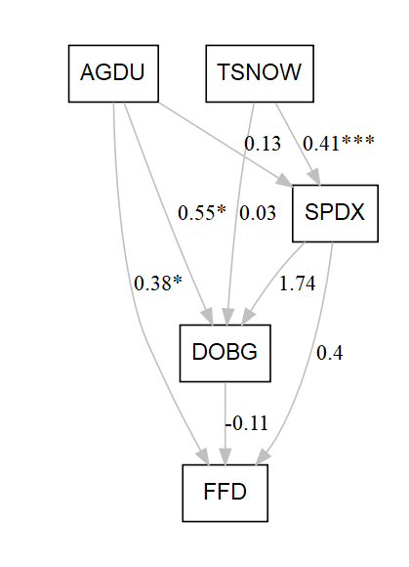
Oxalis violacea

Slide 7
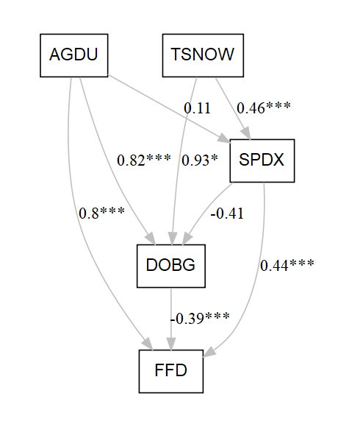
Penstemon gracilis

Slide 8

Penstemon grandiflorus

Slide 9
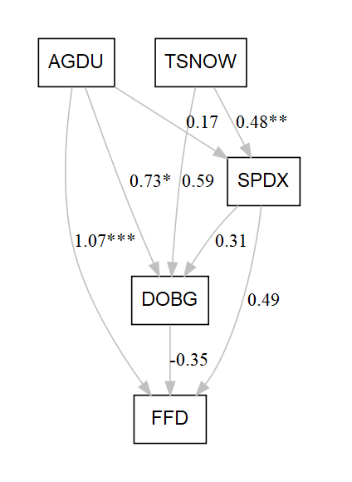
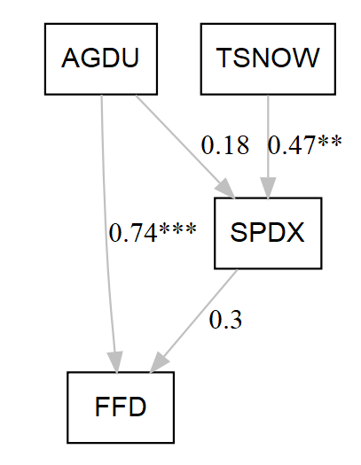
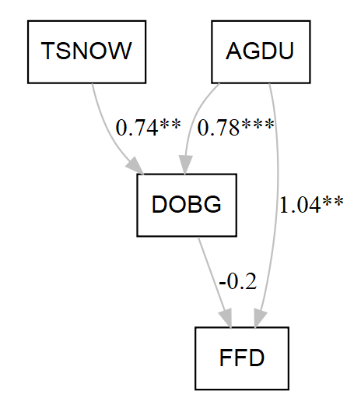
Ranunculus rhomboideus

Slide 10

Zizia aurea

Slide 11
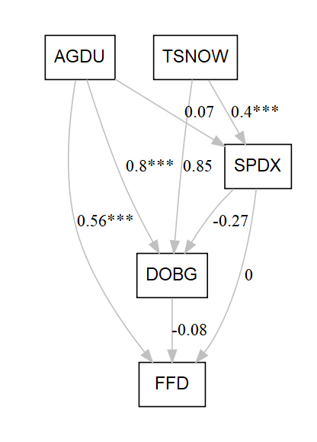
Anemone canadensis

Slide 12

Anemone patens

Slide 13
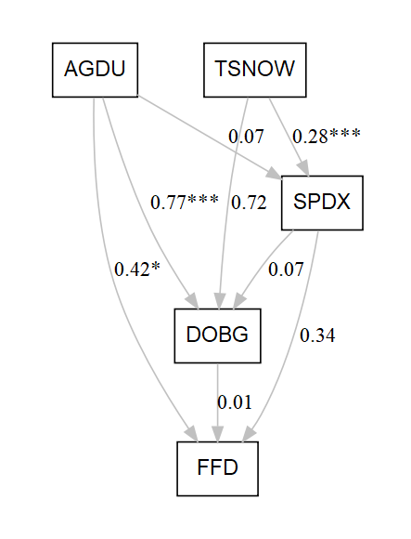
Cerastium arvense

Slide 14
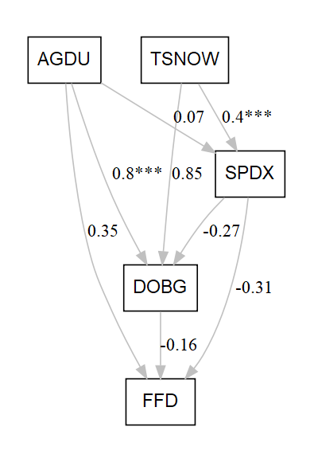
Cypripedium candidum

Slide 15
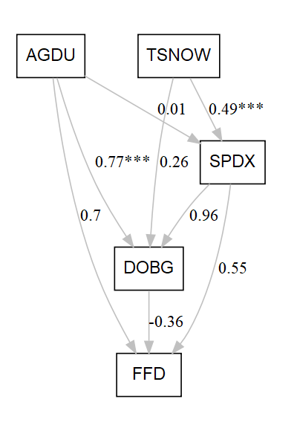
Oxytropis lambertii

Slide 16
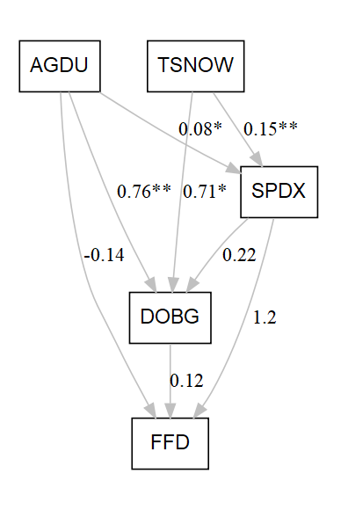
Pedicularis canadensis

Slide 17

Rosa arkansana

Slide 18

Sisyrinchium angustifolium

Slide 19
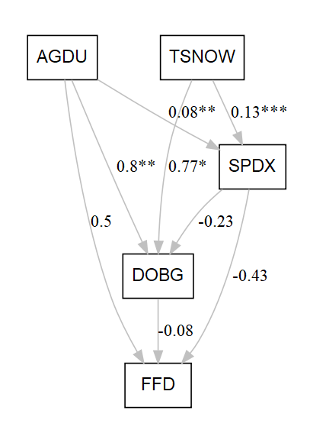
Vicia americana

Slide 20
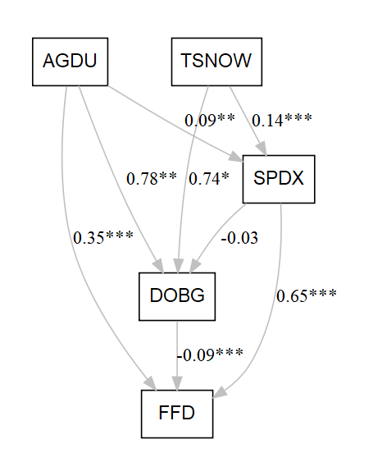
Zigadenus elegans

