Slide 1
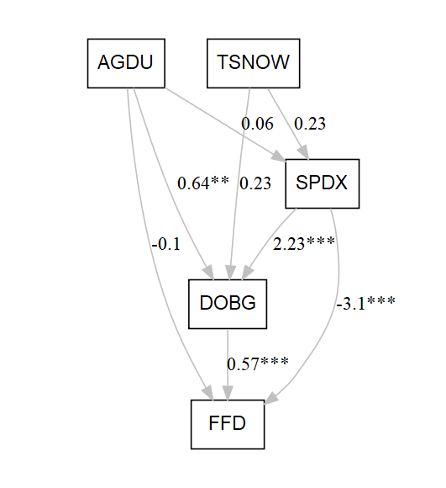
Amorpha canescens

Slide 2
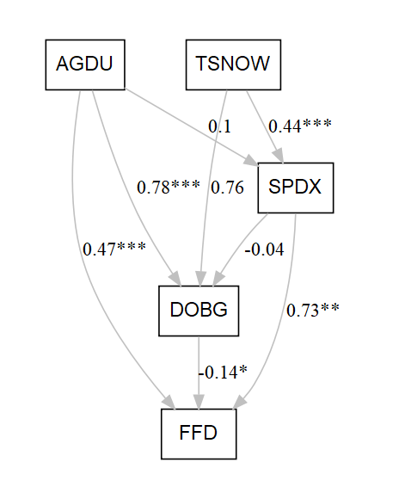
Caltha palustris

Slide 3
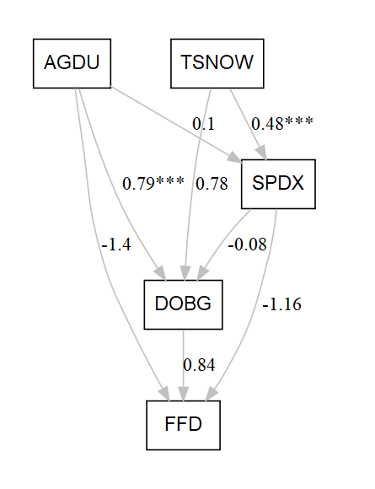
Campanula rotundifolia

Slide 4

Lithospermum canescens

Slide 5
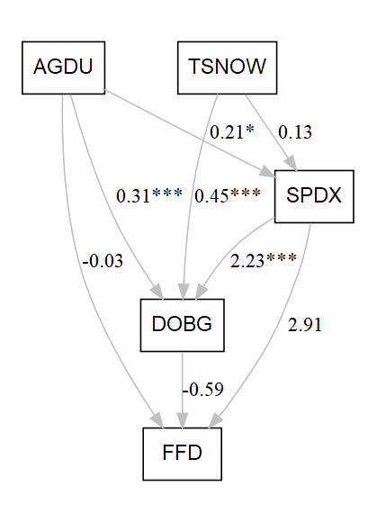
Oenothera nuttallii

Slide 6
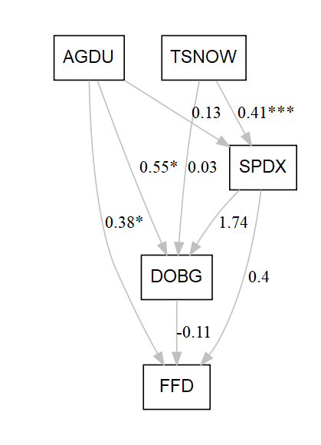
Oxalis violacea

Slide 7
Penstemon gracilis

Slide 8

Penstemon grandiflorus

Slide 9
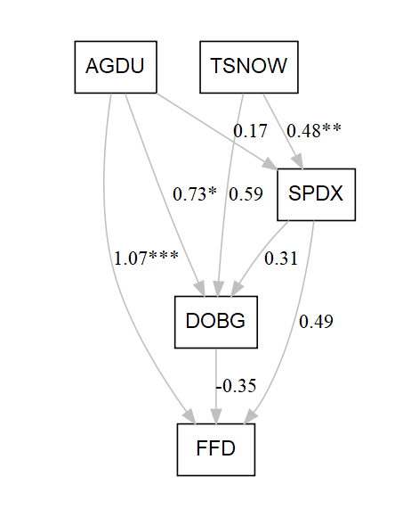
Ranunculus rhomboideus

Slide 10

Zizia aurea

