Slide 1
Liberal + Conservative Speech
Elaine Chang

Slide 2
What am I doing?
The Data
Transcripts of sessions from the House of Representatives
The Question
Can we correctly identify whether the speaker is conservative or liberal?
A Caveat
…assuming the speakers is extremely conservative or liberal.

Slide 3
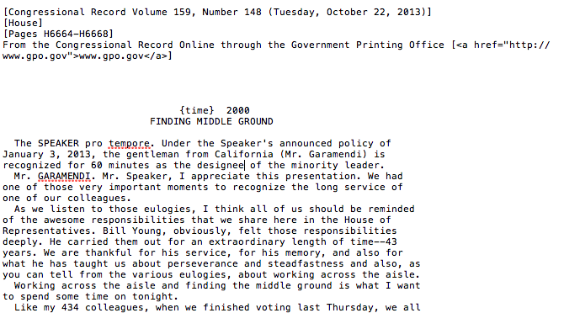
This is what an entry looks like:

Slide 4
Data in Aggregate
Total number of words: ~72k
Conservative: 48%
Liberals: 52%
Lexical diversity:
Conservatives: 14%
Liberals: 15%
Length of average speech:
Conservatives: 498 words
Liberals: 215 words
What this translates to, is greater number of shorter files for liberals. So ~70% of my documents were liberal.

Slide 5
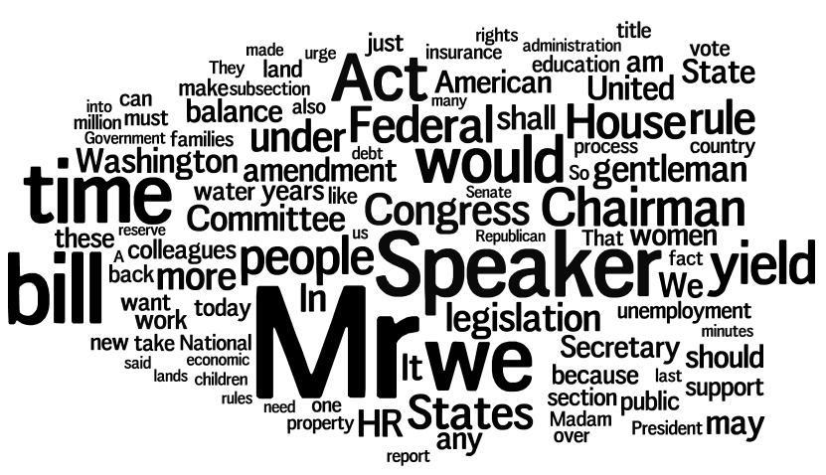
Common Liberal Words

Slide 6
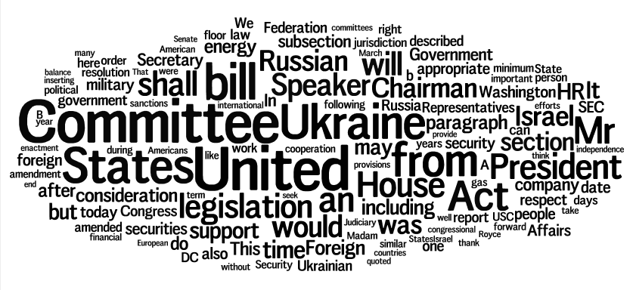
Common Conservative Words

Slide 7
Methodology
Got the data with congressional-record script
Parsed raw text transcripts to get a corpus of speeches by speaker
Kept only speakers who were characterized as very liberal or very conservative
Features were: uni- and bigrams, counts and TF-IDF vectorization

Slide 8
Trial 1: Suspiciously Accurate
Multinomial Naïve Bayes, balanced word count, imbalanced file number
Training score: 96% / Test score: 97%
 | Precision | Recall | F1
Liberal | 1.00 | 0.86 | 0.93
Conservative | 0.96 | 1.00 | 0.98
Avg | 0.97 | 0.97 | 0.97

Slide 9
Trial 2: Removed State Data
Multinomial Naïve Bayes, balanced word count, imbalanced file number
Training score: 95.2% / Test score: 85.2%
 | Precision | Recall | F1
Liberal | 1.00 | 0.38 | 0.56
Conservative | 0.84 | 1.00 | 0.91
Avg | 0.88 | 0.85 | 0.83

Slide 10
Trial 3: Balanced File Number
Multinomial Naïve Bayes, state data removed, balanced file number
Training score: 96% / Test score: 86%
 | Precision | Recall | F1
Liberal | 0.77 | 0.83 | 0.80
Conservative | 0.91 | 0.88 | 0.89
Avg | 0.87 | 0.86 | 0.86

Slide 11
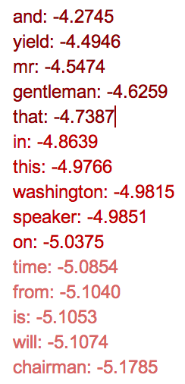
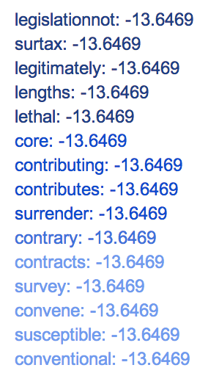

Slide 12
Trial 4: Support Vector Machine
Linear Support Vector, loss=hinge loss, state data removed, balanced file number
Training score: 99.2% / Test score: 83%
 | Precision | Recall | F1
Liberal | 0.71 | 0.83 | 0.77
Conservative | 0.91 | 0.83 | 0.87
Avg | 0.84 | 0.83 | 0.84

Slide 13
Future Directions
Pulling by topic, especially about polarizing ones like birth control
Predictions across time. For instance, training on the first session of 113th Congress and testing on second session.
Use more data!!

