Slide 1
A Domain-Specific Language for Market Monitoring: From Domain Logic to SAS Code
SEASUG 2026; Malvern, PA
Eric C. Grasby, MSIQ
October 22-24, 2026
Notes:
A little about me:
Eric Grasby
I’m a doctoral candidate, UA Little Rock, where I have been a student in the School of Computer and Information Science since 2014 (undergrad)
Currently working on a dissertation that investigates using domain-specific language design in energy markets (specifically in monitoring energy markets – related work)
I do work full-time at SPP, a not-for-profit organization that manages “traffic’ on the bulk electric system for the central corridor of the United States

Slide 2






Thank you: Co-Authors!
Dr. Maria Gingras
Dr. Daniel Berleant
Notes:
Really quickly, before we dive in, I would like to give a “shout out” and thank you to my co-authors on this paper (as well as my dissertation committee).
Dr. Maria Gingras and Dr. Daniel Berleant were instrumental in advising the scope of this paper and in reviewing the content prior to submission. I’m thankful to both of them, and their online profiles can be found via the QR codes that you see here.
This slide is available at the end of this presentation. This slide deck is also available on the Whova conference system (attached to this session).

Slide 3
Problem Landscape
Notes:
Since this is a multiple cross-disciplinary subject, I do want to clarify a few things before we get into the focus of this paper. The title is a pretty good place for us to start.

Slide 4
Unpacking the Title
1
A Domain-Specific Computer Language for Market Monitoring: From Domain Logic to SAS Code
2
3
Notes:
There is a lot that is “compressed” into the title of this paper. I think that there are three (3) areas that are worth calling out and taking a moment to speak about:
DSLs
Market Monitoring (what is that?)
How SAS fits into all of this (after all, that’s why we submitted this paper to this conference)
I know that these 3 things might seem wholly unrelated, but let’s delve into each of these a little bit and the connection will hopefully become more clear.

Slide 5









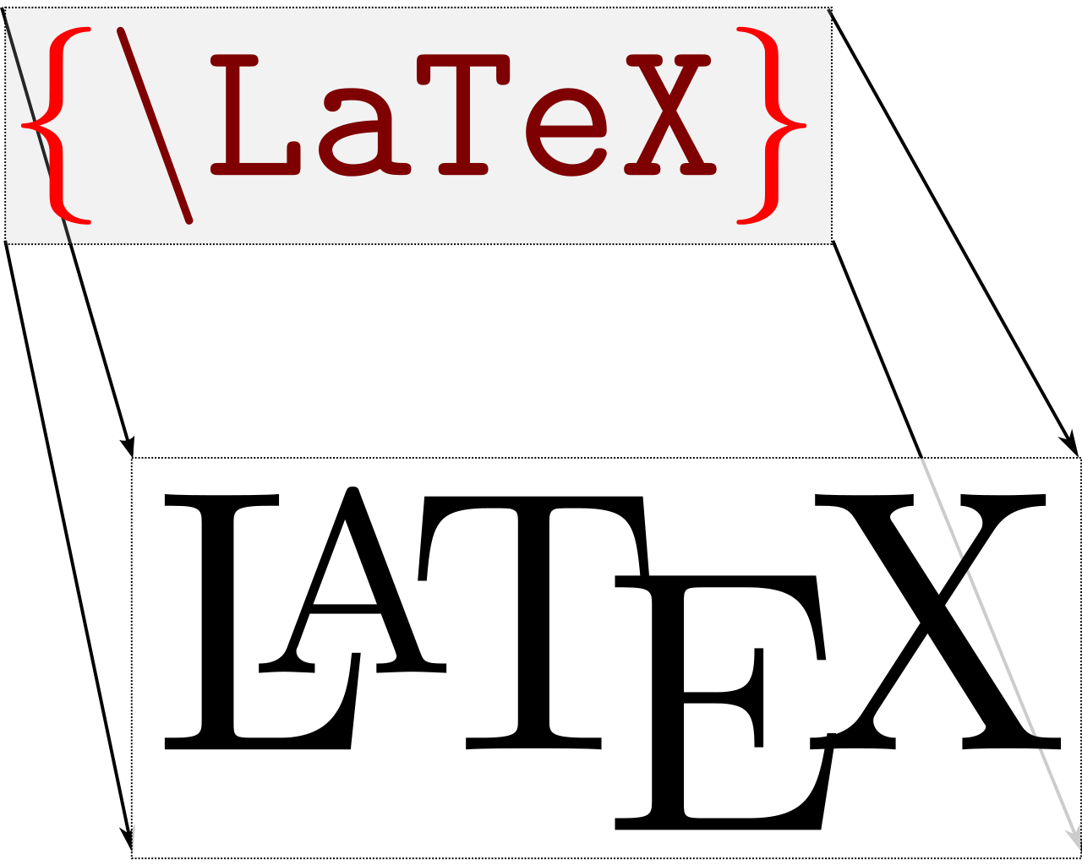



Domain-Specific Languages
A class of programming languages that are distinct from general purpose programming languages (GPLs). Domain-specific languages (DSLs) are programming languages that are:
Narrow in scope
High-level (abstract)
Typically intended for non-developers
(Basically anything)QL
DSLs
?
GPLs
Notes:
Plainly put, a GPL is intended to be general – a language that can be used to develop any kind of software. A DSL is specific, one that is designed to accomplish a set number of tasks within a particular problem domain.

Slide 6

Market Monitoring
Oversight organizations that provide market surveillance and policy analysis services to ensure that organized, wholesale, electric markets remain fair and competitive
Required for all organized electric markets within the United States¹, but also exist outside of the US (APAC, EMEA, etc.)
In the US, market monitors fall under the jurisdiction of the Federal Energy Regulatory Commission (FERC)
The downfall of Enron Corporation brought the need for market monitoring into the public eye
¹https://www.ecfr.gov/current/title-18/chapter-I/subchapter-A/part-1c
Notes:
So what is market monitoring? A discipline that blends forensics and economics to help ensure that these markets are not gamed nor manipulated by unscrupulous participants

Slide 7

So What is a Wholesale Electricity Market?
A highly connected system that optimizes the price of bulk electricity subject to system constraints. Wholesale electricity prices, in the US, are both marginal and location-dependent (spatial).
100 MW @ $10/MW
280 MW Load
Market System
150 MW @ $20/MW
30 MW @ $25/MW
The offers are “stacked” from least → most expensive until the gen/load is balanced
100 MW + 150 MW + 30 MW = 280 MW
Locational Marginal Price (LMP), for this market interval, is set at $25/MW
Notes:
There is a ton of extant research on electricity markets and price formation. This is just intended to help folks understand a sliver of what an electricity market handles so that you understand how complex the data can be.

Slide 8
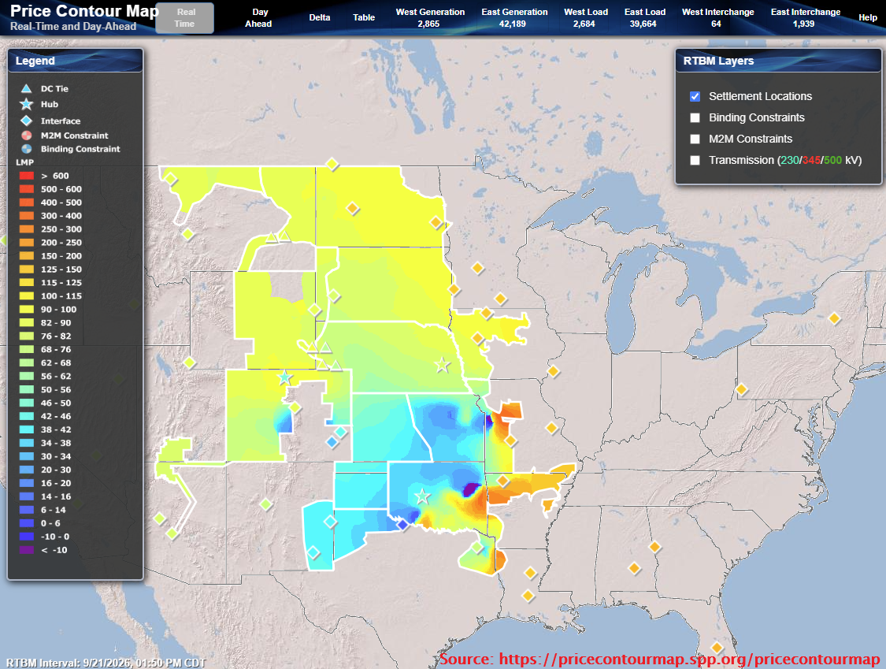
SPP Market Territory
The marginal pricing example from earlier is set at hundreds of different pricing nodes (“PNodes”) in the SPP footprint.
Prices approximated as color gradients where:
Low prices are purple
High prices are red
Under FERC Order 831:
All energy offers are competitive up to $1000/MW.
Any energy offer > $1000/MW is mitigated to cost.
Marginal price shall not exceed $2000/MW
Source: https://pricecontourmap.spp.org/pricecontourmap
Notes:
Here is a map that better visualizes marginal/nodal pricing, using the SPP Market Territory.

Slide 9
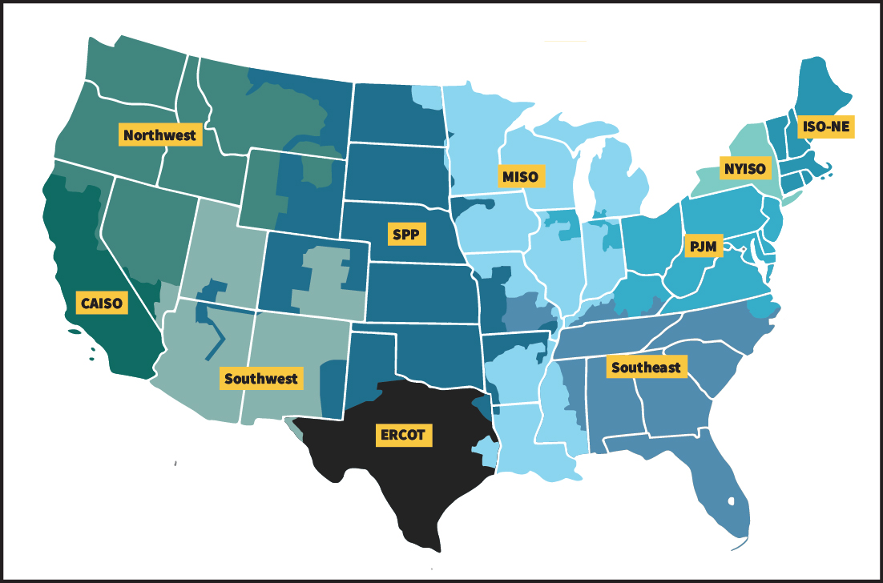
Wholesale Electric Markets in the United States
Source: https://www.ferc.gov/electric-power-markets/
Notes:
Overview map of the FERC jurisdictional electric market territories. There are a few caveats here, the most glaring of which is the “black ink” covering ERCOT, the wholesale electric market for Texas. ERCOT is separate from FERC’s jurisdiction (you’ll recall the 2021 Winter Storm “Uri”). Additionally, the Northwest, Southwest, and Southeast territories are not necessarily governed by RTO/ISO organizations (for example, the Tennessee Valley Authority – TVA, coordinates traffic for part of Tennessee/Appalachia).

Slide 10
Proposed Solution
Notes:
So now that you have the background of the problem domain, let’s talk about what I’m interested in doing about it!

Slide 11
How is SAS involved?
SAS is heavily used in market monitoring
  Somewhere between a DSL and GPL (depending on your perspective)
  Excellent for data processing, but what if you’re not a developer?
New analysts and/or engineers may:
  Inherit old SAS code
  Struggle with the complexity of electricity market data
  “Recreate the wheel”
This is already quite complex … how do you simplify it?
Notes:
Why are you using SAS to manage the complexity?

Slide 12
MLang: Bring the logic closer to the analysts!
What if we used the DSL approach?
Instead of starting with SAS – let’s end with SAS
Express market monitoring tasks in a bespoke programming language
Transpile this new language into valid SAS code
Encapsulate the complex tasks as either SAS Macros, DATA step programs, or custom functions
Let the transpiler determine which “chunk” of code to call
Custom validations and warnings
Alert the user about potential issues prior to runtime
Notes:
This is the heart of the presentation - Monitor Language (“MLang”) is an emerging DSL to bring the logic performed by market monitors closer to the analysts.

Slide 13
Speaking Plainly
Electric markets need to be constantly monitored
The data involved is complex and ever-changing
Monitors wear many hats
Is the solution to require market monitors to also be programmers? No.
Make the programming more accessible to them? Yes!
“The goal is to empower the users to do meaningful work”
Notes:
A quick “checkpoint” summary of what all is being discussed here, because there is a lot going on in this presentation.

Slide 14
Study Design
Notes:
How was it designed? Let’s talk a little bit about the requirements modeling.

Slide 15
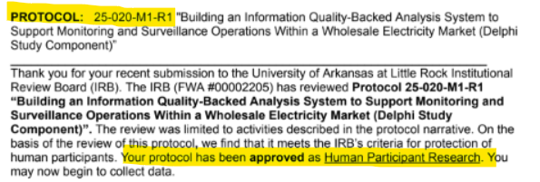
Where to Begin?
Who would best know what a system to aid market monitors should look like?
  The monitors themselves!
Contacted the Energy Intermarket Surveillance Group (EISG)
Requested to conduct a research study to understand workflow
Delphi study (expert panel of anonymous participants)
Notes:
Discussion on how the requirements and design of the language came to be. We used a Delphi study that was composed of members of the EISG (a professional, international, conference of market monitors). Their response to the study is what shaped the system requirements. Also, it was a full-fledged research protocol because the UA Little Rock IRB designated this as “Human Participant Research”, so that added a layer of complexity.

Slide 16

Delphi Study
19 members of the EISG opted to participate
2 rounds of survey questions with a mid-round “recap” paper
  Participants responded anonymously to questions and then received summaries
Anonymity helps filter out bias and reduces groupthink
Processed results became software requirements
Notes:
Let’s discuss a little bit about what Delphi studies are and how they relate to this project. You’ll see here at the bottom, I have highlighted 3 very useful questions that were used in the requirements development process.

Slide 17
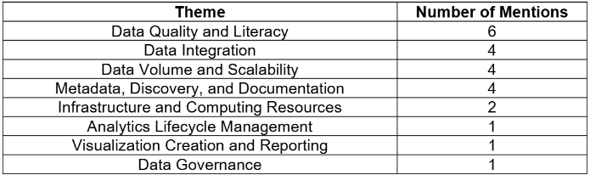
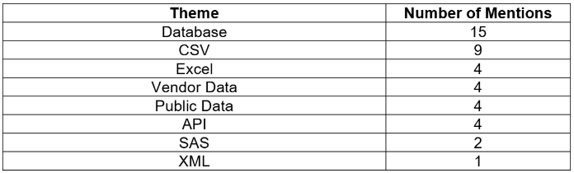
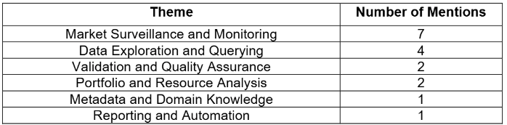
Thematic Coding
Q5
Data Quality Checks
Q7
Import/Export Targets
Q41
Tagging
Notes:
The Delphi results were partially processed (more than just this technique were used) via thematic coding, which is a processing technique that uses human (clerical) review to attach short descriptors to qualitative data. These are used to identify the meaning of a phrase or response. The codes are then grouped according to their frequency and collapsed into “high level” codes that actual requirements are built into.

Slide 18
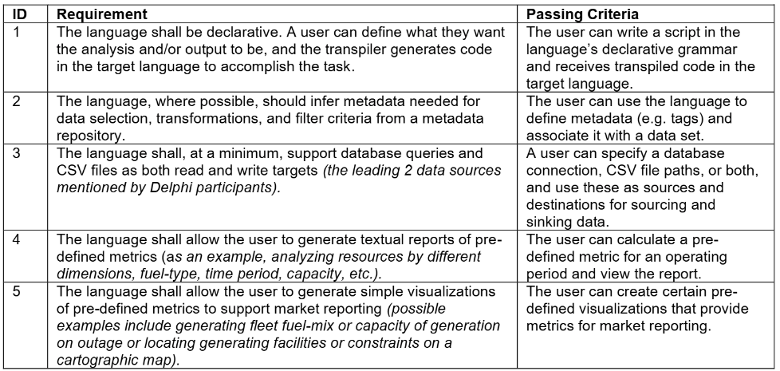
Basic Requirements and Use Cases
Notes:
5 basic requirements that were determined from the processing phase of the Delphi study. While this PoC does not meet every requirement, it does provide a platform on which to build all of this functionality (plus more advanced use cases).

Slide 19
Proof of Concept
Implementation
Notes:
Proof of concept (PoC) implementation slides

Slide 20




Technology Stack
Automates the transpiler process
Produces output logs and *.sas files
Library include
SAS
Builds the MLang parser and syntax trees
User manually uploads and executes code
SAS OnDemand For Academics (SODA)
Notes:
Quick coverage of the technology used in this proof of concept. This is shown in an “exploded” view later in this section.

Slide 21
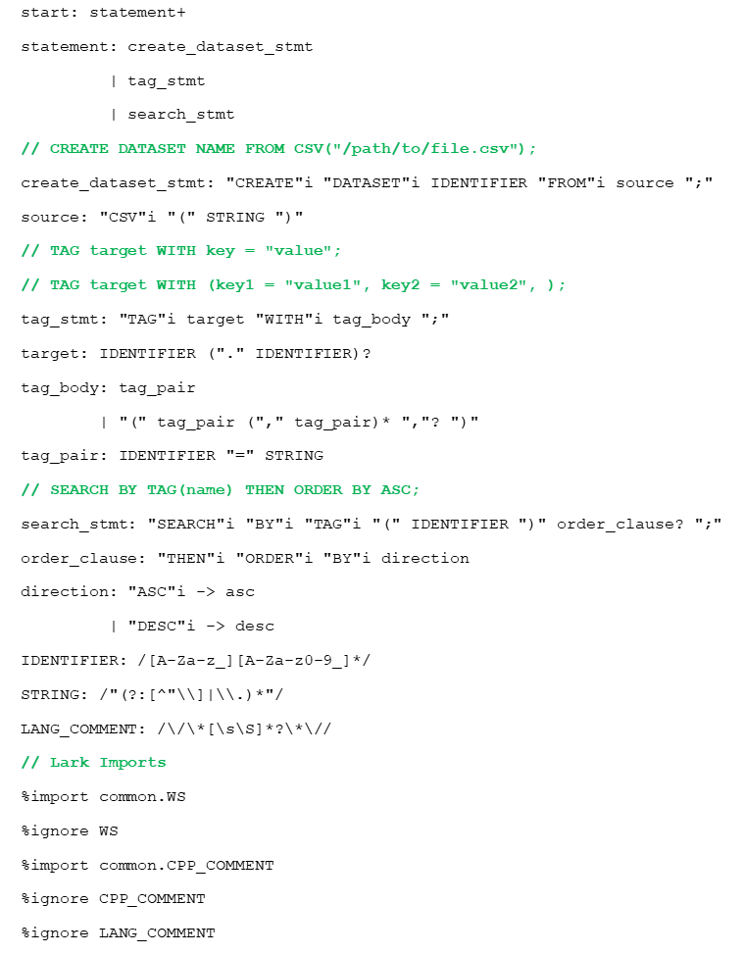
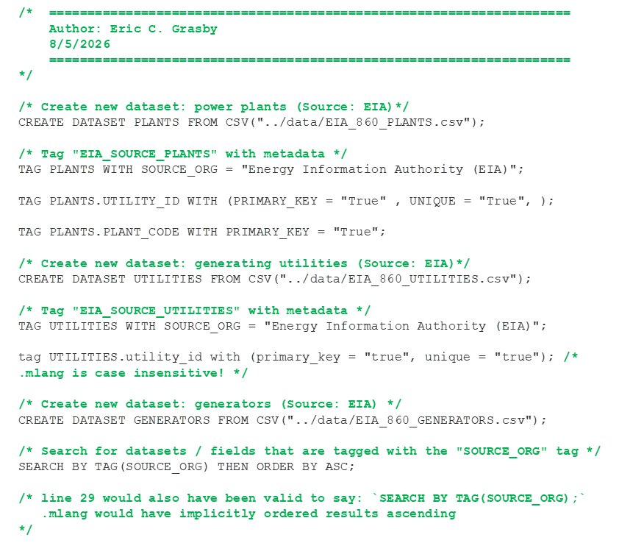
Grammar and MLang Source
Notes:
On the left you’ll see the grammar.lark file that is bundled with the transpiler. Think of this like a set of really specific regex rules that can extract phrases from text with extra metadata. On the right, you’ll see a sample Monitor Language (“MLang”) program. The grammar rules are designed to parse this computer language, specifically. The transpiler takes the parsed code and associated metadata and uses those rules to generate valid SAS code.

Slide 22
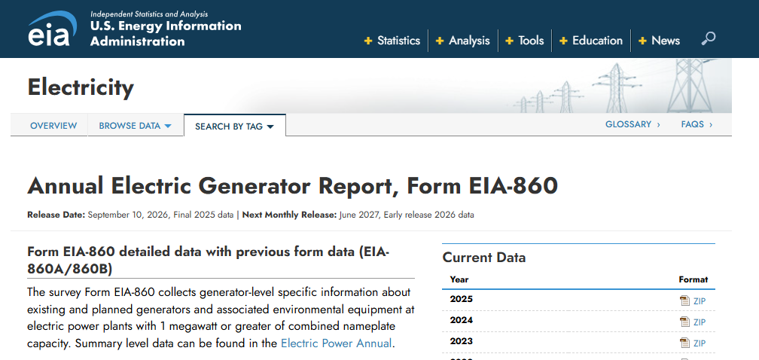
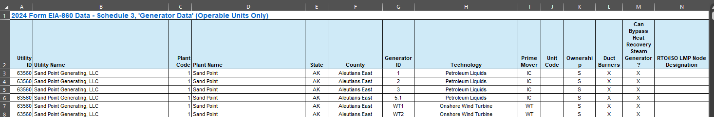
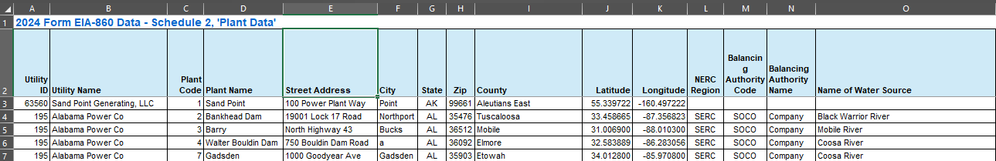
Test Data
https://www.eia.gov/electricity/data/eia860/
EIA Form 860 is a general purpose, publicly available, data set that informs market monitors of generator physical parameters.
The raw data set is messy, non-standardized, and is a good test set to exhibit some of the functionality of MLang.
Notes:
The test data used in this proof of concept is sourced from the Energy Information Authority (EIA), specifically from the annually-updated EIA Form 860 data set.

Slide 23
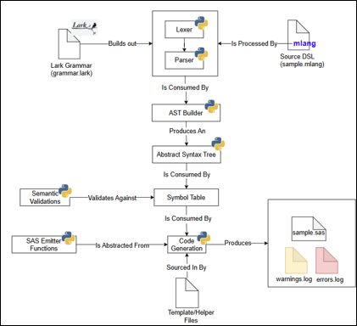
Transpiler
Transpiler (translate + compile) is a source to source compiler program.
High-level lang (A) → Transpile → High-level lang (B)
Igor Khorlo (Syneos Health) has presented on related topics before (SAS Global Forum 2018, 2019):
Automating Migration from the SAS Macro Language to Lua
SASLint: A SAS Program Checker
We are extending this concept, but parsing existing logic and translating it into SAS code.
MLang
Transpiler
Notes:
Transpiler architecture is built in Python and uses Lark to read the MLang grammar.lark file and scaffold an MLang parser. The MLang parser then parses the MLang source code (i.e. sample.mlang) and produces SAS output code

Slide 24
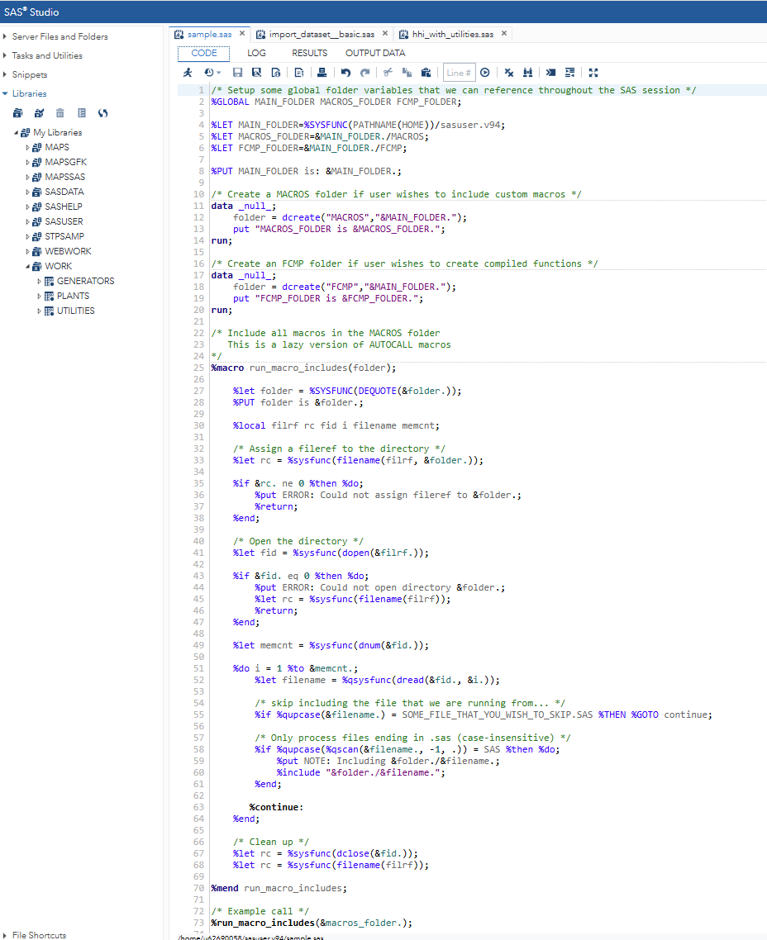
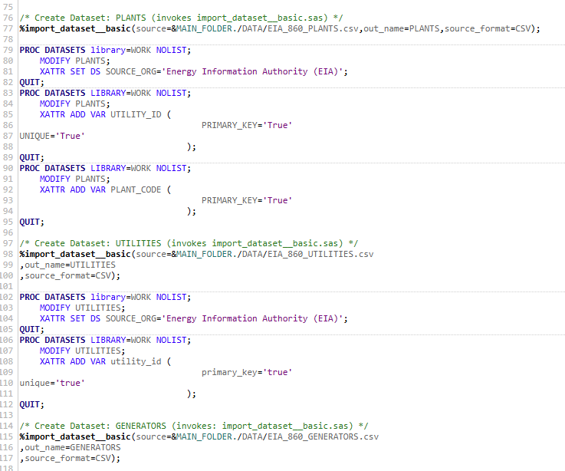
Sample Program Execution
Notes:
Quick example of the “sample.sas” file that was built by the transpiler. You can see that it performed the PROC IMPORT from the import_dataset_basic.sas macro and generated 3 data sets in the WORK library.

Slide 25
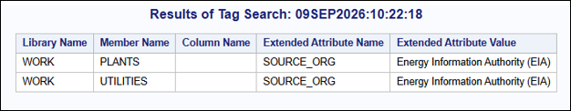
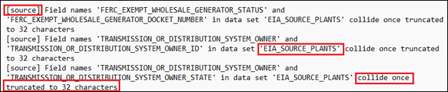
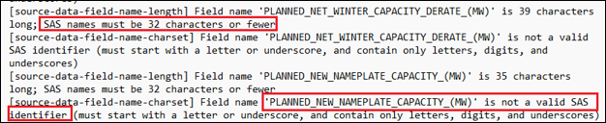
Features
Templated data imports (CSV)
Data tagging (XATTR)
Searching for tags (SASHELP.VXATTR)
Basic data quality checks
  Invalid chars in asset names?
  Asset names > 32 chars?
  Asset name collisions on truncation?
  Asset names shadow existing SAS keywords?
Notes:
Features include: basic data imports from CSV, data tagging using SAS extended attributes (XATTR), and data quality checks upon transpiler invocation

Slide 26
Conclusion and Future Work
Notes:
Alright, let’s start to wrap up with Conclusions and Future Work

Slide 27
Limitations
The POC, currently, supports only a small number of functions
  Data imports
  Basic data quality checks
  Data set and field tagging
  Searching by tags
The transpiler exists entirely as pre-processor directives
  Use of the SAS code requires manual intervention
  No syntax highlighting or LSP support
Must be invoked from a command-line, which isn’t very non-developer friendly
  Run the transpiler program, read the output logs, copy the files, upload them to SODA, etc.
Notes:
The current limitations of MLang and the MLang transpiler

Slide 28
Future Work
Develop support for more varied and complex market monitoring use cases
  Calculating market metrics (e.g. HHI) from language keywords
  Map generation through SGMAP
Including more complex data quality and semantic checks
User experience (UX) support
  Language Server Protocol (LSP)
  Possibly SASLint¹ integration
Automatic execution in a SAS runtime environment
¹ I. Khorlo, https://support.sas.com/resources/papers/proceedings18/2543-2018.pdf
Notes:
Here is what I plan to add to the system next!

Slide 29
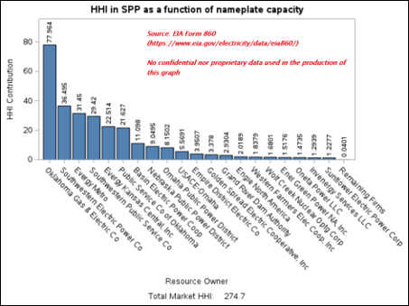

Market Metrics (Development in Progress)
Herfindahl-Hirschman Index (HHI) is a standard measure of market concentration
  Inversely proportional to competitiveness
  HHI < 1000, unconcentrated market
  HHI > 10,000, monopoly
Standard equation, but how you define the inputs to the equation can vary
MLang will be able to compute HHI based upon user-defined input variable
  This example uses “nameplate capacity”
CREATE DATASET NAMEPLATE_HHI FROM HHI(PLANTS, NAMEPLATE_CAP);
CREATE OUTPUT GRAPH NAMEPLATE_HHI_GRAPH FROM NAMEPLATE_HHI WITH PROPERTIES { BAR_COLOR = “BLUE”, … };

Slide 30
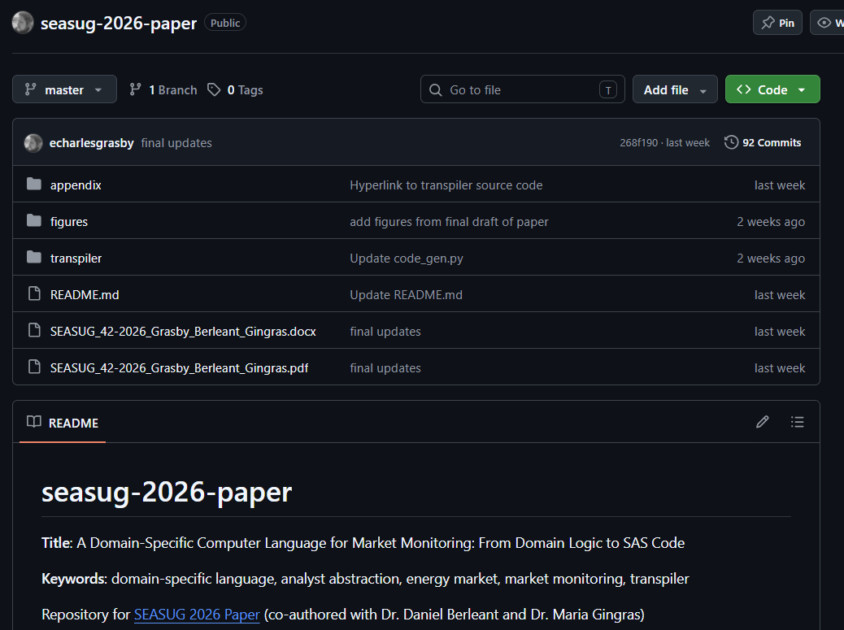
Paper and Source Code Repository
https://github.com/echarlesgrasby/seasug-2026-paper
Notes:
If you wish to view the source code behind this paper, it can be found in the repository linked in this slide, under the “transpiler” directory.

Slide 31

Follow Up Questions?
Feel free to contact the authors:
Eric Grasby, MSIQ (ecgrasby@ualr.edu)
Daniel Berleant, PhD (jdberleant@ualr.edu)
Maria Gingras, PhD (maria@ochotonaanalytics.com)
https://ualr.edu/ | https://spp.org/
Notes:
Any questions? I hope so! If not, please feel free to contact the authors at our respective email addresses.

Slide 32
Thank you: Co-Authors!
Dr. Maria Gingras
Dr. Daniel Berleant
Notes:
In case anyone wants to re-scan these QR codes

