Slide 1
OPPU-RL: LLM Personalization through Reinforcement Learning
Harry Mao

Slide 2
Outline
Background
Dataset
Method
Experiments
Discussion

Slide 3
Outline
Background
Dataset
Method
Experiments
Discussion

Slide 4
Background
Personalization for LLMs based on user’s history
In context learning
Retrieval based
PEFT based – OPPU

Slide 5
Background
OPPU – One Peft Per User
→ Can we utilize Reinforcement Learning?

Slide 6
Outline
Background
Dataset
Method
Experiments
Discussion

Slide 7

Dataset
LaMP – Language Model Personalization
7 Tasks
For each task:
N users
Task Data: {$[(x_{u}^{(i)}$, $y_{u}^{(i)}$), …], …}
User History: {$[(h_{u}^{(i)}$, $o_{u}^{(i)}$), …], …}

Slide 8
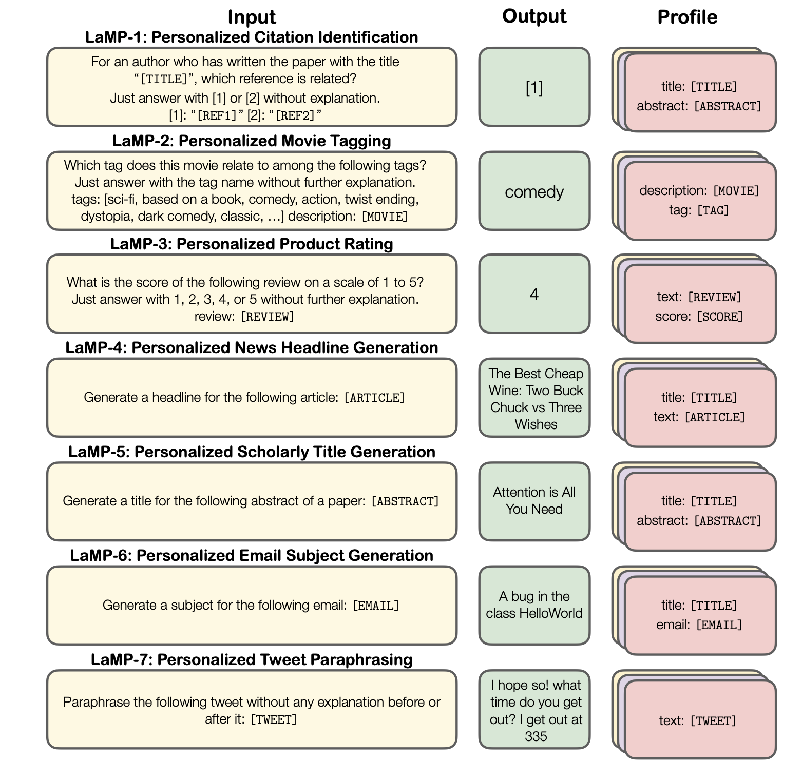
Dataset

Slide 9
Outline
Background
Dataset
Method
Experiments
Discussion

Slide 10



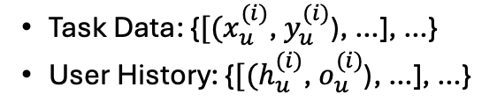
Training Pipeline
Llama-2-7B
User History
x K
SFT-Lora
Task-Lora
SFT
Llama-2-7B
Llama-2-7B
Task Data
Task-Lora
SFT
Llama-2-7B
User History
x K
RFT-Lora
RFT

Slide 11
SFT vs. RFT
Supervise
Sample 1
Compute Reward
Generate
Sample 2
Prompt Logits
Answer Logits
Prompt Logits
Answer
Sample 3
Sample 4
Large Language Model
Large Language Model
Update
Prompt Tokens
Answer Tokens
Prompt Tokens
Supervised Finetuning
Reinforcement Finetuning

Slide 12
Rule-based RL Reward
Categorical: Correctness + Format Penalty + Length Penalty
Numerical: Difference + Format Penalty + Length Penalty
Generative: BertScore + RougeL + Length Penalty

Slide 13
Outline
Background
Dataset
Method
Experiments
Discussion

Slide 14
Metrics
Categorical: Accuracy
Numerical: MAE
Generative: Rouge1, RougeL

Slide 15
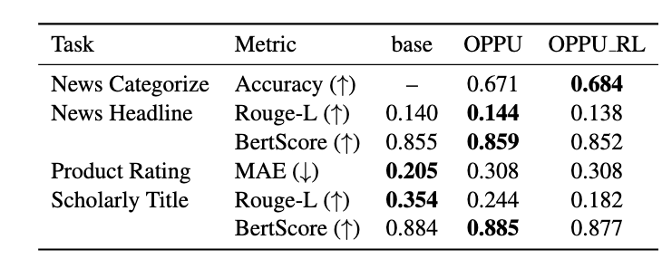
Quantitative Results

Slide 16
Outline
Background
Dataset
Method
Experiments
Discussion

Slide 17
Limitation
Hyperparameter Tuning
Reward Tuning
Model Limitation

Slide 18
Future Work
Use larger model and real-world setting
Use longer trajectory for RL
Combine with RAG
Combine with Per-PCS

