Slide 1
ROSI Rosi Online Scheduler Improved
Lana Borodina
Eric Chen
Benjamin Feder
Paul Floussov
Tyler Haugen-Stanley
Vincent Le
Thomas Robinson

Slide 2
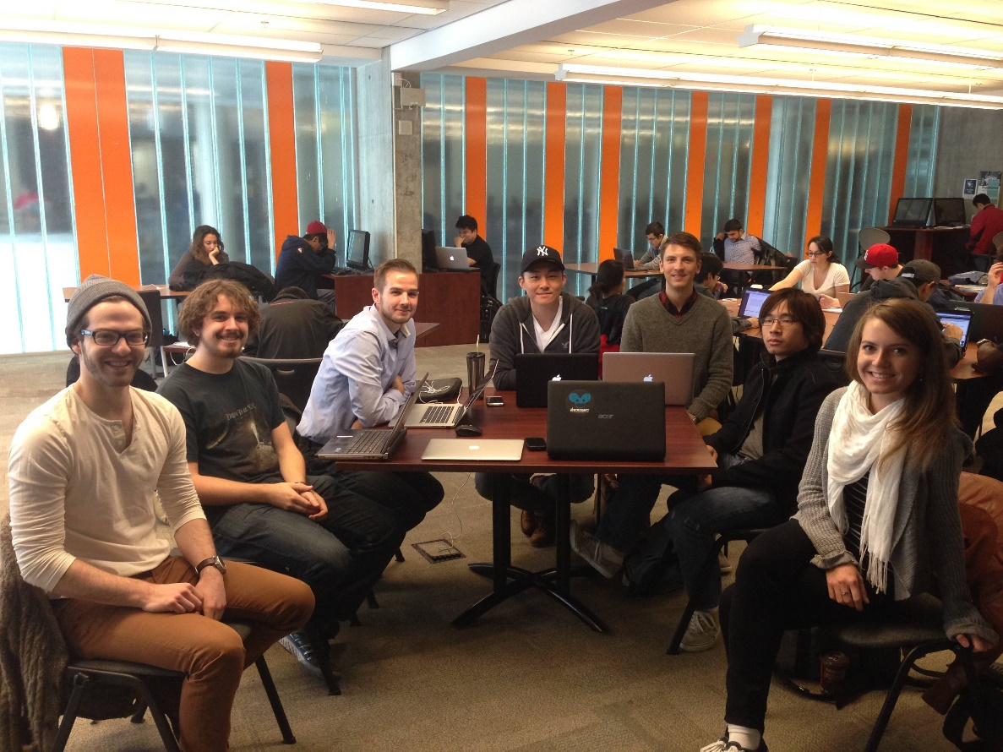
The Team
We are Team 8, from left to right:
Benjamin Feder (3rd year Computer Science Specialist and Mathematics Minor)
Thomas Robinson (3rd year Computer Science Specialist and Mathematics Minor)
Paul Floussov (4th year double major in Computer Science and Economics)
Eric Chen (4th year Computer Science Specialist)
Tyler Haugen-Stanley (4th year Computer Science Specialist)
Vincent Le (4th year double major in Computer Science and Molecular Genetics and Microbiology)
Lana Borodina (4th year Computer Science Specialist)

Slide 3
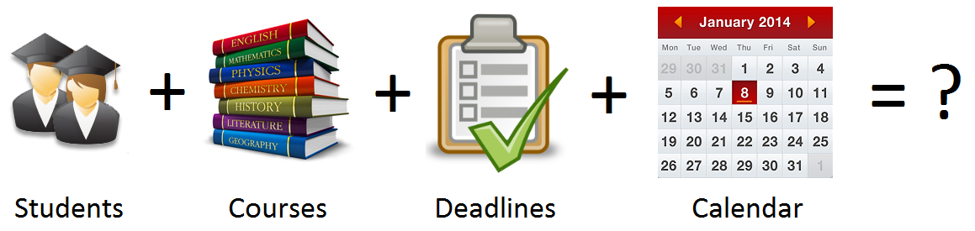
Our Product

Slide 4
ROSI
ROSI Online Scheduler Improved

Slide 5
ROSI: ROSI Online Scheduler Improved
Combines students, courses, deadlines, and a calendar into one comprehensible tool that provides students with better organization and time management
With ROSI, students can:
Add/remove courses to/from their account
Create deadlines for courses
View course information, deadlines, and students enrolled
View courses and deadlines in one integrated calendar
Email individual or all students in a course

Slide 6
What makes our project unique?
Clean, simple, and intuitive design
Calendar view of upcoming events and tasks
Sorted presentation of data
Can add/remove courses to calendar to plan and choose courses to enroll in
Can email individual or all students enrolled in a course
Course due dates are crowd-sourced
System knows course dates, names and times

Slide 7
Software Architecture
Course Scraper
Parses the U of T 2014-2015 Fall-Winter Session Timetable page with all of the course listings
Retrieves information for each course (course code, name, date and time, location, professor/TA)
Stores all of this information in a JSON file
Database Populator
Uses the JSON file populated by the course scraper to store all of the course information in a database
Server
Handles all requests to the database to store and retrieve data

Slide 8
Software Architecture
Manage View Controller
Handles all interactions with the ‘Manage’ page by the user:
Adding/removing a course
Adding/removing a deadline
Displaying of the user’s courses and deadlines
Courses View Controller
Handles all interactions with the ‘Courses’ page by the user:
Displaying all of the user’s courses and course details
Displaying all of the deadlines and students for a given course
Emailing individual or all students of a course
Calendar View Controller
Handles all interactions with the ‘Calendar’ page by the user:
Displaying the user’s calendar by month, week, or day
Displaying the user’s lecture and tutorial sections for each course
Displaying the user’s deadlines

Slide 9
Software Architecture
Technologies and tools we used include:
JavaScript & jQuery
Ajax
JavaScript extensions (fullCalendar)
Python web.py as API
PostgreSQL Database
Heroku Cloud Services

Slide 10
Challenges
Getting the necessary components installed on each team member’s machine to get the environment setup.
Communication challenges and conflicting schedules within the team.
Most people were unfamiliar with web development.
(Re)Learning the APIs, frameworks, libraries, and languages
Merging and integrating code with other team members’ code is always a challenge

Slide 11
Technical Challenges
Major front end redesign and port was especially challenging due to the amount of people working on it simultaneously.
Getting existing current course data to give more to the users so that they don’t have to plug in any data.
Making changes to SQL schema later in the project cause a ripple effect of changes to existing implementation.

Slide 12
DEMO

Slide 13
Questions?

Slide 14
Thank you!

