Slide 1

Biodiversity in National Parks
Emma Cheng

Slide 2

Project Goals
Understand the the biodiversity in national parks through:
Manipulate and calculate the data
Data visualization
Data
observations.csv
species_info.csv
Tool
Jupyter Notebook

Slide 3
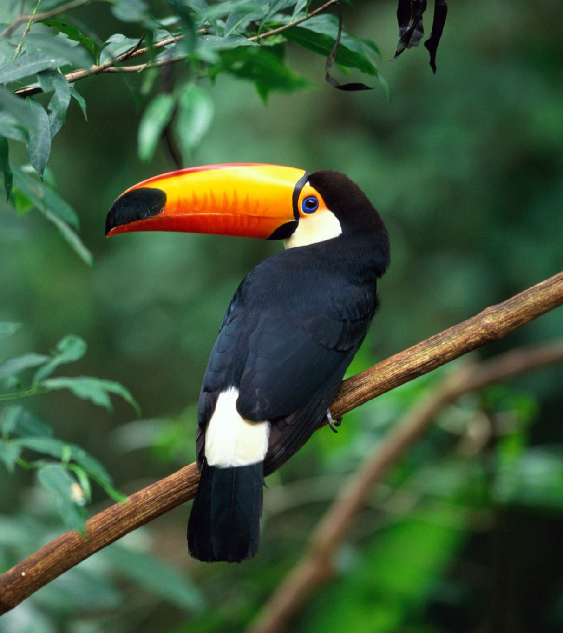
Summary
Vascular plants constitute 77.2% of the total observations; however, they are the least endangered species.
Mammals are at the highest risk, as they suffer the highest proportion of 'endangered' status (1.3%). Fishes rank second with 0.64%.
Birds are of the greatest concern to 12.5% of this category.

Slide 4
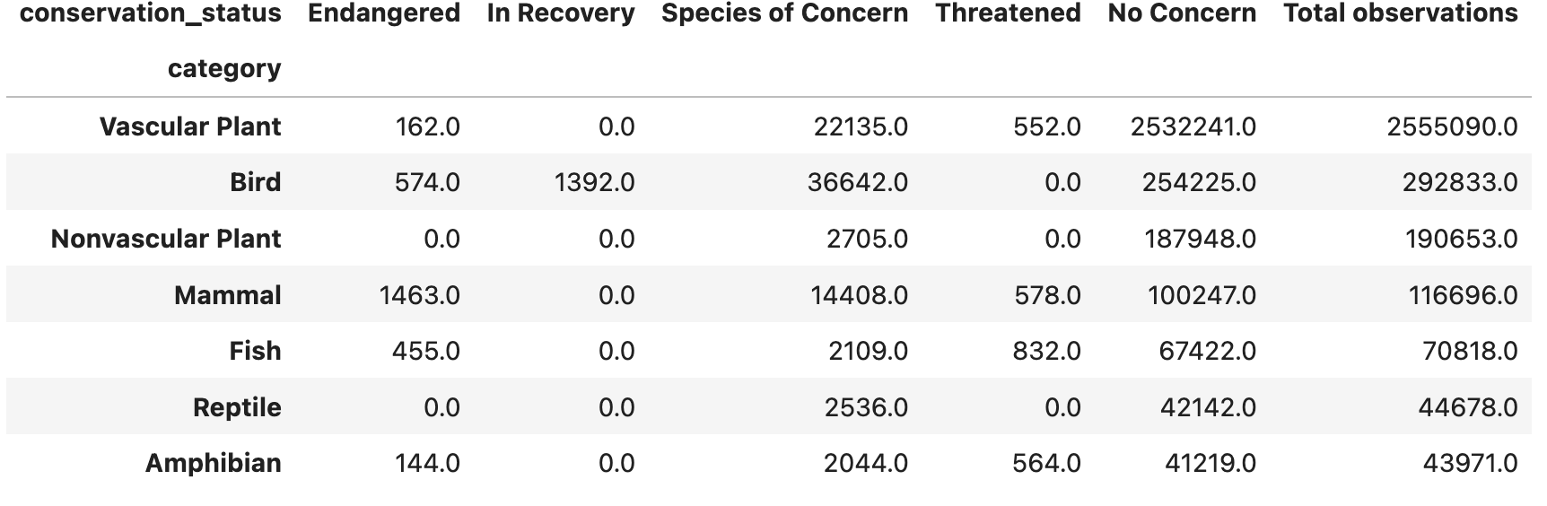
Data
The table below aggregates the observations into a pivot table, with categories of species as the index and conservation statuses as columns.

Slide 5
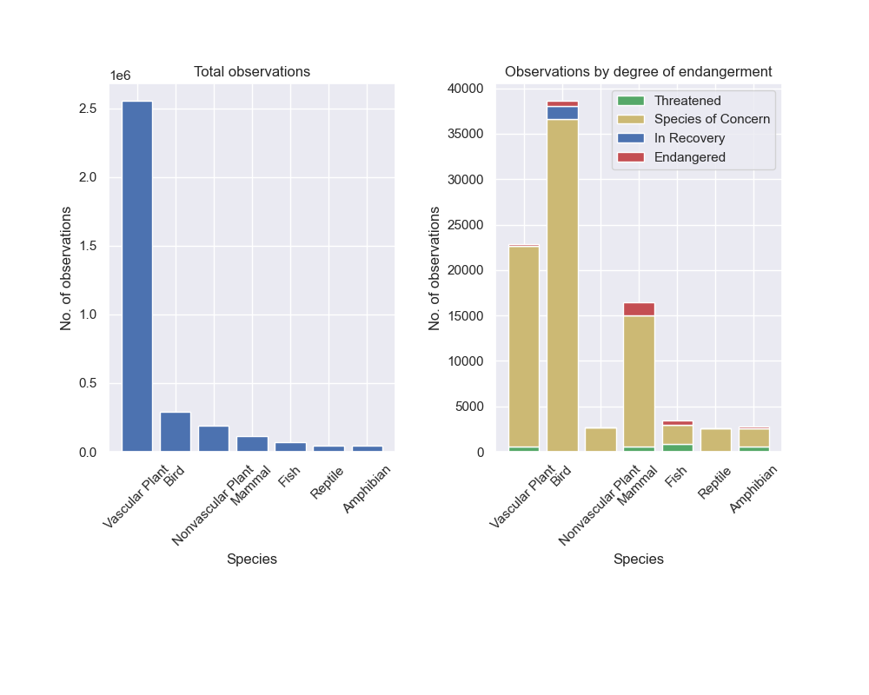
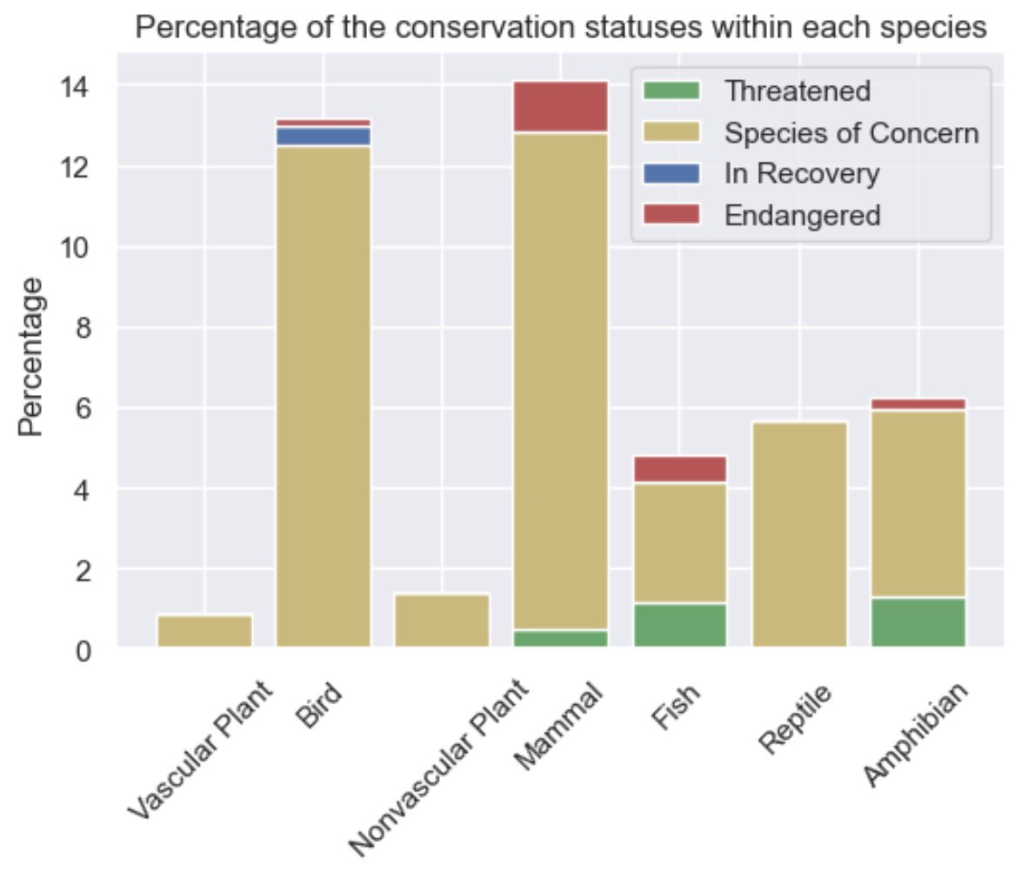
Analysis
Vascular Plants constitutes the largest portion of the total observations, while mammals are at the highest risk of extinction as its highest percentage in conservation statuses, especially ’Endangered’.

Slide 6
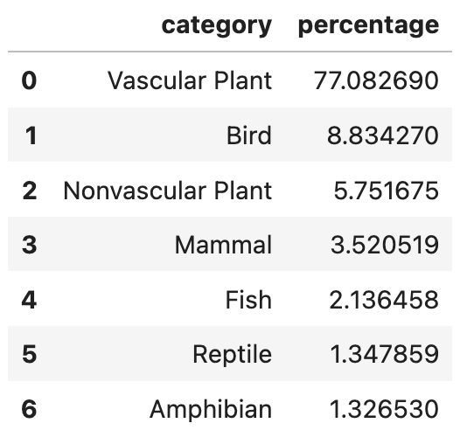
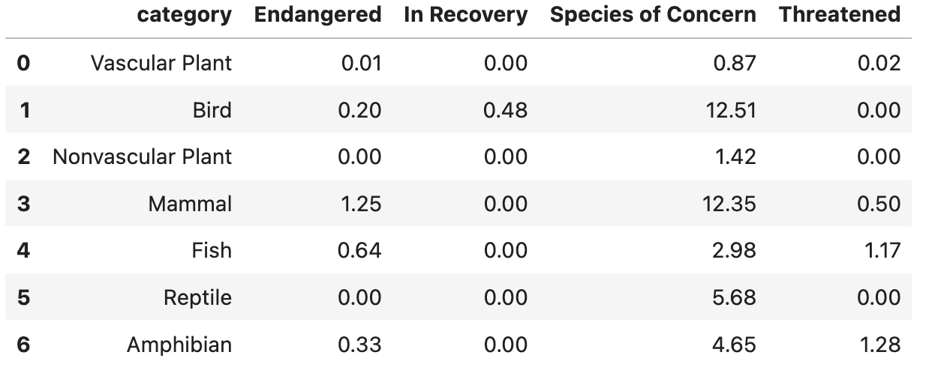
Appendix
Decomposing observations
Percentage by conservation statuses within each species

Slide 7
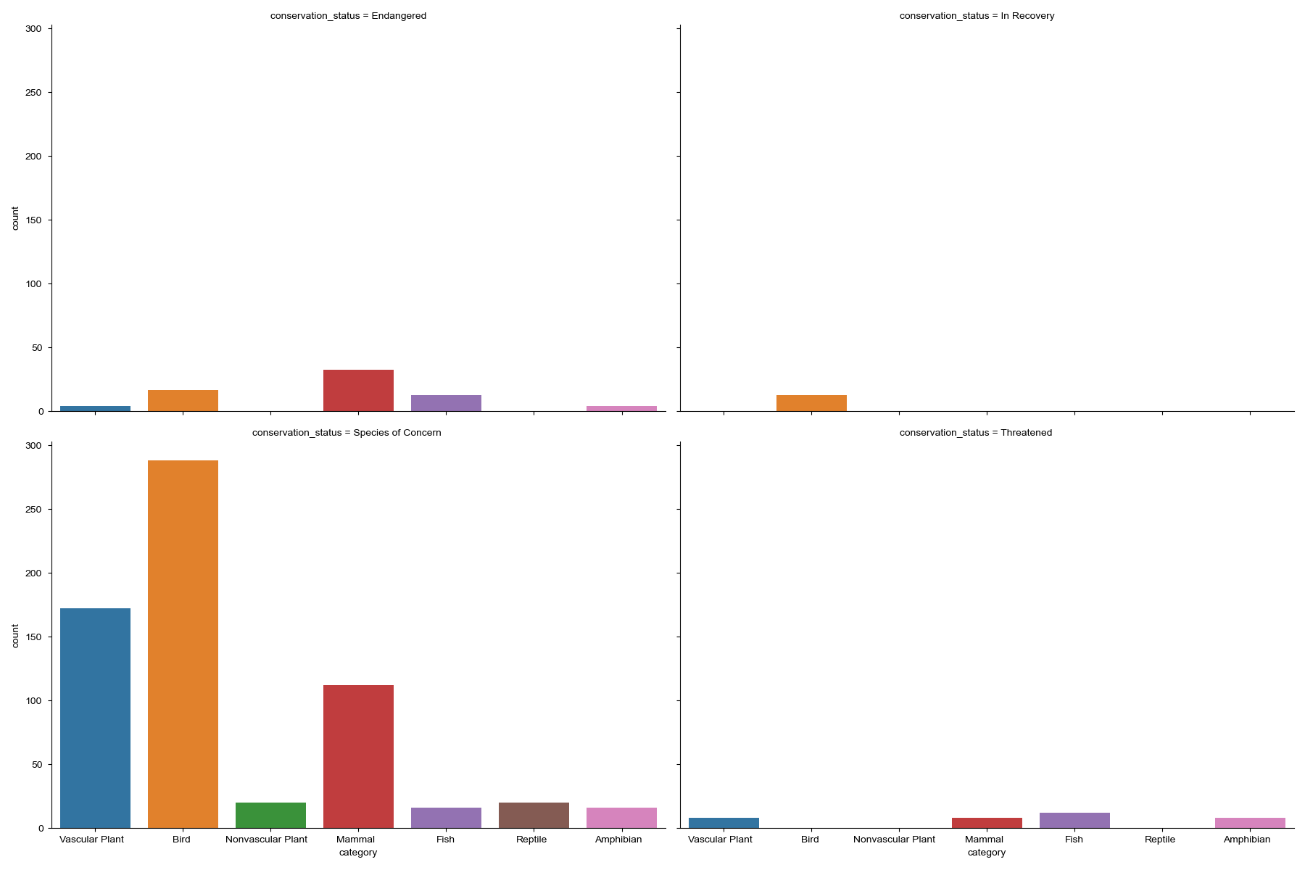
Appendix

Slide 8
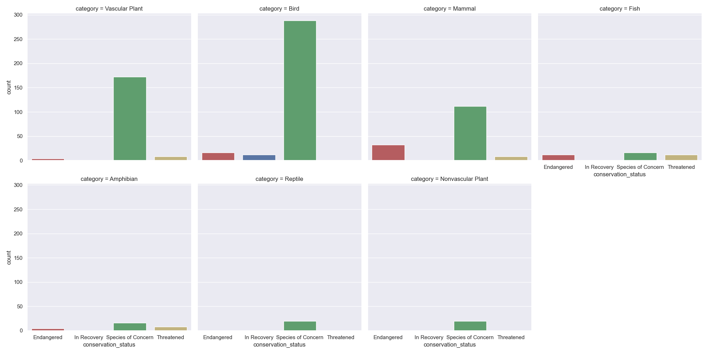
Appendix

