Slide 1
Graph Embedding with Self-clustering
Eya Cherif
Syed Rawshon Jamil
Nurettin Sabri Öztürk
Özer Yenihayat
Seda Toplar

Slide 2
Community Embedding (ComE)
Community Detection
Node Embedding
Community Embedding
Node embedding improves
  Community detection
Community Detection
  Improves node embedding
Community embedding
  improves node embedding
    preserving high order proximity
improves
improves
improves

Slide 3



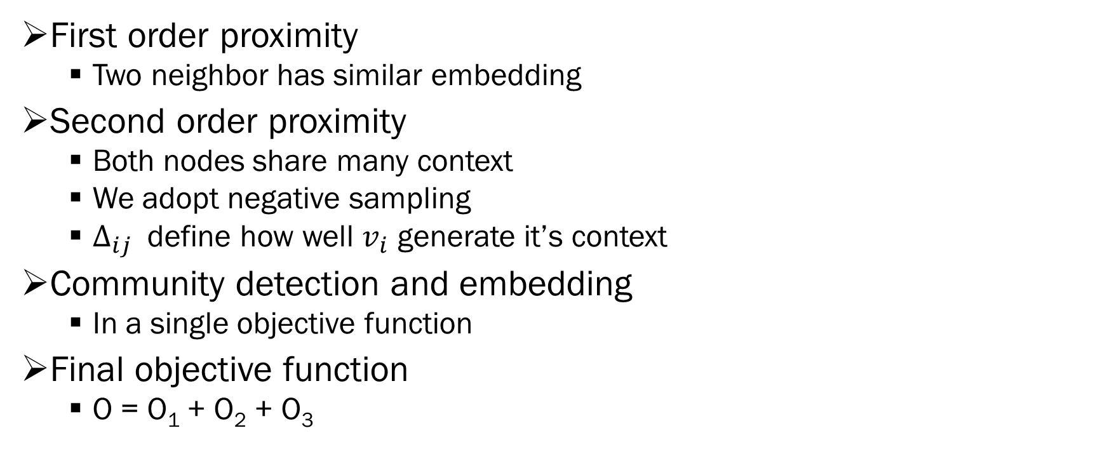
ComE ( Objective funciton)
First order proximity
  Two neighbor has similar embedding
Second order proximity
  Both nodes share many context
  We adopt negative sampling
  $Δ_{ij}$ define how well $v_{i}$ generate it’s context
Community detection and embedding
  In a single objective function
Final objective function
  O = O₁ + O₂ + O₃

