Slide 1
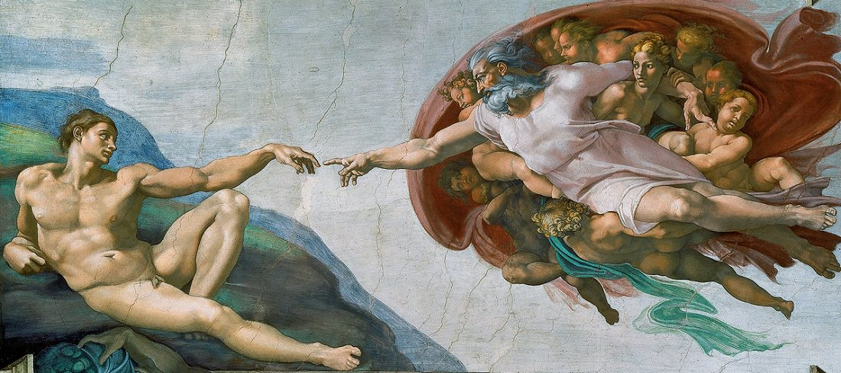
Neural Reconstruction Applying A.I. to Art Restoration
A
ARTWORLD
Presentation by Ed Chin
December 13, 2016

Slide 2

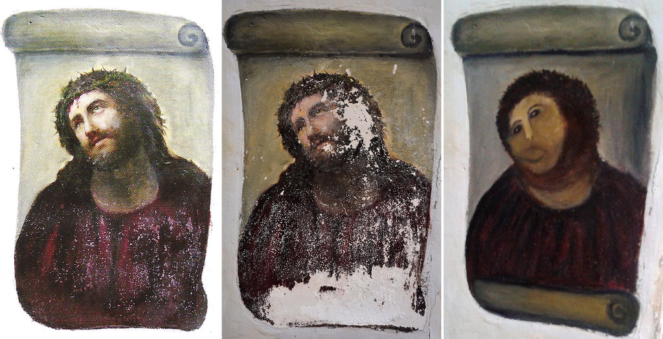
Can Artificial Intelligence rival humans in Semantic Image Reconstruction?
Original Image
Damaged Image
Restored Image
Goal: Restore unseen damaged images/photographs with a content-aware neural net

Slide 3
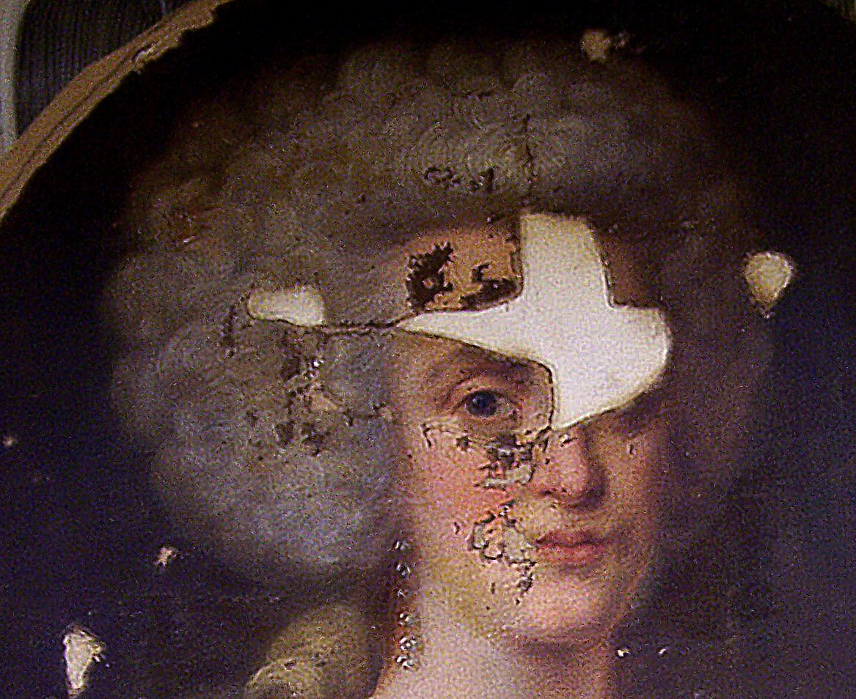
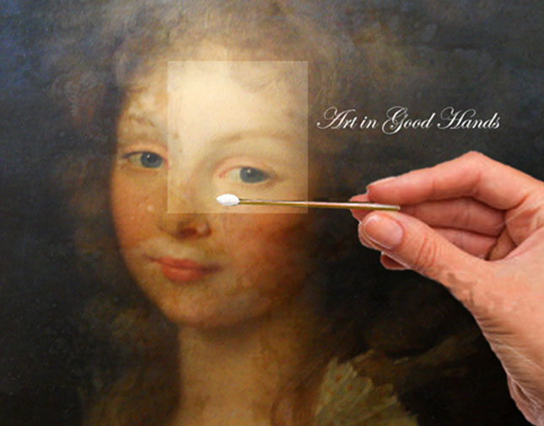
Art Restoration with Deep Learning
How would you fill in the missing information?
Can one train a computer to have the necessary cognition to fill in the missing structural, textual and content information?

Slide 4
Weighing Various Architectures
 | Non-Parametric Image Matching | Variational Sampling | Convolutional Neural Net | Adversarial Networks
Contextual Awareness | ✔ | ✔ | ✔ | ✔
Perceptual Awareness | ✗ | ✔ | ✔ | ✔
High Resolution | ✔ | ✗ | ✗ | ✔
Large Missing Patches | ✗ | ✗ | ✔ | ✔
Easy to Train | ✔ | ✔ | ✗ | ✗

Slide 5







Data Mining and Image Augmentation
1
2
Scrape and augment 200k artsy.net images
Retrieve and pre-process images
3
4
5
Train autoencoder as image generator & extract latent features
Simultaneously train an “adversarial” neural net to discriminate real vs. “fake” images
Image Restoration Application

Slide 6
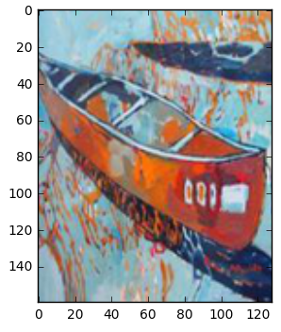
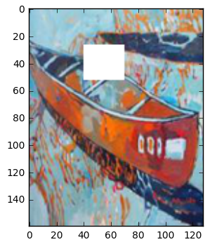
Retrieval and Pre-Processing Pipeline
Images are resized and normalized for zero mean/unit variance
1,000 images are set aside each for validation and test set
Target Image
Training Image
Arbitrarily sized mask is placed randomly to “corrupt” the training image

Slide 7
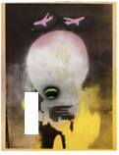
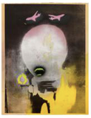
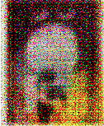
Image Generator Architecture
1024 8 x 10 feature maps
MSE only
Replace final dense layers. Connect output units to input units as autoencoder
Not good!
4 hidden convolution layers
4 hidden deconvolution layers

Slide 8
Deep Convolutional Generative Adversarial Networks (DCGANs)
No heuristic cost functions needed!!!
Real Image
D(Real_BCE)
G(MSE) + D(Fake_BCE)
D(Fake_BCE)
Generator, G()
Discriminator, D()
Fake Image

Slide 9
Key Model Insights
Generative Adversarial Networks, since its introduction by Ian Goodfellow in 2014, is known to be very tricky to train
A number of stabilizing measures were introduced, based on the groundbreaking paper “Unsupervised Representation Learning with Deep Convolutional Generative Adversarial Networks” by Alec Radford, Luke Metz and Soumith Chintala
The main benefit for using adversarial networks is the model’s ability to learn its own cost function in an unsupervised fashion

Slide 10
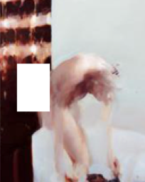

Sample Outputs from Test Set
Damaged Image
Restored Image

Slide 11
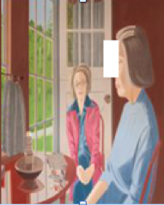
Sample Outputs from Test Set
Damaged Image
Restored Image

Slide 12
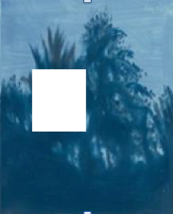
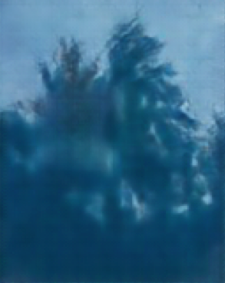
Sample Outputs from Test Set
Damaged Image
Restored Image

Slide 13
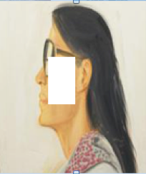

Sample Outputs from Test Set
Damaged Image
Restored Image

Slide 14
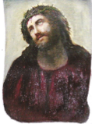
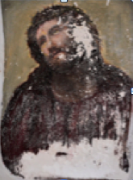
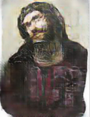



ArtWorld – Image Restoration App
Step 1
Step 2
Step 3
Drag or Upload flawed image to website
Place user defined mask on damaged area
Hit repair button. Receive repaired image instantly

Slide 15
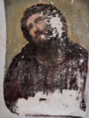
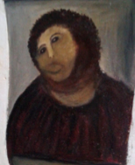
Which one would you prefer?
A.I. Restored Image
Human Restored Image
Damaged Image
OR

Slide 16
Other Commercial Applications of the DCGANs Architecture
Learn high-order functions like reasoning, planning and prediction
Dimension reduction/ Latent Feature Extraction (more powerful than PCA)
Generate super resolution or up-sampled images
Forward video prediction

Slide 17
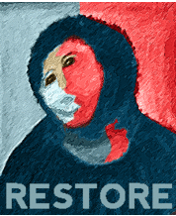
Contact Information
Ed Chin
Email: echin6@gmail.com
Linkedin:
https://www.linkedin.com/in/edwin-chin-62392b1
Repo: github.com/echin6/my_recent_projects

