Slide 1

When there is only a column of ones, the vector of coefficients is the mean vector
When there are additional columns of dummy variables, the first row vector of coefficients is the group 1 mean; the rest are change vectors to describe other group means.
$${\hat{B}}_{R}={\left({\tilde{X}}_{R}^{T}{\tilde{X}}_{R}\right)}^{−1}{\tilde{X}}_{R}^{T}\tilde{Z}={\overline{z}}^{T}$$

Slide 2
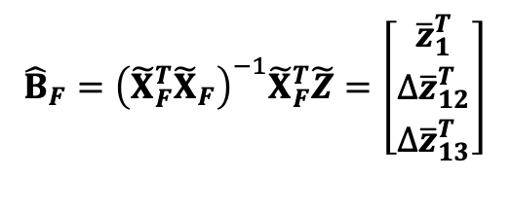
When there is only a column of ones, the vector of coefficients is the mean vector
When there are additional columns of dummy variables, the first row vector of coefficients is the group 1 mean; the rest are change vectors to describe other group means.
$${\hat{B}}_{R}={\left({\tilde{X}}_{R}^{T}{\tilde{X}}_{R}\right)}^{−1}{\tilde{X}}_{R}^{T}\tilde{Z}={\overline{z}}^{T}$$
$${\hat{B}}_{F}={\left({\tilde{X}}_{F}^{T}{\tilde{X}}_{F}\right)}^{−1}{\tilde{X}}_{F}^{T}\tilde{Z}=\left[\begin{matrix}{\overline{z}}_{1}^{T} \\ {∆\overline{z}}_{12}^{T} \\ ∆{\overline{z}}_{13}^{T}\end{matrix}\right]$$

Slide 3


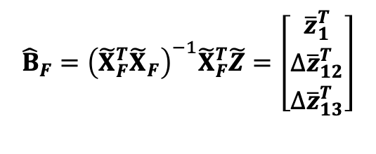

Predicted values are group means, whether there is one group or more.
$${\hat{B}}_{R}={\left({\tilde{X}}_{R}^{T}{\tilde{X}}_{R}\right)}^{−1}{\tilde{X}}_{R}^{T}\tilde{Z}={\overline{z}}^{T}$$
$$H_{R}Z$$
$${\hat{B}}_{F}={\left({\tilde{X}}_{F}^{T}{\tilde{X}}_{F}\right)}^{−1}{\tilde{X}}_{F}^{T}\tilde{Z}=\left[\begin{matrix}{\overline{z}}_{1}^{T} \\ {∆\overline{z}}_{12}^{T} \\ ∆{\overline{z}}_{13}^{T}\end{matrix}\right]$$
$$H_{F}Z$$

Slide 4

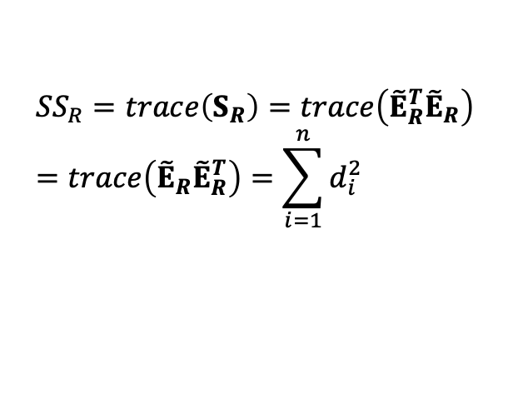

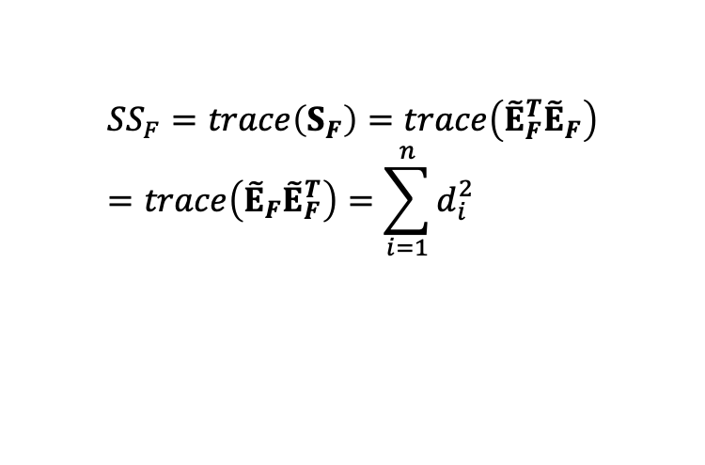


Residuals describe within-group dispersion.
Diagonal of outer-product of error represents distances from mean
$$E_{R}=\left(I−H_{R}\right)Z$$
$${SS}_{R}=trace\left(S_{R}\right)=trace\left({\tilde{E}}_{R}^{T}{\tilde{E}}_{R}\right)=trace\left({\tilde{E}}_{R}{\tilde{E}}_{R}^{T}\right)=\sum_{i=1}^{n}{d_{i}^{2}}$$
$$d_{i}^{2}=diag\left({\tilde{E}}_{R}{\tilde{E}}_{R}^{T}\right)$$
$$E_{F}=\left(I−H_{F}\right)Z$$
$${SS}_{F}=trace\left(S_{F}\right)=trace\left({\tilde{E}}_{F}^{T}{\tilde{E}}_{F}\right)=trace\left({\tilde{E}}_{F}{\tilde{E}}_{F}^{T}\right)=\sum_{i=1}^{n}{d_{i}^{2}}$$
$$d_{i}^{2}=diag\left({\tilde{E}}_{F}{\tilde{E}}_{F}^{T}\right)$$

Slide 5

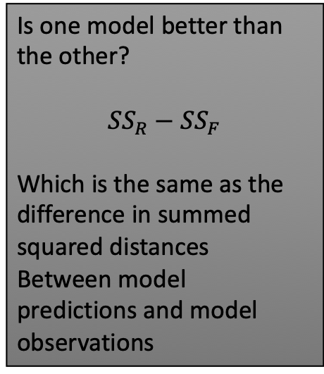
Residuals describe within-group dispersion.
Diagonal of outer-product of error represents distances from mean
Is one model better than the other?
$${SS}_{R}−{SS}_{F}$$
Which is the same as the difference in summed squared distances
Between model predictions and model observations
${SS}_{W}$= ${SS}_{F}$
Anderson MJ (2001). Austral Ecology 26: 32-46

Slide 6
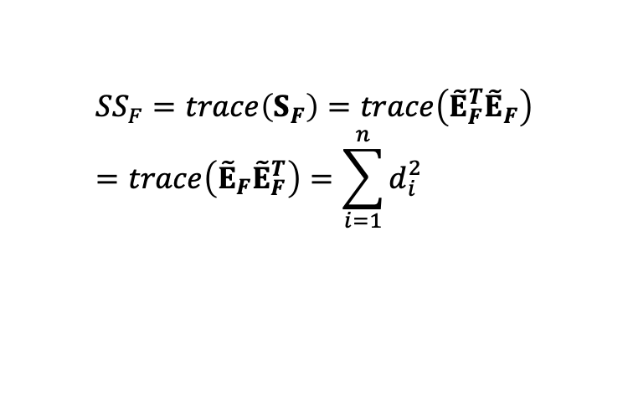


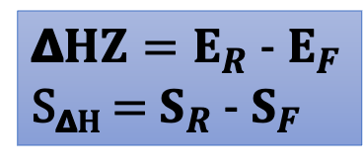
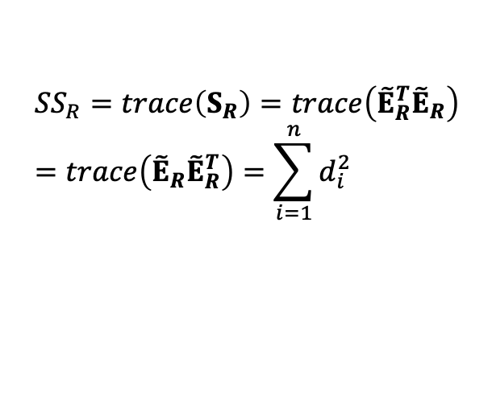
Residuals describe within-group dispersion.
Diagonal of outer-product of error represents distances from mean
$$E_{R}=\left(I−H_{R}\right)Z$$
$${SS}_{R}=trace\left(S_{R}\right)=trace\left({\tilde{E}}_{R}^{T}{\tilde{E}}_{R}\right)=trace\left({\tilde{E}}_{R}{\tilde{E}}_{R}^{T}\right)=\sum_{i=1}^{n}{d_{i}^{2}}$$
𝝙$HZ=E_{R}$ - $E_{F}$
S_{𝝙}$H$ = $S_{R}$ - $S_{F}$
$$E_{F}=\left(I−H_{F}\right)Z$$
${SS}_{W}$= ${SS}_{F}$
$${SS}_{F}=trace\left(S_{F}\right)=trace\left({\tilde{E}}_{F}^{T}{\tilde{E}}_{F}\right)=trace\left({\tilde{E}}_{F}{\tilde{E}}_{F}^{T}\right)=\sum_{i=1}^{n}{d_{i}^{2}}$$

Slide 7
Null Hypothesis
Viable test statistics
Anderson MJ (2001). Austral Ecology 26: 32-46

