Slide 1
TOCHKA
Agent-driven location intelligence
for Hong Kong banking — a proposal to the HKSTP Spatial AI Sandbox
Corporate partner Bank of China (Hong Kong)
Team shults & partners
Submitted 26 May 2026

Slide 2
2 / 12
THE OPENING
Why now
DEMAND HAS MOVED
PUBLIC SPATIAL DATA IS READY
AGENTS CAN ORCHESTRATE THIS
Hong Kong branch and ATM networks were sized for a population that has shifted. New residential growth, ageing in place, and post-2020 mobility patterns have changed who lives within a 10-minute walk of every branch.
CSDI now publishes the 3D Pedestrian Network, full HK Population Distribution (Mar 2025), and iGeoCom — enough depth to drive real catchment analysis without licensing private datasets.
Single-LLM tools are not enough — spatial analysis needs methodology selection, tool sequencing, and narrative synthesis. Qwen-class agents finally do this reliably.

Slide 3
3 / 12
THE CUSTOMER PROBLEM
BOCHK's challenge in three pictures
Three independent narratives, one shared root cause: the bank lacks a spatial intelligence layer that ties branch operations to the city it serves. The next three slides illustrate what Tochka would surface during a 12-week sandbox engagement.
A
Branch coverage
B
Queue pressure
C
Wealth affinity
Where the network misses high-density residential zones.
Which branches run hot at peak hour despite identical staffing.
Where premium-POI density and transaction value diverge.
All three pictures use illustrative synthetic data — real BOCHK figures emerge during the sandbox engagement.

Slide 4
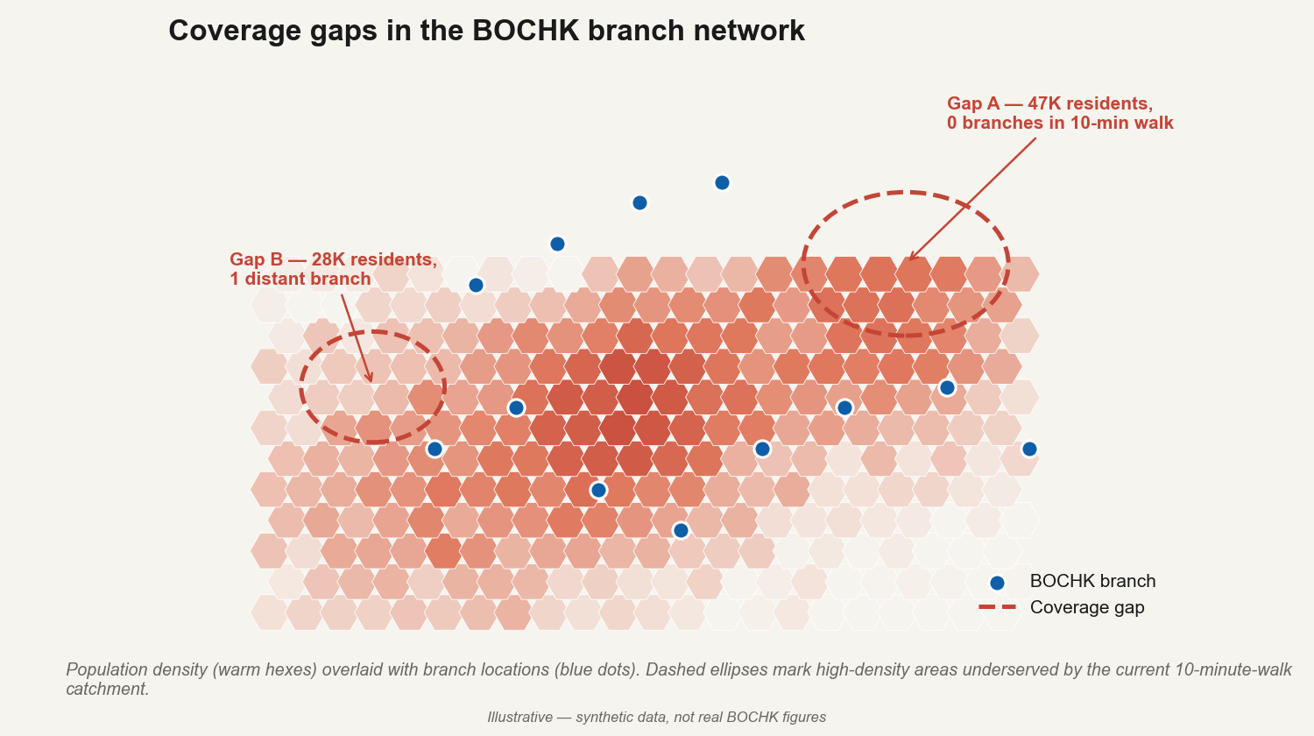
4 / 12
PICTURE A · BRANCH COVERAGE
Where the network misses dense residential demand
Catchments built on the CSDI 3D Pedestrian Network — not crow-flies circles — make the gap obvious and rankable. The agent ranks every 250m cell in HK by uncovered demand and shortlists the top five candidate locations.

Slide 5
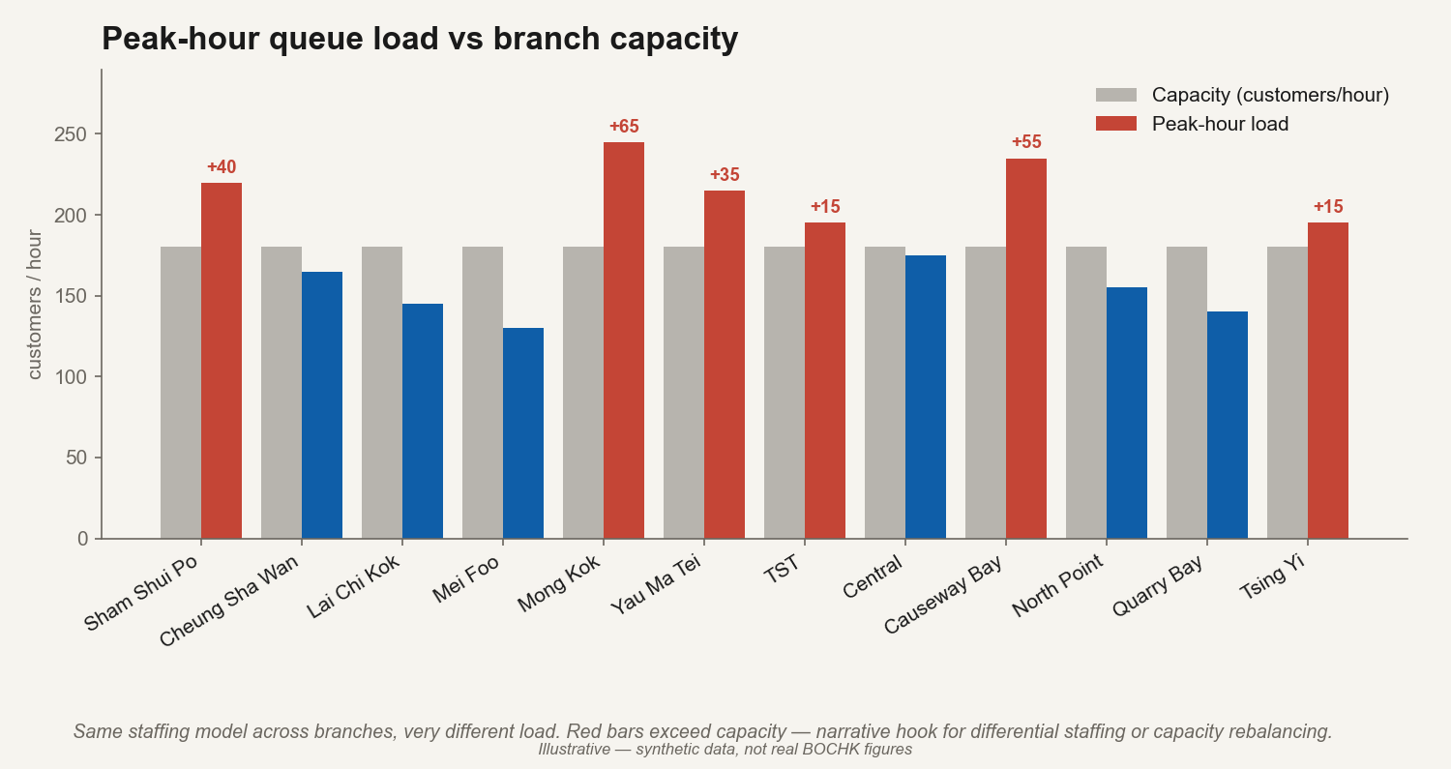
5 / 12
PICTURE B · QUEUE PRESSURE
Same staffing, very different load
Demand-weighted staffing follows from the same catchment data: spatio-temporal load profiles per branch let the agent recommend differential staffing or capacity rebalancing without site visits.

Slide 6
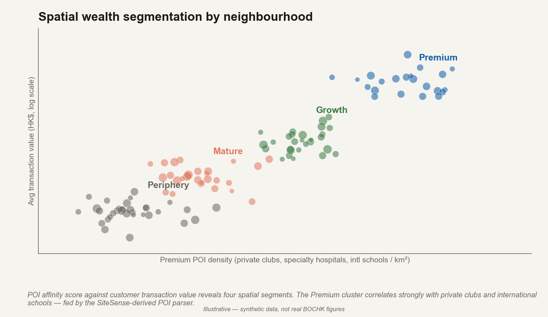
6 / 12
PICTURE C · WEALTH PROSPECTING
Premium POI density predicts transaction value
Spatial wealth segmentation from POI affinity scoring — private clubs, specialty hospitals, international schools — gives Private Banking a city-wide prospecting map without touching customer PII.

Slide 7
7 / 12
THE PRODUCT
Upload a CSV. Read a storymap.
FIVE SECTIONS
Your network at a glance
1
Your network at a glance
30 branches across 9 districts.
summary KPIs + location map
Within a 10-min walk of 1.2M residents.
2
Who you reach today
isochrones + population captured
Three underperformers vs Huff baseline.
3
What's working, what's not
Top five candidate openings ranked.
anomaly detection on Huff baseline
4
Where the opportunity is
ranked gap-analysis hex map
5
Next steps
concrete actions, click-to-rationale
Schematic. Live UI uses MapLibre + CSDI Vector basemap, scroll-driven via the Mapbox Storytelling pattern.

Slide 8
8 / 12
METHODOLOGY
How the agent thinks — four questions, in order
1
2
3
4
Your network
Demand model
Analytical question
Data plan
POI type, geographic extent, geocoding via CSDI ALS.
People-driven, visit-driven, flow-driven, or catchment-fixed.
Diagnose · Expand · Rationalise. Composable.
User fields → CSDI → parsed GMaps → OSM fallback.
Tools are deterministic Python functions. The LLM picks tools and reads results — it does not do the math.

Slide 9
9 / 12
PUBLIC DATA INSIDE
CSDI is the spine of every analysis
Storymap section | CSDI Map APIs | CSDI datasets / FSDTs
1. Your network at a glance | Vector Map (basemap) | ALS (Address Lookup), iGeoCom
2. Who you reach today | 3D Pedestrian Route Search | Population Distribution (Mar 2025), 3D Pedestrian Network
3. What's working, what's not | Search Nearby | Building footprints, iGeoCom
4. Where the opportunity is | Location Search, Identify | Population Distribution, Streetscape 360
5. Next steps | Streetscape 360 (drill-in) | 3D Visualisation Map (HK-wide)
CSDI Map APIs and FSDT datasets account for 50% of HKSTP's assessment weight. This proposal commits to using them as primary sources, not fallbacks.

Slide 10
10 / 12
ENGAGEMENT
12-week sandbox plan
Weeks | Milestone | Outputs
1–2 | BOCHK data intake, methodology lock-in | Signed scope, data access agreement, baseline metrics
3–5 | CSDI integration deep dive | ALS + 3D Pedestrian Route Search wired, isochrone pipeline
6–8 | Diagnose + Expand archetypes end-to-end | Storymap on full real BOCHK network, top-5 opportunity list
9–10 | Rationalise archetype, ATM cluster routing | Replenishment-route templates, cannibalisation analysis
11–12 | Polish, internal demo, public showcase | HKSTP public demo + BOCHK case-study brief
Decision gate at end of week 5: do we have enough real-data evidence to commit to the full diagnose+expand storymap, or do we narrow scope.

Slide 11
11 / 12
GENERALISATION
Same engine, different inputs
Retail chains
Healthcare networks
Convenience, F&B, pharmacy. Demand = people-driven + visit-driven blend.
Clinics, day-care centres. Demand = visit-driven + demographic targeting.
Social services
Real estate
HKCYS routing, elderly outreach. Catchment-fixed under slope constraints.
Site selection, redevelopment scoring. Wealth and accessibility layers.

Slide 12
12 / 12
CLOSING
The ask
A 12-week HKSTP Spatial AI Sandbox slot with BOCHK as the corporate partner.
We come with the engine built (FastAPI + Qwen agent + DuckDB-spatial + CSDI clients), the storymap UX shipped (MapLibre + scrollytelling), and the methodology committed (the four-question orchestrator). The sandbox is where it meets real BOCHK data, validates the recommendations against operational ground truth, and graduates to a productised offering.
Sandbox slot
Data access
Success criteria
12-week engagement, HKSTP facilities.
BOCHK branch / ATM list, anonymised transaction footprint.
Jointly defined at week 2; measured at week 12.

