Slide 1
CAMEL-AI Overview
Exploring the Scaling Laws of Agents

Slide 2
Introduction to CAMEL-AI
Open-source community
Focus on multi-agent systems
Task automation and world simulation

Slide 3
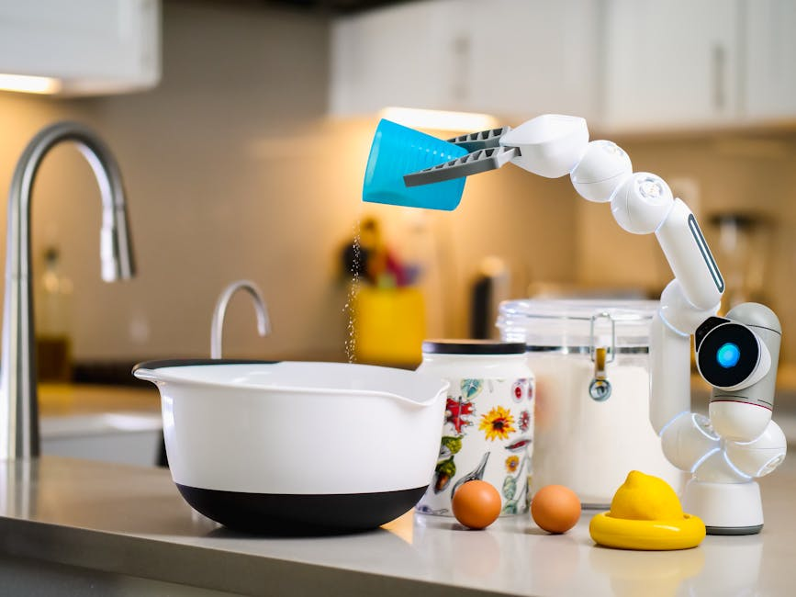
Key Features
Data generation
World simulation
Task automation

Slide 4
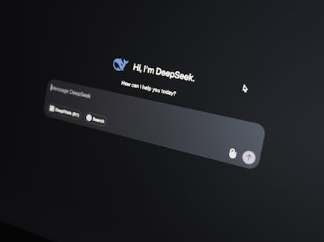
Community and Collaboration
Join the community
Collaborate on projects
Access to resources

Slide 5
CAMEL-AI Tools
Tool | Description
Data Generator | Generates data for simulations
World Simulator | Simulates complex environments
Task Automator | Automates repetitive tasks

