Slide 1
Key Logger Analysis
By Alexander Joslin

Slide 2

General Statistics

Slide 3
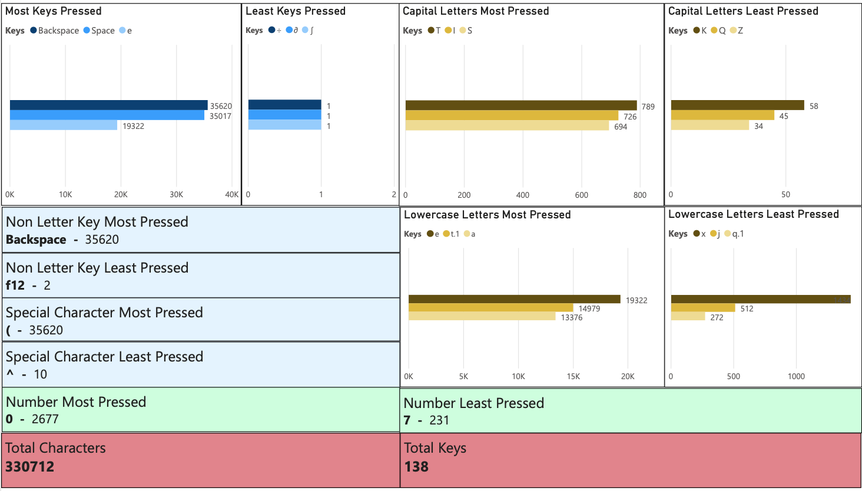

Slide 4

All Key Totals

Slide 5
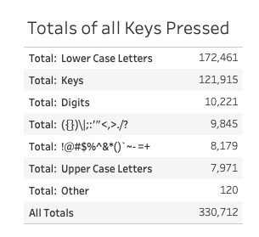
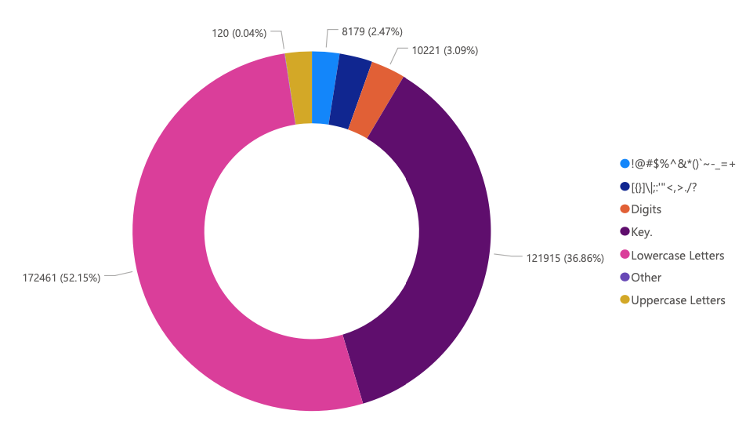

Slide 6

Number Totals

Slide 7
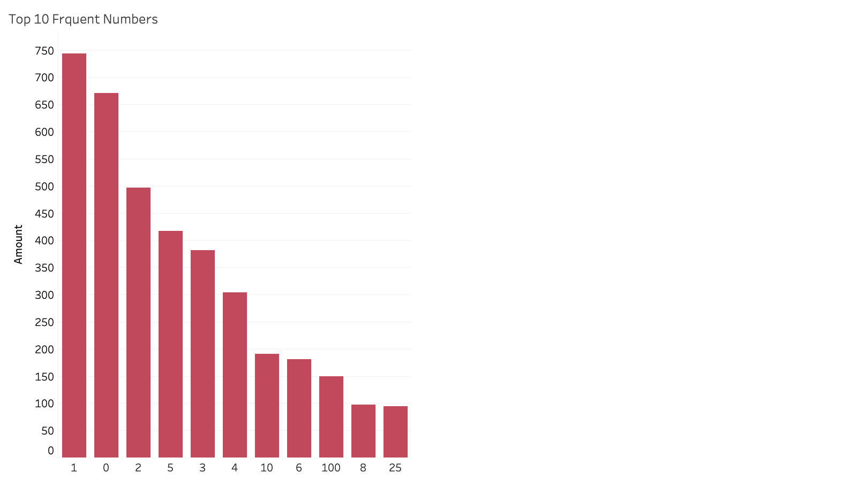

Slide 8

Word Totals

Slide 9
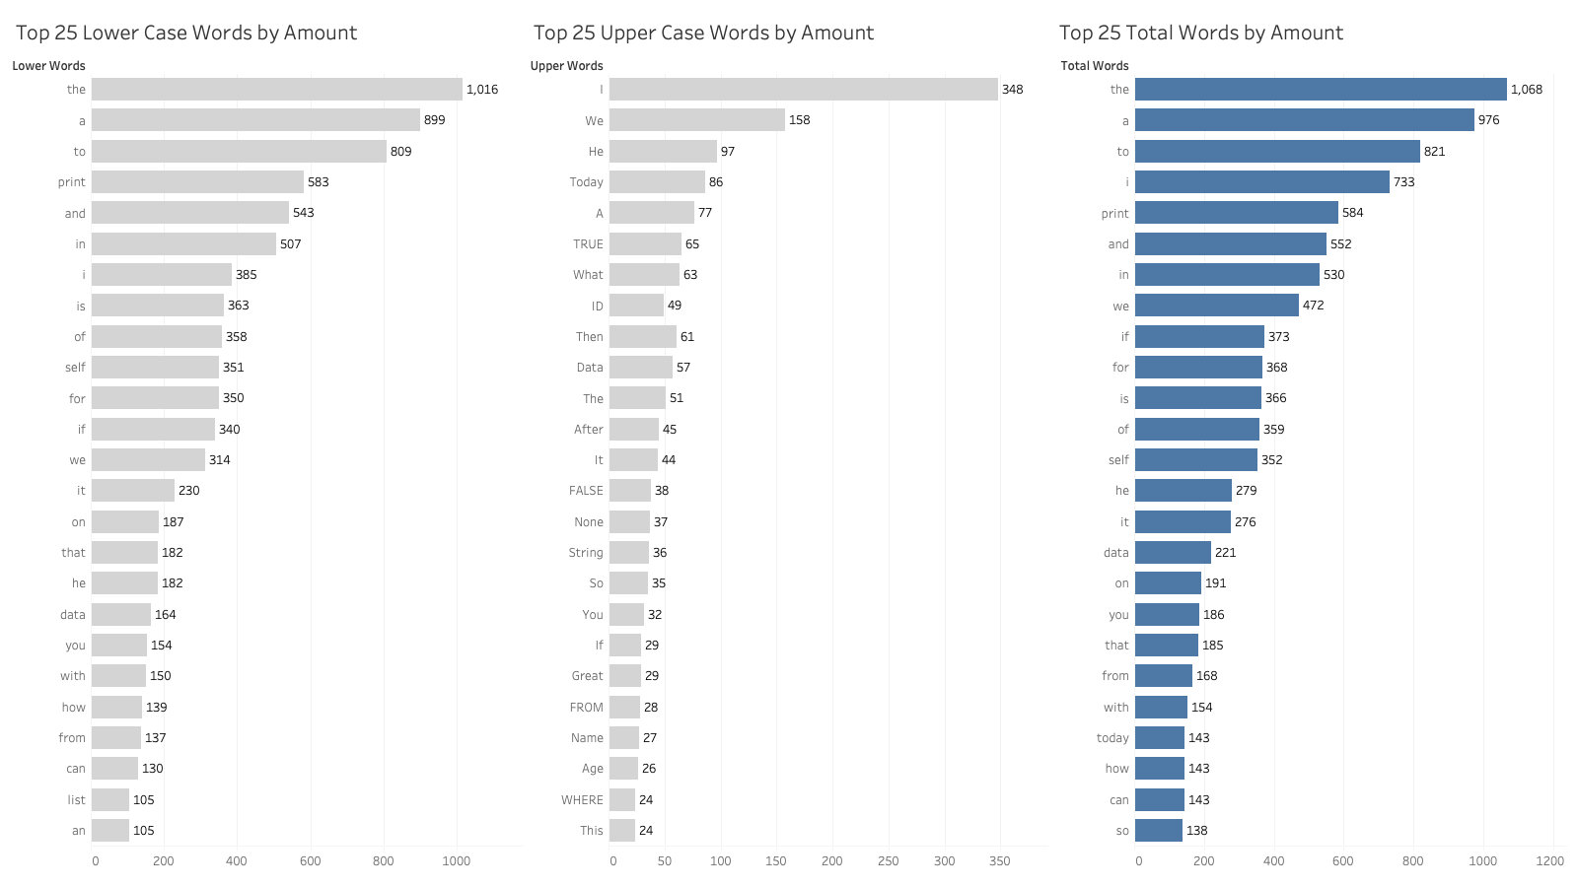

Slide 10
Most Frequent Words

Slide 11
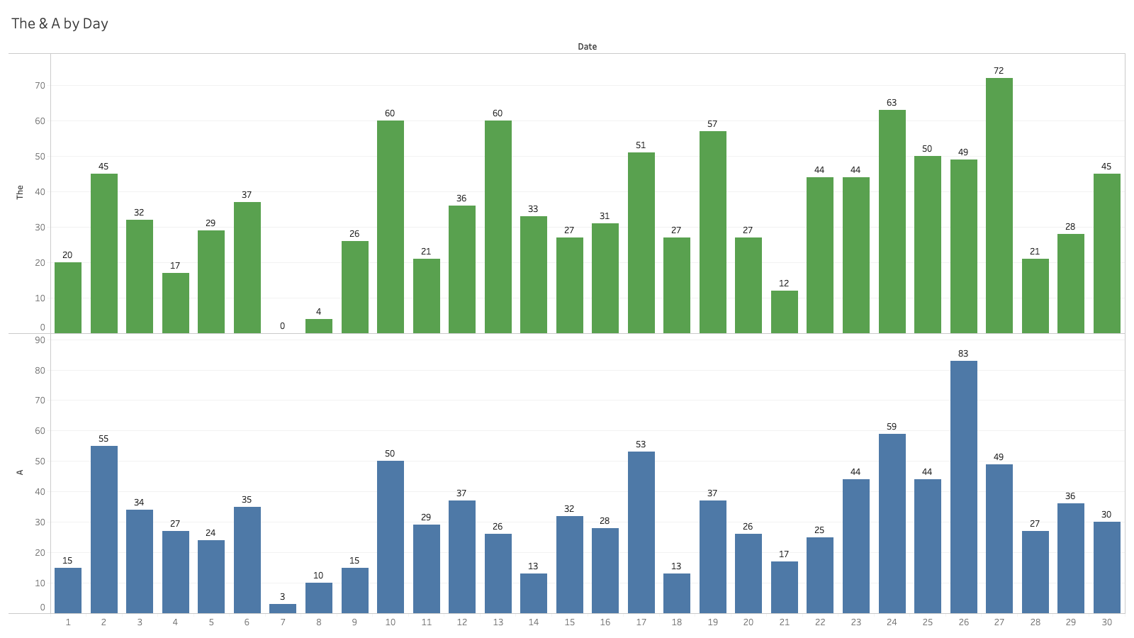

Slide 12
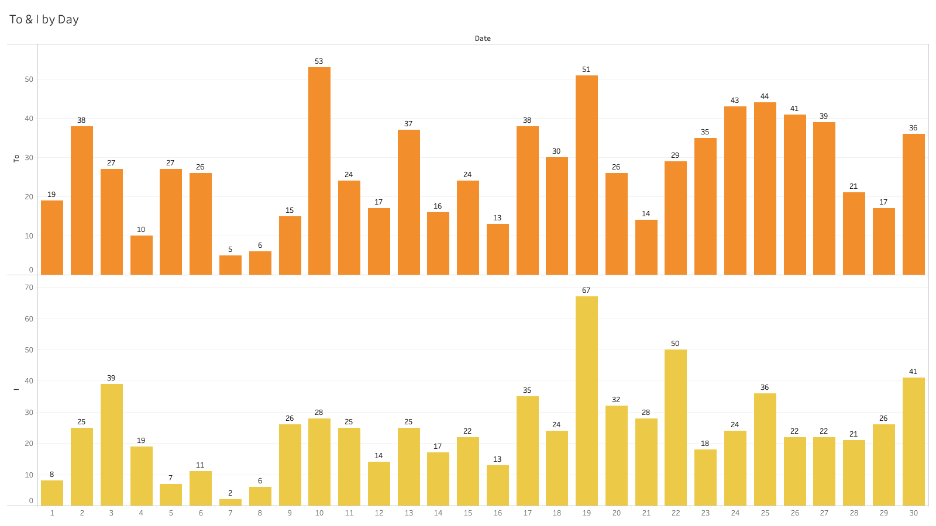

Slide 13
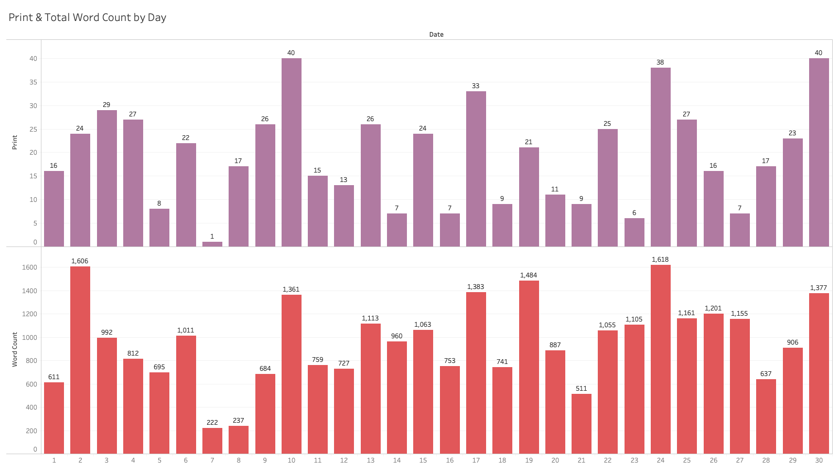

Slide 14

Thank You

