Slide 1
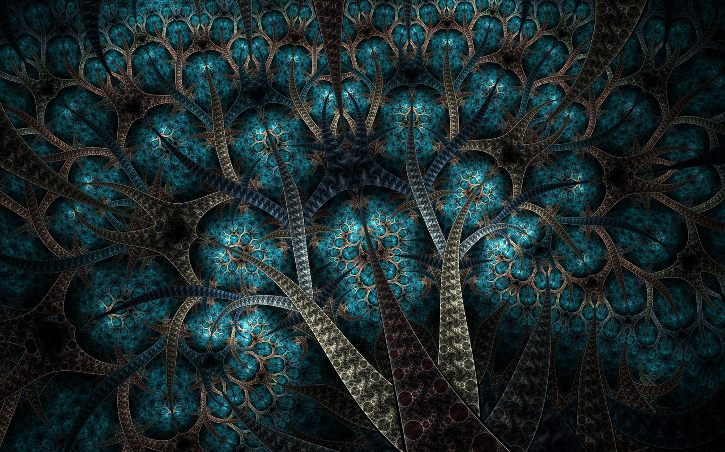
Recursion
By Alex Joslin

Slide 2
What is Recursion?
In computer science, recursion is when a function calls itself.
Example
def func():
// code
func()
func()

Slide 3
How do functions work behind the scenes
def d(): pass def c(): d() def b(): c() def a(): b() c() a()

Slide 4
How do functions work behind the scenes
def d(): pass def c(): d() def b(): c() def a(): b() c() a()

Slide 5
How do functions work behind the scenes
a()
def d(): pass def c(): d() def b(): c() def a(): b() c() a()

Slide 6
How do functions work behind the scenes
a()
def d(): pass def c(): d() def b(): c() def a(): b() c() a()

Slide 7
How do functions work behind the scenes
b()
a()
def d(): pass def c(): d() def b(): c() def a(): b() c() a()

Slide 8
How do functions work behind the scenes
b()
a()
def d(): pass def c(): d() def b(): c() def a(): b() c() a()

Slide 9
How do functions work behind the scenes
c()
b()
a()
def d(): pass def c(): d() def b(): c() def a(): b() c() a()

Slide 10
How do functions work behind the scenes
c()
b()
a()
def d(): pass def c(): d() def b(): c() def a(): b() c() a()

Slide 11
How do functions work behind the scenes
d()
c()
b()
a()
def d(): pass def c(): d() def b(): c() def a(): b() c() a()

Slide 12
How do functions work behind the scenes
d()
c()
b()
a()
def d(): pass def c(): d() def b(): c() def a(): b() c() a()

Slide 13
How do functions work behind the scenes
c()
b()
a()
def d(): pass def c(): d() def b(): c() def a(): b() c() a()

Slide 14
How do functions work behind the scenes
b()
a()
def d(): pass def c(): d() def b(): c() def a(): b() c() a()

Slide 15
How do functions work behind the scenes
a()
def d(): pass def c(): d() def b(): c() def a(): b() c() a()

Slide 16
How do functions work behind the scenes
a()
def d(): pass def c(): d() def b(): c() def a(): b() c() a()

Slide 17
How do functions work behind the scenes
c()
a()
def d(): pass def c(): d() def b(): c() def a(): b() c() a()

Slide 18
How do functions work behind the scenes
c()
a()
def d(): pass def c(): d() def b(): c() def a(): b() c() a()

Slide 19
How do functions work behind the scenes
d()
c()
a()
def d(): pass def c(): d() def b(): c() def a(): b() c() a()

Slide 20
How do functions work behind the scenes
d()
c()
a()
def d(): pass def c(): d() def b(): c() def a(): b() c() a()

Slide 21
How do functions work behind the scenes
c()
a()
def d(): pass def c(): d() def b(): c() def a(): b() c() a()

Slide 22
How do functions work behind the scenes
a()
def d(): pass def c(): d() def b(): c() def a(): b() c() a()

Slide 23
How do functions work behind the scenes
def d(): pass def c(): d() def b(): c() def a(): b() c() a()

Slide 24
Recursion
def a(): a() a()

Slide 25
Recursion
a()
def a(): a() a()

Slide 26
Recursion
a()
def a(): a() a()

Slide 27
Recursion
a()
a()
def a(): a() a()

Slide 28
Recursion
a()
a()
def a(): a() a()

Slide 29
Recursion
a()
a()
a()
def a(): a() a()

Slide 30
Recursion
a()
a()
a()
def a(): a() a()

Slide 31
Recursion
a()
a()
a()
a()
def a(): a() a()

Slide 32
Recursion
a()
a()
a()
a()
def a(): a() a()

Slide 33
Recursion
a()
a()
a()
a()
a()
a()
a()
a()
def a(): a() a()

Slide 34
Recursion
a()
a()
a()
a()
a()
a()
a()
a()
STACK OVERFLOW
def a(): a() a()

Slide 35
Recursion – With Base Case
def a(i): if i == 3: return a(i+1) a(1)
Base Case
( A condition used to
terminate recursive calls )

Slide 36
Recursion – With Base Case
def a(i): if i == 3: return a(i+1) a(1)

Slide 37
Recursion – With Base Case
a(1)
def a(i): if i == 3: return a(i+1) a(1)

Slide 38
Recursion – With Base Case
a(1)
def a(i): if i == 3: return a(i+1) a(1)

Slide 39
Recursion – With Base Case
a(1)
def a(i): if i == 3: return a(i+1) a(1)

Slide 40
Recursion – With Base Case
a(2)
a(1)
def a(i): if i == 3: return a(i+1) a(1)

Slide 41
Recursion – With Base Case
a(2)
a(1)
def a(i): if i == 3: return a(i+1) a(1)

Slide 42
Recursion – With Base Case
a(2)
a(1)
def a(i): if i == 3: return a(i+1) a(1)

Slide 43
Recursion – With Base Case
a(3)
a(2)
a(1)
def a(i): if i == 3: return a(i+1) a(1)

Slide 44
Recursion – With Base Case
a(3)
a(2)
a(1)
def a(i): if i == 3: return a(i+1) a(1)

Slide 45
Recursion – With Base Case
a(3)
a(2)
a(1)
def a(i): if i == 3: return a(i+1) a(1)

Slide 46
Recursion – With Base Case
a(2)
a(1)
def a(i): if i == 3: return a(i+1) a(1)

Slide 47
Recursion – With Base Case
a(1)
def a(i): if i == 3: return a(i+1) a(1)

Slide 48
Recursion – With Base Case
def a(i): if i == 3: return a(i+1) a(1)

Slide 49
Fibonacci Sequence Recursion

