Slide 1
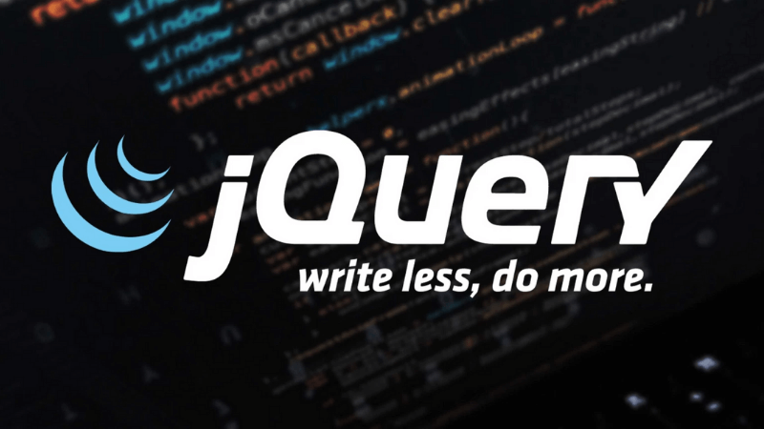

Slide 2
The Most Popular JS library of all time.
jQuery takes a lot of common tasks that require many lines of JavaScript code to accomplish.
The jQuery library contains the following features:
CSS manipulation
HTML/DOM manipulation
HTML event methods
Effects and animations
AJAX

Slide 3
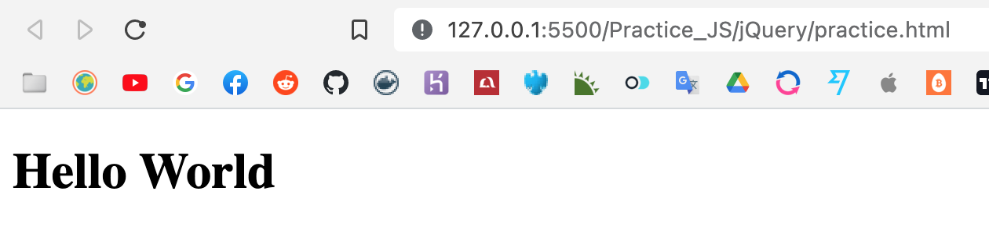
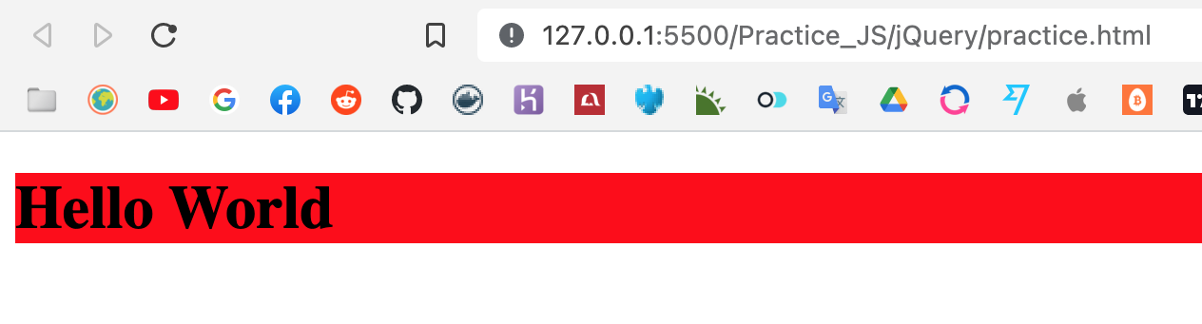
CSS Manipulation

Slide 4
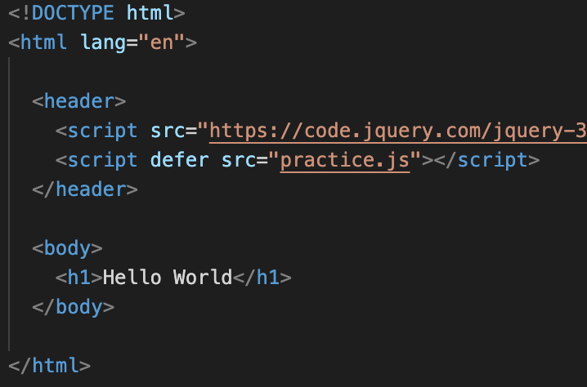
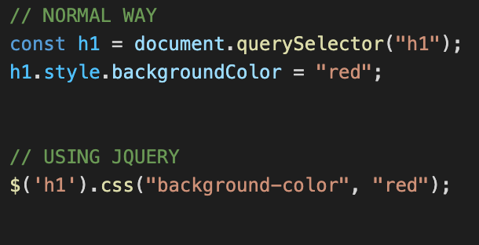

Slide 5
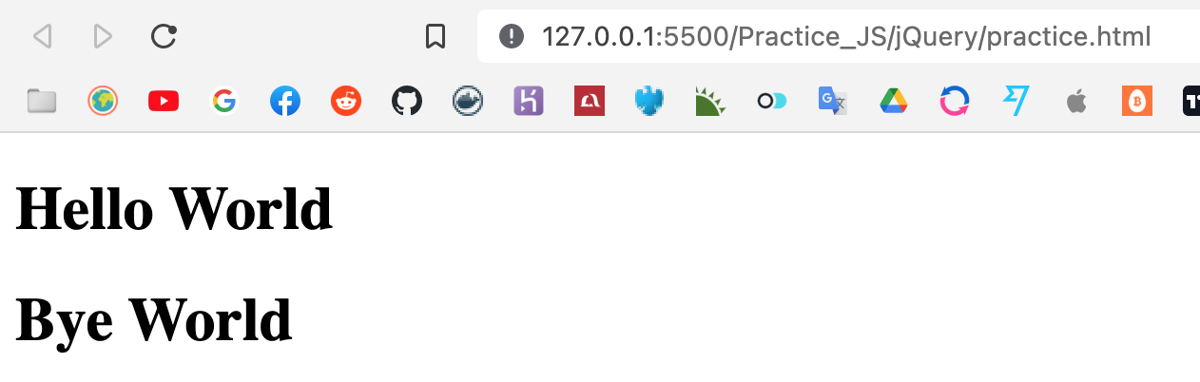
HTML / DOM Manipulation

Slide 6
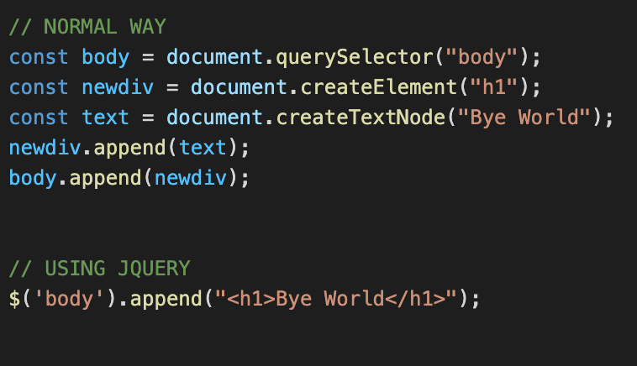

Slide 7

HTML Event Methods
WHEN CLICKED*

Slide 8
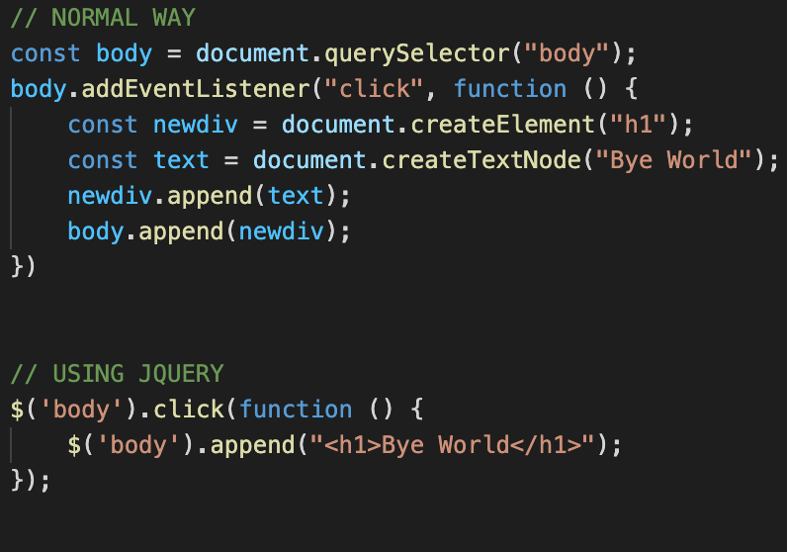

Slide 9
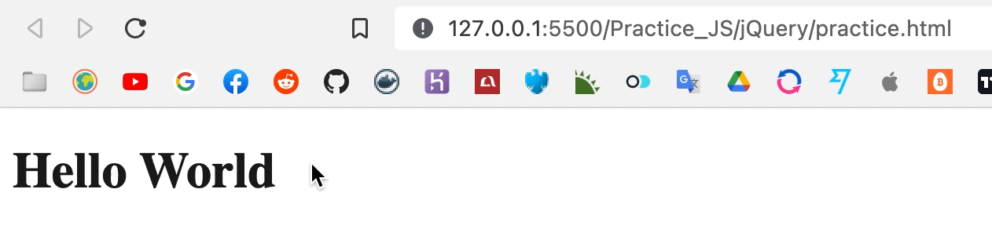
Effects and Animation
WHEN CLICKED*

Slide 10
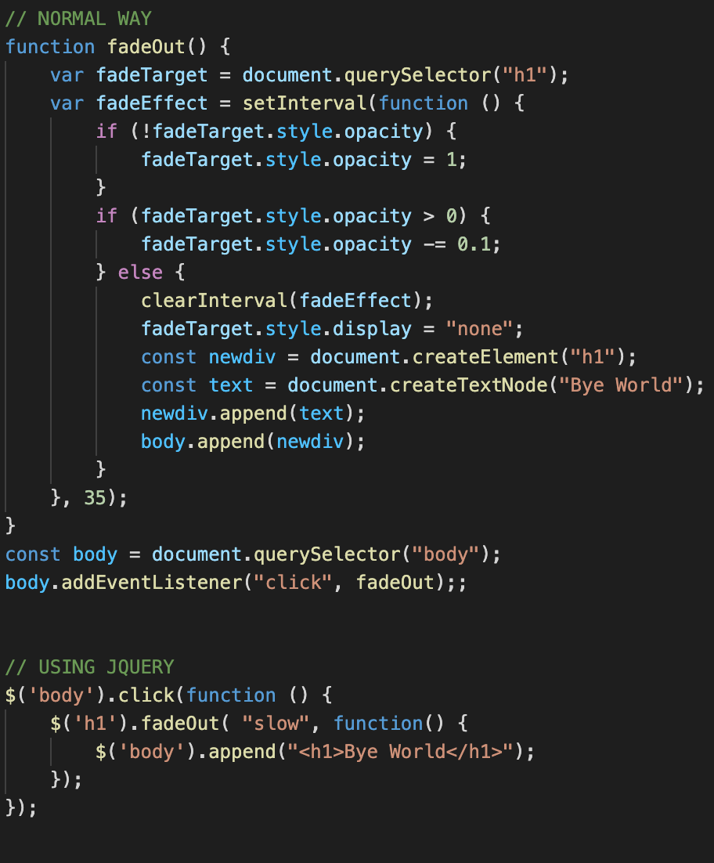

Slide 11
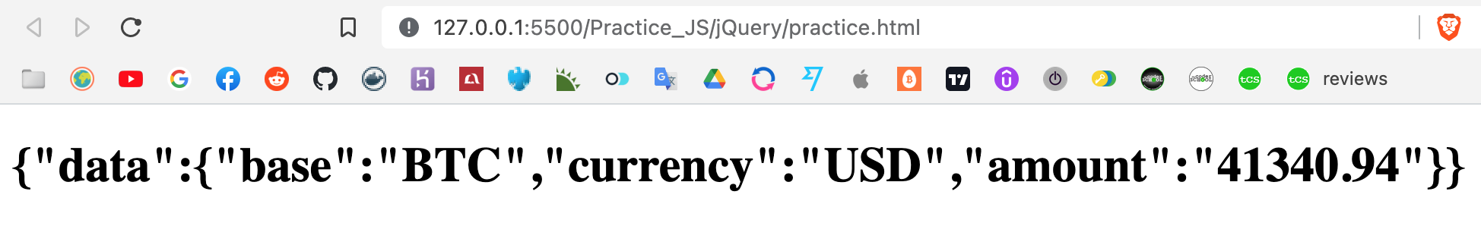
Effects and Animation

Slide 12
