Slide 1
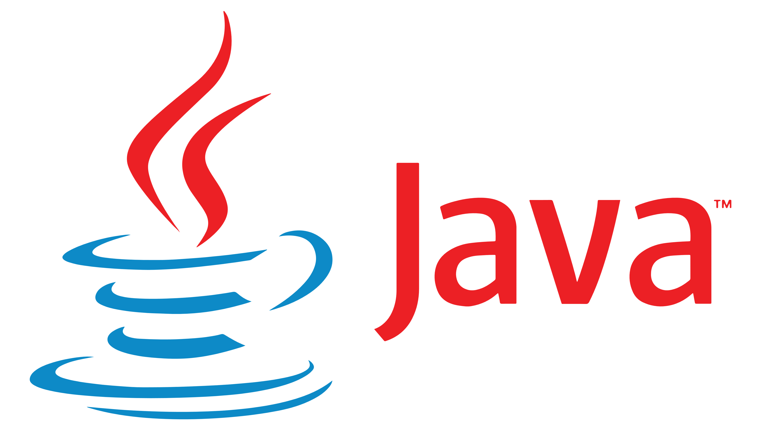
By Alex Joslin

Slide 2

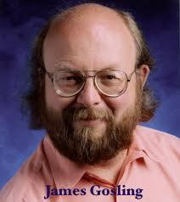
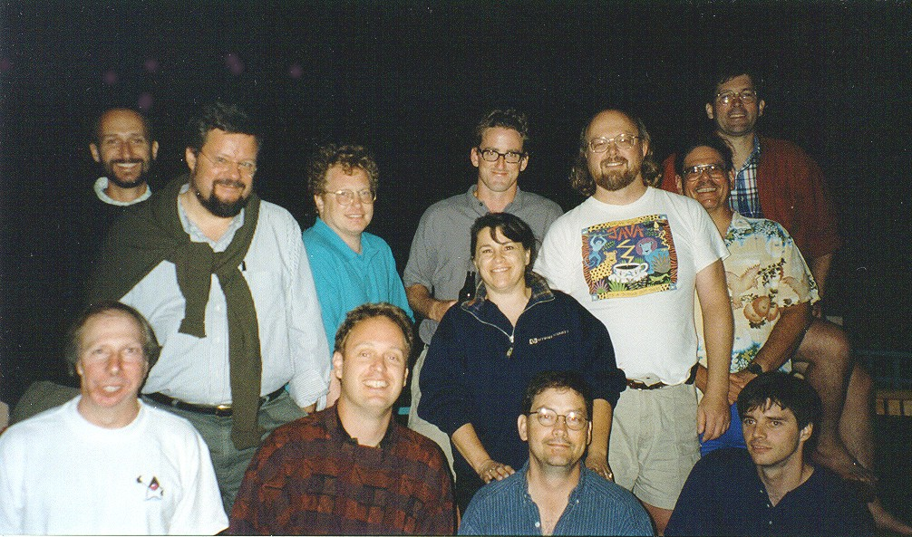
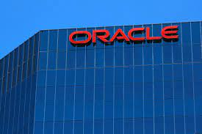
History of Java
Green Team
Green Talk
James Gosling, Mike Sheridan, Patrick Naughton ....
Oak
Oracle bought out Sun
in 2009 for $7.4B
dynamic, alive, impact, revolutionary,
DNA, silk, WRL, lyric, pepper, NetProse, Neon.
Final Candiates: Silk, DNA, Java

Slide 3
Python Interpretation vs Java Compilation
How does a computer execute a program?
Programs written in Python are interpreted.
Programs written in Java are Compiled.
(More or Less)
Python executes at run-time.
Java first compiles code then executes at run-time
More Info

Slide 4
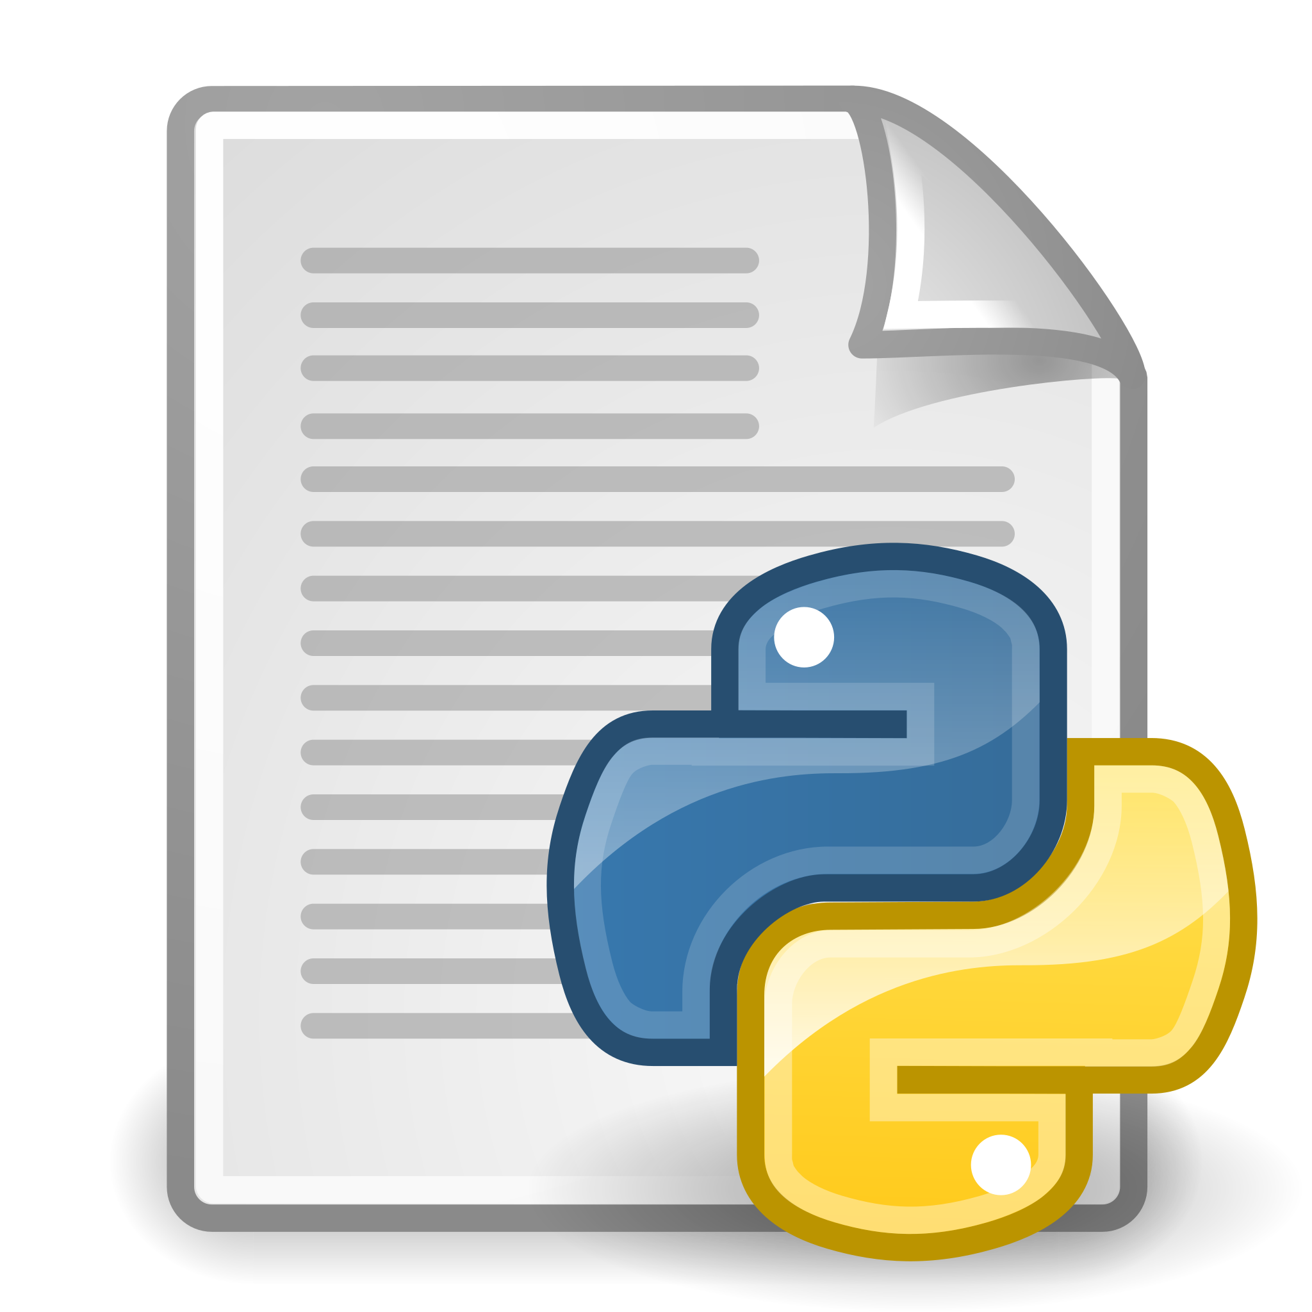
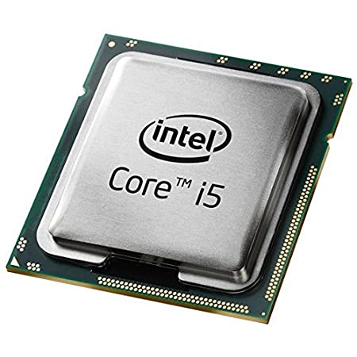

Python Interpretation
Run-time Environment
Python Interpreter
Lexing
Parser
Compiler
i += 1
i
+=
1
byte code
main.py
__pychache__
Python Virtual Machine
Machine code
01011101001
main.pyc
Run time / execution

Slide 5
Java Compilation
Compile-time Environment
Run-time Environment
Main.java
Java Virtual Machine
main(){
Person()
Employee()
}
Main.class
Byte Code
Class Loader
Loads class files
Person.java
Person.class
Java Compiler
Byte Code Verifier
class Person{
...
}
Byte Code
Employee.class
security & error checks
Employee.java
Byte Code
Just-in-time (JIT) Compiler
class Employee{
...
}
Converts to Machine Code
0101011010011

Slide 6
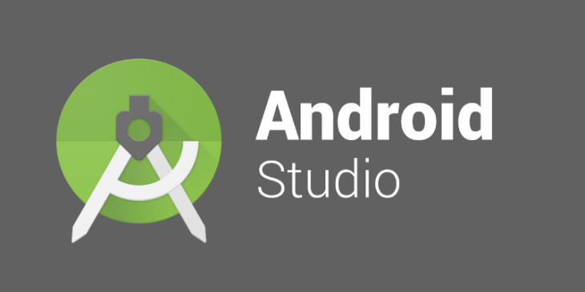
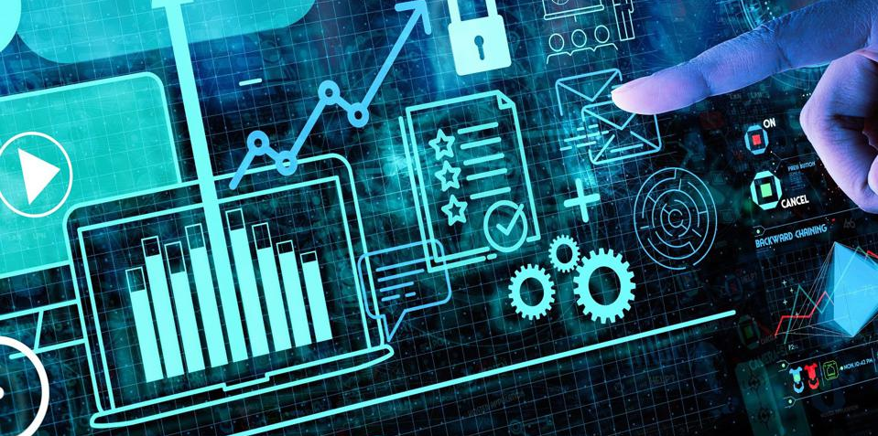

What is Java used for?
Mobile Applications (Android)
Web Applications (Spring)
Test Engineering (Selenium)
Big Data
Gaming (Minecraft)
Desktop Applications (JavaFX, Swing)

