Slide 1

Protocols
By Alex Joslin

Slide 2
What is a Protocol
A set of rules that dictate how data is communicated across a network.
Many different networking protocols.
Each protocol have their own dedicated port number.

Slide 3

Examples of Protocols

Slide 4
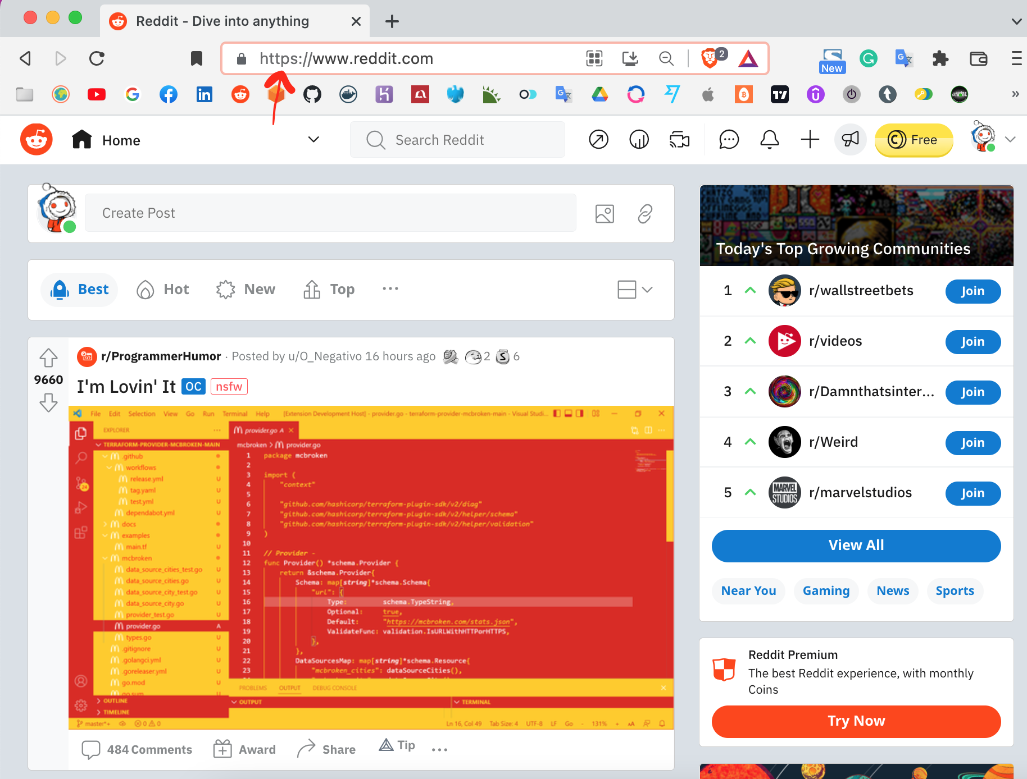
HTTP & HTTPS
Hypertext Transfer Protocol (Secure)
You open a web browser and navigate to https://www.reddit.com
Your browser sends a request to a server that is hosting that web page.
This request is sent through a protocol called http.

Slide 5

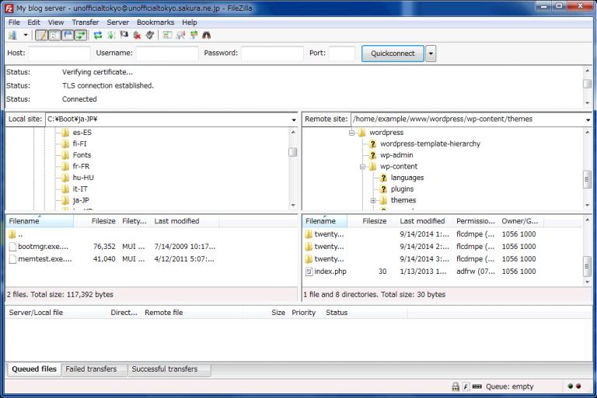
FTP
File Transfer Protocol
A way for computers to transfer files between one another through the internet. (Without a Web Browser)
Example: FileZilla
Notes:
What is the difference between Internet and World Wide Web?
You can also transfer files through HTTP.

Slide 6
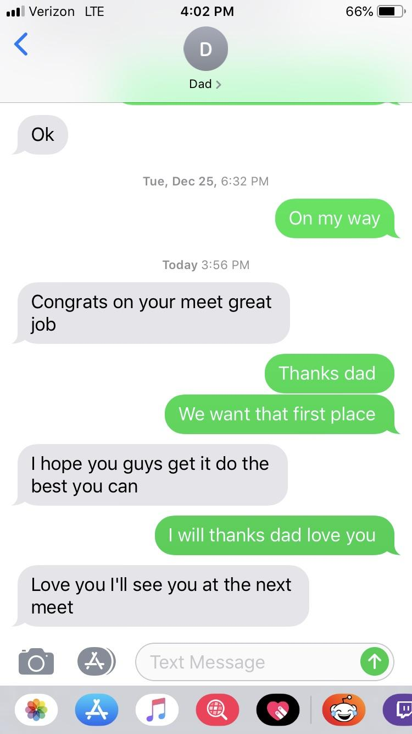
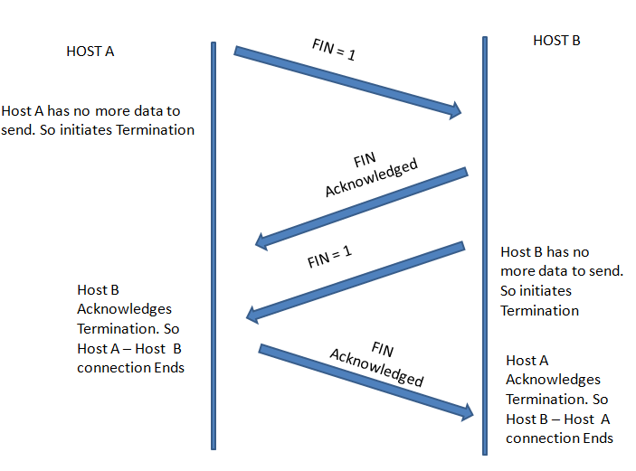
TCP
Transmission Control Protocol
Defines how to establish and maintain a network conversation by which apps can exchange data.
Specifically designed to solve the issue of packet loss and packet corruption.
No matter what all packets will arrive to the receiver
Example: Text Messages
Notes:
What is the difference between Internet and World Wide Web?
You can also transfer files through HTTP.

Slide 7



UDP
User Datagram Protocol
Primarily used to establish low-latency and loss-tolerating connections between applications through the internet.
All packets are not guaranteed to arrive or be in the same order, but packet sizes are smaller has faster communication.
Example: Video Chat
Notes:
What is the difference between Internet and World Wide Web?
You can also transfer files through HTTP.

Slide 8
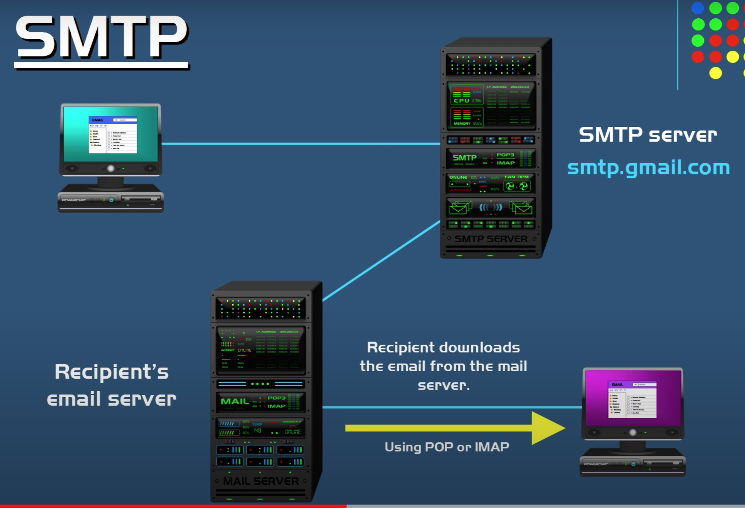
SMTP
Simple Mail Transfer Protocol
A protocol that authenticates and directs the transfer of email.
When you send an email it goes through SMTP to a SMTP server. Then it relays that email to recipient’s server. When the receiver opens up their email, it is downloaded from the server via another protocol either POP or IMAP.
Notes:
What is the difference between Internet and World Wide Web?
You can also transfer files through HTTP.

Slide 9
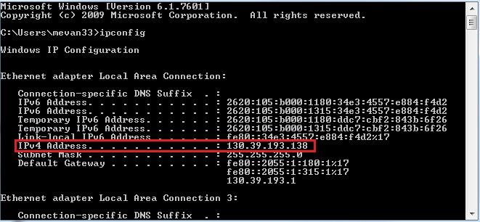
IP
Internet Protocol
A protocol used for identifying devices on a given network.
It follows a set of rules for how data is via the internet or local network.
Notes:
What is the difference between Internet and World Wide Web?
You can also transfer files through HTTP.

Slide 10
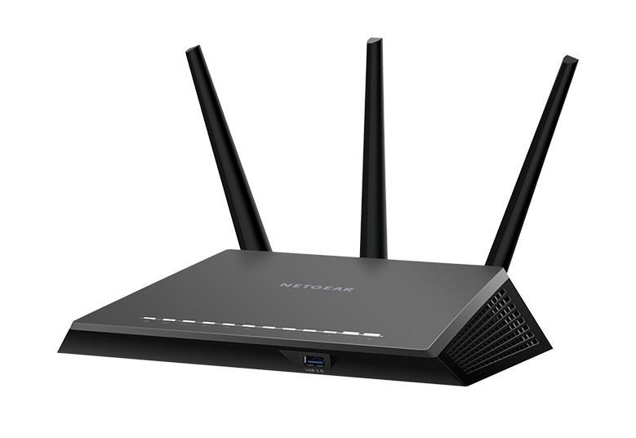
DHCP
Dynamic Host Configuration Protocol
A client server protocol that automatically provides a unique IP address to a device connecting to its network.
Examples: A router assigning your computer a unique IP address.
Notes:
What is the difference between Internet and World Wide Web?
You can also transfer files through HTTP.

Slide 11
